Slide 1
Kubernetes com piloto automático na Google Cloud
Anderson Bispo

Slide 2

Anderson Bispo
21 de experiência em TI
Servidor Público do TJBA
ConsTrutor 4Linux
Graduado em SI
Especialista em Gestão de TI e MBA em DW/BI
HashiCorp Certified: Terraform Associate
Google Cloud Certified Professional Cloud Architect
AWS Solutions Architect Associate
OCI Certified Architect Professional
PSMI- Professional Scrum Master I
Contato:
https://www.linkedin.com/in/andersonbispo/

Slide 3
Slides e Demos:
https://github.com/andersonbispos/4Linux-k8s-day

Slide 4
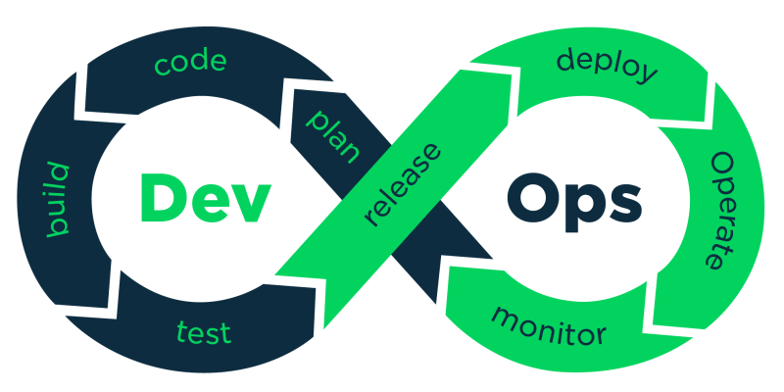

Slide 5
Code Cloud Source Repository
Build Cloud Build
Release Artifact Registry
Deploy Cloud Build
Monitor Cloud Operations

Slide 6
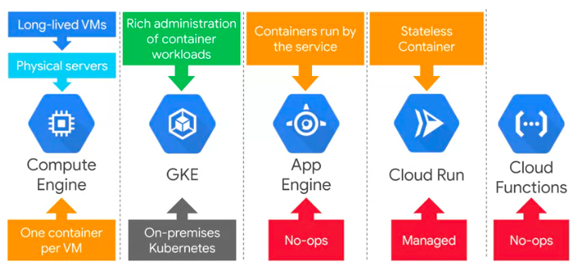
https://www.youtube.com/watch?v=63Suartio6Q&t=1942s

Slide 7
NA MASSA!

Slide 8
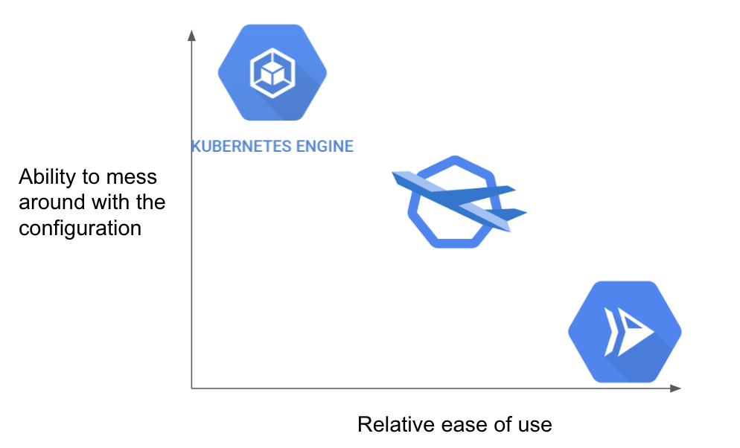

Slide 9
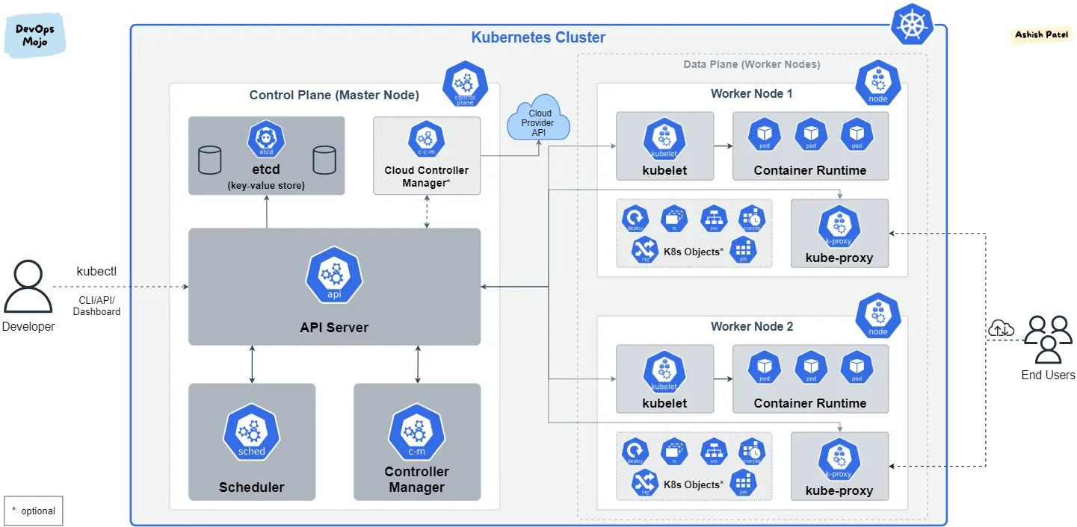

Slide 10
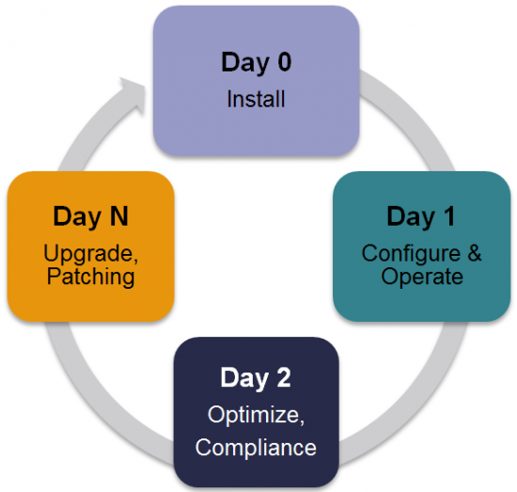

Slide 11
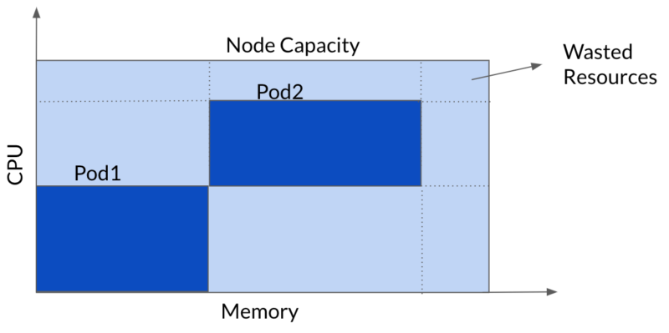

Slide 12
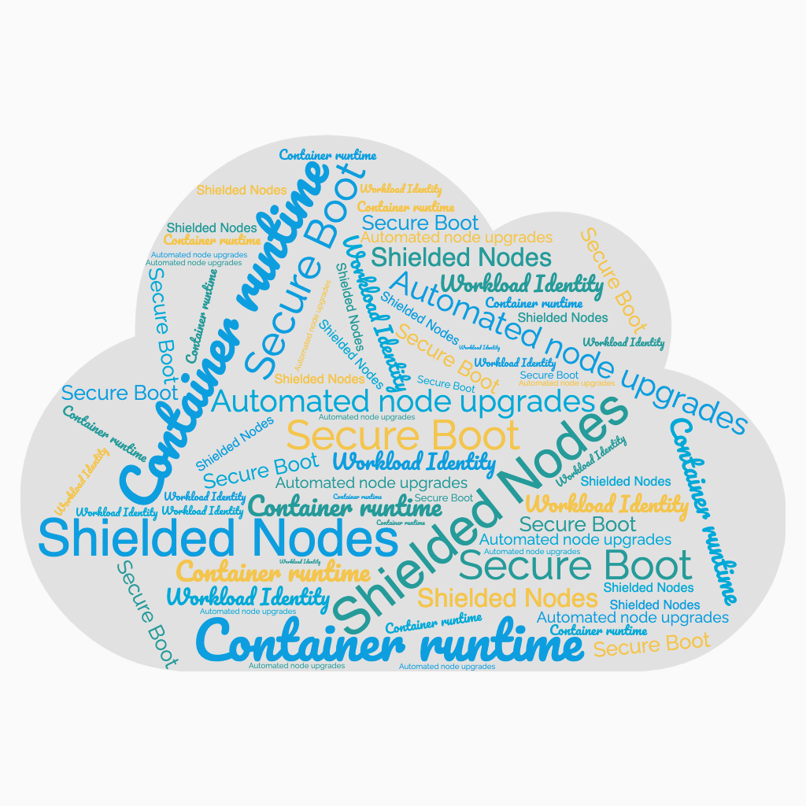

Slide 13
NA MASSA!

Slide 14
TEMOS DÚVIDAS?

