Slide 1
Akka Streams
Brief Overview

Slide 2
What we will cover
Stream concepts
Simple scala example (code walk through)
Definitions
What Akka brings to streams (code walk through)
Graphs
Simple (code walk through)
Complex (code overview)
Reservation Api usage (graph overview)
Applications, use cases for travel (time permitting)

Slide 3
Concepts
A stream, in its simplest conceptual form, is a type of data flow.
It takes data from a source, transforms it using flows, and dumps it to a sink when it is done.
Source, Flow, Sink are elements in a stream
Example:
Given a list of Comment objects (source)
Transform them (flows)
From comment object to body (string)
From body (string) to count of words (int)
Print the sum of all word counts (sink)
Code example (without akka stuff)
TransformSpec - (a simple stream)
Streams Tutorial (https://github.com/andersondk7/streamsTutorial)

Slide 4
Adding Akka
Simple scala transforms are fine, but…
Memory constraints ...
Processing rates may differ ...
Source may produce data faster than flows/sink can consume
Flow/Sink may consume faster than than the source can produce
Solved with Backpressure - consumer tells producer when to emit data
Non-Blocking operations
A blocking element does not hinder the progress of the calling thread
Solved using asynchronous processing with actors, messages and futures
Asynchronous (Parallelization - Sequential)
Do some things concurrently
Other things sequentially

Slide 5
Adding Akka (con’t)
Akka adds:
When we talk about asynchronous, non-blocking backpressure we mean that the processing stages available in Akka Streams will not use blocking calls but asynchronous message passing to exchange messages between each other, and they will use asynchronous means to slow down a fast producer, without blocking its thread. This is a thread-pool friendly design, since entities that need to wait (a fast producer waiting on a slow consumer) will not block the thread but can hand it back for further use to an underlying thread-pool. (from doc.akka.io)

Slide 6
Definitions (akka style)
Source - emits data
Output only
Source[Out, Mat]
Flow - transforms data
Input to output
Flow[In, Out, Mat]
Sink - consumes data
Input only
Sink[In, Mat]
Stage
Building block
Map
Filter
Partition
Junctions
Broadcast
Merge
Graph
Flow with both ends attached
Source → flow → Sink
Once defined, it can be ‘run()’

Slide 7
Code Sample
Code example (with akka stuff)
TransformSpec - (a simple stream)
Streams Tutorial (https://github.com/andersondk7/streamsTutorial)

Slide 8
Adding Graphs
Representing Streams (data flows) as a picture
Simpler than via, toMat, etc
Uses the gof Builder pattern
Code Example
TransformSpec - (an akka graph)
Streams Tutorial (https://github.com/andersondk7/streamsTutorial)

Slide 9
Complex Graphs
Complex flows
FanOut
Partition (split to a specific flow based on criteria)
Broadcast (send to all flows, ie. parallel execution)
FanIn
Merge (combine flows)
Pre-Build Stages
Source (http://doc.akka.io/docs/akka/2.5.3/scala/stream/stages-overview.html#source-stages)
Sink (http://doc.akka.io/docs/akka/2.5.3/scala/stream/stages-overview.html#sink-stages)
Flow (http://doc.akka.io/docs/akka/2.5.3/scala/stream/stages-overview.html#flow-stages)
Map, filter, collect, group, sliding, scan, fold, drop, take
Recover, recoverWith
Throttle, limit

Slide 10
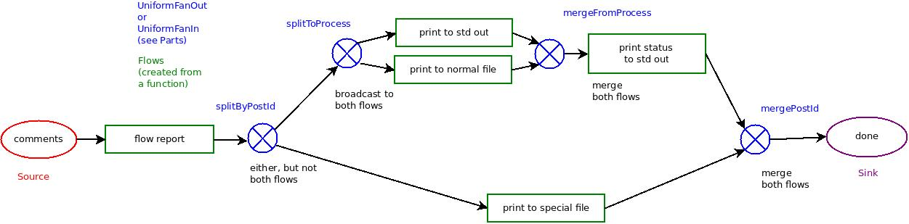
Complex Graphs - Example
Code Example
Tutorial - Step 13
Streams Tutorial (https://github.com/andersondk7/streamsTutorial)
Flow.Parts
Flow.buildGraph

Slide 11
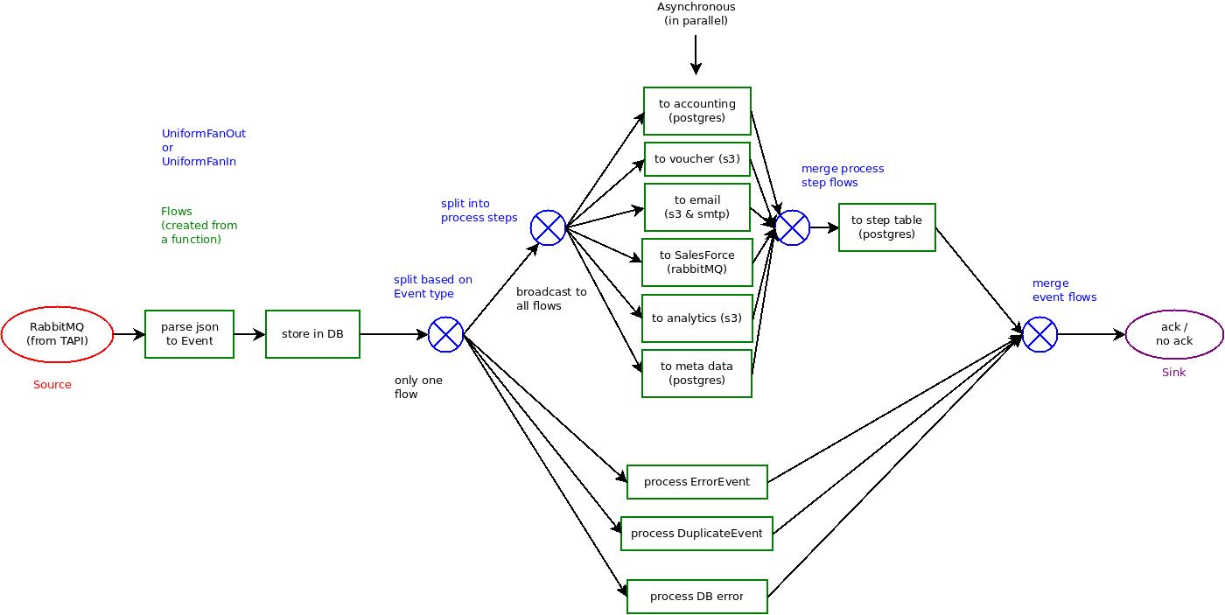
Reservation Api
Notes:
12 functions
1 graph
5 instances
= Reservation Api

Slide 12
Summary
Streams allow for processing of data elements via
Asynchronous
Back Pressure
Non-Blocking
Sources
Database query
Rabbit MQ
Web calls
Actors
Flows
Based on functions
Graph Based
Visual description of data flow
Pre-packaged stages (split, map, filter, partition, collect etc.)

