Slide 1


Vestal Pro Shoe Launch
Campaign Performance Report
North America eCommerce
Active campaign: June 1 – June 20, 2026
Marketing Insights & Analytics · **synthetic case data**

Slide 2

CAMPAIGN RECAP
20-day GTM campaign; success measured against campaign forecast.
PRIMARY OBJECTIVES
SUCCESS CRITERIA
• Create incremental footwear revenue
• Acquire new trail-running consumers
• Establish Vestal Pro as flagship Salomon ultra-running shoe
• Incremental revenue ≥ +10% vs no-campaign counterfactual
• New customers ≥ 25% of Vestal Pro purchasers
• Cannibalization < 15% of Vestal Pro sales
• Halo ≥ +5% lift across adjacent trail categories
• Branded search ≥ 10% vs counterfactual baseline.
SECONDARY OBJECTIVES
• Grow the email / SMS consumer database
• Generate halo demand across adjacent trail categories
• Increase Salomon brand awareness
• Limit cannibalization of existing footwear franchises
MEASUREMENT WINDOWS
PRE-CAMPAIGN BASELINE
March 1 – May 31 · 13 Weeks
Status Quo demand, traffic, and channel patterns.
Minimal activations and no launches.
ACTIVE CAMPAIGN
June 1 – June 20 · 3 weeks
GTM Strategy supported by paid media, CRM, site merchandising, and affiliate partners.
POST-CAMPAIGN
June 21 – July 20 · 4 weeks
Demand persistence, delayed returns, CLV retention measurement.
Salomon NA eCommerce · Vestal Pro launch
3

Slide 3
EXECUTIVE SUMMARY
Successful Launch; Monitor for continued cannibalization and shifting sales mix
INCREMENTAL FOOTWEAR REVENUE
NEW-CUSTOMER SHARE, VESTAL PRO BUYERS
FRANCHISE CANNIBALIZATION, EST.
ADJACENT-CATEGORY HALO
+33%
44%
22–30%
+9%
+$134.6K vs modeled no-campaign baseline
590 of 1,335 buyers new to Salomon
17–42% across baseline models
95% CI +3% to +15% vs baseline
Target ≥ +10% · PASS
Target ≥ 25% · PASS
Guardrail < 10% · FLAG & MONITOR
Target ≥ +5% · PASS
VERDICT — a commercial success limited by availability.
The Vestal Pro delivered $207.7K of direct revenue and $142.5K of net incremental revenue (+29% vs the no-campaign baseline).
Gross Margin was $114.2K. After direct marketing expenses, Contribution Margin (CM3) is $24.1K
Limited factors included cannibalization of existing portfolio and limited availability in core sizes.
Salomon NA eCommerce · Vestal Pro launch readout
2

Slide 4
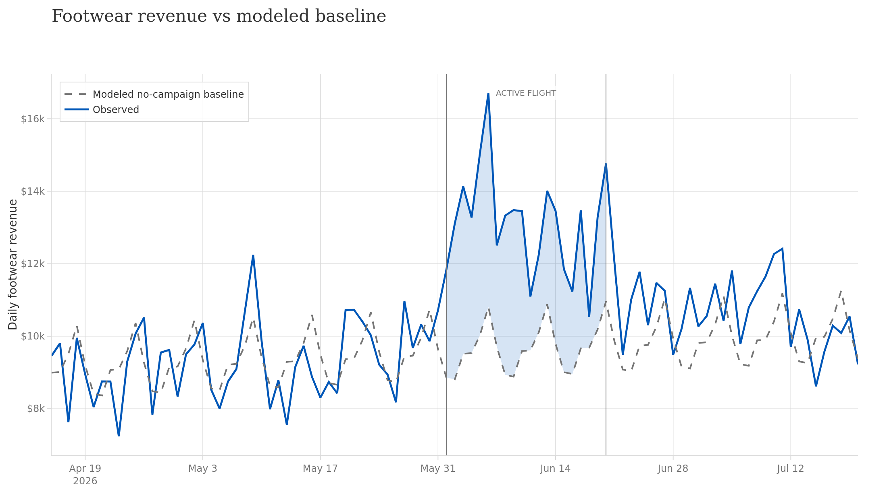
TOPLINE PERFORMANCE
Footwear revenue was 33% above the no-campaign baseline throughout the launch
Campaign start · June 1
Final comms
Incrementality Persists
ACTIVE CAMPAIGN, ~3 WEEKS
Observed
$262.8K
Counterfactual baseline
$193.5K
Incremental
+$69.3K (+35.8%)
95% CI +32% to +40% · every campaign week ran above baseline · peak gap +$29K in launch week
Salomon NA eCommerce · Vestal Pro launch readout · Baseline: pre-period trend + weekly seasonality; backtest MAPE 10.1% · FOOTWEAR ONLY
5

Slide 5
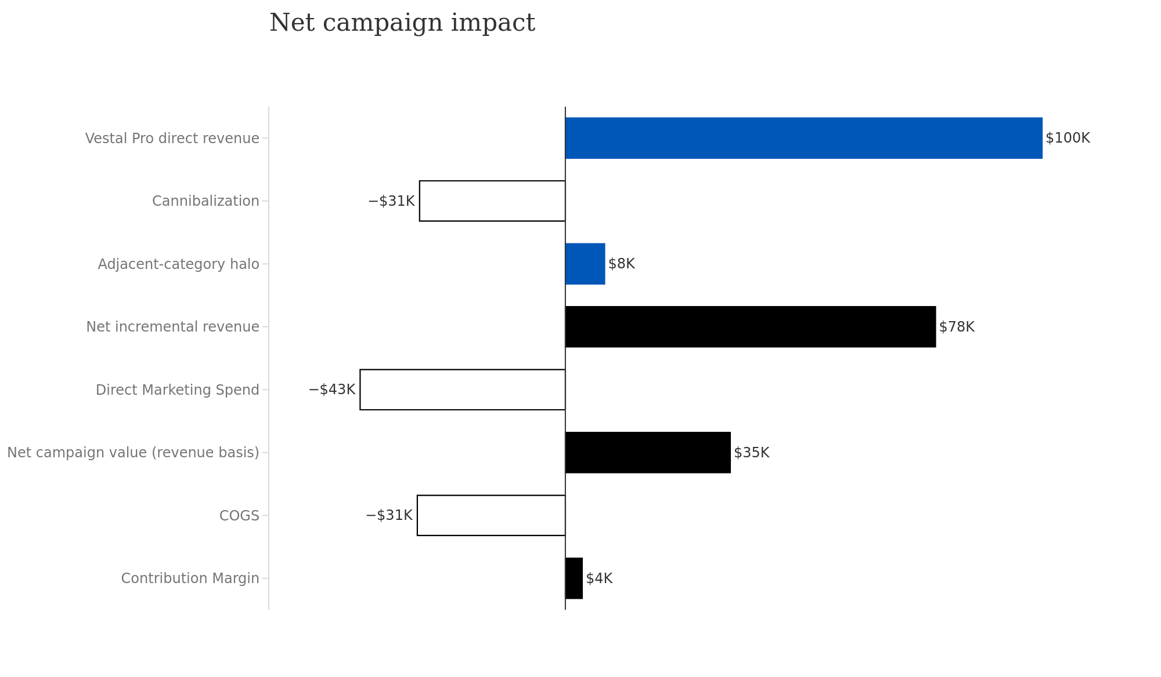
SALES DECOMPOSITION
Contribution Margin of ~4K limited by Franchise Shift
INCREMENTALITY BREAKDOWN
Primary Concern
Baseline: $234.0K of business would have occurred without the campaign and is excluded. Only movement vs. baseline is counted.
Sales Shift: $30.5K of Vestal Pro revenue displaced Ultra Glide and Sense Ride sales, net of Speedcross gains (19–32% of Vestal Pro units).
Marketing: $74.6K campaign spend less $31.6K baseline 20-day run rate → $43.0K additional spend.
** Paid investment is persistent (more on this…) **
Return on Marketing: $77.5K ÷ $43.0K = 1.80× on a revenue basis.
Contribution Margin (CM3): After accounting for COGS and direct overhead, CM3 sit at $3.5K.
Persistent effect
Salomon NA eCommerce · Vestal Pro launch readout
6

Slide 6
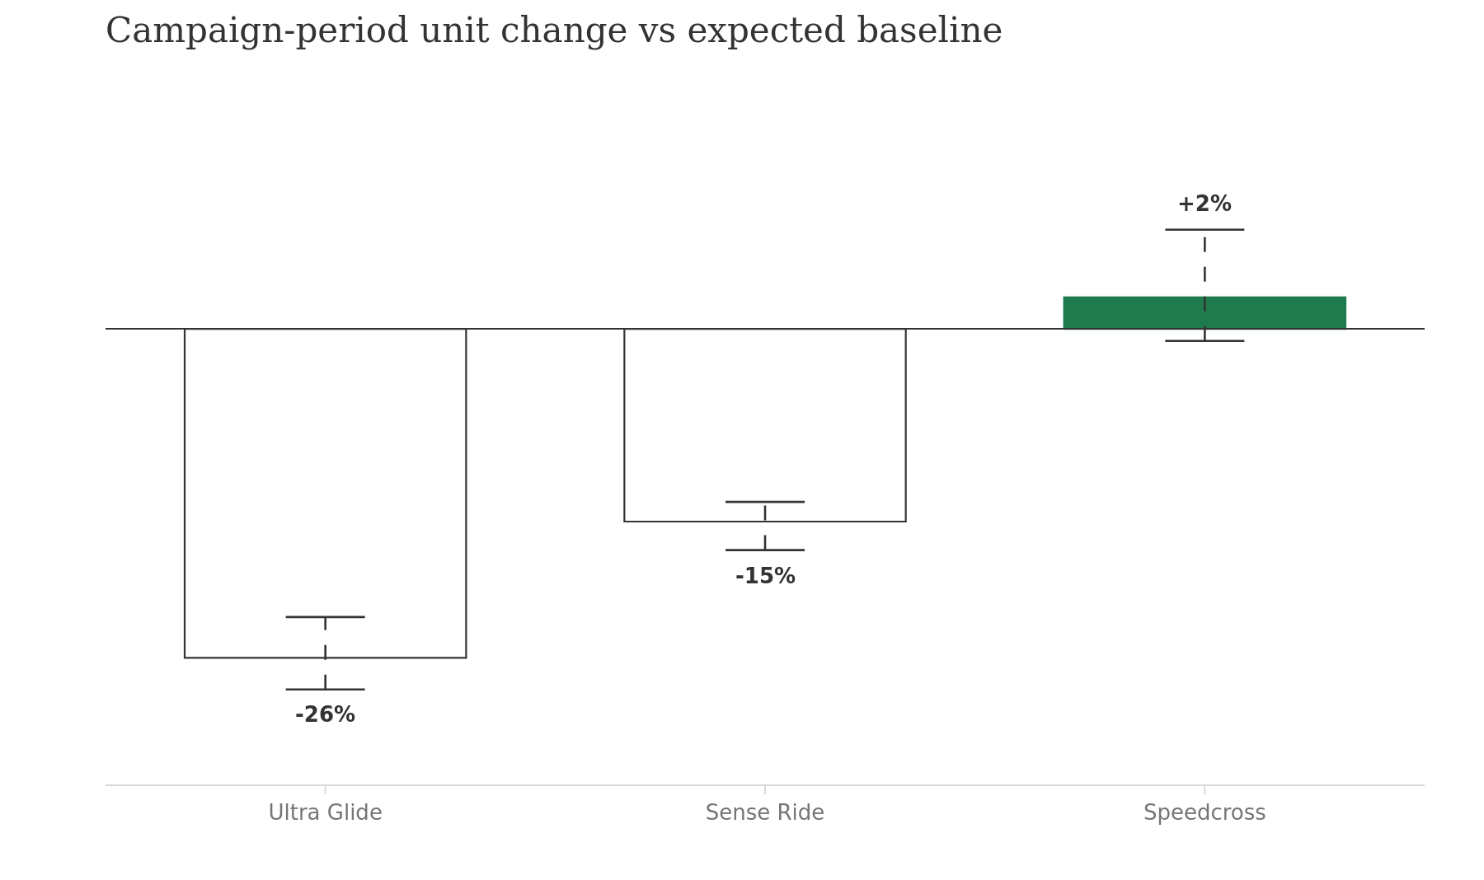
CANNIBALIZATION BREAKDOWN
19–32% of Vestal Pro units shifted from existing shoes; exceeding 10% threshold.
OVERALL CANNIBALIZATION ESTIMATE
19–32%
Goal < 10% · WATCH
of Vestal Pro units cannibalized existing portfolio
• The three baseline estimates are 19%, 28%, and 32%, with a median of 28%.
• $30.5K of existing-shoe revenue was displaced by about 31% of Vestal Pro's $99.8K direct revenue.
• Sales shift is concentrated where product positioning overlaps.
• The launch remains net positive: +$69.3K in additional footwear revenue after the shift.
• Speedcross displacement is insignificant.
MANAGE franchise shift with merchandising that reduces head-to-head substitution.
Salomon NA eCommerce · Vestal Pro launch readout · Unit baselines per franchise; range reflects baseline forecast uncertainty
8

Slide 7
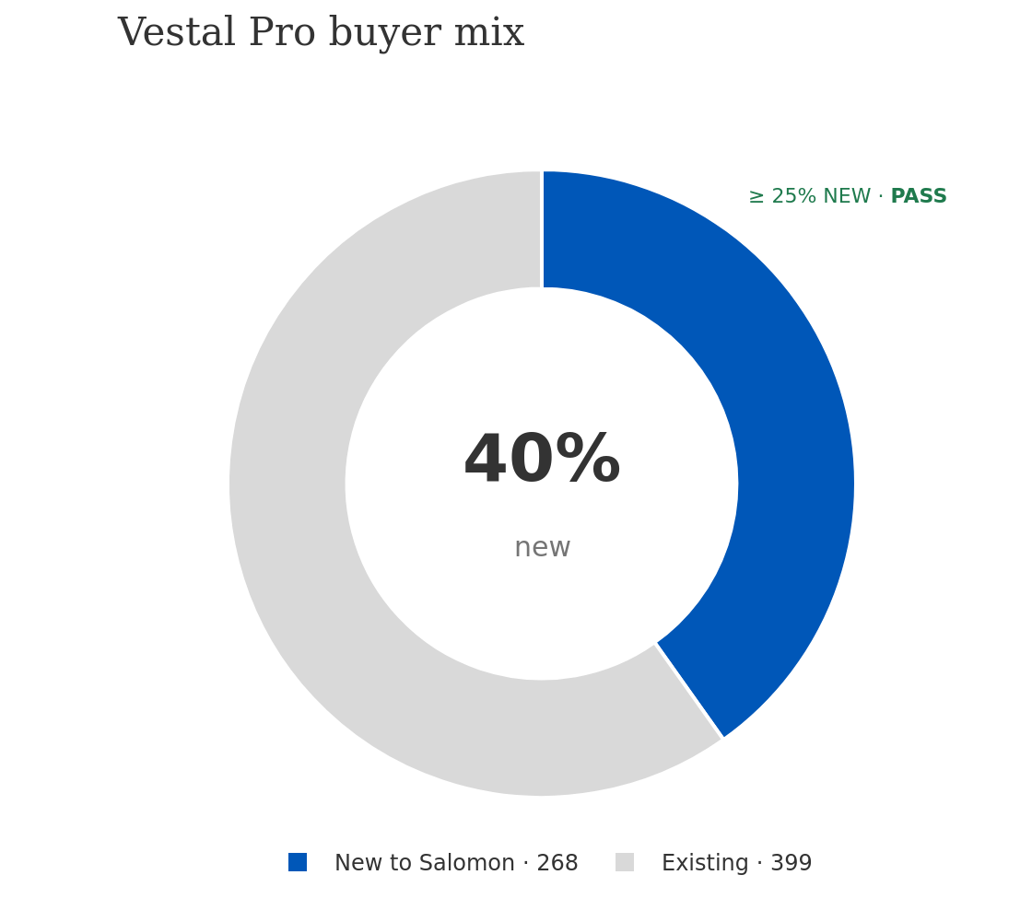
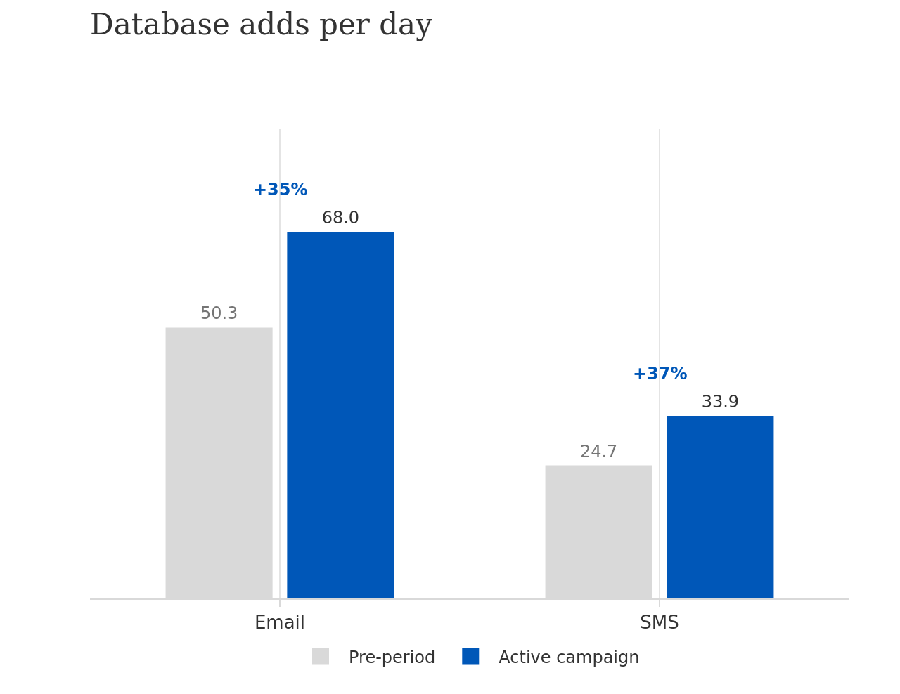
CUSTOMER ACQUISITION AND LTV
40% of Vestal Pro buyers were new to Salomon. Acquired at half early value
ACQUISITION METRICS
$102 Blended CAC
$155.8K spend ÷ 730 new customers
$129 First-order value
average first basket, new customers
$188 Early customer value
revenue through June 20 · 1.8× CAC
28.1% Post-period repeat rate
repurchased within 4 weeks of initial purchase
1,361 email and 678 SMS adds during the 20-day campaign.
New Vestal Pro buyers opt in at 72% email / 40% SMS, vs 51% / 24% for existing buyers.
Salomon NA eCommerce · Vestal Pro launch readout
7

Slide 8
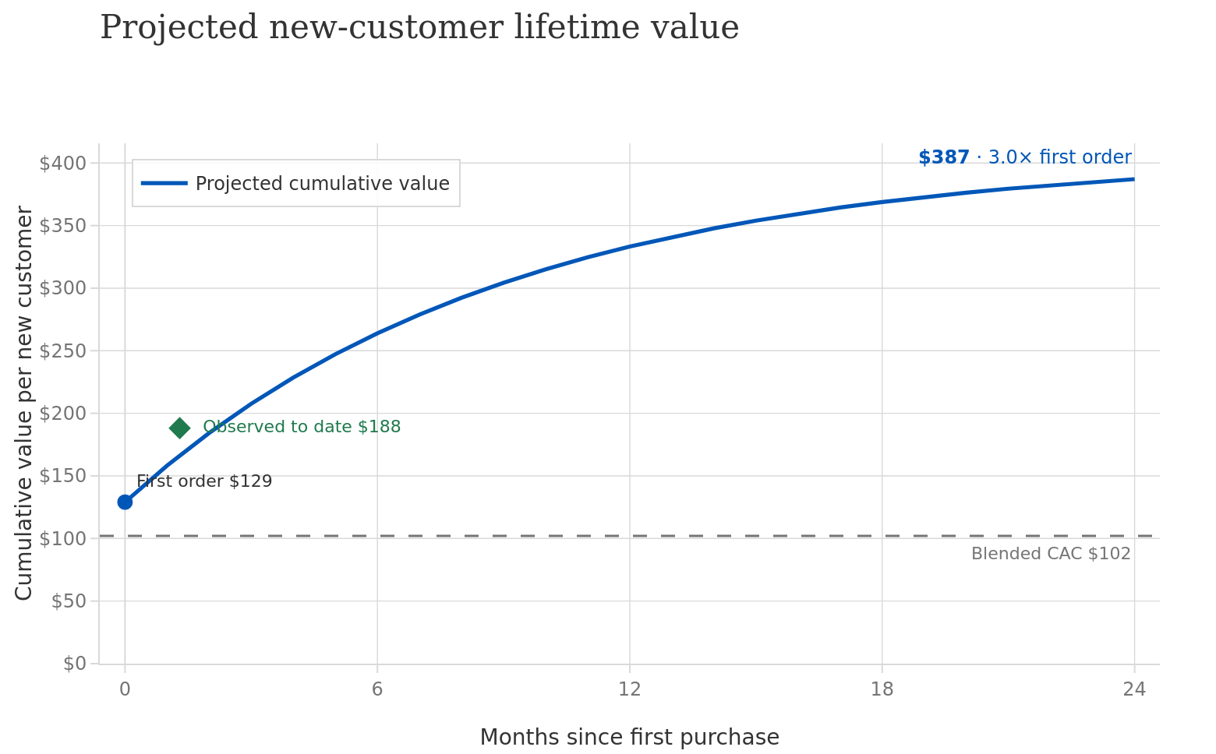
CUSTOMER ACQUISITION AND LTV
Projected 24-month value of ~$387 per new customer; 3.8× acquisition cost
Prior CLV cohort analysis
LIFETIME VALUE FORECAST
• LTV Forecast of $387/customer at 24 months (3.8x CAC) based on prior CLV cohort analysis.
• Value is front-loaded: We will see most of the LTV within the first 12 months (Roughly 86% accrues within the first year).
• Currently outperforming LTV forecast at $188 after 4 weeks (1.8x CAC)
Salomon NA eCommerce · Vestal Pro launch readout
7

Slide 9
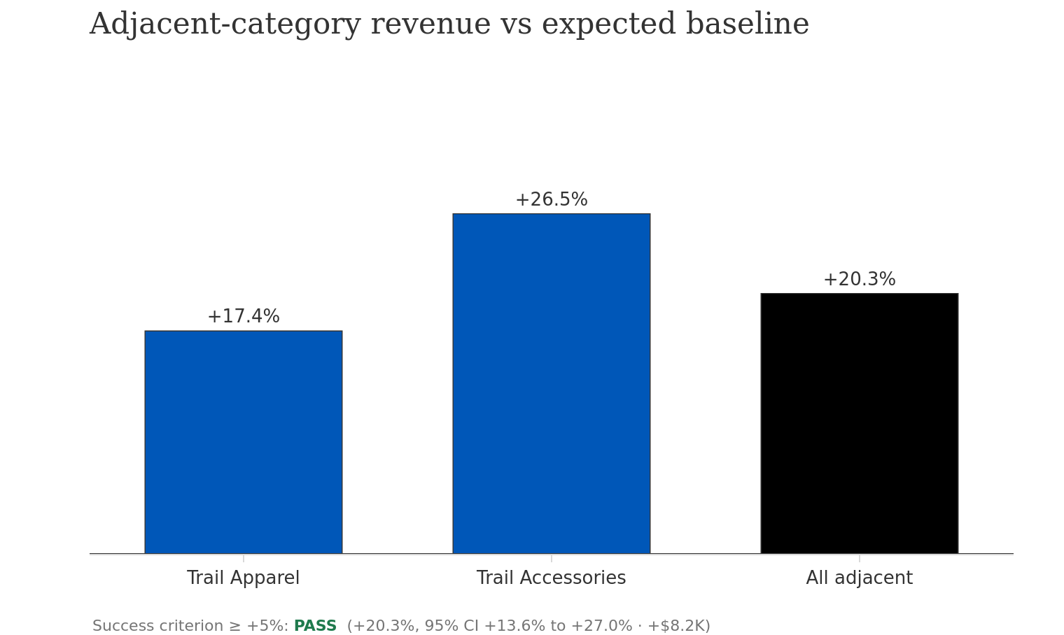
HALO EFFECT
Adjacent categories lifted +20% driven by larger Vestal Pro carts
ATTACH RATE TO VESTAL PRO ORDERS
21.6% +4.1ppts vs 17.5% historical average
$8.2K of incremental halo revenue
• Halo effect realized mostly through larger Vestal Pro carts. New buyers attached accessories at a higher rate. Standalone adjacent demand up only 1%.
• Accessories led (+26.5%); apparel followed (+17.4%). Other adjacent categories lifted at 20.3%
• Opportunity:
PDP bundles (socks, jerseys, hydration) and enhanced item-item recommendation systems to support ancillary products.
Email & CRM messaging to Vestal Pro customers supporting frequent follow-up purchase products.
Salomon NA eCommerce · Vestal Pro launch readout · Baseline: pre-period trend + weekly seasonality per category
9

Slide 10
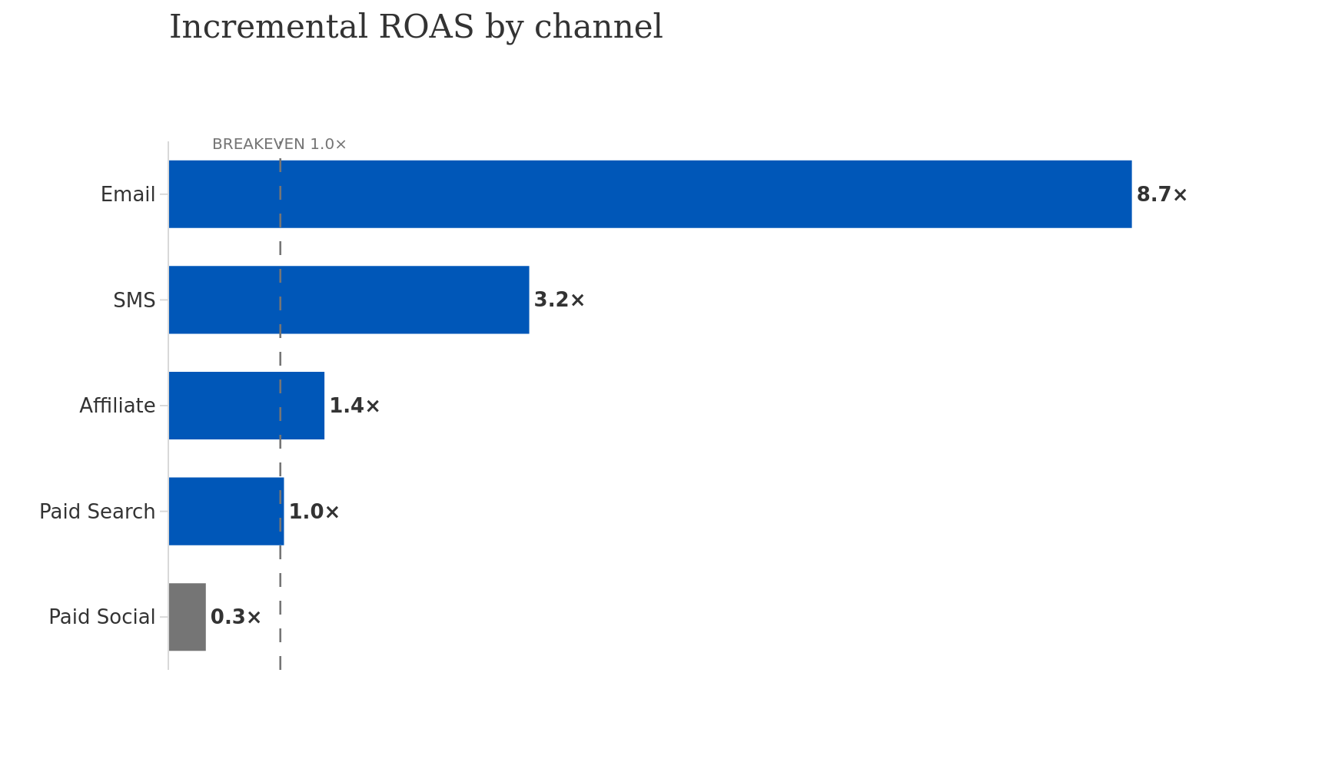
CHANNEL PERFORMANCE
All channels cleared breakeven except for paid social
ROAS × Incremental Revenue Factor of .34
• CRM: 8% of spend, 47% of attributed revenue. Efficient activation of an existing low-funnel audience. High-intent buyers inflate the metric.
• Paid social: 60% of spend at only 0.3× iROAS. However, PS acquired 297 of 730 new customers (41%) at $151 CAC vs $188 early value. Acquisition will pay back via LTV.
• Paid search: 25% of spend at 1× iROAS. Second largest acquisition source (175 new customers at $108 CAC). Efficiency dropped through campaign as size curves broke.
• Affiliate: 7% of spend at 1.4× iROAS and lowest CAC at $82. Small share but positive. TEST SCALING
Salomon NA eCommerce · Vestal Pro launch readout
10
Notes:
In reality, we would want a more nuanced, geo and channel based estimate of incremental ROAS instead of a uniform application.

Slide 11
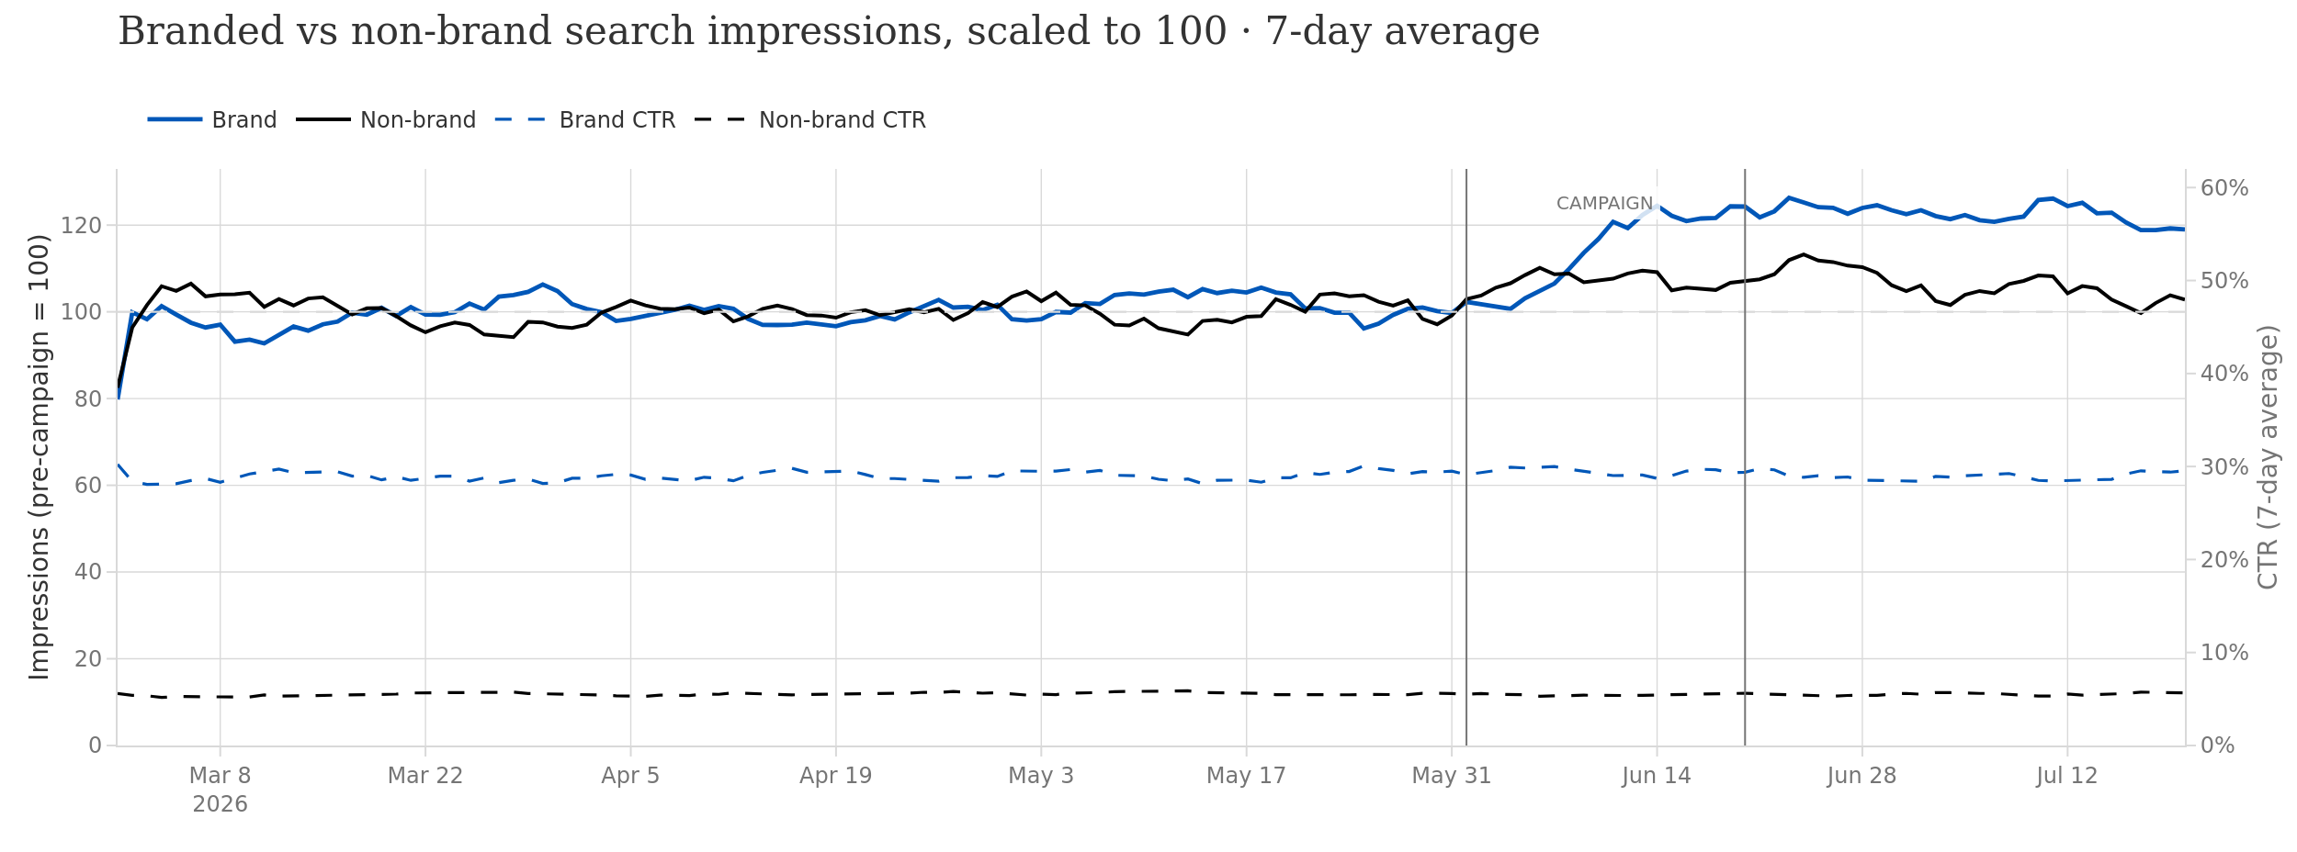
BRAND AWARENESS
Campaign investment supports persistent brand awareness and recognition
Lag due to 7day MA and paid media ramp
Persistence brand lift
22%
lift in branded
search impressions.
• Paid Media investment during campaign supports lasting brand awareness impact.
• Brand impressions and clicks +20% during campaign and persist at +22% above pre-campaign levels in the final two weeks (Jul 7–20). Brand awareness did not decay with media spend.
• Non-brand search rose slightly (+8%) and reverted toward baseline (+5%) after campaign. The win is in brand awareness, not ultra-running market or seasonality.
• Brand Clicks lifted in-line with impressions. Impression quality did not deteriorate.
STABLE
Impression quality
measured by CTR
Salomon NA eCommerce · Vestal Pro launch readout
10

Slide 12
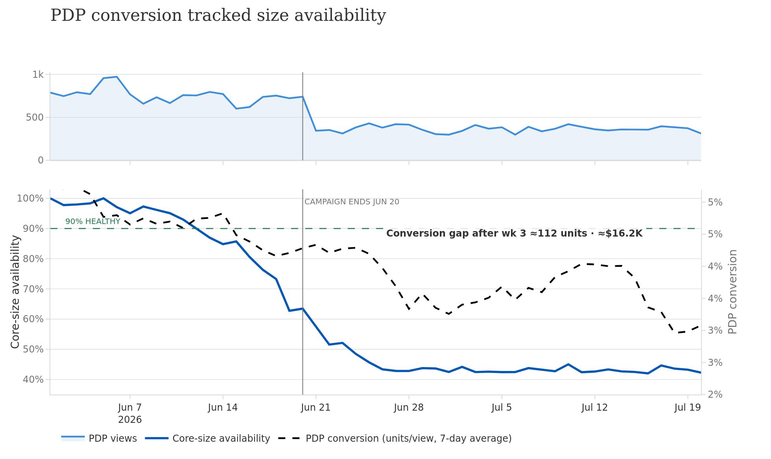
INVENTORY AND SALES PLANNING
Broken size curves after 6 weeks cost an estimated $16.2K in demand
Traffic follows paid media divestment
DEMAND OUTLIVED SUPPLY
• Inventory (not demand) constrained the campaign and demand capture. Core sizes fell below 90% threshold by week 3.
• Conversion rate depression depressed from 4.6% → 3% due to inventory constraints.
• Unmet Demand: 112 units // ~16.2K value, modeled through conversion drop from baseline.
• No substitution offset counteracted lost Vestral Pro sales. Adjacent shoe categories held flat.
• Opportunity:
• Increase WOS purchasing plan on core sizes to create sales buffer.
• Tie inventory indicators to purchasing and paid media actions including replenishment triggers and paid spend throttling.
June 1 Campaign Start
Core Sizes = M9-11 & W7-9
Salomon NA eCommerce · Vestal Pro launch readout
12
Notes:
Weeks run from the June 1 launch; weeks 4–7 are post-campaign (Jun 21–Jul 19). Core-size availability = share of core sizes (M9–11, W7–9) in stock, daily average. PDP conversion = Vestal Pro units ÷ PDP views, 7-day average. Unmet demand = campaign-period conversion (4.6%) applied to weeks 4–7 PDP traffic, less actual units, at the $145 average selling price. Illustrative synthetic case data.

Slide 13
RECOMMENDATIONS
Changes for next launch
1
Buy deeper on core sizes and replenish behind the launch. Core-size availability broke 90% in week 2 and bottomed near 43%, costing ≈112 units (≈$16.2K). Increase the WOS purchasing plan on core sizes and trigger replenishment order when ATS breaks threshold.
2
Gate and rebalance paid media. Tie spend to inventory signals. Throttle when core availability breaks 90% rather than pushing traffic into a broken size curve. 41% of new customers at $151 CAC vs $188 early value; set the CAC target pre-launch and add a day-90 LTV readout.
3
Judge paid social on acquisition economics, not last-click revenue. 41% of new customers at $151 CAC vs $188 early value; set the CAC target pre-launch and add a day-90 LTV forecast.
4
Cannibalization Management. ~28% of Vestal Pro units shifted from existing shoes displacing with $30.5K. Next launch, improve product positioning, communication, and audience separation against overlapping models. Monitor cannibalization throughout campaign.
5
Support additional halo effects. Double down on PDP bundles and item-item recommendations. Message buyers to push cross selling-products and common follow-up purchases.
Salomon NA eCommerce · Vestal Pro launch readout

Slide 14

THANK YOU
MERCI
Marketing Insights & Analytics

Slide 15
APPENDIX
Marketing Insights & Analytics

