Slide 1


Vestal Pro Shoe Launch
Campaign Performance Report
North America eCommerce
Active campaign: June 1 – June 20, 2026
Marketing Insights & Analytics · **synthetic case data**

Slide 2

AGENDA
CASE AGENDA
Case Setup & Executive Summary · Background, objectives, success criteria, campaign verdict
1
Sales Performance · Topline vs. baseline, decomposition, cannibalization, halo
2
Customer Acquisition & LTV · CAC, 24-month LTV forecast
3
Channel Performance · Spend mix, iROAS, each channel’s role
4
Brand Awareness · Branded search demand during and after the campaign
5
Inventory · Size-curve availability and unmet demand
Recommendations · Changes for the next launch
Salomon NA eCommerce · Vestal Pro launch
2

Slide 3
CASE SETUP
Vestal Pro: a new ultra-running line, launched with a 20-day GTM campaign
BACKGROUND
June 2026 launch of a high-cushion ultra-running trail in Salomon’s North American market.
DATA USED
GA4 sessions, source, views & conversion; order-level sales; marketing spend by channel; ATS inventory; GSC brand queries
OBJECTIVE | PRIORITY | SUCCESS CRITERIA
Create incremental footwear revenue | Primary | Incremental revenue ≥ +10% vs no-campaign counterfactual
Acquire new trail-running consumers | Primary | New customers ≥ 25% of Vestal Pro purchasers
Establish a flagship ultra-running franchise | Primary | Launch-period revenue meets campaign forecast
Limit cannibalization of existing footwear | Secondary | Sales shift < 10% of Vestal Pro sales
Generate halo demand in adjacent categories | Secondary | Halo lift ≥ +5% across adjacent trail categories
Increase Salomon brand awareness | Secondary | Branded search ≥ +10% vs counterfactual baseline
Grow the email / SMS consumer database | Secondary | Email / SMS acquisition meets campaign targets
MEASUREMENT WINDOWS
PRE-CAMPAIGN BASELINE
Mar 1 – May 31 · 13 weeks
Status-quo demand, traffic, and channel patterns
POST-CAMPAIGN
Jun 21 – Jul 20 · 4 weeks
Demand persistence, returns, repeat purchase
MAR 1
ACTIVE CAMPAIGN
Jun 1 – Jun 20 · 3 weeks
Paid media, CRM, site merchandising, affiliates
JUL 20
Salomon NA eCommerce · Vestal Pro launch
3
Notes:
Named after 1 of my favorite mtns in Colorado. Vestal Peak on Wham Ridge outside of Silverton. Its an ultra just to get to the mtn. 25 mile round trip.

Slide 4
EXECUTIVE SUMMARY
Launch was successful; Monitor for continued cannibalization and shifting sales mix
PASS
PASS
PASS
FAIL
INCREMENTAL FOOTWEAR REVENUE
NEW-CUSTOMER SHARE, VESTAL PRO BUYERS
ADJACENT-CATEGORY HALO
FRANCHISE CANNIBALIZATION, EST.
+36%
40%
+20%
19–32%
+$69.3K vs modeled no-campaign baseline
268 of 667 buyers new to Salomon
95% CI +14% to +27% vs baseline
−$30.5K existing-shoe revenue displaced
Target ≥ +10% · PASS
Target ≥ 25% · PASS
Target ≥ +5% · PASS
Guardrail < 10% · FLAG & MONITOR
VERDICT: a commercial success limited by availability.
$99.8K direct revenue · $77.5K net incremental revenue (+33% vs baseline) ·
$34.5K after incremental media · $3.5K CM3.
Cannibalization and core-size availability capped the upside.
Salomon NA eCommerce · Vestal Pro launch readout
4

Slide 5
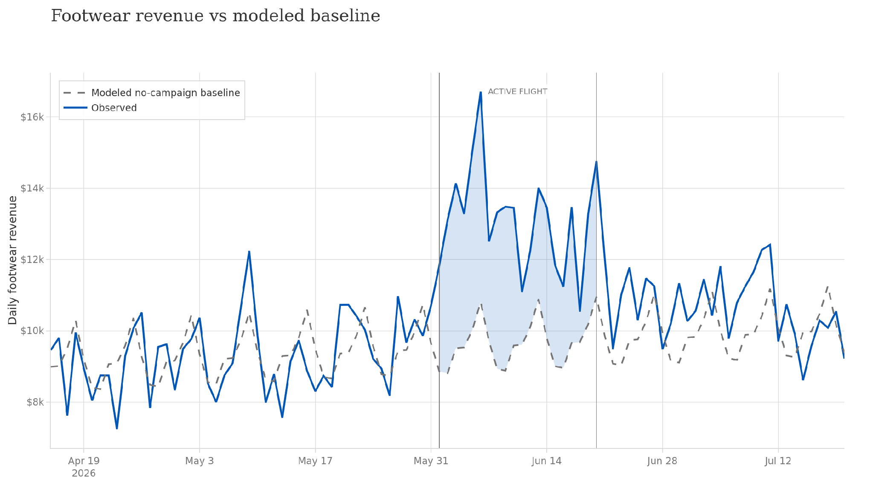
TOPLINE PERFORMANCE
Footwear revenue was 36% above the no-campaign baseline throughout the launch
Campaign start · June 1
Final comms
Incrementality Persists
ACTIVE CAMPAIGN, ~3 WEEKS
Observed
$262.8K
Counterfactual baseline
$193.5K
Incremental
+$69.3K (+35.8%)
Every campaign week ran above baseline; Peak gap +$29K in launch week
Salomon NA eCommerce · Vestal Pro launch readout · Baseline: pre-period trend + weekly seasonality; backtest MAPE 8.0% · FOOTWEAR ONLY
5
Notes:
95% CI +32% to +40% above baseline

Slide 6
SALES DECOMPOSITION
Contribution Margin of ~4K limited by Cannibalization
CAMPAIGN P&L — 20-DAY LAUNCH
INCREMENTALITY BREAKDOWN
Vestal Pro direct revenue
+$99.8K
• Only movement vs. baseline is counted.
• $30.5K of Ultra Glide and Sense Ride sales displaced by Vestal Pro campaign.
• Paid investment is persistent. Lasting effects on brand awareness and CLV
• Return on Incremental Media: $77.5K ÷ $43.0K = 1.80×
• Contribution Margin: After accounting for COGS and direct overhead, CM3 sit at $3.5K.
Sales shifted from existing shoes (19–32% of units)
−$30.5K
Primary Concern
Halo — attached apparel & accessories
+$8.2K
Net incremental revenue (+33% vs no-campaign baseline)
+$77.5K
Incremental media spend ($74.6K total less $31.6K run rate)
−$43.0K
Persistent Effect
Net campaign value after media
+$34.5K
Contribution margin (CM3) at 60% gross margin
+$3.5K
Salomon NA eCommerce · Vestal Pro launch readout
6
Notes:
BASELINE: $234.0K of business would have occurred without the campaign and is excluded.
• $74.6K campaign spend less $31.6K baseline 20-day run rate → $43.0K additional spend.
Check the 1.8 number here vs the iROAS in later slide

Slide 7
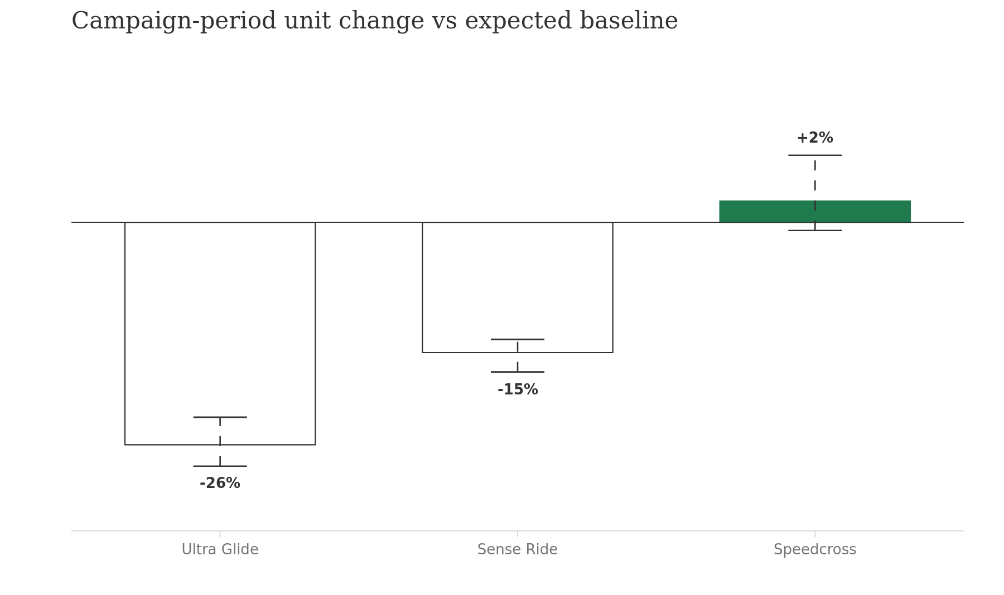
CANNIBALIZATION BREAKDOWN
19–32% of Vestal Pro units shifted from existing shoes; exceeding 10% threshold.
OVERALL CANNIBALIZATION ESTIMATE
19–32%
Goal < 10% · WATCH
of Vestal Pro units cannibalized existing portfolio
• $30.5K of existing-shoe revenue was displaced
• Sales shift is concentrated where product positioning overlaps.
• The launch remains net positive: +$69.3K in additional footwear revenue after the shift.
• Speedcross displacement is insignificant.
MANAGE franchise shift with merchandising that reduces head-to-head substitution.
Salomon NA eCommerce · Vestal Pro launch readout · Unit baselines per franchise; range reflects baseline forecast uncertainty
7
Notes:
• The three baseline estimates are 19%, 28%, and 32%, with a median of 28%.
• $30.5K of existing-shoe revenue was displaced by about 31% of Vestal Pro's $99.8K direct revenue.

Slide 8
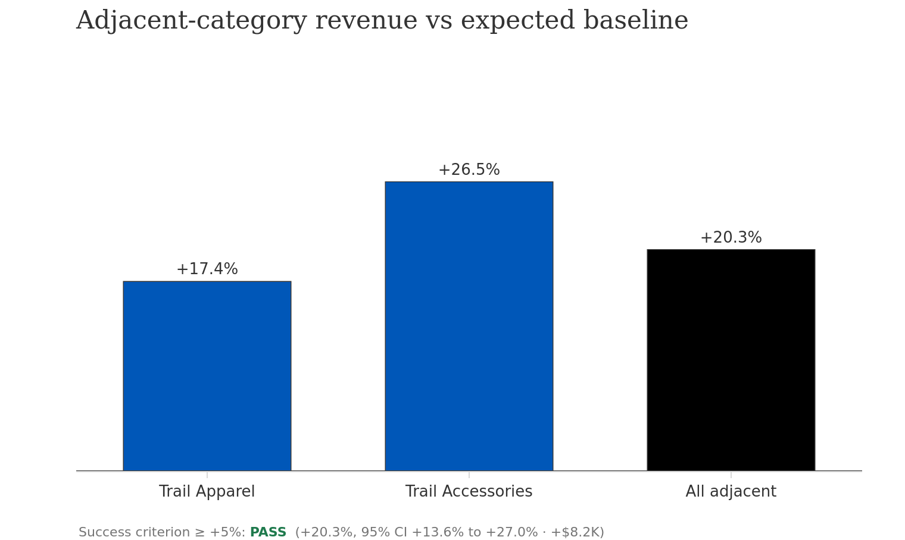
HALO EFFECT
Adjacent categories lifted 20% driven by larger Vestal Pro carts
ATTACH RATE TO VESTAL PRO ORDERS
21.6% +4.1ppts vs 17.5% historical average
$8.2K of incremental halo revenue
• Halo effect realized through larger Vestal Pro carts.
• Accessories led (+26.5%); apparel followed (+17.4%). All adjacent categories combined lifted 20.3%
• OPPORTUNITY:
PDP bundles and enhanced item-item recommendation systems to support ancillary products.
Email & CRM messaging to Vestal Pro customers supporting follow-up products.
Salomon NA eCommerce · Vestal Pro launch readout · Baseline: pre-period trend + weekly seasonality per category
8
Notes:
LARGER CARTS drove halo effect. New buyers attached accessories at a higher rate. Standalone adjacent demand up only 1%.
OPPORTUNITIES: (socks, jerseys, hydration)

Slide 9
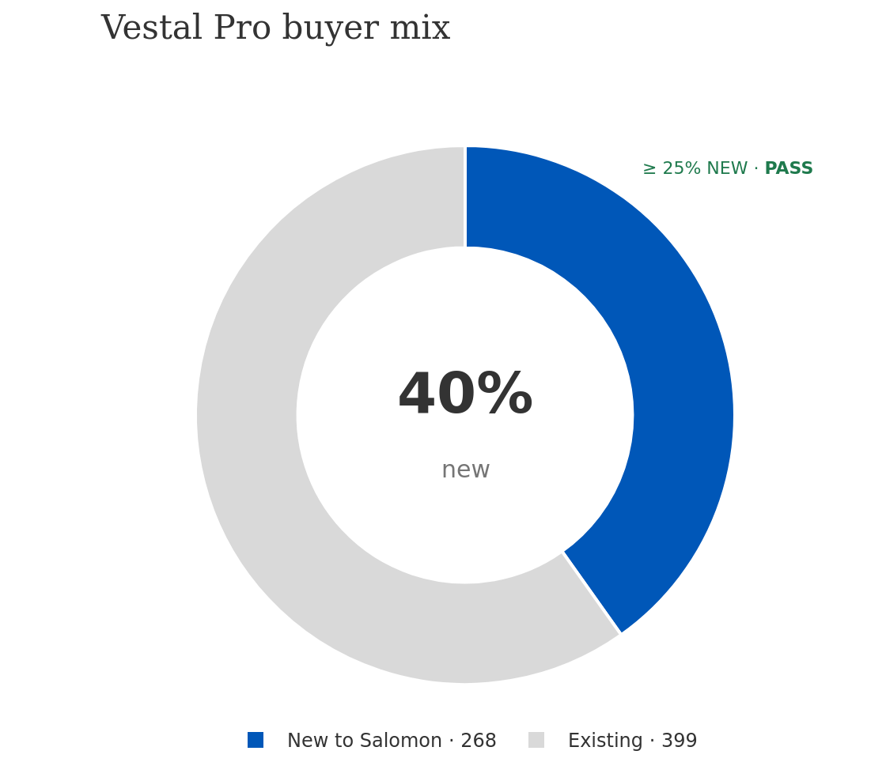
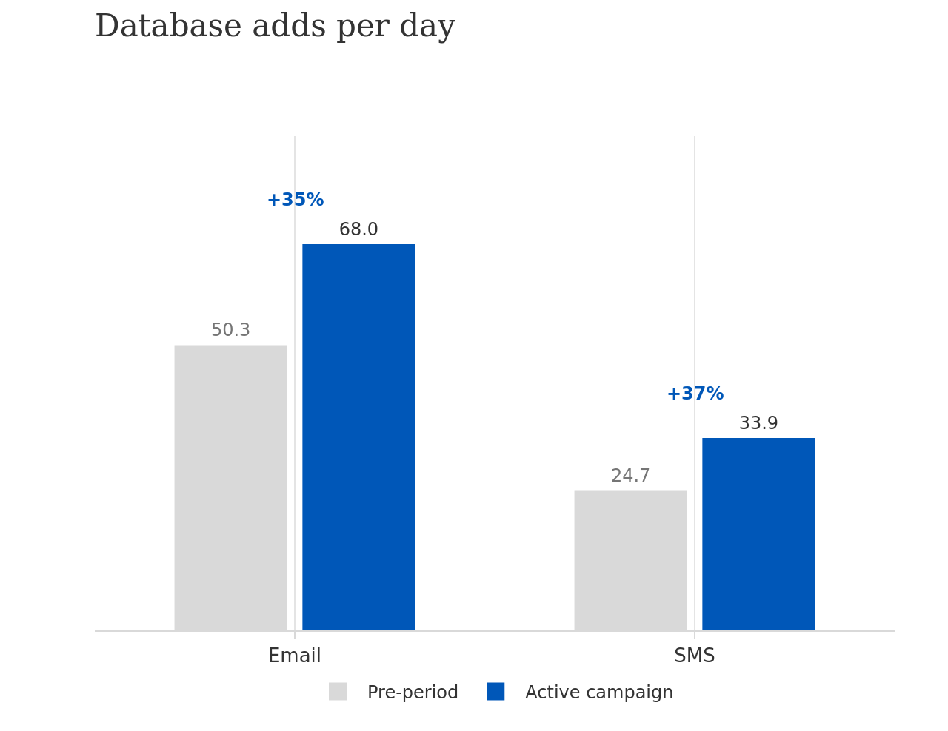
CUSTOMER ACQUISITION AND LTV
40% of Vestal Pro buyers were new to Salomon. Acquired at about half early value.
ACQUISITION METRICS
$102 Blended CAC
$74.6K paid spend ÷ 730 new customers
$129 First-order value
average first basket, new customers
$188 Early customer value
revenue through July 20 · 1.8× CAC
28.1% Post-period repeat rate
repurchased within 4 weeks of initial purchase
1,361 email and 678 SMS adds during campaign.
New Vestal Pro buyers opt in at 72% email / 40% SMS, vs 51% / 24% for existing buyers.
Salomon NA eCommerce · Vestal Pro launch readout
9

Slide 10
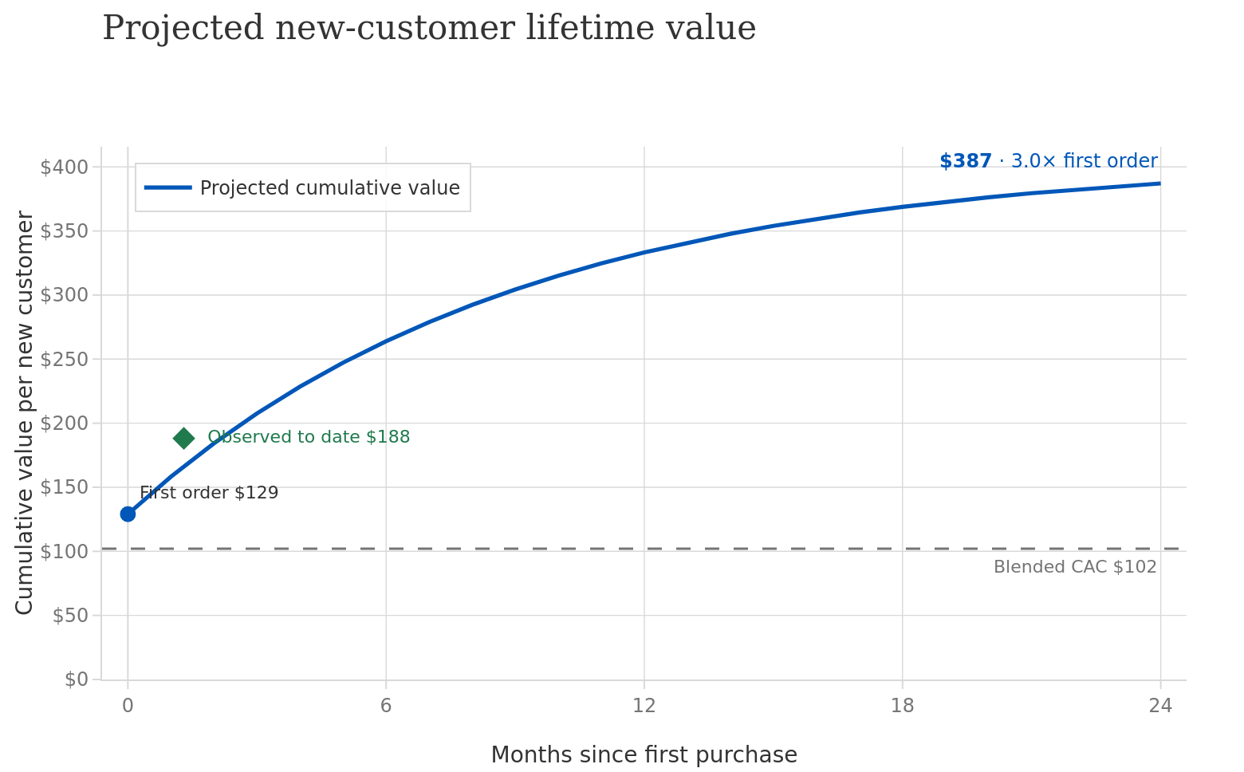
CUSTOMER ACQUISITION AND LTV
Projected 24-month value of $387 per new customer; 3.8× acquisition cost
Prior CLV cohort analysis
LIFETIME VALUE FORECAST
• LTV Forecast of $387/customer at 24 months (3.8x CAC) based on prior CLV cohort analysis.
• Value is front-loaded: We will see most of the LTV within the first 12 months (Roughly 86% accrues within the first year).
• Currently outperforming LTV forecast at $188 after 4 weeks (1.8x CAC)
Salomon NA eCommerce · Vestal Pro launch readout
10

Slide 11
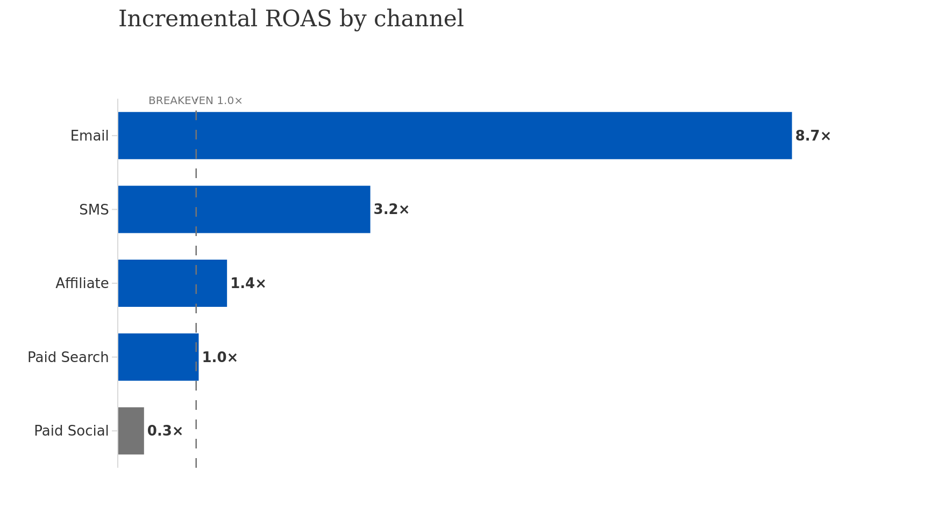
CHANNEL PERFORMANCE
All channels cleared breakeven except paid social; Paid is highest acquisition source
ROAS × Incremental Revenue Factor of .34
Channel | Spend | % of spend | Attributed revenue | % of attributed | ROAS | Est. iROAS | New customers | CAC (new)
Paid Social | $44,969 | 60% | $44,247 | 19% | 1.0× | 0.3× | 297 | $151
Paid Search | $18,849 | 25% | $58,008 | 25% | 3.1× | 1.0× | 175 | $108
Affiliate | $4,991 | 7% | $20,771 | 9% | 4.2× | 1.4× | 61 | $82
Email | $3,255 | 4% | $83,945 | 36% | 25.8× | 8.7× | 39 | $83
SMS | $2,490 | 3% | $24,017 | 10% | 9.6× | 3.2× | 20 | $124
Total | $74,554 | 100% | $230,988 | 100% | 3.1× | 1.0× | 592 | $126
• CRM: Efficient activation of an existing low-funnel audience. High-intent buyers inflate the metric.
• Paid social acquired 297 of 730 new customers (41%) at $151 CAC vs $188 early value. Will pay back via LTV.
• Paid search: Second largest acquisition source. Efficiency dropped through campaign as size curves broke.
• Affiliate: Lowest CAC at $82. Small share but positive. TEST SCALING
Salomon NA eCommerce · Vestal Pro launch readout
11
Notes:
In reality, we would want a more nuanced, geo and channel based estimate of incremental ROAS instead of a uniform application.
CRM: 8% of spend, 47% of attributed revenue.
PAID SOCIAL: 60% of spend at only 0.3× iROAS.
PAID SEARCH: 25% of spend at 1× iROAS. (175 new customers at $108 CAC)
AFFILIATE: 7% of spend at 1.4× iROAS.

Slide 12
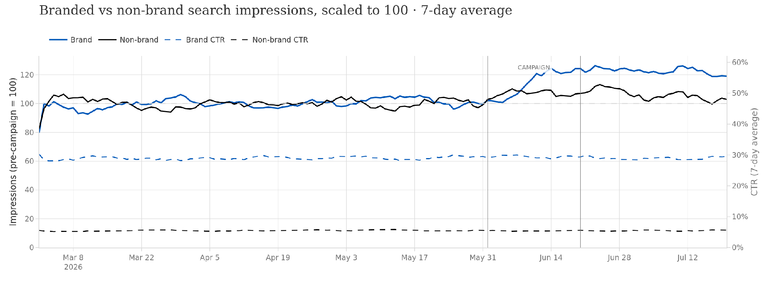
BRAND AWARENESS
Campaign investment supports persistent brand awareness and recognition
Lag due to 7day MA and paid media ramp
Persistence brand lift
22%
• Paid Media during campaign supports lasting brand awareness impact.
• Brand impressions and clicks +20% during campaign and persist after the campaign.
• Non-brand search represents market and seasonal trends.
• Brand Clicks lifted in-line with impressions. Impression quality did not deteriorate.
lift in branded
search impressions.
STABLE
Impression quality
measured by CTR
Salomon NA eCommerce · Vestal Pro launch readout
12
Notes:
BRAND IMPRESSIONS AND CLICKS: +20% during campaign and continues to increase +22% above pre-campaign levels in the final two weeks (Jul 7–20) vs baseline
BRAND AWARENESS DOES NOT DECAY with media spend divestment after campaign.
BASELINE IS 100.
NONBRAND rose slightly (+8%) and reverted toward baseline (+5%) after campaign. The win is in brand awareness, not ultra-running market or seasonality.

Slide 13
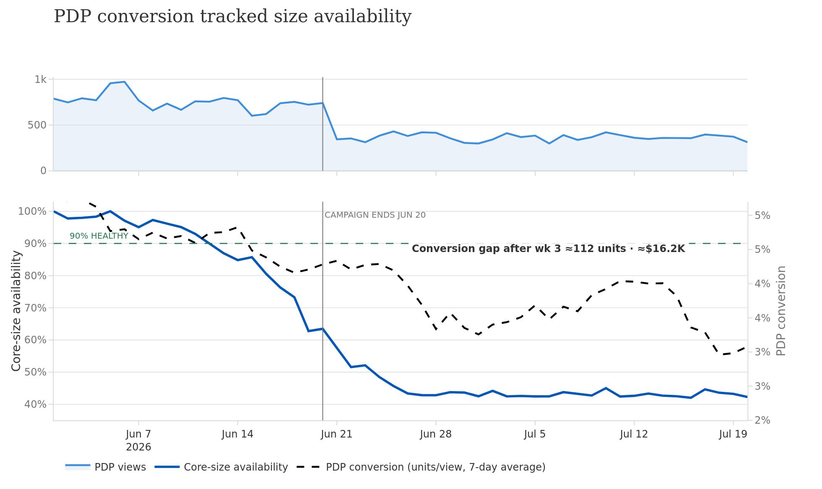
INVENTORY AND SALES PLANNING
Broken size curves from week 4 cost an estimated $16.2K in demand
Traffic follows paid media divestment
DEMAND OUTLIVED SUPPLY
• Inventory (not demand) constrained campaign and demand capture.
• Conversion rate depressed from 4.6% → 3% as core sizes fell below 90% threshold by week 3.
• Unmet Demand: 112 units / ~$16.2K value.
• No substitution offset to counteract lost Vestal Pro sales.
• OPPORTUNITY:
1. ↑WOS purchasing plan on core sizes to create sales buffer.
2. Tie inventory indicators to purchasing and paid media.
June 1 Campaign Start
Core Sizes = M9-11 & W7-9
Salomon NA eCommerce · Vestal Pro launch readout
13
Notes:
Weeks run from the June 1 launch; weeks 4–7 are post-campaign (Jun 21–Jul 19). Core-size availability = share of core sizes (M9–11, W7–9) in stock, daily average. PDP conversion = Vestal Pro units ÷ PDP views, 7-day average. Unmet demand = campaign-period conversion (4.6%) applied to weeks 4–7 PDP traffic, less actual units, at the $145 average selling price. Illustrative synthetic case data.
UNMET DEMAND is modeled through conversion drop from baseline multiplied with Vestal Pro traffic
NO SUBSTITUTION OFFSET: Adjacent shoe categories held flat.
OPPORTUNITIES:
1. Increase buy plan on core sizes to create buffer. Revisit sales forecasting during launches and activations.
2. Inventory indicators should flag indicators around replenishment and paid spend throttling to divest from products that are out of stock

Slide 14
RECOMMENDATIONS
Changes for next launch
1
Buy deeper on core sizes and restock. Increase WOS purchasing plan on core sizes and trigger replenishment when ATS breaks threshold.
2
Gate and rebalance paid media. Tie spend to inventory signals. Throttle when core availability breaks.
3
Judge paid social on acquisition economics, not last-click revenue. Set the CAC target pre-launch and add a day-90 LTV forecast.
4
Cannibalization Management. Next launch, improve product positioning, communication, and audience separation against overlapping models.
5
Support additional halo effects. Double down on PDP bundles and item-item recommendations. Message buyers to push cross selling-products.
Salomon NA eCommerce · Vestal Pro launch readout
Notes:
Core-size availability broke 90% in week 3 and bottomed near 43%, costing ≈112 units (≈$16.2K)
We don’t want to push traffic into a broken areas, especially when it costs money and yields $0.
Paid Social: Responsible for 41% of new customers at $151 CAC vs $188 early value.
Cannibalization: ~30% of Vestal Pro units shifted from existing shoes displacing with $30.5K. Monitor cannibalization throughout campaign.

Slide 15

THANK YOU
MERCI
Marketing Insights & Analytics

Slide 16
APPENDIX
Marketing Insights & Analytics

