Slide 1



ESS 408/508: Python for Interdisciplinary Earth System Science Applications
R Case Study – ingest irregularly-spaced rainfall station data for one day and interpolate them to a grid
8 April 2015 (updated 21 Sep 2016)
Eric Anderson
eric.anderson@nsstc.uah.edu
The University of Alabama in Huntsville
Atmospheric Science Dept. / Earth System Science Program

Slide 2
Agenda
Yesterday
Background, goals, etc.
What is R? Why use R?
R basics, terms, concepts
Case study introduction
Pseudo-code group activity
Present your approaches
Today
Case study refresher
Open R, basic commands
Load packages
Explore input data
Plot input data
Geoprocessing
Plot results
Discussion
Conclusions

Slide 3
Case study introduction
Daily rainfall data from rain gauges, spread irregularly throughout a region
Interested in gridded depiction of rainfall across region
Needs to be an open source solution

Slide 4
Group activity
Develop a pseudo-code
Inputs
Outputs
Workflow
Loops
Conditions
Variables
Functions

Slide 5

Open R
From Start Menu or Desktop

Slide 6
Working directory
What is the current working directory?
> getwd()
[1] "C:/Users/Eric/Documents"
Set a new working directory
> setwd(“C:/GIS/r”)
Error in setwd(“C:/GIS/r”) : ...

Slide 7
Working directory
Create a directory
> dir.create(“C:/GIS/r”)
Set a new working directory
> setwd(“C:/GIS/r”)
Check your working directory
> getwd()
[1] "C:/GIS/r"

Slide 8
Basic commands
Create a scalar
> a = 4
> a
[1] 4
> print(a)
[1] 4

Slide 9
Basic commands
Create a vector
> b = c(3,4,5)
> b
[1] 3 4 5

Slide 10
Before we continue…
Assignment operators in R: '=' and '<-'
Do not confuse the assignment operator = with the Boolean operator for equality ==. <- is an older assignment operator, allowed everywhere in R. = is only allowed at top levels.
http://stackoverflow.com/questions/3433729/are-and-exactly-the-same-in-r?lq=1
http://stackoverflow.com/questions/1741820/assignment-operators-in-r-and?lq=1
http://google-styleguide.googlecode.com/svn/trunk/google-r-style.html#assignment

Slide 11
Basic commands
Create a data frame
> mat = matrix(data=c(9,2,3,4,5,6),ncol=3)
> mat
[,1][,2] [,3]
[1,] 9 3 5
[2,] 2 4 6

Slide 12
Basic commands
Create a data frame
> table = data.frame(x = c(11,12,14), y = c(19,20,21), z=c(10,9,7))
> table
x y z
1 11 19 10
2 12 20 9
3 14 21 7

Slide 13
What’s in the workspace?
> ls()
[1] "a" "b" "mat" "table"

Slide 14
What were a, b, mat, and table, again?
> class(mat)
[1] "matrix"
> class(table)
[1] "data.frame"

Slide 15
Tell me more…
> summary(table)
x y z
Min. :11.00 Min. :19.0 Min. : 7.000
1st Qu.:11.50 1st Qu.:19.5 1st Qu.: 8.000
Median :12.00 Median :20.0 Median : 9.000
Mean :12.33 Mean :20.0 Mean : 8.667
3rd Qu.:13.00 3rd Qu.:20.5 3rd Qu.: 9.500
Max. :14.00 Max. :21.0 Max. :10.000

Slide 16
More matrix properties
Length, number of columns, number of rows
> ncol(mat)
[1] 3
> nrow(mat)
[1] 2
> length(mat)
[1] 6

Slide 17
Oops. Our matrix is transposed.
> t(mat)
[,1] [,2]
[1,] 9 2
[2,] 3 4
[3,] 5 6
> mat
[,1] [,2] [,3]
[1,] 9 3 5
[2,] 2 4 6

Slide 18
Oops. Our matrix is transposed.
Assign the transposed matrix to the original matrix
> mat <- t(mat)
> mat
[,1] [,2]
[1,] 9 2
[2,] 3 4
[3,] 5 6

Slide 19
Create a vector using sequence
Make c a vector with values from 0 to 20 in increments of 5
> c = seq(0,20,5)
> c
[1] 0 5 10 15 20

Slide 20
Create a vector using sequence
Make d a vector with values from 0 to pi in increments of pi/12
> d = seq(0,pi,pi/12)
> d
[1] 0.0000000 0.2617994 0.5235988 0.7853982 1.0471976 1.3089969 1.5707963
[8] 1.8325957 2.0943951 2.3561945 2.6179939 2.8797933 3.1415927

Slide 21
Load packages
Packages / Install Packages…
Select a CRAN mirror
Install the following packages
maptools
raster
rgeos
rgdal
akima
fields

Slide 22

Let’s grid some rainfall
Open up a text editor (e.g., Notepad++)
Save as…
Save as type “All types (*.*)”
Name the file anything with a .r extension

Slide 23
Header, purpose, date, etc.
# Eric Anderson
#
# Spline interpolate rain gauge data to 0.1
# degree grids and save to .csv
#
# Version 1.0
# 8 April 2015
#
# The purpose of this program is to ingest .csv
# rainfall data for one day, interpolate them to
# 0.1 degree grid spacing, and save them to
# another .csv.

Slide 24
Load libraries (packages)
# load libraries
library(maptools) # autoloads sp
library(raster)
library(rgeos)
library(rgdal)
library(akima)
library(fields)

Slide 25
Set workspace
# set workspace
setwd("C:/GIS/r")

Slide 26
Do you have the inputs?
Download contents from https://github.com/andersoner/interpolate_point_to_grid_r
Into your working directory (“C:/GIS/r”)
Check for
Shapefile called aoi_sv_buff10_gcs
2 csv files: coords.csv and daily_rain.csv
Note: daily_rain.csv is fake rain gauge over El Salvador

Slide 27
Create area of interest
# Create area of interest for masking final interpolation (and extrapolation if necessary)
# This file should stay the same
aoi <- readShapePoly("aoi_sv_buff10_gcs.shp")
At this point, save your .r file

Slide 28
Back to R console…
Load all of the libraries (copy and paste the 6 library functions and hit enter)
Explore the aoi
Copy and paste the last line we typed in our code
Get some general information about it
> class(aoi)
> summary(aoi)
> plot(aoi)

Slide 29
Back to .r file… set up your grid
# Create vectors for x and y grid
# spacing. This will only need to be
# created once per area to interpolate.
ygrids <- seq(13,14.5,0.1) # ~10km
xgrids <- seq(-90.2,-87, 0.1) # ~10km

Slide 30
Load rainfall data to R
# Load station data points (this file
# will be different every day)
pluv_raw <- read.csv(file="daily_rain.csv")
# Note that this may include missing
# gauge data, but it must be stored as
#"NaN"

Slide 31
Remove missing data
# Remove rows with missing rain data
pluv <- pluv_raw[complete.cases(pluv_raw),]
# Print yourself a nice message.
print("Rain gauge data read and missing data removed.",quote=0)
At this point, save your .r file

Slide 32
Compare rainfall datasets
Compare pluv_raw and pluv using R
Copy / paste the last few lines of code into R console
> pluv
> pluv_raw
How many entries do pluv and pluv_raw have?

Slide 33
Compare rainfall datasets
How many entries do pluv and pluv_raw have?
> length(pluv_raw[,1])
[1] 22
> length(pluv[,1])
[1] 21

Slide 34
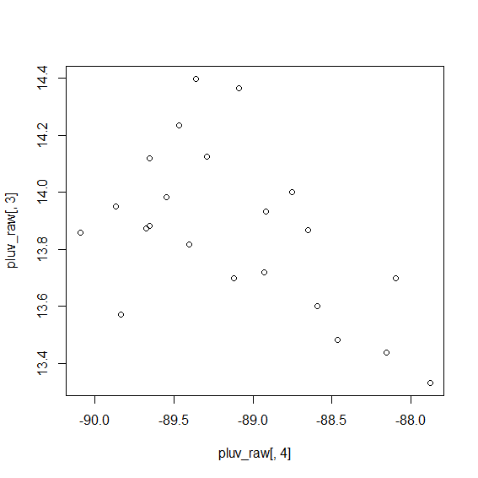
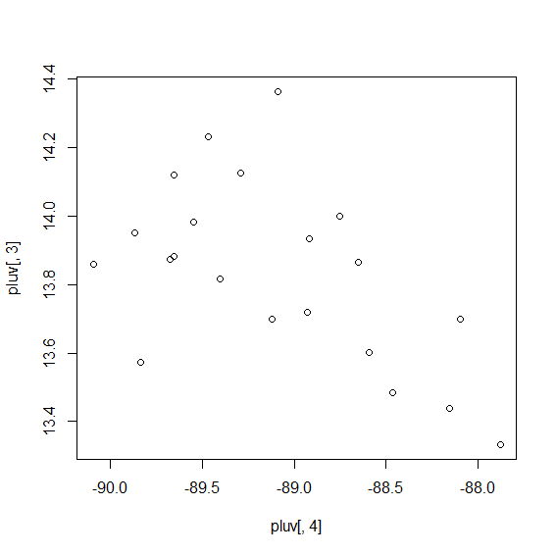
Compare rainfall datasets
Plot rain gauge locations
> plot(pluv[,4],pluv[,3])
> plot(pluv_raw[,4],pluv_raw[,3])

Slide 35
Back to .r file…
Load coordinates to which you will output interpolated data
# Load coordinates to be interpolated
# This file will only need to be
# created once per area to interpolate
pt <- read.csv(file="coords.csv")
coordinates(pt)= ~ longitude+ latitude

Slide 36
Set up interpolation
We’ll allow for 2 interpolation types, spline and linear
This choice influences whether we can extrapolate to get to the country borders
Set up:
# Interpolate the rain data to surface rasters
## Pick ONE of the following interpolation
## techniques by setting extLogical to TRUE or
## FALSE
extLogical <- TRUE # if extLogical is true, spline is used
#extLogical <- FALSE # if extLogical is false, linear is used

Slide 37
Set up interpolation
We’ll allow for 2 interpolation types, spline and linear
This choice influences whether we can extrapolate to get to the country borders
Set up:
# set linLogical to true or false
# based on extrapolation choice
if (extLogical == TRUE) linLogical <- FALSE
if (extLogical == FALSE) linLogical <- TRUE

Slide 38
Define x, y, z (lat, lon, precip)
# Define x, y (same for every day)
# and interpolated z values
# (different for every day)
x <- pluv[,4]; y <- pluv[,3]; z <- pluv[,5]
interpex <- mask(raster(interp(x,y,z, linear=linLogical, extrap=extLogical, xo=xgrids, yo=ygrids)),aoi)

Slide 39
Plot the results
# Tell me I'm finished and how to
# plot an image
print("Interpolation complete. Use plot(interpex) command to see results in R console.",quote=0)

Slide 40
Store as stacked raster (helpful for multiple days)
# Stack interpolated rasters...
# (only needed if many days are to
# be prepared at the same time)
rStack = stack(interpex)

Slide 41
Extract raster values to grid
# Perform the value extraction on
# the raster stack (extracts
# interpolated rain values from
# raster to the 0.1 degree-spaced
# points)
rVal = extract(rStack,pt)
rVal[rVal<0] <- 0 #replace all negative values to 0 (artifact of extrapolating to edge)

Slide 42
Write output to .csv
# Combine these extracted results
# with the lat/lon of 0.1 degree
# spaced csv points
write.table(cbind(pt,data.frame(rVal)),file="pluv_daily_spline.csv", append=FALSE, sep= ",", row.names=FALSE, col.names=TRUE)

Slide 43
Congratulate yourself.
print("Program complete. Output saved to pluv_daily_spline.csv.",quote=0)
# Program complete.
At this point, save your .r file

Slide 44
Return to R console
Run you program.
> source("r_interp.r")
[1] Rain gauge data read and missing data removed.
[1] Interpolation complete. Use plot(interpex) command to see results in R console.
[1] Program complete. Output saved to pluv_daily_spline.csv.

Slide 45
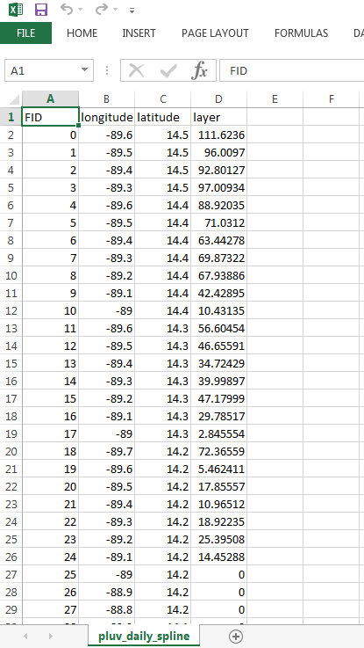
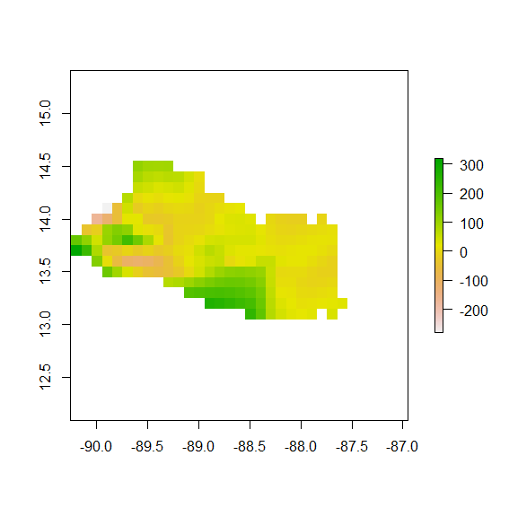
Check your output
plot(interpex)

Slide 46
Summary
Inputs
.csv of daily rainfall with lat, lon, and rainfall
One-time .csv with centerpoints of final grid
Area of interest shapefile
Output
.csv of interpolated (“gridded”) rainfall
Note—with only the output, we can’t know the location of the rain gauges
Process
Setup, spline interpolation, extract values to 0.1 degree-spaced points, write out to new .csv

Slide 47
Discussion
Improvements?
How would we do this in an ArcGIS environment?
Pros and cons of this approach?

Slide 48
Discussion
How to aggregate hourly data, etc.
How to optimize program for multiple days
Summary statistics as regular output
Classification of outputs
Dynamic or User-defined grid spacing
Dynamic or User-defined area of interest
Pros and cons of dynamic or user-defined inputs
Quality control / quality assurance
Consistency vs. flexibility

Slide 49
Case study II setup
Searching for relationship between landslide occurrence and rainfall
100s of known landslide points for different dates
1000s of days of rainfall rasters
How do you determine how much it rained before and on the same day as a landslide?

Slide 50
Group activity
Develop a pseudo-code
Inputs
Outputs
Workflow
Loops
Conditions
Variables
Functions
(draw from known ArcGIS functions if needed)

Slide 51
More R tutorials, introductions
http://www.r-tutor.com/r-introduction
Basic data types through data frames
http://dept.stat.lsa.umich.edu/~kshedden/Courses/Stat600/Notes/R_introduction.pdf
http://cran.r-project.org/doc/contrib/Torfs+Brauer-Short-R-Intro.pdf
http://www.amnh.org/our-research/center-for-biodiversity-conservation/biodiversity-informatics/open-source-software-and-scripts and https://bitbucket.org/rsbiodiv/

Slide 52
Thank you!
eric.anderson@nsstc.uah.edu

