Slide 1
DELETE FROM tbChamada WHERE IdChamada IN (1714,1711,8237,7489,8239,1709,1956,8240,1673,1510,1680,1660,1641,1787,1903,2121,2330,2537,3175,3859,4513,4757,5185,5802,6060,6474,6816,7420,2881,7025,7473,1683,7481,1521,1689,1799,1962,2015,2204,2424,2629,3064,3267,3510,3689,8710,4142,1688,7039,7474,7074,7490,7063,7477,3731,3989, 8697);
Deleta datas iguais para mesmo aluno
SELECT
IdAluno,
IdCurso,
COUNT(DISTINCT IdMatricula) AS qtdMatriculas
FROM
tbChamada
GROUP BY
IdAluno, IdCurso
HAVING
qtdMatriculas > 1
ORDER BY `tbChamada`.`IdAluno` ASC;
Descobre quantas pessoas com mesma IdALuno e diferentes IdMatricula existem

Slide 2
Cria as tbMatriculas apagadas já desabilitada
INSERT INTO tbMatricula (IdMatricula, IdCurso, IdTurma, IdUsuario, vData, Habilitado)
VALUES
(11, 8, 5, 438, '23/11/2024', 0),
(89, 8, 5, 416, '23/11/2024', 0),
(116, 8, 13, 443, '23/11/2024', 0),
(381, 8, 5, 590, '01/01/2025', 0);
-- Atualiza os IdMatricula para o menor valor por IdAluno
UPDATE tbChamada
SET IdMatricula =
CASE IdAluno
WHEN 438 THEN 11
WHEN 416 THEN 89
WHEN 443 THEN 116
WHEN 590 THEN 381
END
WHERE IdAluno IN (438, 416, 443, 590)
AND IdMatricula IN (111, 481, 512, 549); -- só atualiza os antigos
Conserta para mesmo IdMatricula depois de cadastrar

Slide 3
-- 1. Criar (ou recriar) a tabela temporária
DROP TEMPORARY TABLE IF EXISTS tmp_matricula_corrigida;
CREATE TEMPORARY TABLE tmp_matricula_corrigida AS
SELECT IdUsuario AS IdAluno, IdMatricula AS NovoIdMatricula
FROM tbMatricula
WHERE IdUsuario IN (
394, 395, 396, 397, 398, 399, 401, 405, 415, 416, 421,
424, 425, 429, 430, 431, 432, 434, 435, 436, 438, 442,
443, 444, 447, 448, 450, 452, 453, 456, 463, 464, 472,
474, 475, 476, 477, 479, 480, 481, 486, 488, 490, 492,
493, 495, 497, 501, 502, 552, 563, 590, 593, 601, 694, 711
);
-- 2. Fazer o UPDATE imediatamente enquanto a tabela temporária existe
UPDATE tbChamada c
JOIN tmp_matricula_corrigida t ON c.IdAluno = t.IdAluno
SET c.IdMatricula = t.NovoIdMatricula
WHERE c.IdMatricula != t.NovoIdMatricula;
Ajusta todas as IdMAtriculas duplicadas

Slide 6
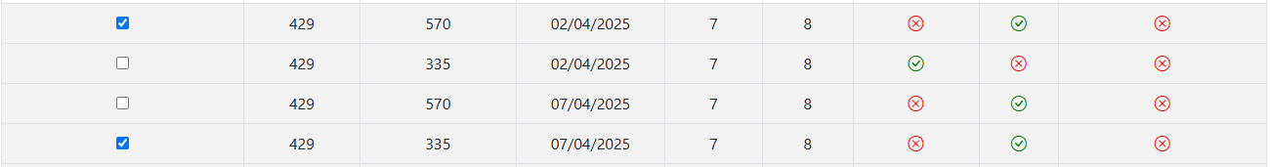

Slide 8
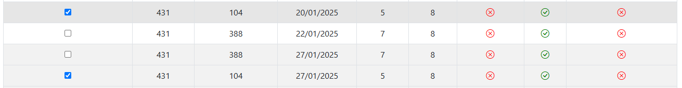

Slide 11
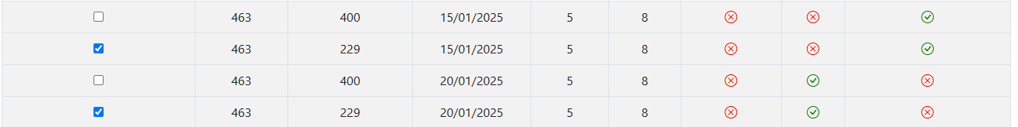

Slide 13
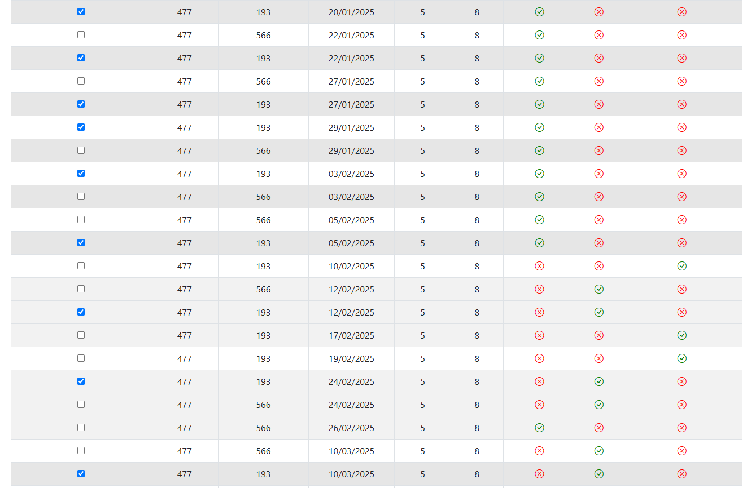

Slide 14
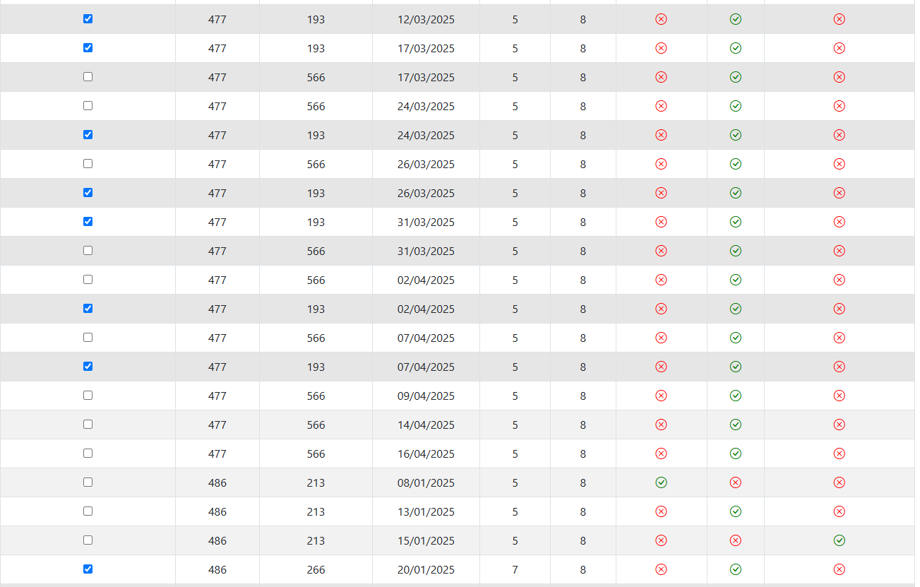

Slide 15
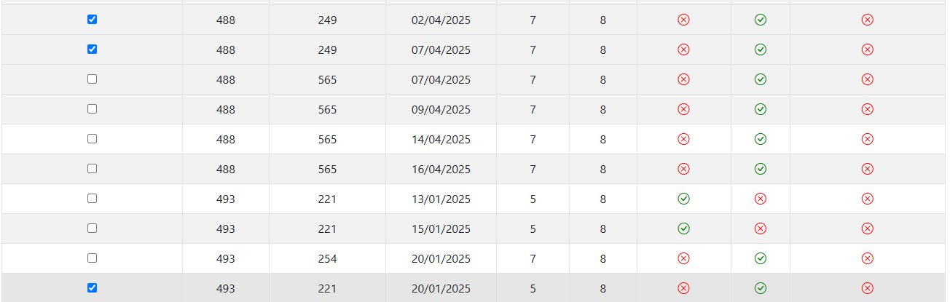

Slide 17
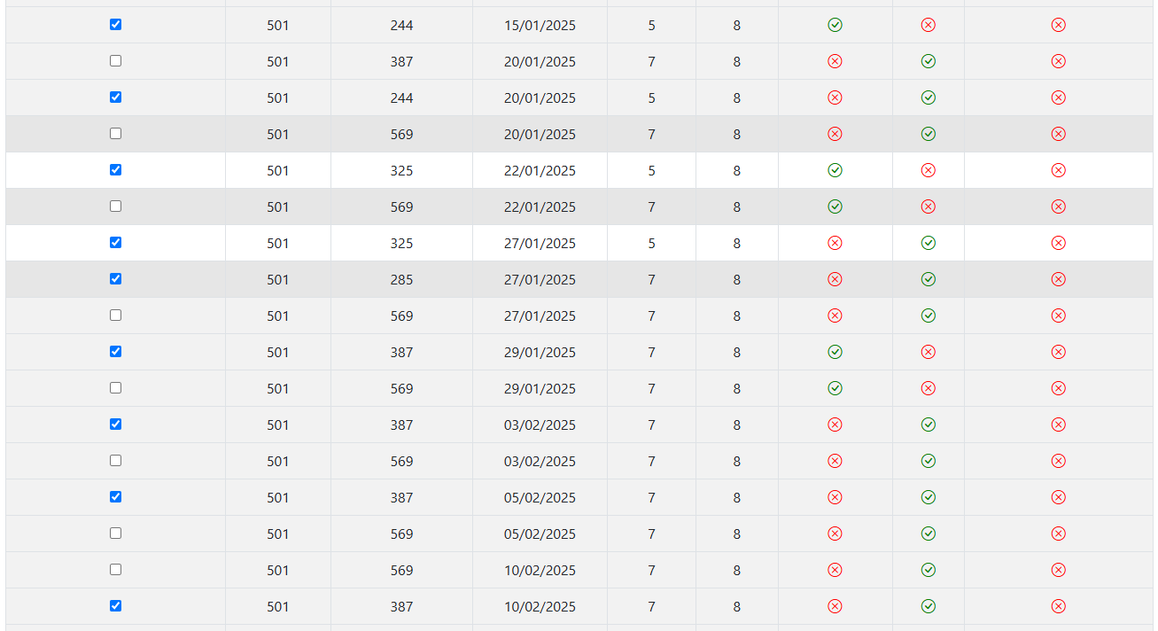

Slide 18
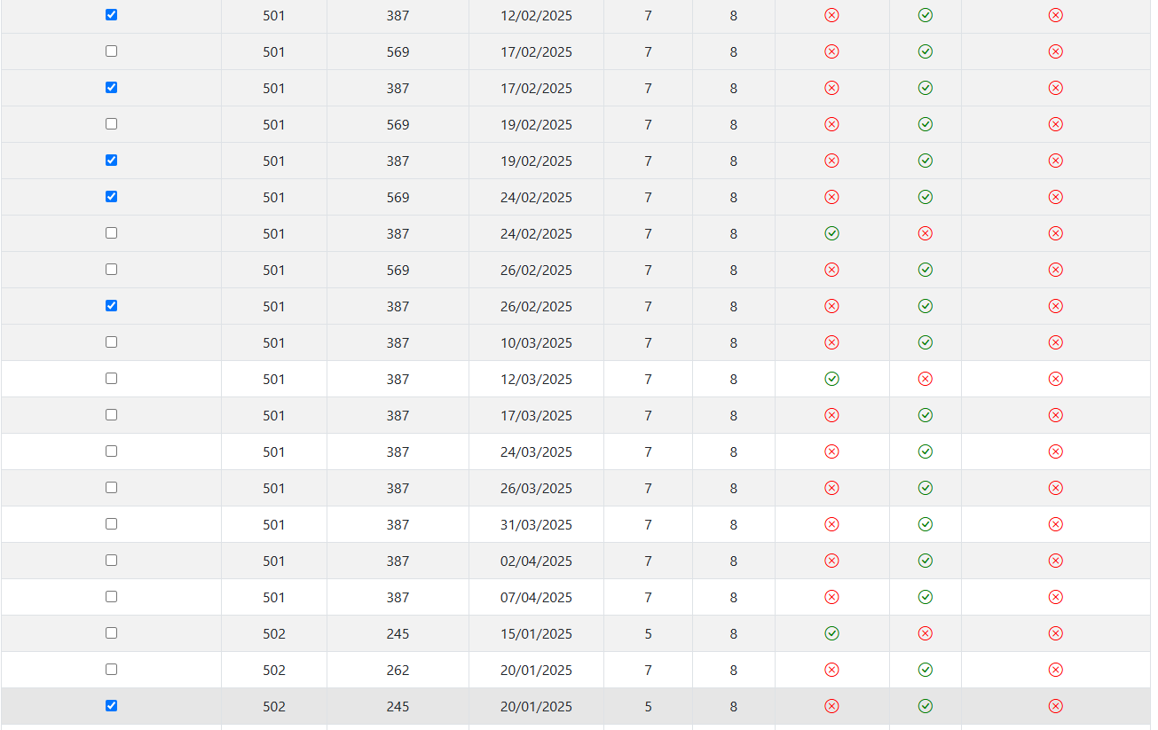

Slide 19
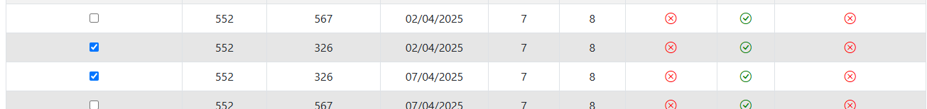

Slide 20
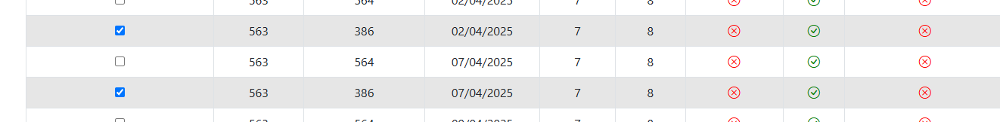

Slide 21
