Slide 1



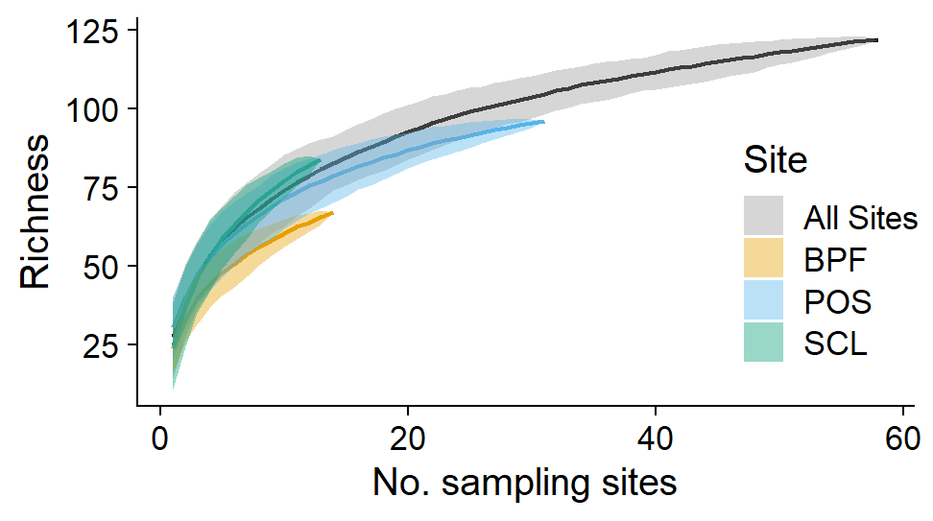
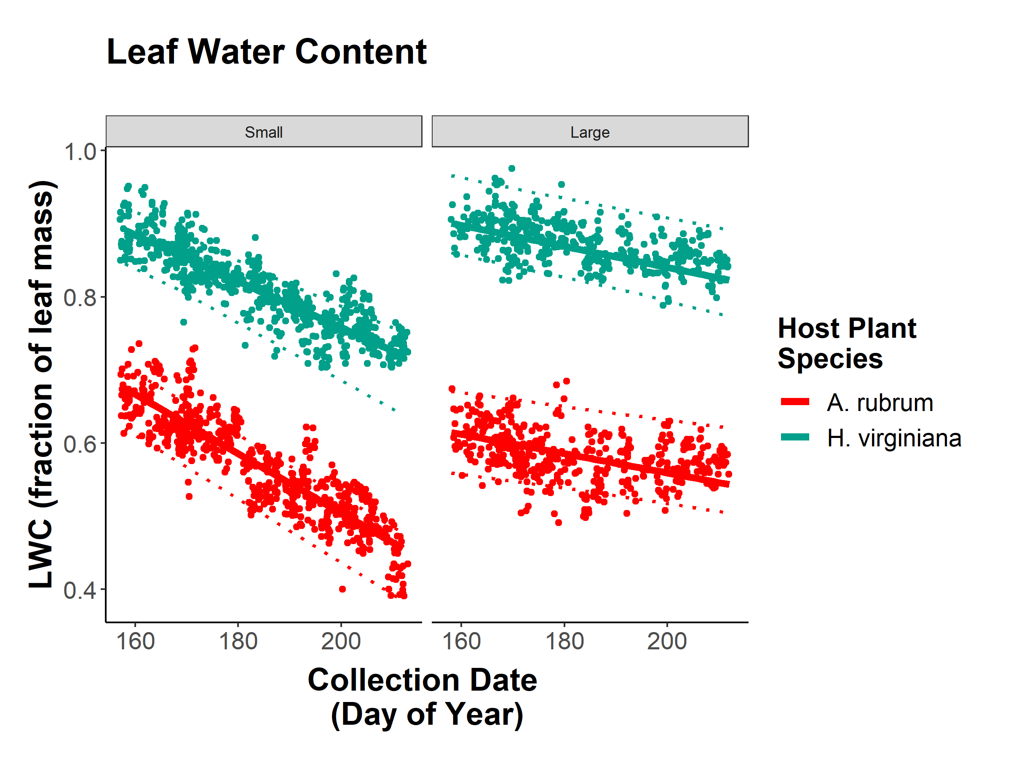
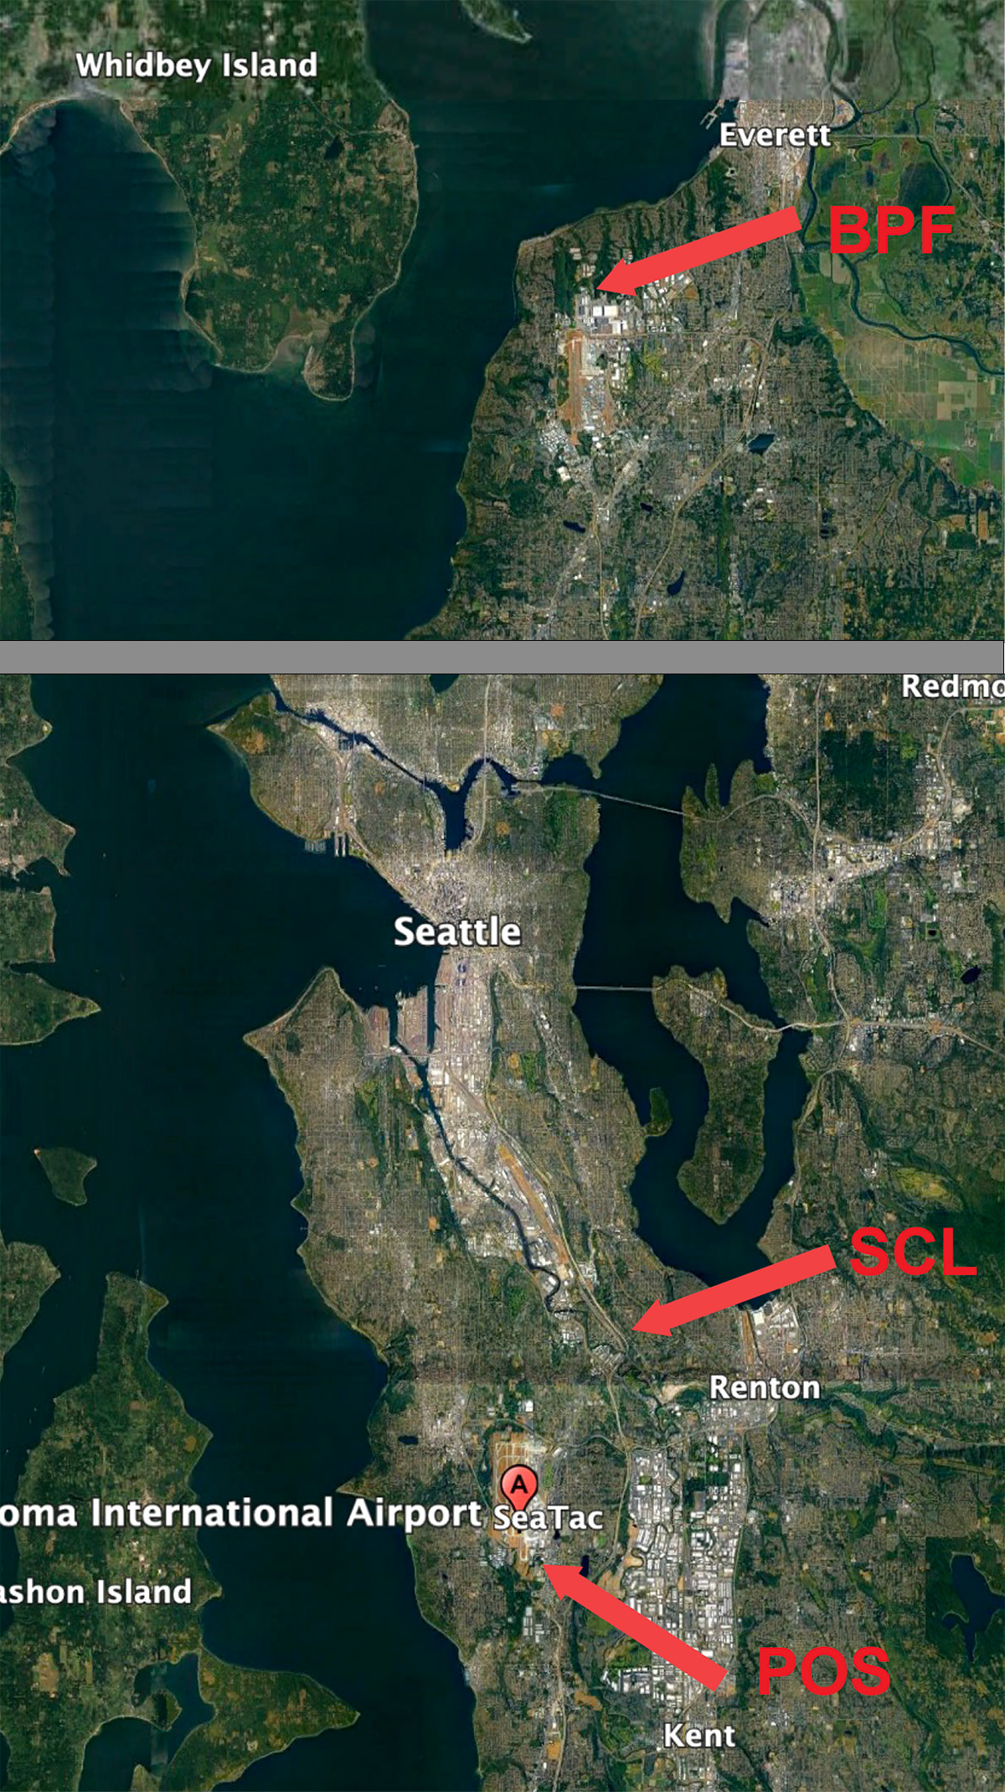
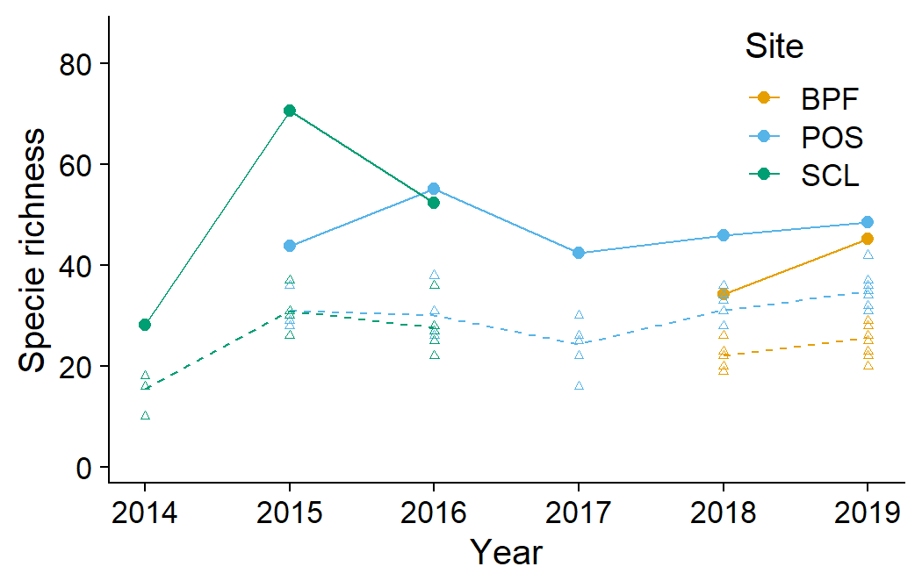
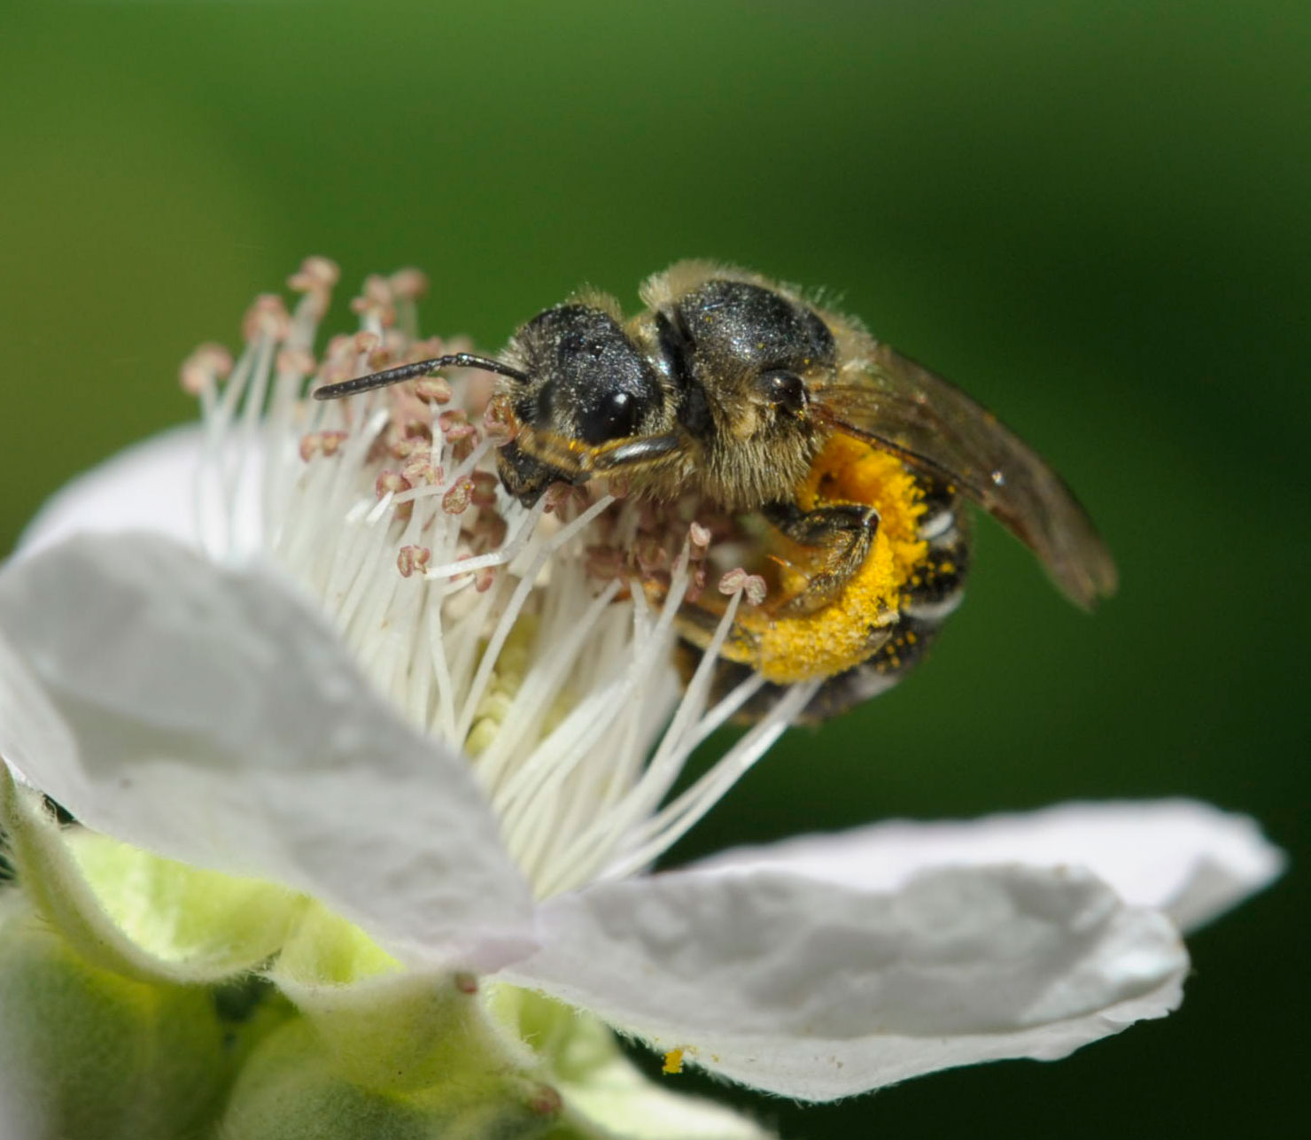
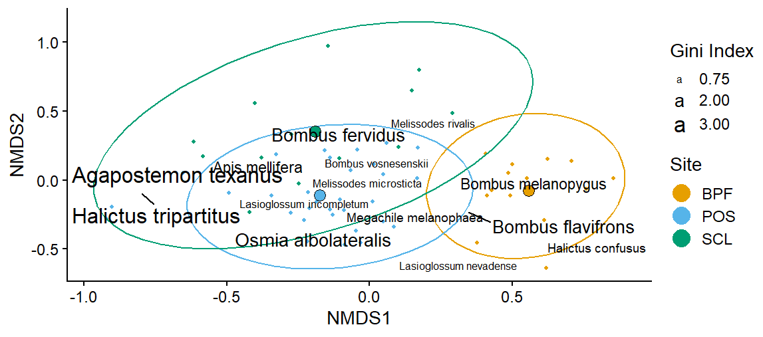
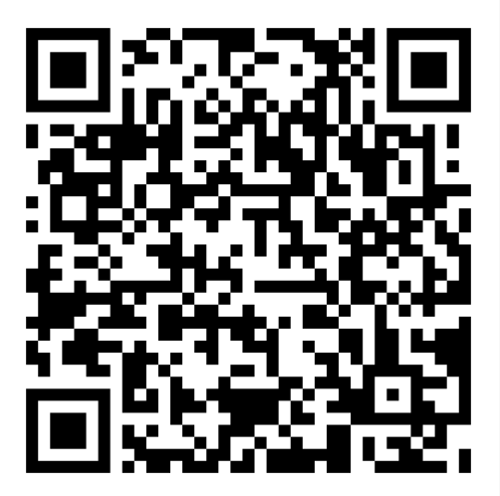
Bee Diversity in Lowland Puget Sound Marginal Lands
Evan Sudgen¹, Will Peterman², Riley Anderson³, Bob Redmond⁴
¹Entomo-Logic, Salt Lake City, UT evan@entomologic.com, ²Bee Search, Seattle, WA will@beesearch.org, ³Washington State University, Pullman, WA riley.m.anderson@wsu.edu, ⁴ The Common Acre, (deceased)
Introduction
Results
In total, 25,400 specimens were collected, preserved, identified, and cataloged.
We identified 155 morphogroups, representing at least 141 species.
Important findings are summarized in Table 1.
Chao richness index estimates suggest the actual aggregate alpha diversity could be as high as <180> species. Particularly rich were the genera Andrena, Lasioglossum, and Osmia.
The aggregate species accumulation curve (Fig. 2) suggests that we have accounted for near <>% of the total species richness.
We were able to resolve significant variation in community composition across sites (Fig. 3) and possibly between collecting seasons (Mar-May/Jun-Jul/Aug-Sep).
Despite 2 honey bee apiaries within 1 km of our study site at POS, Apis mellifera accounted for only 2.26 % of specimens collected.
The Puget Sound zone west of the Cascade Range is known for relatively low insect diversity in many taxonomic groups compared with other areas in non-maritime North America. Whether this pattern holds for bee fauna as well remains untested as this group is largely undescribed and unsampled. Recent research, including this study, has provided the foundation for a more complete analysis. The newly conceived and implemented Washington Bee Atlas project is assembling the data collected over the past few years, sponsoring more focused sampling, and supplementing this data with specimen collections curated by Washington State University. As a contribution to the scientific understanding of the bees of the region, we collected bees for 7 years on marginal lowlands of the Puget Sound area as part of a revegetation monitoring effort that began in 2014, sponsored by The Common Acre. Here, we present a description of the bee species we found and the communities they shape.
Species accumulation curves. Sampling effort is derived from permutation resampling. The data exclude some morphospecies, and all net caught records. At the site level, curves are stunted by singleton records, in the aggregate, these species are found more often.
Conclusions
This research has revealed that bee diversity and bee community complexity is substantial in disturbed, largely weedy habitats of marginal lands of the lower Puget Sound.
Across the region, we present a well-sampled estimate of 122 species.
Species accumulation curves at the site level are stunted by singletons, in the aggregate, our sample is robust.
While species identity across sites is similar, large differences in proportional abundance account for the compositional peculiarities of the BPF site.
Our results are comparable to those of Bloom, et al. (2021), who made similar collections in Puget Sound small farms, gardens and parks. Together, the two studies extend our current knowledge of pollinators of the region and form a baseline for monitoring bee diversity into the future.
Halictus tripartitus (Halictidae), an all-female population in our study area and the most common bee in our collections (body size approx. 6 mm). Photo © Will Peterman
Species richness across sites and sampling years. Points are Chao1 minimum estimated species richness, triangles are raw species counts at each substation within each site. Chao richness estimates are lifted by an additive parameter that accounts for rare species likely missed in the sampling. The data exclude some morphospecies, and all net caught records.
Methods
References Cited
Bloom, EH, EC Oeller, RL Olsson, MR Brousil, RM Schaeffer, S Basu, Z Fu, DW Crowder. 2022. Documenting pollinators, floral hosts, and plant–pollinator interactions in U.S. Pacific Northwest agroecosystems. Ecology 103:e3606.
Bloom, EH, JG Illan, MR Brousil, JP Reganold, TD Northfield, DW Crowder. 2023. Long-term organic farming and floral diversity promotes stability of bee communities in agroecosystems. Func. Ecol. 00:1-17.
Sites included select parcels within properties of Seattle City Light, Port of Seattle, and Boeing Paine field (Fig. 1).
Standard field methods were used, including colored bowl and blue vane traps set in multiple 15/3 series (1 set per station) for one 24-hour period per month.
Traps were monitored March-September and supplemented with opportunistic net collecting.
Bees were preserved in the field in alcohol, labeled and pinned in the lab, identified to species with the help of specialists, and cataloged.
Acknowledgments
Variation in community composition across sites. Bee species are plotted on the first two axes of a three-dimensional non-metric multidimensional scaling ordination of the 58 combinations of station (subsite) and year, across the three sites. Small points are the individual station/year combinations. Large points are the centroids of the three sites. Ellipses are 95% confidence intervals around the site centroids. Bee species shown are the most representative (top 10th percentile of a random forest analysis) of the compositional differences among sites. Text size of the labels is proportional to variable importance score (mean decrease in Gini score).
For identification service we thank Terry Giswold, Harold Ikerd and Diana Cox-Foster, USDA, ARS, Pollinating Insects Collection, Logan, UT; James Strange, OH State U.; Jason Gibbs, U. Manitoba, Winnipeg, CAN; Joel Gardner, Washington State U. and Robbin Thorp, University of California, Davis (deceased). Kami Koyamatsu assisted in specimen preparation. Chris Looney of Washington State Department of Agriculture provided practical advice. Field site access and support was provided by Seattle City Light, The Port of Seattle, and Boeing Corp. Major funding was provided by the Bullitt Foundation. Allison Rynard, Nat Mengist and Talia London of the Common Acre provided administrative support. Our late colleague and co-worker Bob Redmond conceived of and actuated the project.
Data are carefully curated and open to all!
Check out our GitHub page with all data and code publicly available:
Study sites
BPF = Boeing Paine Field (8 stations).
POS = Port of Seattle (SeaTac Airport) (22 stations).
SCL = Seattle City Light power corridor (5 stations).
(Map is divided for graphical fitting.)
Scan me!
Github.com/andersonrm/BeeSearch/tree/main

Slide 2
Bee Diversity in Lowland Puget Sound Marginal Lands
Evan Sudgen¹, Will Peterman², Riley Anderson³, Bob Redmond⁴
¹Entomo-Logic, Salt Lake City, UT evan@entomologic.com, ²Bee Search, Seattle, WA will@beesearch.org, ³Washington State University, Pullman, WA riley.m.anderson@wsu.edu, ⁴ The Common Acre, (deceased)
Introduction
Results
In total, 25,400 specimens were collected, preserved, identified, and cataloged.
We identified 155 morphogroups, representing at least 141 species.
Important findings are summarized in Table 1.
Chao richness index estimates suggest the actual aggregate alpha diversity could be as high as <180> species. Particularly rich were the genera Andrena, Lasioglossum, and Osmia.
The aggregate species accumulation curve (Fig. 2) suggests that we have accounted for near <>% of the total species richness.
We were able to resolve significant variation in community composition across sites (Fig. 3) and possibly between collecting seasons (Mar-May/Jun-Jul/Aug-Sep).
Despite 2 honey bee apiaries within 1 km of our study site at POS, Apis mellifera accounted for only 2.26 % of specimens collected.
The Puget Sound zone west of the Cascade Range is known for relatively low insect diversity in many taxonomic groups compared with other areas in non-maritime North America. Whether this pattern holds for bee fauna as well remains untested as this group is largely undescribed and unsampled. Recent research, including this study, has provided the foundation for a more complete analysis. The newly conceived and implemented Washington Bee Atlas project is assembling the data collected over the past few years, sponsoring more focused sampling, and supplementing this data with specimen collections curated by Washington State University. As a contribution to the scientific understanding of the bees of the region, we collected bees for 7 years on marginal lowlands of the Puget Sound area as part of a revegetation monitoring effort that began in 2014, sponsored by The Common Acre. Here, we present a description of the bee species we found and the communities they shape.
Species accumulation curves. Sampling effort is derived from permutation resampling. The data exclude some morphospecies, and all net caught records.
Table 1. Singular important findings.
Conclusions
This research has revealed that bee diversity and bee community complexity is substantial in disturbed, largely weedy habitats of marginal lands of the lower Puget Sound. As patches, our sites nevertheless show significant inter-site variation.
Our results are comparable to those of Bloom, et al. (2021), who made similar collections in Puget Sound small farms, gardens and parks. Together, the two studies extend our current knowledge of pollinators of the region and form a baseline for monitoring bee diversity into the future.
Halictus tripartitus (Halictidae), an all-female population in our study area and the most common bee in our collections (body size approx. 6 mm). Photo © Will Peterman
Species richness across sites and sampling years. Points are Chao1 minimum estimated species richness, triangles are raw species counts at each substation within each site. Chao richness estimates are lifted by an additive parameter that accounts for rare species likely missed in the sampling. The data exclude some morphospecies, and all net caught records.
References Cited
Bloom, EH, EC Oeller, RL Olsson, MR Brousil, RM Schaeffer, S Basu, Z Fu, DW Crowder. 2022. Documenting pollinators, floral hosts, and plant–pollinator interactions in U.S. Pacific Northwest agroecosystems. Ecology 103:e3606.
Bloom, EH, JG Illan, MR Brousil, JP Reganold, TD Northfield, DW Crowder. 2023. Long-term organic farming and floral diversity promotes stability of bee communities in agroecosystems. Func. Ecol. 00:1-17.
Methods
Sites included select parcels within properties of Seattle City Light, Port of Seattle, and Boeing Paine field (Fig. 1).
Standard field methods were used, including colored bowl and blue vane traps set in multiple 15/3 series (1 set per station) for one 24-hour period per month.
Traps were monitored March-September and supplemented with opportunistic net collecting.
Bees were preserved in the field in alcohol, labeled and pinned in the lab, identified to species with the help of specialists, and cataloged.
Acknowledgments
Variation in community composition across sites. Bee species are plotted on the first two axes of a three-dimensional non-metric multidimensional scaling ordination of the 58 combinations of station (subsite) and year, across the three sites. Small points are the individual station/year combinations. Large points are the centroids of the three sites. Ellipses are 95% confidence intervals around the site centroids. Bee species shown are the most representative (top 10th percentile of a random forest analysis) of the compositional differences among sites. Text size of the labels is proportional to variable importance score (mean decrease in Gini score).
For identification service we thank Terry Giswold, Harold Ikerd and Diana Cox-Foster, USDA, ARS, Pollinating Insects Collection, Logan, UT; James Strange, OH State U.; Jason Gibbs, U. Manitoba, Winnipeg, CAN; Joel Gardner, Washington State U. and Robbin Thorp, University of California, Davis (deceased). Kami Koyamatsu assisted in specimen preparation. Chris Looney of Washington State Department of Agriculture provided practical advice. Field site access and support was provided by Seattle City Light, The Port of Seattle, and Boeing Corp. Major funding was provided by the Bullitt Foundation. Allison Rynard, Nat Mengist and Talia London of the Common Acre provided administrative support. Our late colleague and co-worker Bob Redmond conceived of and actuated the project.
Data are carefully curated and open to all!
Check out our GitHub page with all data and code publicly available:
Study sites
BPF = Boeing Paine Field (8 stations).
POS = Port of Seattle (SeaTac Airport) (22 stations).
SCL = Seattle City Light power corridor (5 stations).
(Map is divided for graphical fitting.)
Scan me!
Github.com/andersonrm/BeeSearch/tree/main

Slide 3
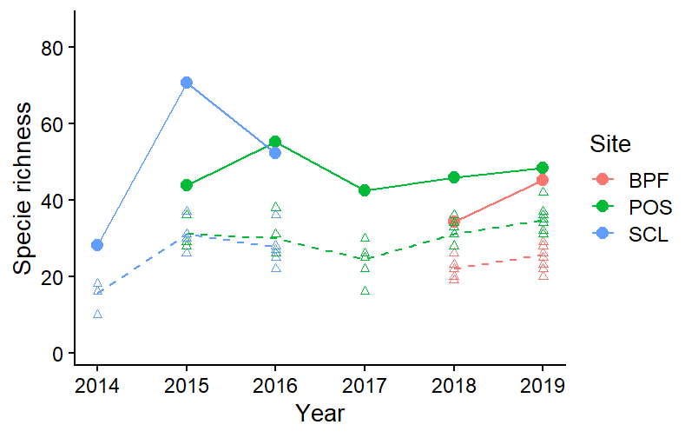
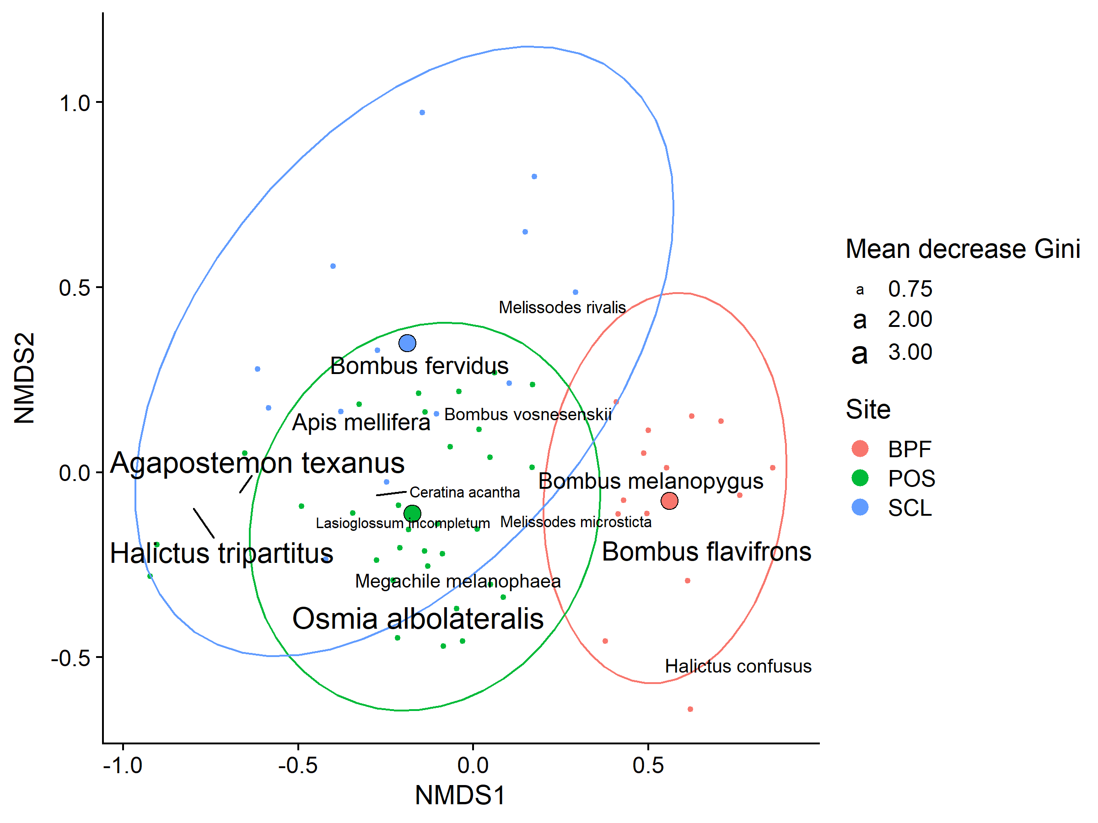
Bee Diversity in Lowland Puget Sound Marginal Lands
Evan Sudgen¹, Will Peterman², Riley Anderson³, Bob Redmond⁴
¹Entomo-Logic, Salt Lake City, UT evan@entomologic.com, ²Bee Search, Seattle, WA will@beesearch.org, ³Washington State University, Pullman, WA riley.m.anderson@wsu.edu, ⁴ The Common Acre, (deceased)
Introduction
Results
In total, 25,400 specimens were collected, preserved, identified, and cataloged.
We identified 155 morphogroups, representing at least 141 species.
Chao richness index estimates suggest the actual aggregate alpha diversity could be as high as <180> species. Particularly rich were the genera Andrena, Lasioglossum, and Osmia.
The aggregate species accumulation curve (Fig. 2) suggests that we have accounted for near <>% of the total species richness.
Important findings are summarized in Table 1.
We were able to resolve significant variation in community composition across sites (Fig. 3) and possibly between collecting seasons (Mar-May/Jun-Jul/Aug-Sep).
The maritime Puget Sound zone west of the Cascade Range is known for relatively low insect diversity in many taxonomic groups compared with other areas in North America. Whether this pattern holds for bee fauna as well remains untested as this group is largely undescribed and unsampled. Recent research, including this study, has provided the foundation for a more complete analysis. The newly conceived and implemented Washington Bee Atlas project is assembling the data collected over the past few years, sponsoring more focused sampling, and supplementing this data with specimen collections curated by Washington State University. As a contribution to the scientific understanding of the bees of the region, we collected bees for 7 years on marginal lowlands of the Puget Sound area as part of a revegetation monitoring effort that began in 2014, sponsored by The Common Acre. Here, we present a description of the bee species we found and the communities they shape.
Species richness across sites and sampling years. Points are Chao1 minimum estimated species richness, triangles are raw species counts at each substation within each site. Chao richness estimates are lifted by an additive parameter that accounts for rare species likely missed in the sampling. The data exclude some morphospecies, and all net caught records.
Table 1. Singular important findings.
Conclusions
This research has revealed a surprising diversity of bees in marginal lands of the lower Puget Sound.
Our results are comparable to those of Bloom, et al. (2021), who made similar collections in Puget Sound small farms, gardens and parks. Together, the two studies extend our current knowledge of pollinators of the region and form a baseline for monitoring bee diversity into the future.
Halictus tripartitus (Halictidae), an all-female population in our study area and the most common bee in our collections (body size approx. 6 mm). Photo © Will Peterman
References Cited
Bloom, EH, EC Oeller, RL Olsson, MR Brousil, RM Schaeffer, S Basu, Z Fu, DW Crowder. 2022. Documenting pollinators, floral hosts, and plant–pollinator interactions in U.S. Pacific Northwest agroecosystems. Ecology 103:e3606.
Bloom, EH, JG Illan, MR Brousil, JP Reganold, TD Northfield, DW Crowder. 2023. Long-term organic farming and floral diversity promotes stability of bee communities in agroecosystems. Func. Ecol. 00:1-17.
Methods
Sites included select parcels within properties of Seattle City Light, Port of Seattle, and Boeing Paine field (Fig. 1).
Standard field methods were used, including colored bowl and blue vane traps set in multiple 15/3 series (1 set per station) for one 24-hour period per month.
Traps were monitored March-September and supplemented with opportunistic net collecting.
Bees were preserved in the field in alcohol, labeled and pinned in the lab, identified to species with the help of specialists, and cataloged.
Acknowledgments
Variation in community composition across sites. Bee species are plotted on the first two axes of a three-dimensional non-metric multidimensional scaling ordination of the 58 combinations of station (subsite) and year, across the three sites. Small points are the individual station/year combinations. Large points are the centroids of the three sites. Ellipses are 95% confidence intervals around the site centroids. Bee species shown are the most representative (top 10th percentile of a random forest analysis) of the compositional differences among sites. Text size of the labels is proportional to variable importance score (mean decrease in Gini score).
For identification service we thank Terry Giswold, Harold Ikerd and Diana Cox-Foster, USDA, ARS, Pollinating Insects Collection, Logan, UT; James Strange, OH State U.; Jason Gibbs, U. Manitoba, Winnipeg, CAN; Joel Gardner, Washington State U. and Robbin Thorp, University of California, Davis (deceased). Kami Koyamatsu assisted in specimen preparation. Chris Looney of Washington State Department of Agriculture provided practical advice. Field site access and support was provided by Seattle City Light, The Port of Seattle, and Boeing Corp. Major funding was provided by the Bullitt Foundation. Allison Rynard, Nat Mengist and Talia London of the Common Acre provided administrative support. Our late colleague and co-worker Bob Redmond conceived of and actuated the project.
Data are carefully curated and open to all!
Check out our GitHub page with all data and code publicly available:
Study sites
BPF = Boeing Paine Field (8 stations).
POS = Port of Seattle (SeaTac Airport) (22 stations).
SCL = Seattle City Light power corridor (5 stations).
Scan me!
Github.com/andersonrm/BeeSearch/tree/main

Slide 4
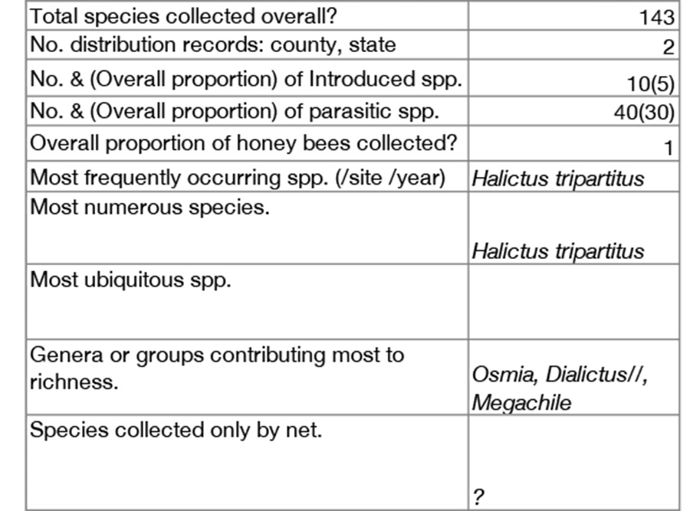
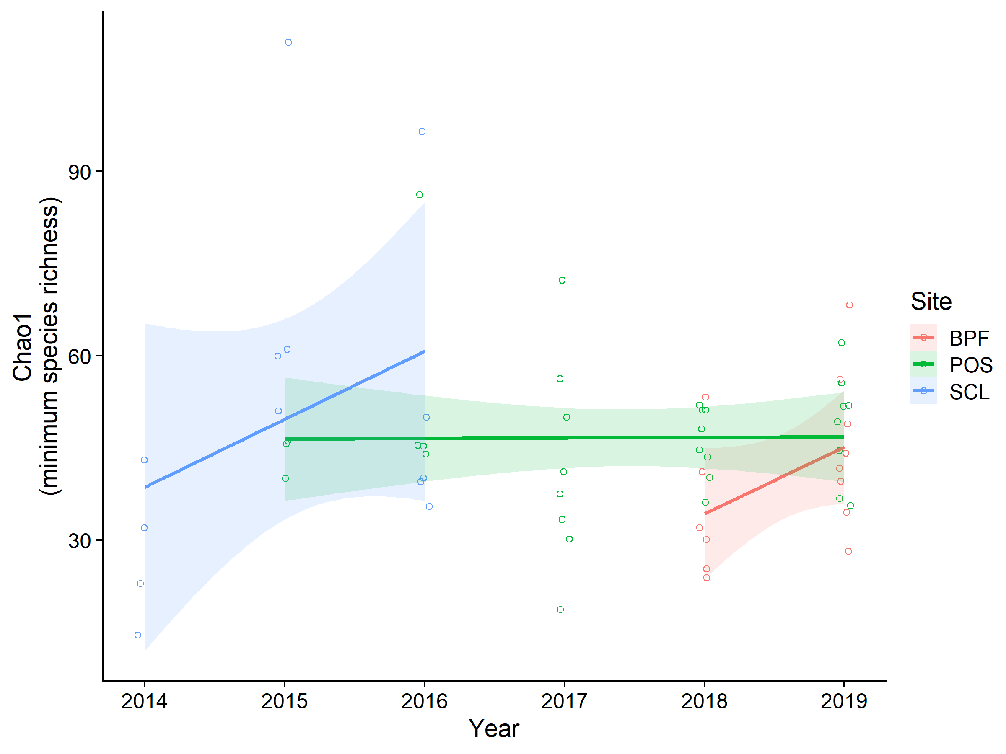
Bee Diversity in Lowland Puget Sound Marginal Lands
Evan Sudgen¹, Will Peterman², Riley Anderson³, Bob Redmond⁴
¹Entomo-Logic, Salt Lake City, UT evan@entomologic.com, ²Bee Search, Seattle, WA will@beesearch.org, ³Washington State University, Pullman, WA riley.m.anderson@wsu.edu, ⁴ The Common Acre, (deceased)
Introduction
Study sites
Conclusions
The maritime Puget Sound zone west of the Cascade Range has remained largely undescribed and unsampled for bee diversity. We collected bees for 7 years on marginal lowlands of the Puget Sound area as part of a revegetation monitoring effort that began in 2014, sponsored by The Common Acre. Here, we present a description of the bee communities found.
In total, 25,400 specimens were collected, preserved, identified, and cataloged.
We identified 155 morphogroups, representing at least 141 species.
Chao richness index estimates suggest the actual aggregate alpha diversity could be as high as <180> species. Particularly rich were the genera Andrena, Lasioglossum, and Osmia.
We were able to resolve significant variation in community composition across sites and possibly between collecting seasons.
BPF = Boeing Paine Field (8 stations).
POS = Port of Seattle (SeaTac Airport) (22 stations).
SCL = Seattle City Light power corridor (5 stations).
Room for any additional info
Any concluding remarks or main findings
Halictus tripartitus (Halictidae), an all-female population in our study area and the most common bee in our collections (body size approx. 6 mm). Photo © Will Peterman
Methods
Sites included select parcels within properties of Seattle City Light, Port of Seattle, and Boeing Paine field.
Standard field methods were used, including colored bowl and blue vane traps set in multiple 15/3 series (1 set per station) for one 24-hour period per month.
Traps were monitored March-September and supplemented with opportunistic net collecting.
Bees were preserved in the field in alcohol, labeled and pinned in the lab, identified to species with the help of specialists, and cataloged.
Acknowledgments
For identification service we thank Terry Griswold and Harold Ikerd, USDA, ARS, Logan, UT; James Strange, OH State U.; Jason Gibbs, U. Manitoba, Winnipeg, CAN; Joel Gardner, Washington State U; and Robbin Thorp, UC Davis (deceased). Kami Koyamatsu assisted in specimen preparation. The Port of Seattle, Seattle City Light, the Boeing Corporation, and the Bullitt Foundation provided funding, and the Common Acre, notably Allison Rinard, provided support. Our late colleague and co-worker Bob Redmond conceived of and actuated the project.
Data are carefully curated and open to all!
Check out our GitHub page with all data and code publicly available:
Scan me!
Github.com/andersonrm/BeeSearch/tree/main

Slide 5
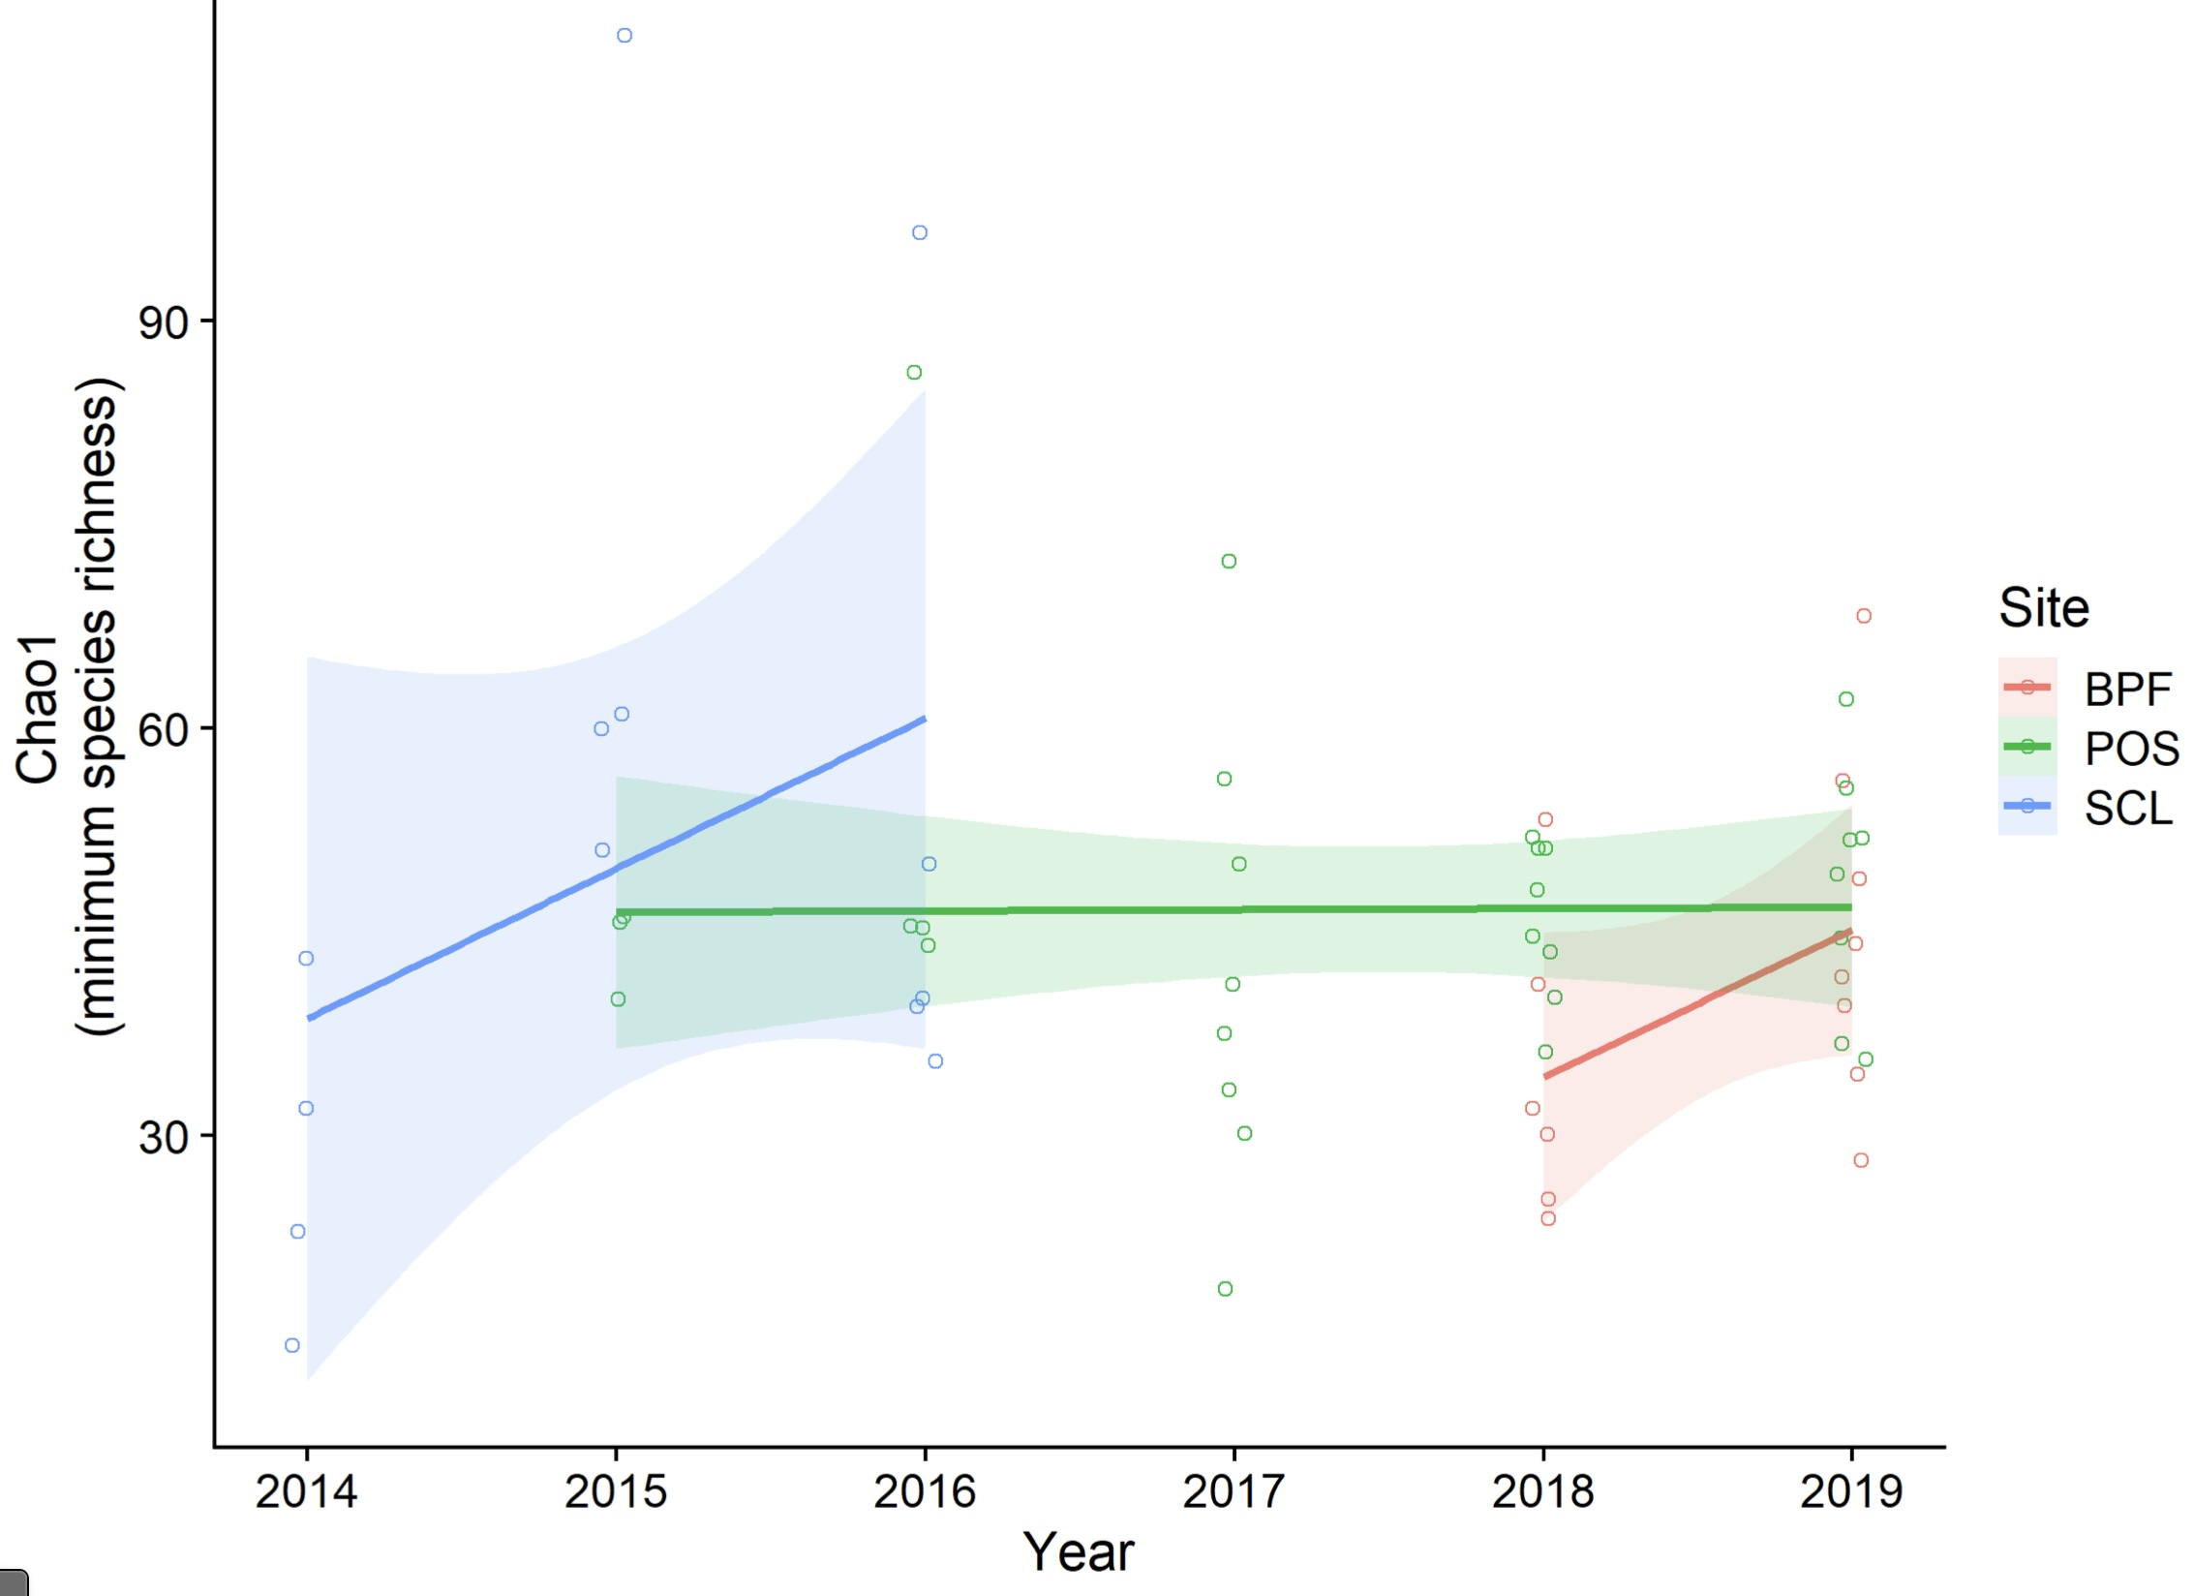
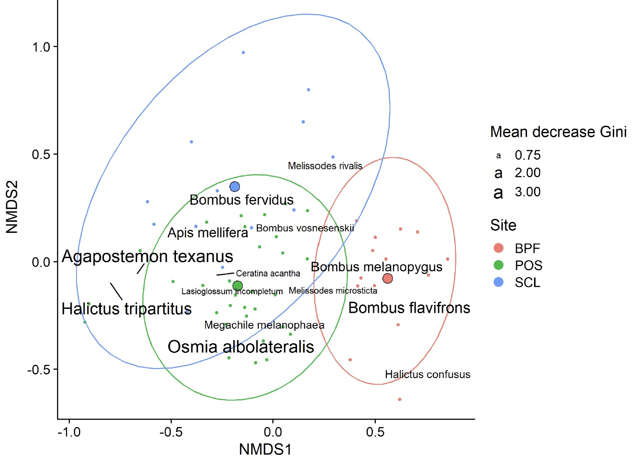
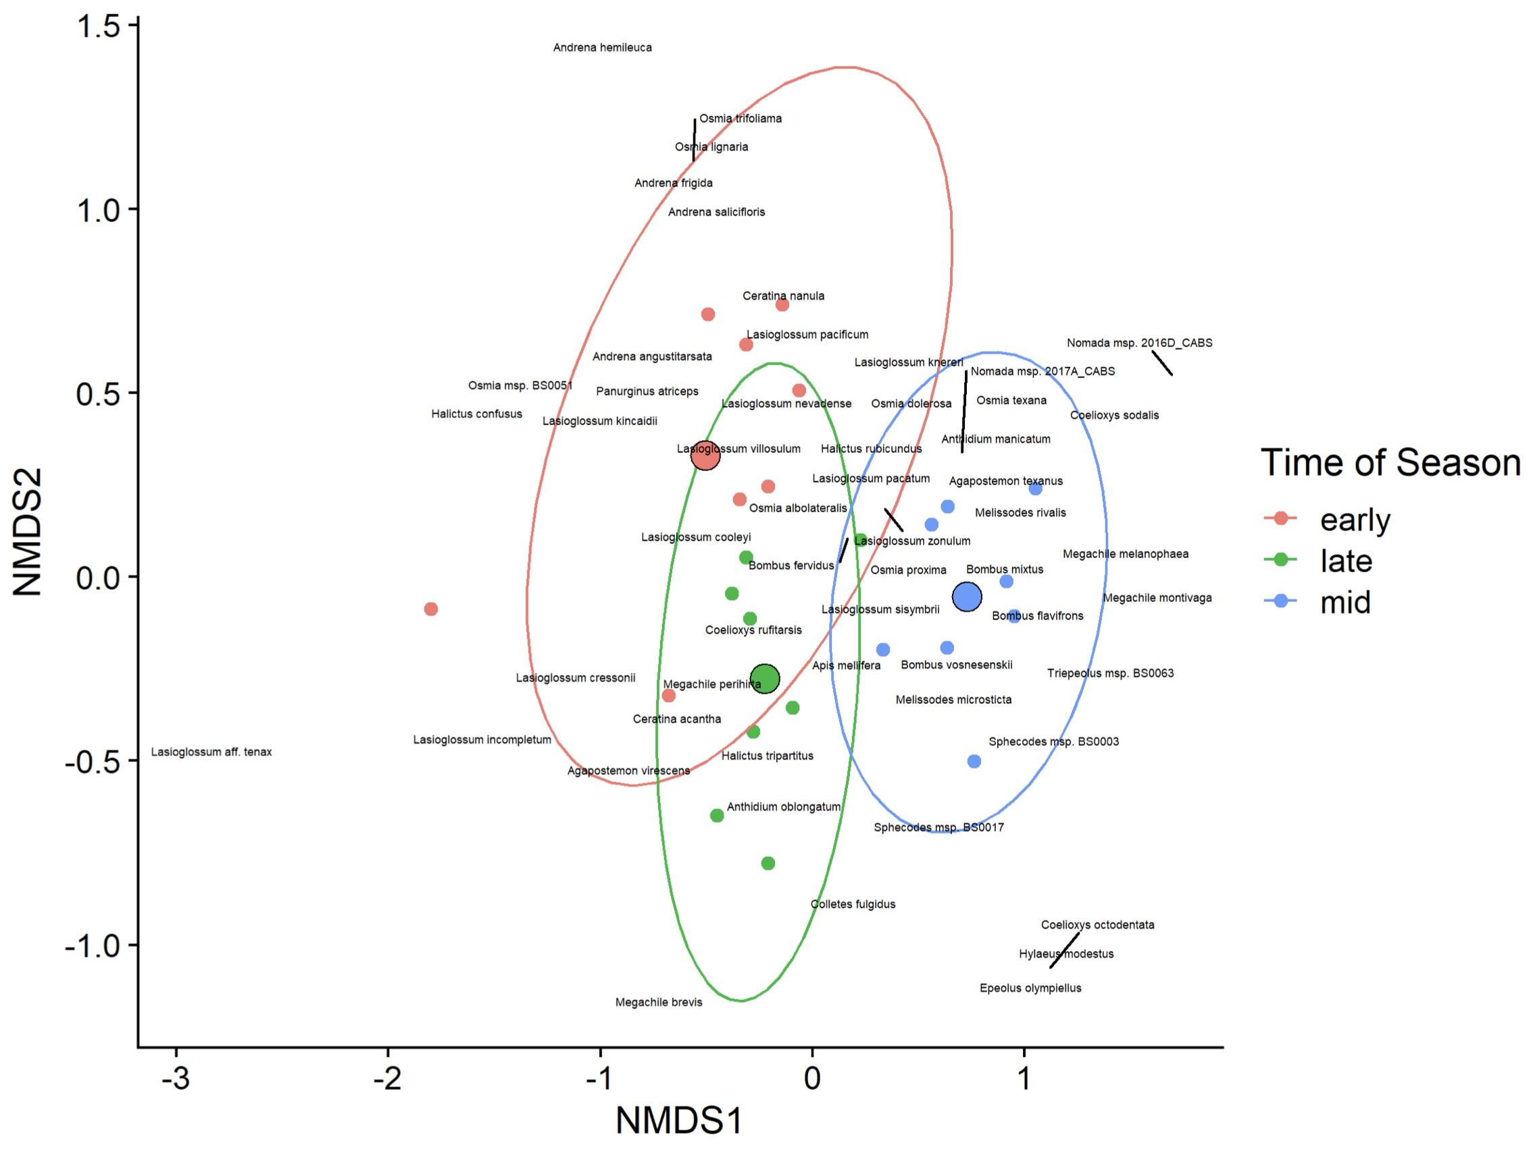
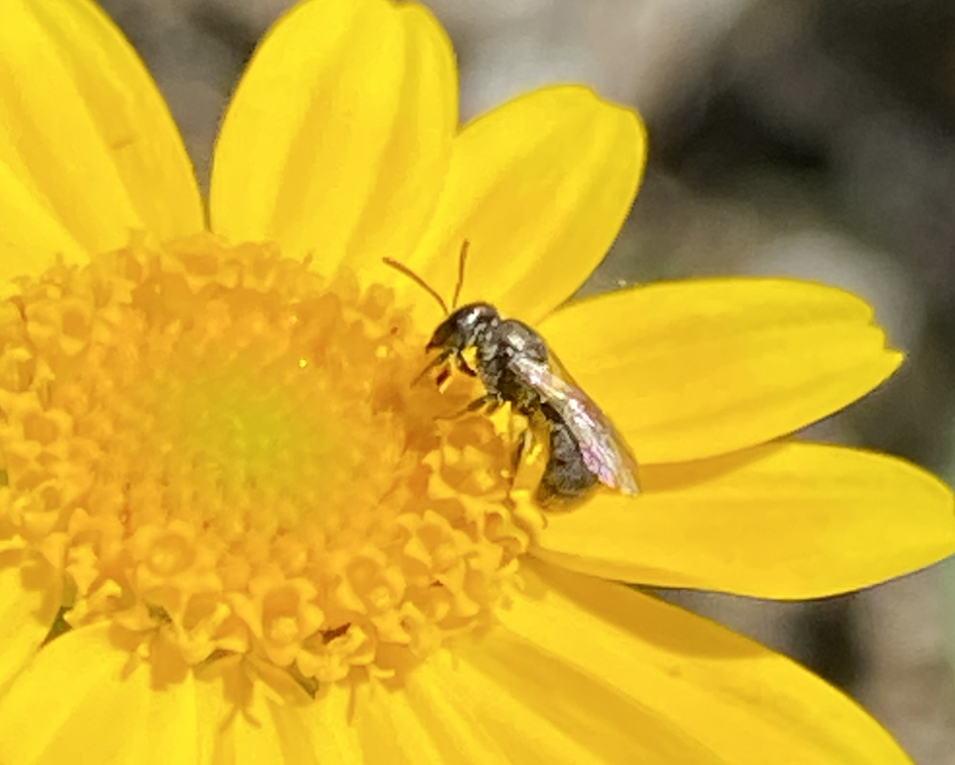
Bee Diversity in Lowland Puget Sound Marginal Lands
Evan Sugden¹, Will Peterman², Riley Anderson³, Bob Redmond⁴
¹Entomo-Logic, Salt Lake City, UT evan@entomologic.com, ²Bee Search, Seattle, WA will@beasearch.com, ³Washington State University, Pullman, WA riley.m.anderson@wsu.edu, ⁴ The Common Acre, (deceased)
Abstract We collected bees for 7 years on marginal lowlands of the Puget Sound area as part of a revegetation monitoring effort begun in 201 sponsored by The Common Acre.. A total of <22,543> specimens were collected, preserved, identified, and cataloged. We collected <143> species; Chao index analysis suggests the actual aggregate alpha diversity could be as high as <180> species. <Particularly rich were the genera Osmia and Andrena.> We were able to resolve significant variation in community composition across sites and possibly between collecting seasons.
Methods Sites included select parcels within properties of Seattle City Light, Port of Seattle, and Boeing Paine field (Fig. 1). Standard field methods were used, including colored bowl and blue vane traps set in multiple 15/3 series (1 set per station) for one 24-hour period per month (March-Sept) plus opportunistic net collecting. Bees were preserved in the field in alcohol, labeled and pinned in the lab, identified to species with the help of specialists, and cataloged.
Results Our basic data appear in Table 1. Our species accumulation curve indicates <>90%> of existing diversity was recovered (Fig. 2.) We found differences in bee community composition between sites (Fig. 3), with BPF having the most distinct character. There was a strong suggestion albeit not statistically robust, that bee communities differed at POS, our most sampled site, between seasons (Mar-Apr, May-Jun, Jul-Sept) (Fig. 4). Overall, bee communities at the site level appeared stable from year-to year.
Table 1. Basic data findings.
Fig. 2. Species richness across sites over all years. Bands indicate Chao diversity estimates.
Fig. 3. NMDS plot bee community similarity between sites. BPF is most distinctive.
Fig. 4. NMDS plot bee community similarity between seasons. Differences not significant as tested.
Discussion Our results are comparable to recent collections reported from Puget Sound small farms, gardens and parks (Bloom et al. 2022). Together, the two studies extend our current knowledge of pollinators of the region and form a baseline for monitoring bee diversity and community stability into the future (Bloom et al. 2023).
References/Acknowledgements
Bloom, EH, EC Oeller, RL Olsson, MR Brousil, RM Schaeffer, S Basu, Z Fu, DW Crowder. 2022. Documenting pollinators, floral hosts, and plant–pollinator interactions in U.S. Pacific Northwest agroecosystems. Ecology 103:e3606.
Bloom, EH, JG Illan, MR Brousil, JP Reganold, TD Northfield, DW Crowder. 2023. Long-term organic farming and floral diversity promotes stability of bee communities in agroecosystems. Func. Ecol. 00:1-17.
For identification service we thank Terry Giswold and Harold Ikerd, USDA, ARS, Logan, UT; James Strange, OH State U.; Jason Gibbs, U. Manitoba, Winnipeg, CAN; and Joel Gardner, Washington State U. Kami Koyamatsu assisted in specimen preparation. The personnel at the Common Acre provided support and a funding portal. Our late colleague and co-worker Bob Redmond conceived of and actuated the project.
Fig. 5. Halictus tripartitus (Halictidae), an all-female population in our study area and the most common bee in our collections (body size approx. 6 mm). Photo © Will Peterman
Fig. 1. Study sites. BPF = Boeing Paine Field, POS = Port of Seattle (SeaTac Airport), SLC = Seattle City Light power corridor (5 stations).

