Slide 1



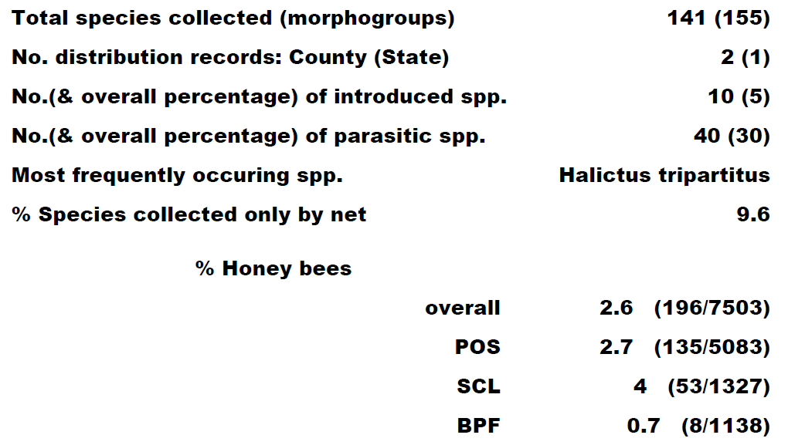
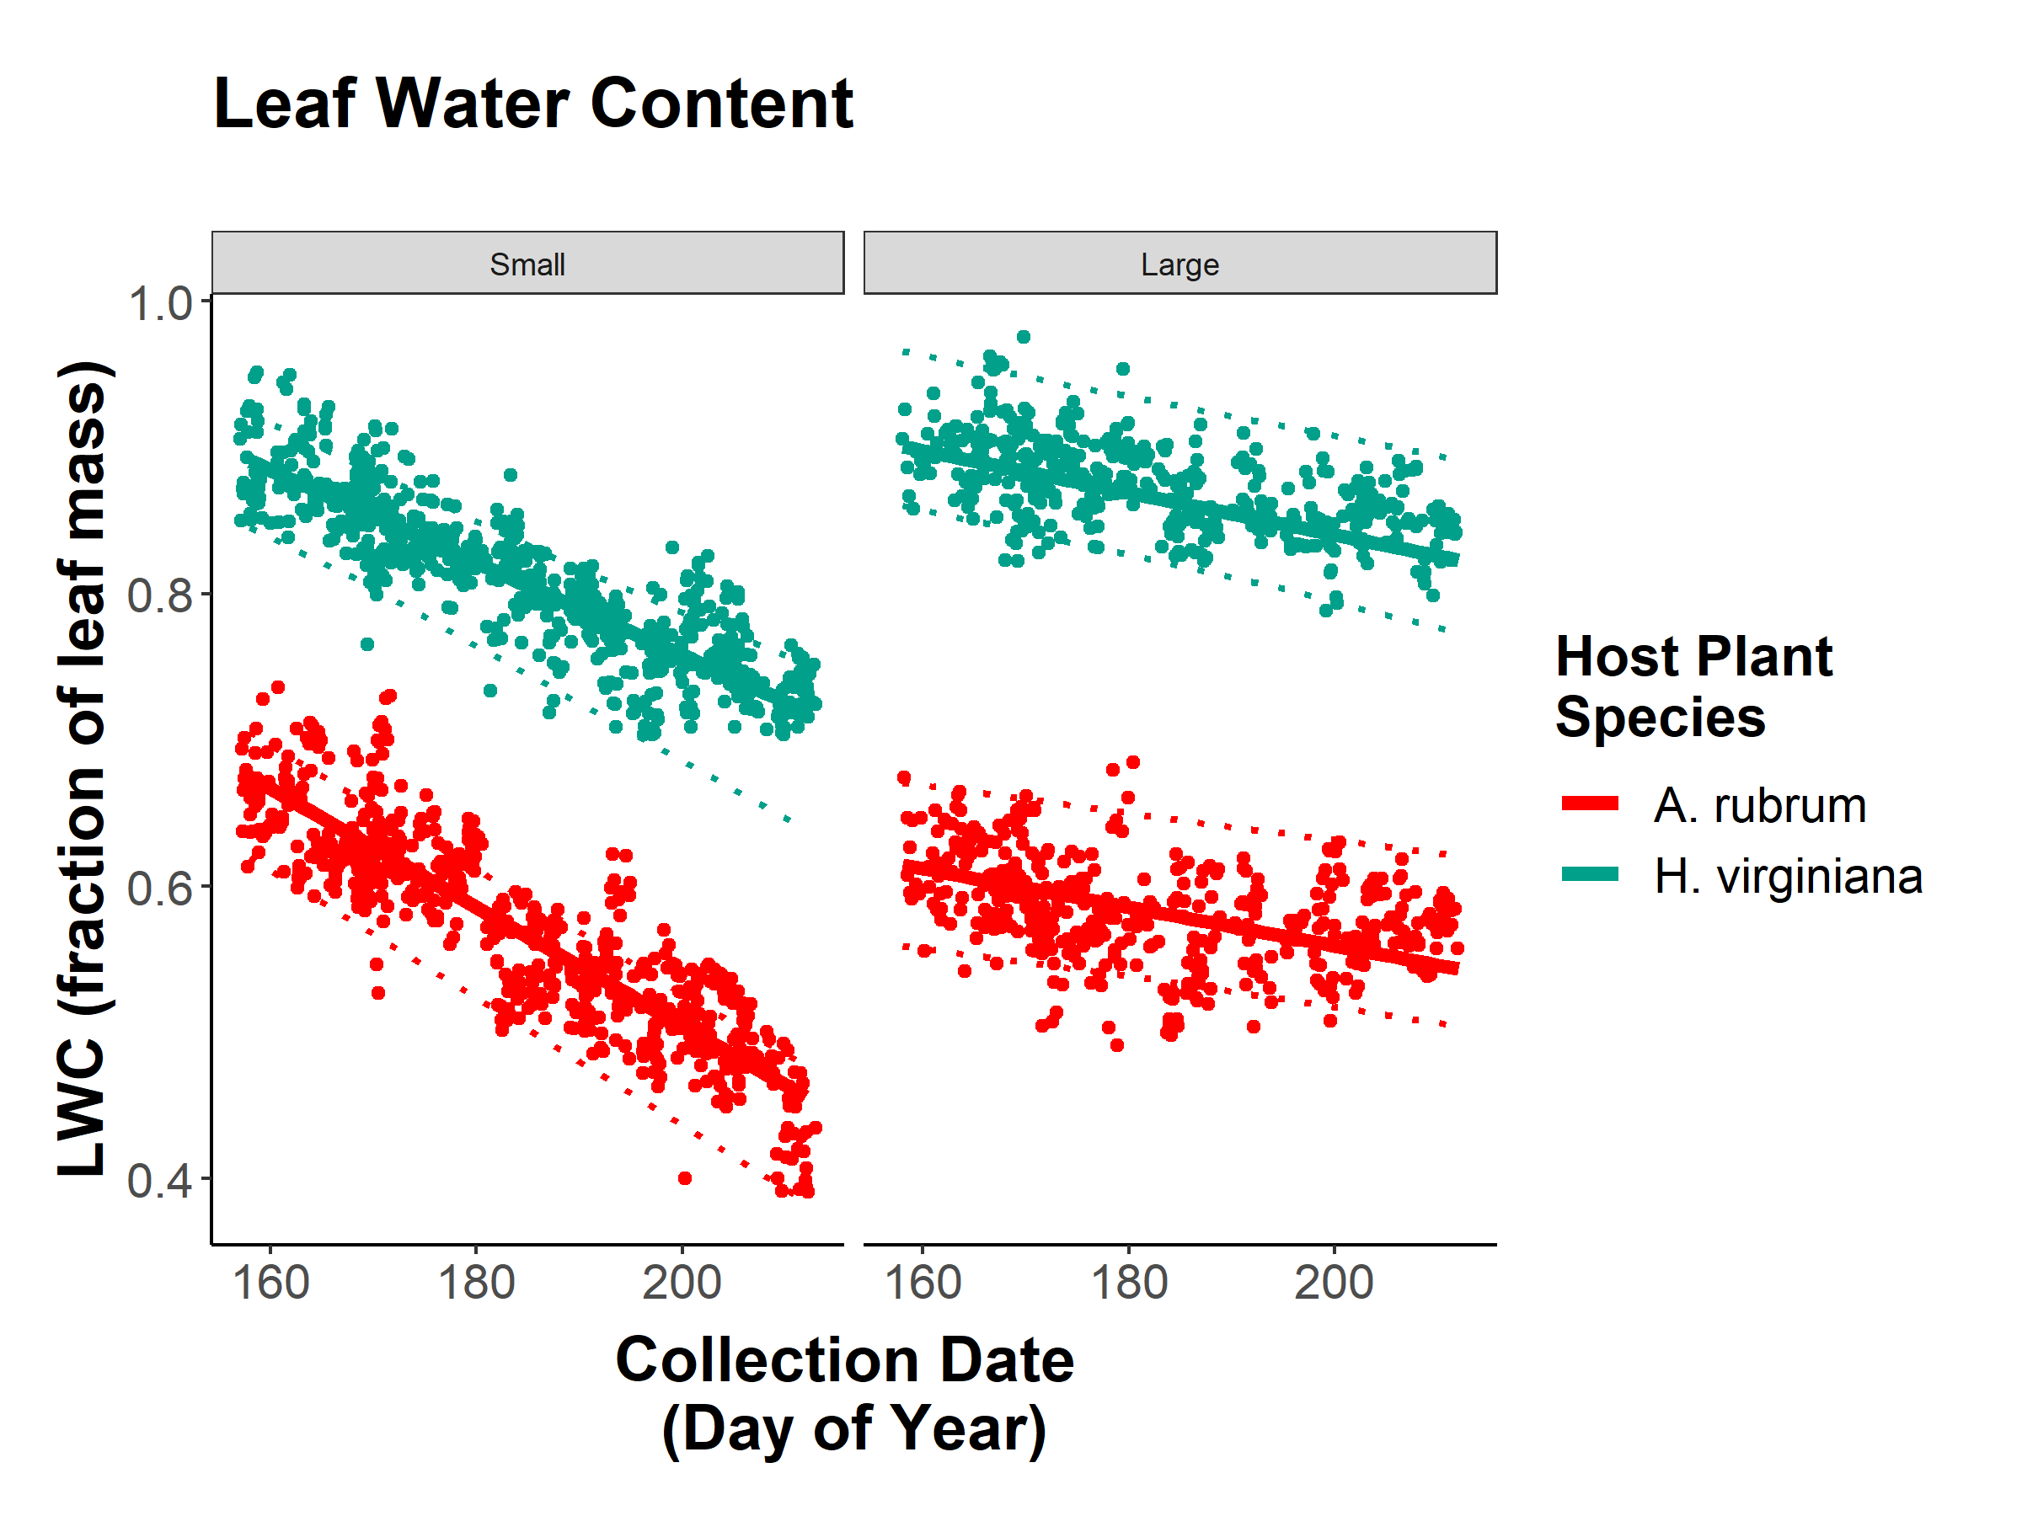
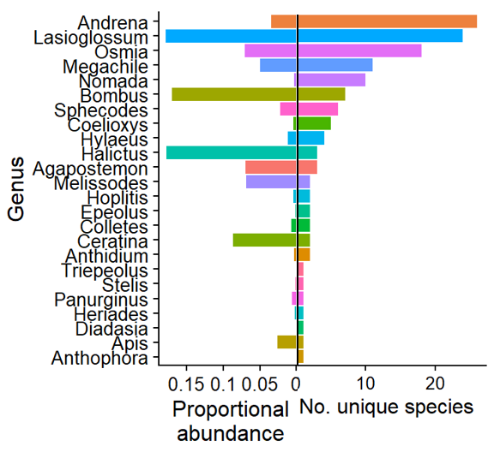
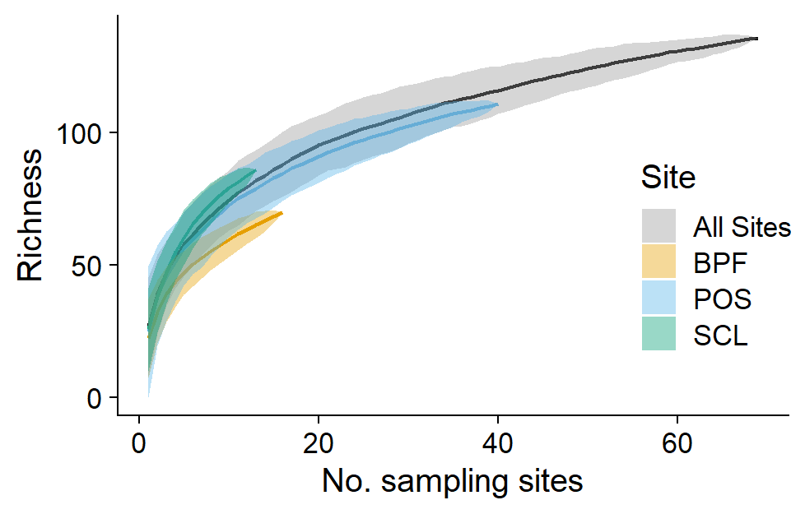
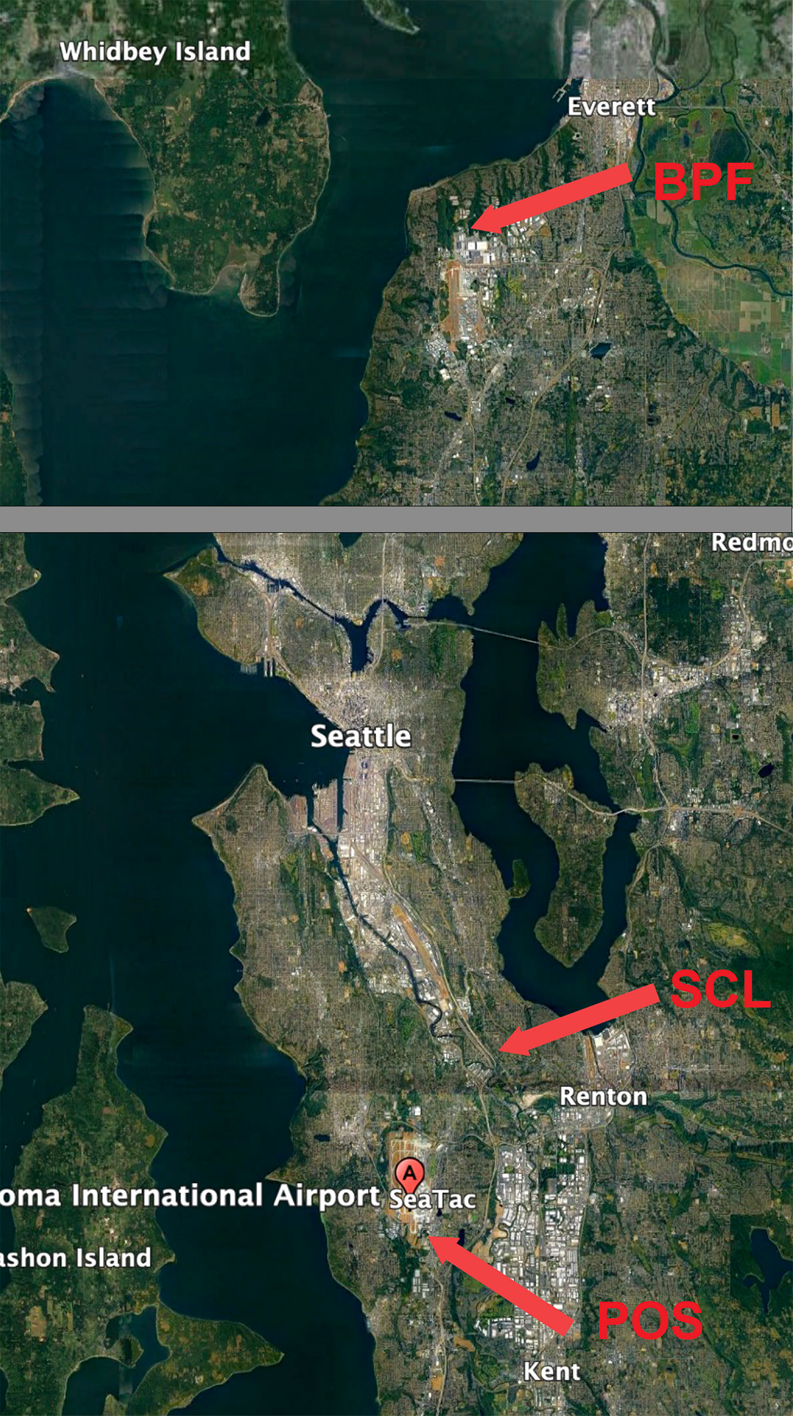
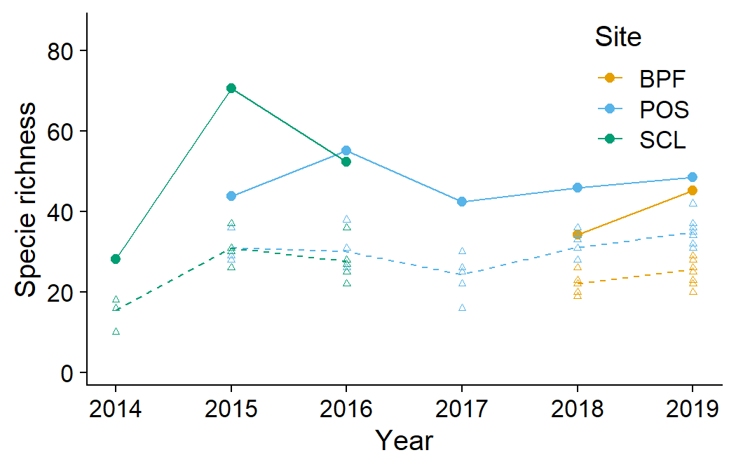
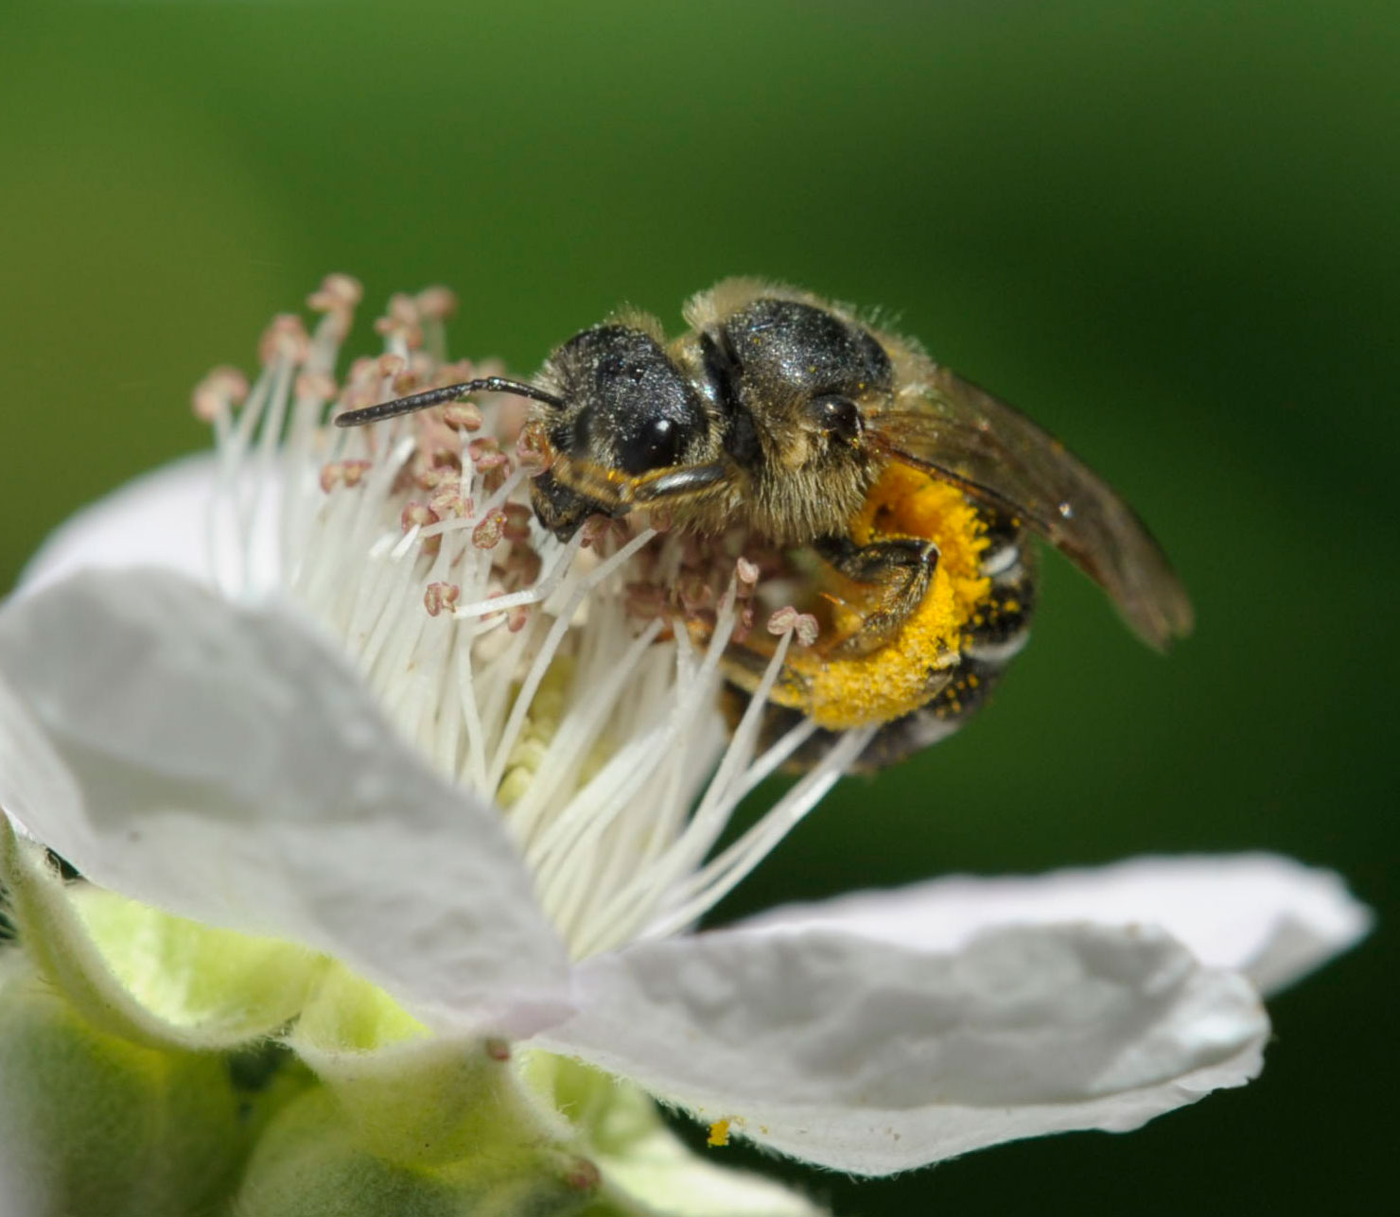
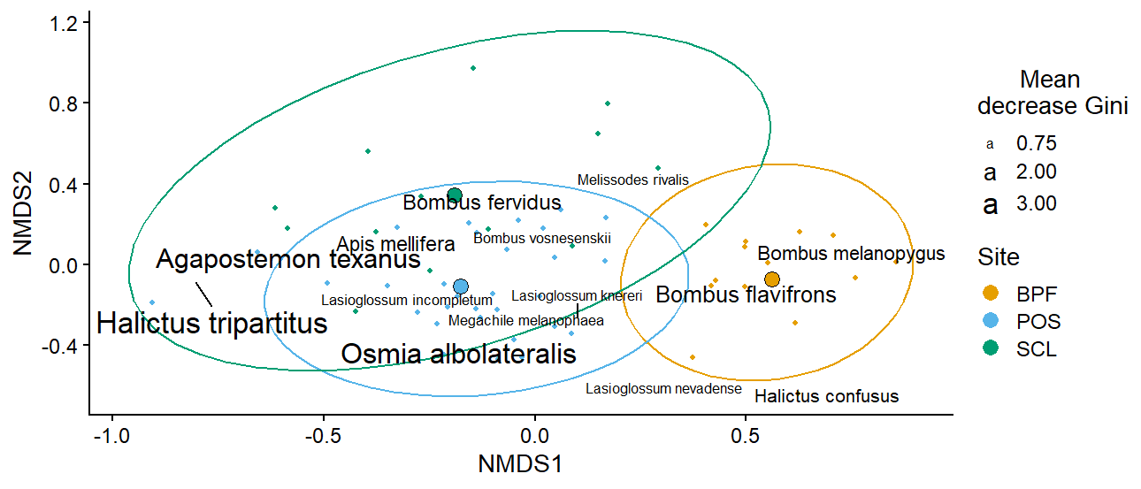
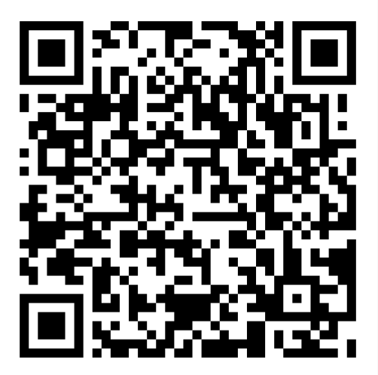
Bee Diversity in Lowland Puget Sound Marginal Lands
Evan Sudgen¹, Will Peterman², Riley Anderson³, Bob Redmond⁴
¹Entomo-Logic, Salt Lake City, UT evan@entomologic.com, ²Bee Search, Seattle, WA will@beesearch.org, ³Washington State University, Pullman, WA riley.m.anderson@wsu.edu, ⁴ The Common Acre, (deceased)
Introduction
The Puget Sound zone west of the Cascade Range is known for relatively low insect diversity in many taxonomic groups compared with other areas in non-maritime North America. Whether this pattern holds for bee fauna as well remains untested as this group is largely undescribed and unsampled. Recent research, including this study, has provided the foundation for a more complete analysis. The newly conceived and implemented Washington Bee Atlas project is assembling the data collected over the past few years, sponsoring more focused sampling, and supplementing this data with specimen collections curated by Washington State University. As a contribution to the scientific understanding of the bees of the region, we collected bees for 7 years on marginal lowlands of the Puget Sound area as part of a revegetation monitoring effort that began in 2014, sponsored by The Common Acre. Here, we present a description of the bee species we found and the communities they shape.
Key descriptive highlights from the survey. Data presented are raw counts, unmanipulated by minimum richness estimators (i.e., Chao richness). Species percentages are calculated based on richness. Honeybee percentages are calculated based on abundance.
Species accumulation curves. Sampling effort is derived from permutation resampling, where each sampling event is a substation/year. The data include all blue vane trap, and all net caught records. At the site level, curves are stunted by singleton records, in the aggregate, these species are found more often.
Proportional abundance and richness by genera. Genera found in the survey are plotted by proportional abundance (left) and species richness (right). Data are raw counts and exclude some morphospecies.
Conclusions
This research has revealed that bee diversity and bee community complexity is substantial in disturbed, largely weedy habitats of marginal lands of the lower Puget Sound.
In total, 25,400 specimens were collected, preserved, identified, and cataloged.
We identified 155 morphogroups, representing at least 141 species.
Across the region, Chao1 minimum richness estimates 182.5 species, meaning our sample captured ~77% (141/182.5) of unique species.
Species accumulation curves at the site level are stunted by singletons, in the aggregate, our sample is robust.
While species identity across sites is similar, large differences in proportional abundance account for the compositional peculiarities of the BPF site.
Despite 2 honeybee apiaries within 1 km of our study site at POS, Apis mellifera accounted for only 2.7 % of specimens collected.
Our results are comparable to those of Bloom, et al. (2021), who made similar collections in Puget Sound small farms, gardens and parks. Together, the two studies extend our current knowledge of pollinators of the region and form a baseline for monitoring bee diversity into the future.
Species richness across sites and sampling years. Points are Chao1 minimum estimated species richness, triangles are raw species counts at each substation within each site. Chao richness estimates are lifted by an additive parameter that accounts for rare species likely missed in the sampling. The data exclude some morphospecies, and all net caught records.
Halictus tripartitus (Halictidae), an all-female population in our study area and the most common bee in our collections (body size approx. 6 mm). Photo © Will Peterman
Methods
Sites included select parcels within properties of Seattle City Light, Port of Seattle, and Boeing Paine field (Fig. 1).
Standard field methods were used, including colored bowl and blue vane traps set in multiple 15/3 series (1 set per station) for one 24-hour period per month.
Traps were monitored March-September and supplemented with opportunistic net collecting.
Bees were preserved in the field in alcohol, labeled and pinned in the lab, identified to species with the help of specialists, and cataloged.
Acknowledgments
Variation in community composition across sites. Bee species are plotted on the first two axes of a three-dimensional non-metric multidimensional scaling ordination of the 58 combinations of station (subsite) and year, across the three sites. Small points are the individual station/year combinations. Large points are the centroids of the three sites. Ellipses are 95% confidence intervals around the site centroids. Bee species shown are the most representative (top 10th percentile of a random forest analysis) of the compositional differences among sites. Text size of the labels is proportional to variable importance score (mean decrease in Gini score).
For identification service we thank Terry Giswold, Harold Ikerd and Diana Cox-Foster, USDA, ARS, Pollinating Insects Collection, Logan, UT; James Strange, OH State U.; Jason Gibbs, U. Manitoba, Winnipeg, CAN; Joel Gardner, Washington State U. and Robbin Thorp, University of California, Davis (deceased). Kami Koyamatsu assisted in specimen preparation. Chris Looney of Washington State Department of Agriculture provided practical advice. Field site access and support was provided by Seattle City Light, The Port of Seattle, and Boeing Corp. Major funding was provided by the Bullitt Foundation. Allison Rynard, Nat Mengist and Talia London of the Common Acre provided administrative support. Our late colleague and co-worker Bob Redmond conceived of and actuated the project.
Data are carefully curated and open to all!
Check out our GitHub page with all data and code publicly available:
Study sites
BPF = Boeing Paine Field (8 stations).
POS = Port of Seattle (SeaTac Airport) (22 stations).
SCL = Seattle City Light power corridor (5 stations).
(Map is divided for graphical fitting.)
Scan me!
Github.com/andersonrm/BeeSearch/tree/main

