Slide 1



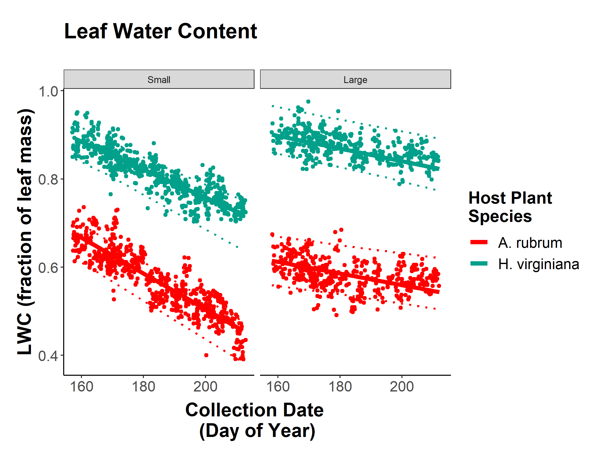
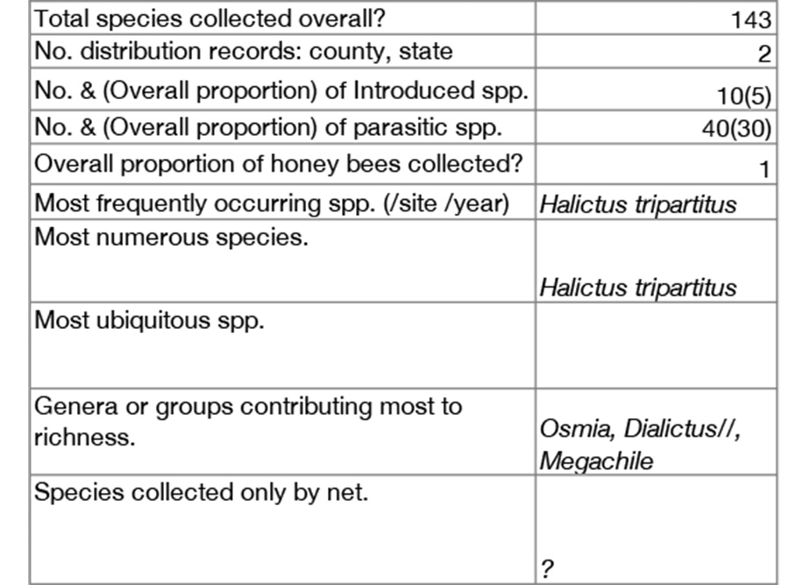
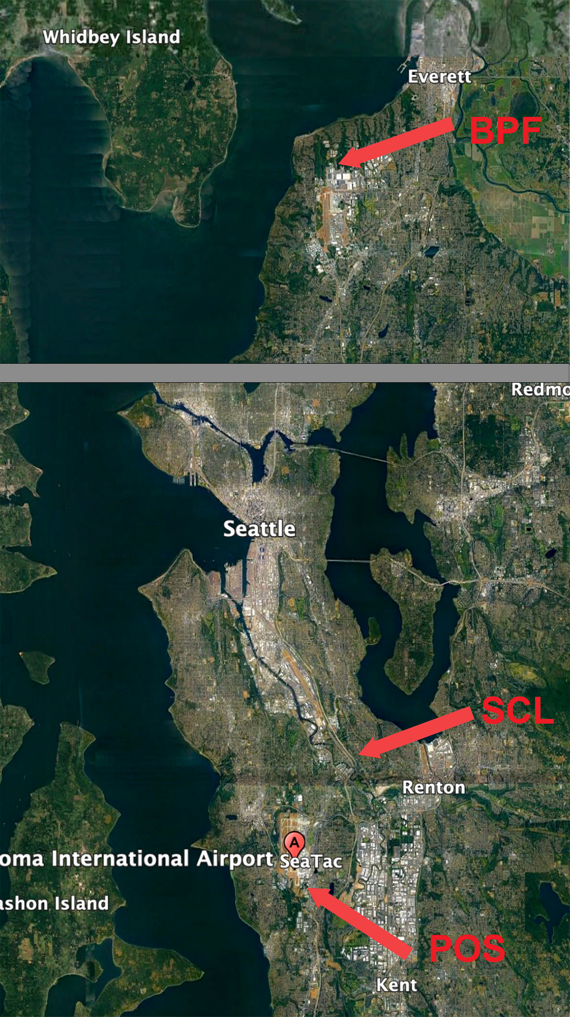
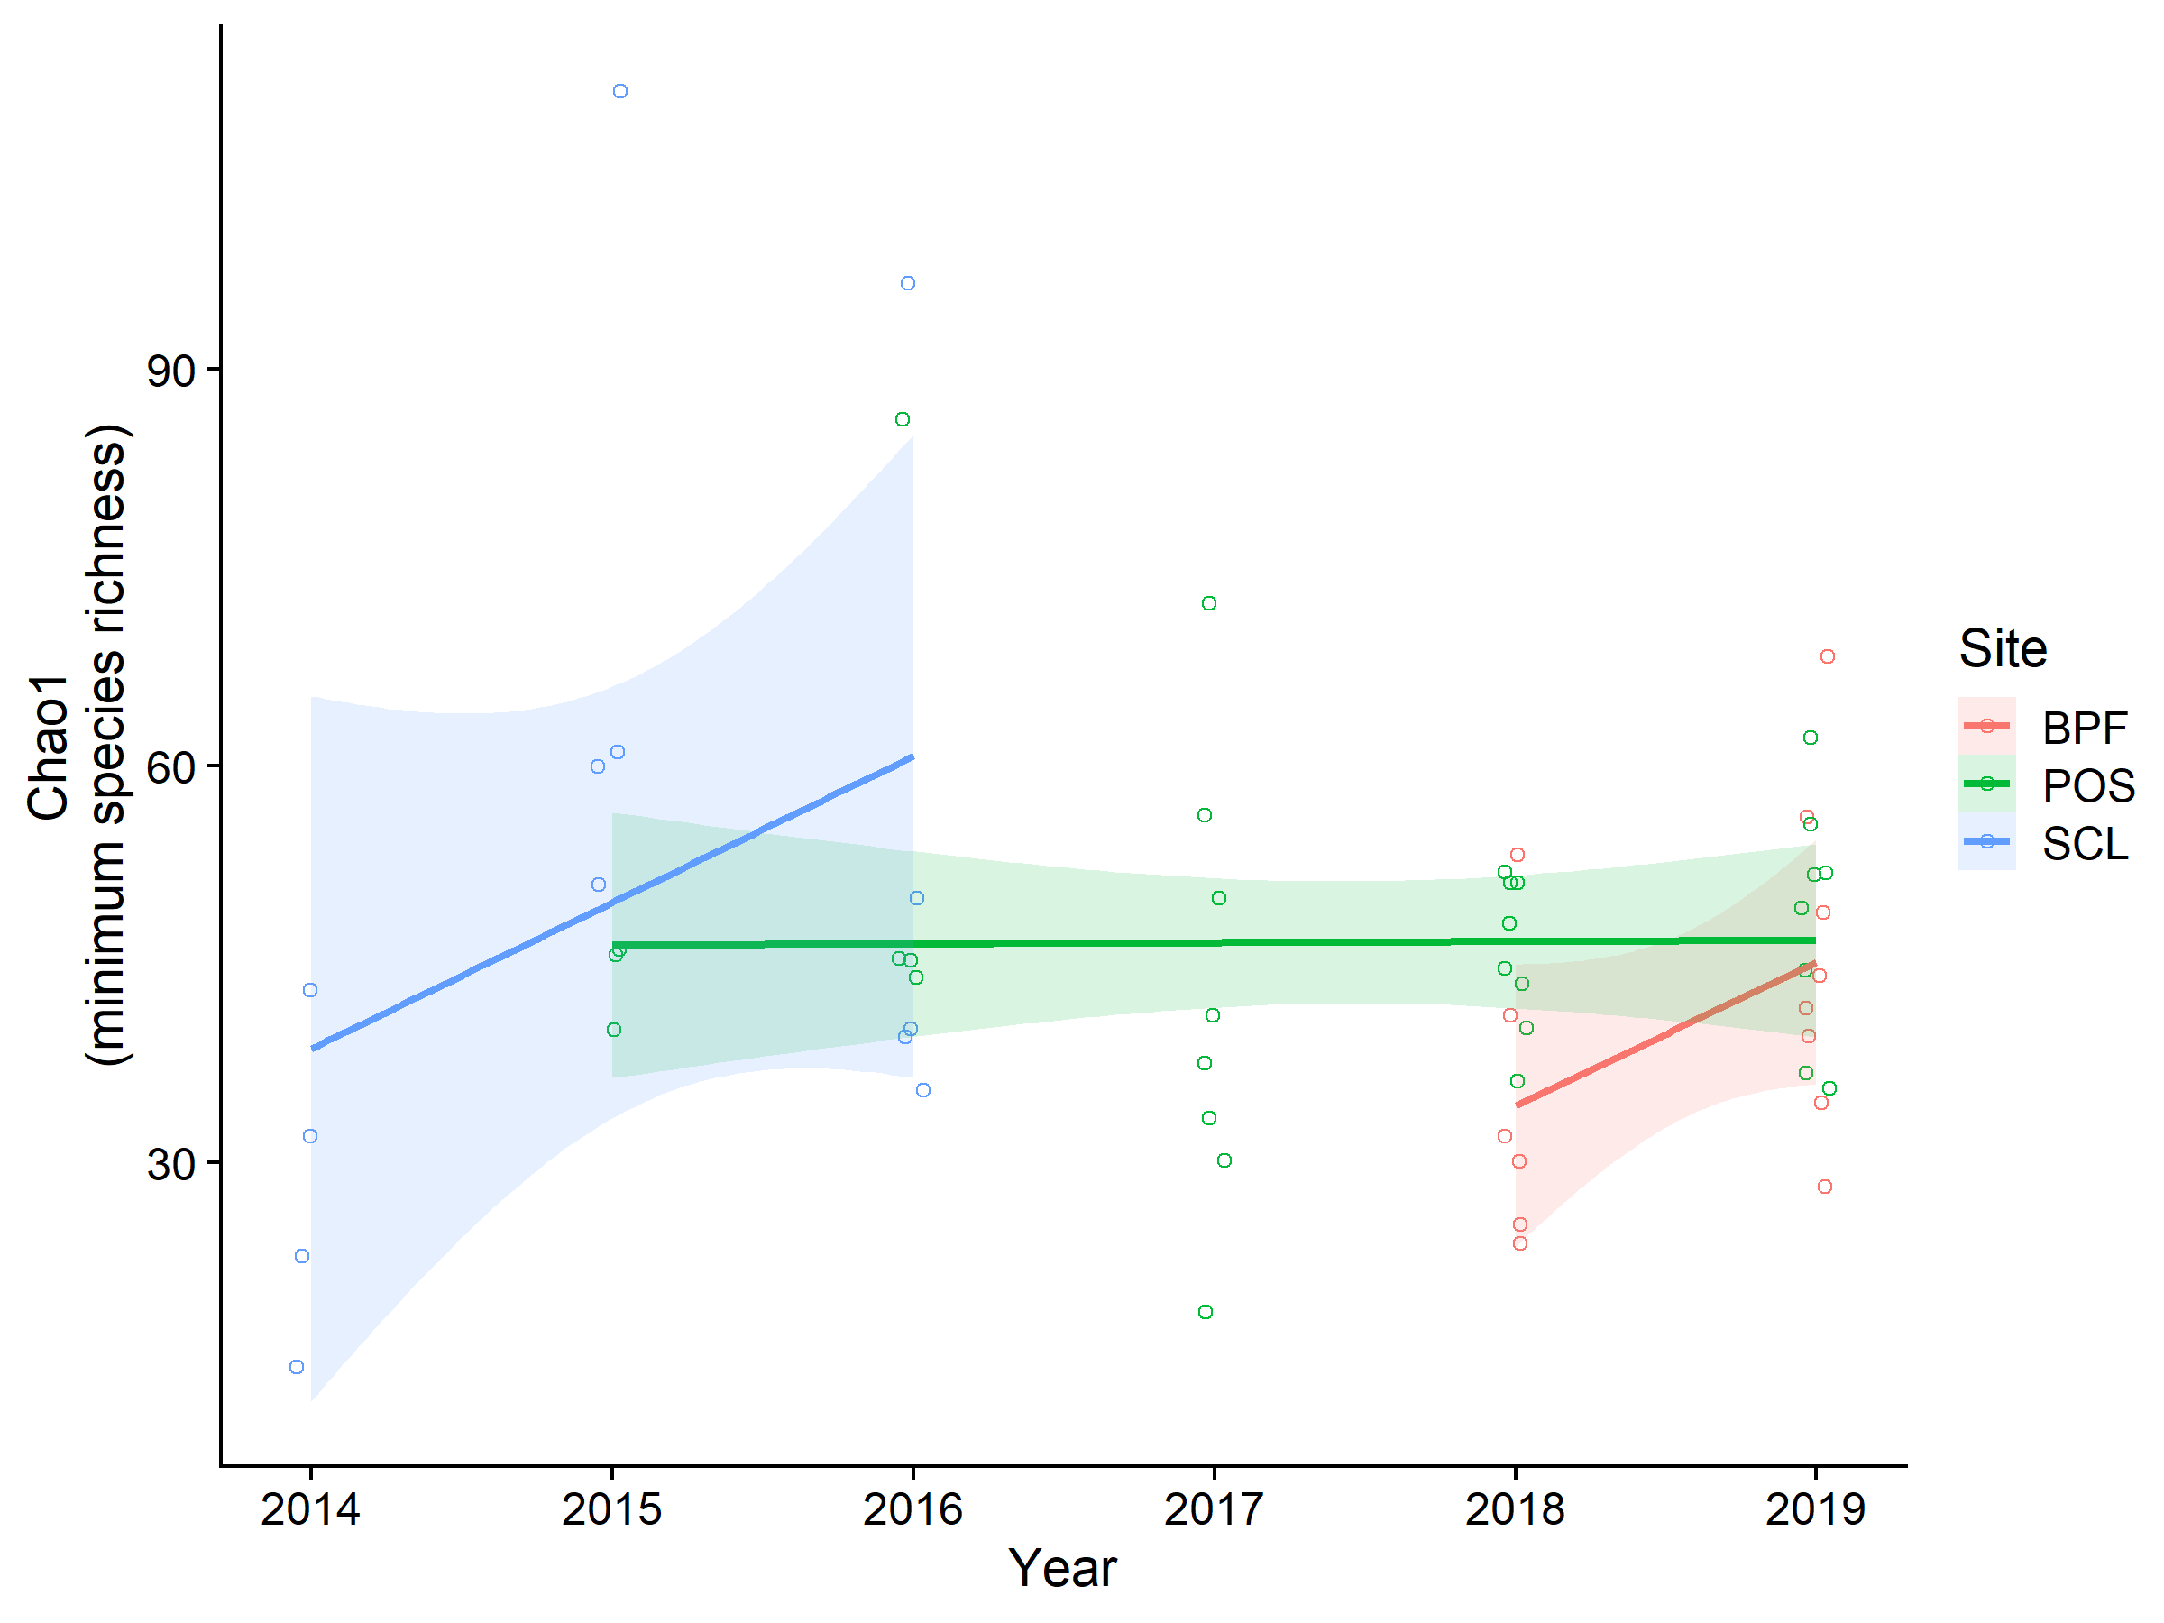
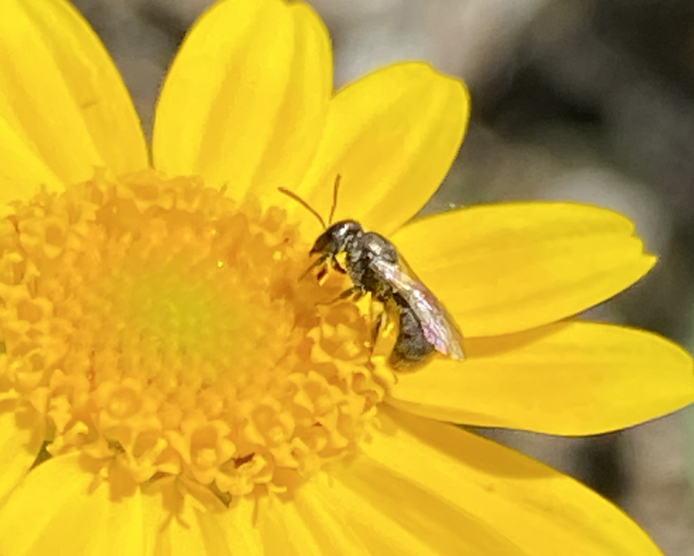
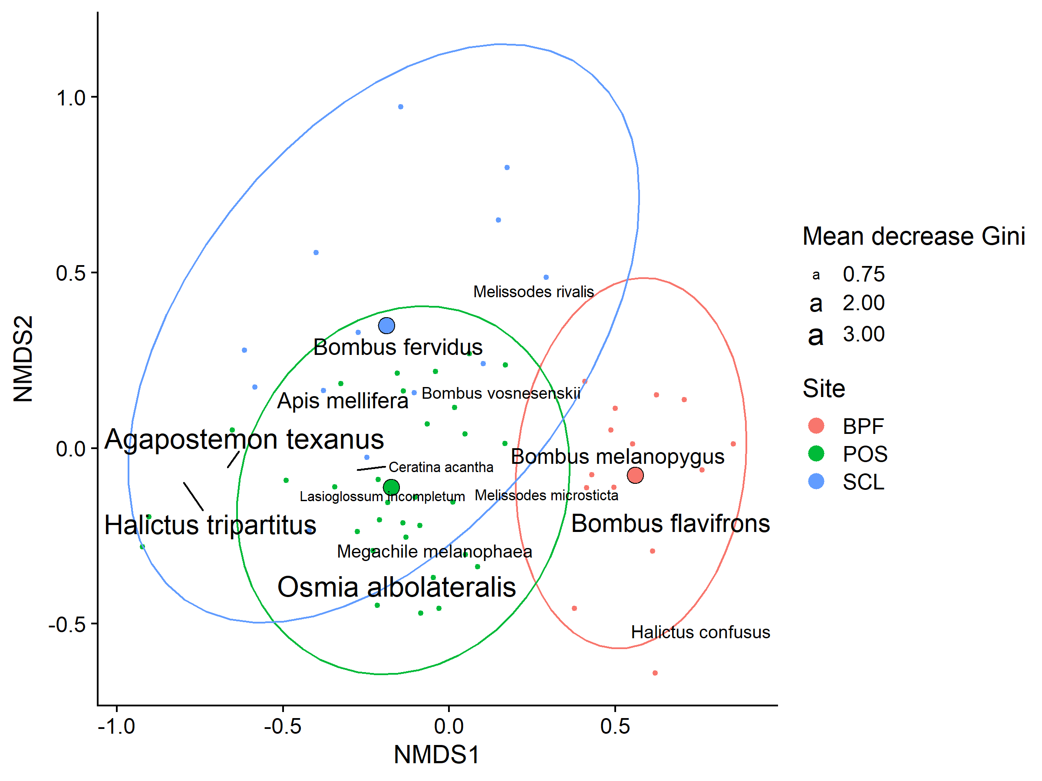
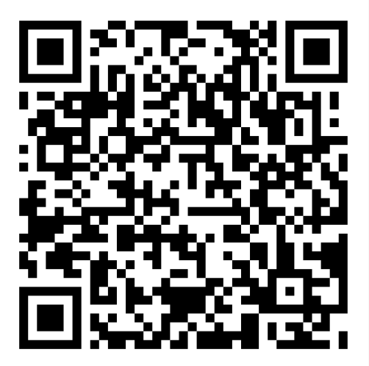
Bee Diversity in Lowland Puget Sound Marginal Lands
Evan Sudgen¹, Will Peterman², Riley Anderson³, Bob Redman⁴
¹Entomo-Logic, Salt Lake City, UT evan@entomologic.com, ²Bee Search, Seattle, WA will@beasearch.com, ³Washington State University, Pullman, WA riley.m.anderson@wsu.edu, ⁴ The Common Acre, (deceased)
Introduction
Study sites
Conclusions
The maritime Puget Sound zone west of the Cascade Range has remained largely undescribed and unsampled for bee diversity. We collected bees for 7 years on marginal lowlands of the Puget Sound area as part of a revegetation monitoring effort that began in 2014, sponsored by The Common Acre. Here, we present a description of the bee communities found.
In total, <25,400> specimens were collected, preserved, identified, and cataloged.
We collected <155> morphogroups.
Chao richness index estimates suggest the actual aggregate alpha diversity could be as high as <180> species. Particularly rich were the genera Osmia <> and Andrena <>.
We were able to resolve significant variation in community composition across sites and possibly between collecting seasons.
BPF = Boeing Paine Field (X stations).
POS = Port of Seattle (SeaTac Airport) (X stations).
SLC = Seattle City Light power corridor (5 stations).
Room for any additional info
Any concluding remarks or main findings
Halictus tripartitus (Halictidae), an all-female population in our study area and the most common bee in our collections (body size approx. 6 mm). Photo © Will Peterman
Methods
Sites included select parcels within properties of Seattle City Light, Port of Seattle, and Boeing Paine field.
Standard field methods were used, including colored bowl and blue vane traps set in multiple 15/3 series (1 set per station) for one 24-hour period per month.
Traps were monitored March-September and supplemented with opportunistic net collecting.
Bees were preserved in the field in alcohol, labeled and pinned in the lab, identified to species with the help of specialists, and cataloged.
Acknowledgments
For identification service we thank Terry Giswold and Harold Ikerd, USDA, ARS, Logan, UT; James Strange, OH State U.; Jason Gibbs, U. Manitoba, Winnipeg, CAN; and Joel Gardner, Washington State U. Kami Koyamatsu assisted in specimen preparation. The personnel at the Common Acre provided support and a funding portal. Our late colleague and co-worker Bob Redmond conceived of and actuated the project.
Data are carefully curated and open to all!
Check out our GitHub page with all data and code publicly available:
Scan me!
Github.com/andersonrm/BeeSearch/tree/main

Slide 2
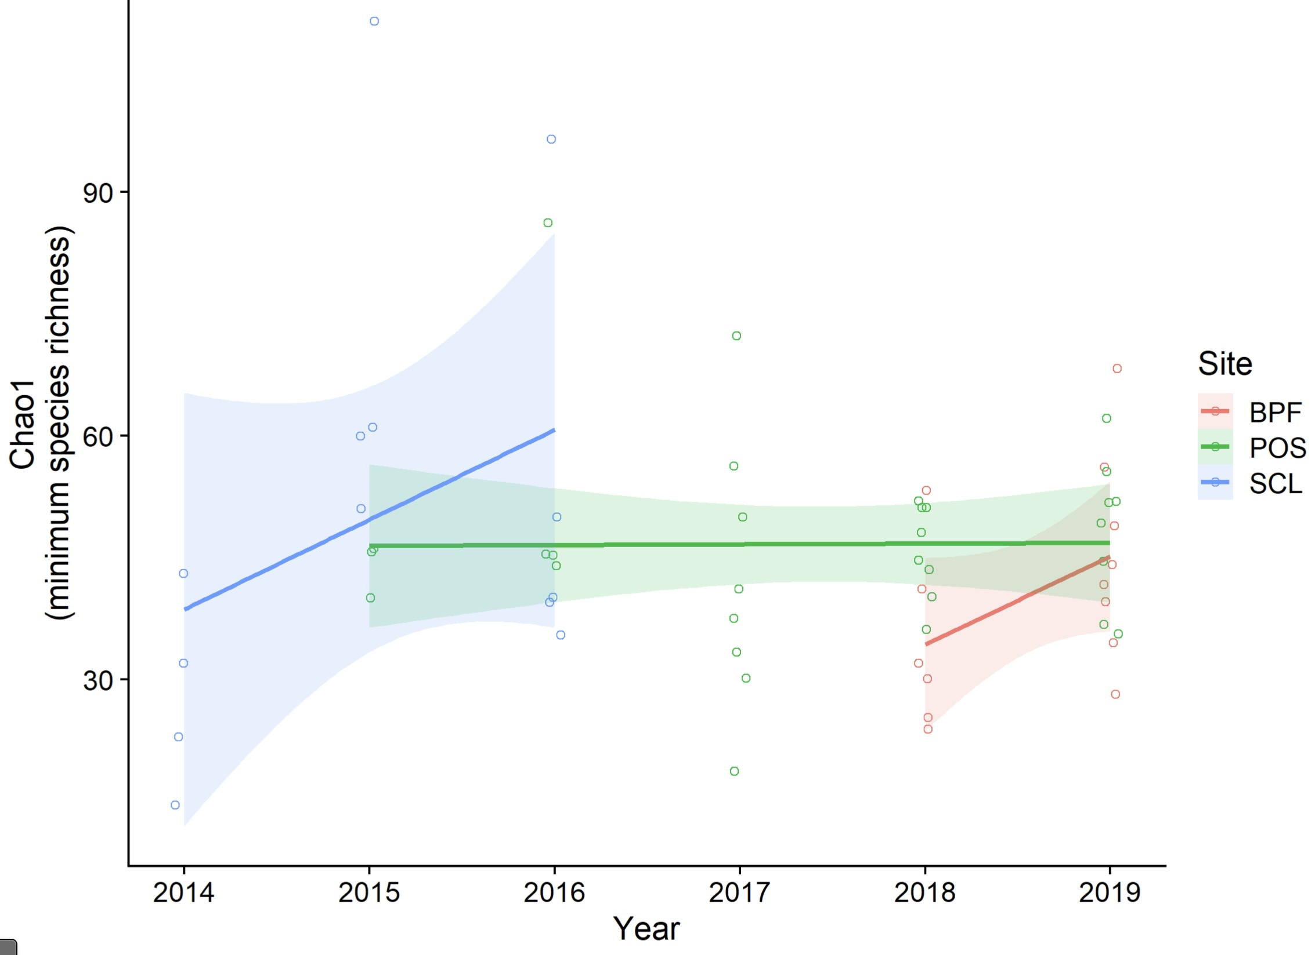
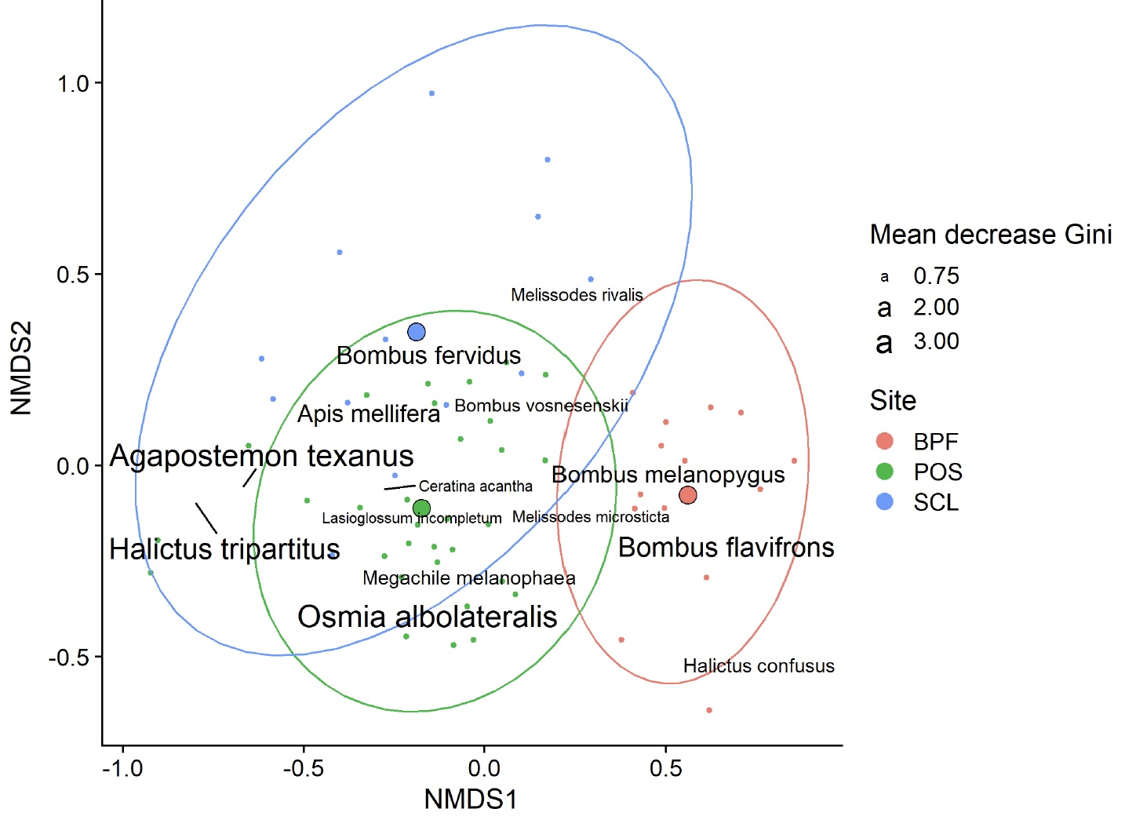
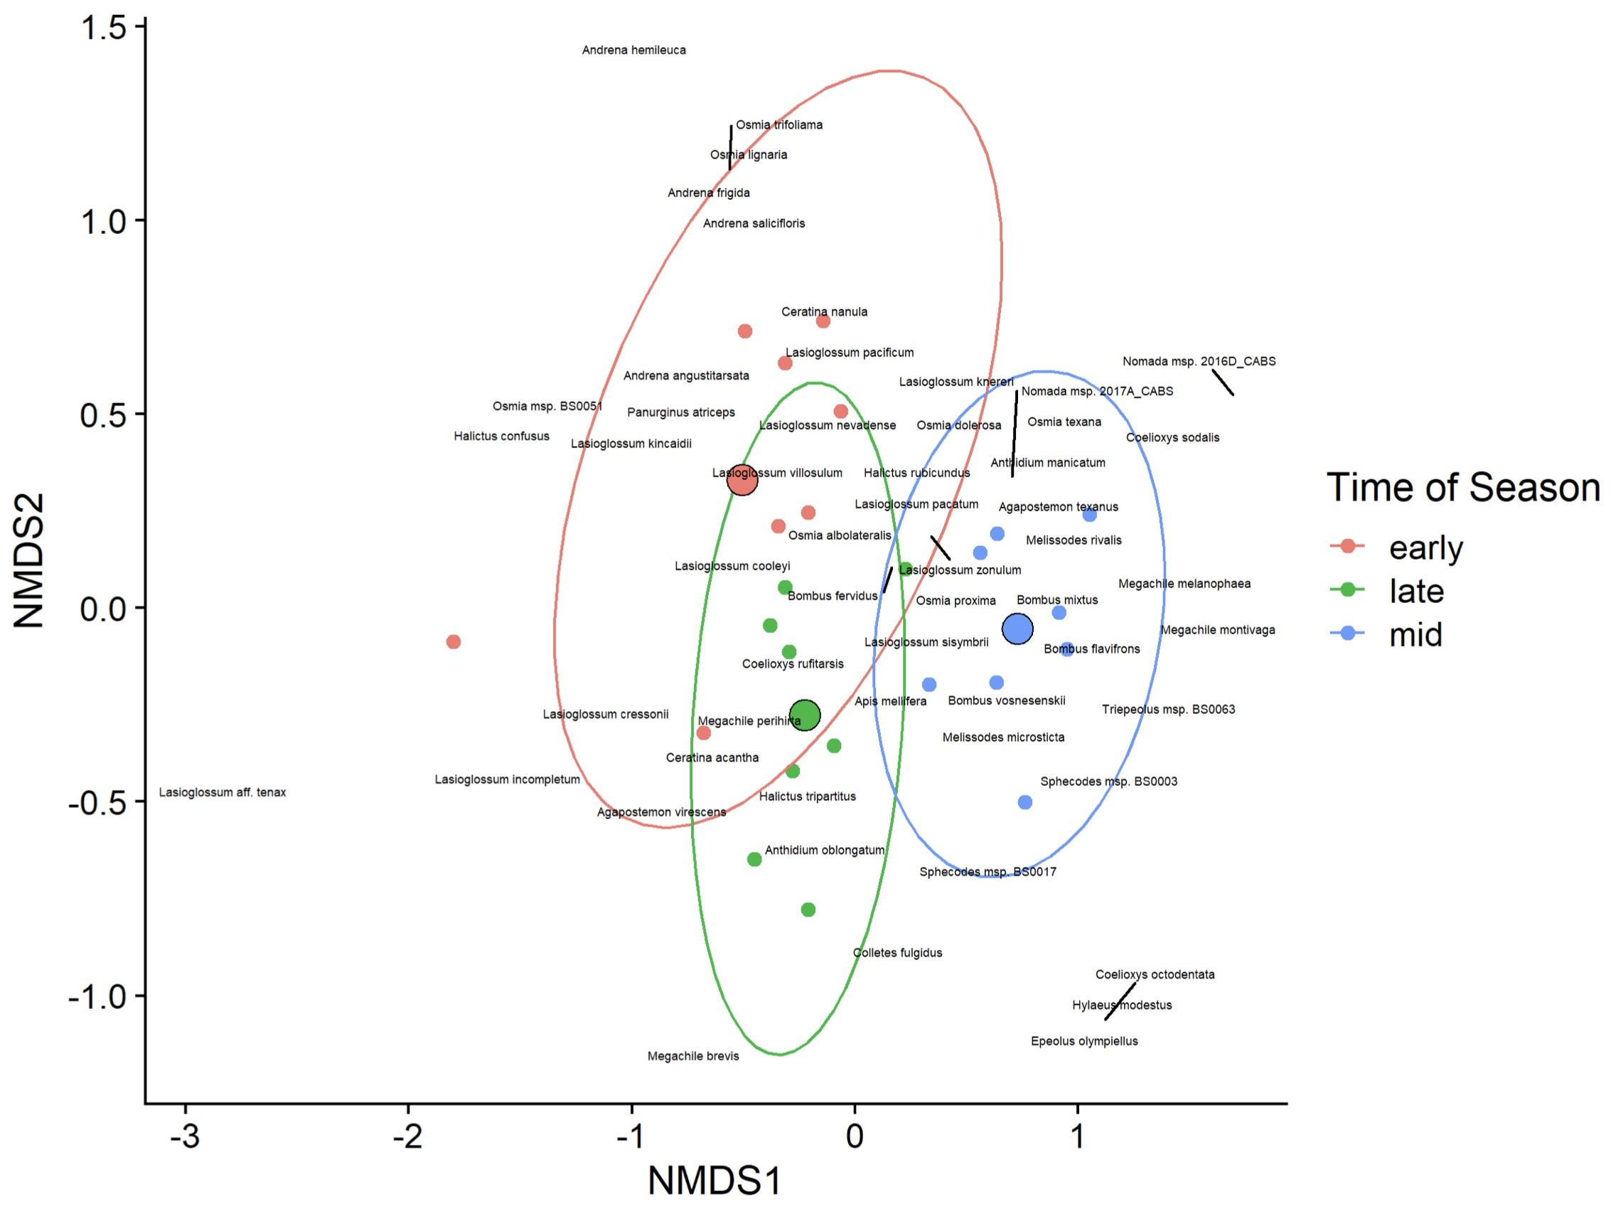
Bee Diversity in Lowland Puget Sound Marginal Lands
Evan Sugden¹, Will Peterman², Riley Anderson³, Bob Redmond⁴
¹Entomo-Logic, Salt Lake City, UT evan@entomologic.com, ²Bee Search, Seattle, WA will@beasearch.com, ³Washington State University, Pullman, WA riley.m.anderson@wsu.edu, ⁴ The Common Acre, (deceased)
Abstract We collected bees for 7 years on marginal lowlands of the Puget Sound area as part of a revegetation monitoring effort begun in 201 sponsored by The Common Acre.. A total of <22,543> specimens were collected, preserved, identified, and cataloged. We collected <143> species; Chao index analysis suggests the actual aggregate alpha diversity could be as high as <180> species. <Particularly rich were the genera Osmia and Andrena.> We were able to resolve significant variation in community composition across sites and possibly between collecting seasons.
Methods Sites included select parcels within properties of Seattle City Light, Port of Seattle, and Boeing Paine field (Fig. 1). Standard field methods were used, including colored bowl and blue vane traps set in multiple 15/3 series (1 set per station) for one 24-hour period per month (March-Sept) plus opportunistic net collecting. Bees were preserved in the field in alcohol, labeled and pinned in the lab, identified to species with the help of specialists, and cataloged.
Results Our basic data appear in Table 1. Our species accumulation curve indicates <>90%> of existing diversity was recovered (Fig. 2.) We found differences in bee community composition between sites (Fig. 3), with BPF having the most distinct character. There was a strong suggestion albeit not statistically robust, that bee communities differed at POS, our most sampled site, between seasons (Mar-Apr, May-Jun, Jul-Sept) (Fig. 4). Overall, bee communities at the site level appeared stable from year-to year.
Table 1. Basic data findings.
Fig. 2. Species richness across sites over all years. Bands indicate Chao diversity estimates.
Fig. 3. NMDS plot bee community similarity between sites. BPF is most distinctive.
Fig. 4. NMDS plot bee community similarity between seasons. Differences not significant as tested.
Discussion Our results are comparable to recent collections reported from Puget Sound small farms, gardens and parks (Bloom et al. 2022). Together, the two studies extend our current knowledge of pollinators of the region and form a baseline for monitoring bee diversity and community stability into the future (Bloom et al. 2023).
References/Acknowledgements
Bloom, EH, EC Oeller, RL Olsson, MR Brousil, RM Schaeffer, S Basu, Z Fu, DW Crowder. 2022. Documenting pollinators, floral hosts, and plant–pollinator interactions in U.S. Pacific Northwest agroecosystems. Ecology 103:e3606.
Bloom, EH, JG Illan, MR Brousil, JP Reganold, TD Northfield, DW Crowder. 2023. Long-term organic farming and floral diversity promotes stability of bee communities in agroecosystems. Func. Ecol. 00:1-17.
For identification service we thank Terry Giswold and Harold Ikerd, USDA, ARS, Logan, UT; James Strange, OH State U.; Jason Gibbs, U. Manitoba, Winnipeg, CAN; and Joel Gardner, Washington State U. Kami Koyamatsu assisted in specimen preparation. The personnel at the Common Acre provided support and a funding portal. Our late colleague and co-worker Bob Redmond conceived of and actuated the project.
Fig. 5. Halictus tripartitus (Halictidae), an all-female population in our study area and the most common bee in our collections (body size approx. 6 mm). Photo © Will Peterman
Fig. 1. Study sites. BPF = Boeing Paine Field, POS = Port of Seattle (SeaTac Airport), SLC = Seattle City Light power corridor (5 stations).

