Slide 1
BIG BYTE
SODV1201 – Introduction To Web Programming
Group Project Presentation
2018-Apr-18
Anderson Resende
Oswaldo Salazar

Slide 2
Web Application
Initial approach – App for a catering business
Final implementation –
Art shop website:
Site map
CRUD
Authentication, Authorization and session management
Bootstrap

Slide 3
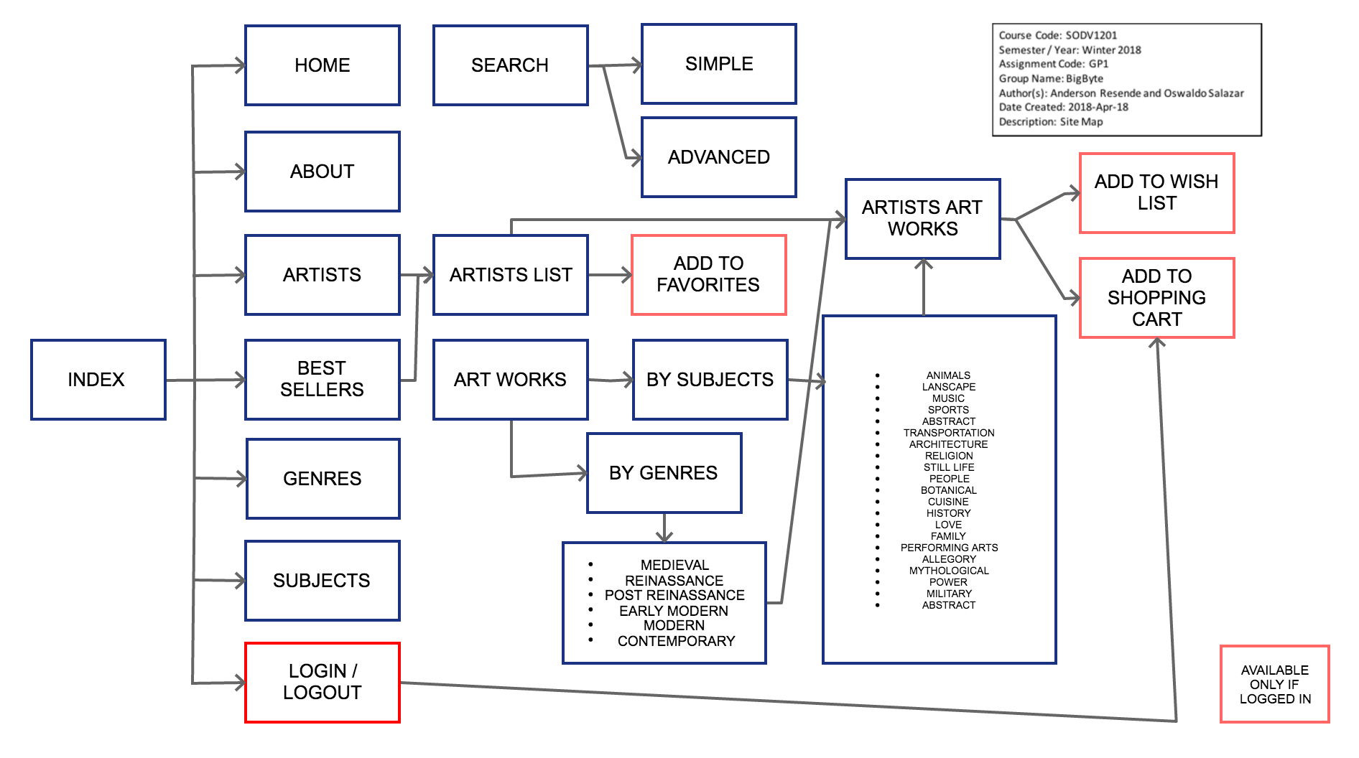

Slide 4

CRUD – Create / Read / Update / Delete
Create: Database used was provided
Read: Sample sql statement:
Used to retrieve and display DB data
sqlJoinPaintingAndArtists =
"SELECT art.Artists.ArtistID, art.Artists.FirstName, art.Artists.LastName
FROM art.Paintings
JOIN art.Artists
ON art.Paintings.ArtistID = art.Artists.ArtistID
WHERE PaintingID = :requestedPaintingID";

Slide 5
CRUD – Create / Read / Update / Delete
UPDATE: Sample Sql Statement:
Used to update tables in
the DB.
DELETE: No functionality was implemented for record deletion.
$sql =
"UPDATE art.Customers AS c
JOIN art.CustomerLogon
ON c.CustomerID = art.CustomerLogon.CustomerID
SET c.FirstName = :FirstName,
c.LastName = :LastName,
c.Address = :AddressCust,
c.City = :City,
c.Country = :Country,
c.Region= :Region,
c.Postal = :Postal,
c.Phone = :Phone
WHERE CustomerLogon.UserName = :userEmail";

Slide 6

Development Environment
Visual Studio was used as main tool for development.
All pages are tested in Chrome and Safari.
The use cases were discussed, along with strategies to follow.
Coding was troubleshoot by team members and other collaborators.
Repository maintained in Gitlab.

Slide 7
Lessons Learned
Team work is more effective when developing in the same physical space.
No technical issues were presented - All member used the same OS.
Use cases allowed for substantial project progress. Must have for future implementations.
Constant communication among team members is key.
Support from non-team members is invaluable.

Slide 8
Potential Improvements
Completion of Shopping Cart functionality.
Add Music and Videos as other art expressions – Challenging functionality on web environment.
Ensure accessibility functionality is available.

Slide 9
THANK YOU!

