Slide 1

Development of a Network Forensic Analytic System
Pitch Presentation Team 19
Zheng Xu
Junjie Guo

Slide 2

Outline
01
Why is it important?
why does that problem need to be solved?
02
What is the project?
What problem will the project solve?
03
Conclusion
Answers

Slide 3
01
Why is it important?
Solve the network security problem

Slide 4
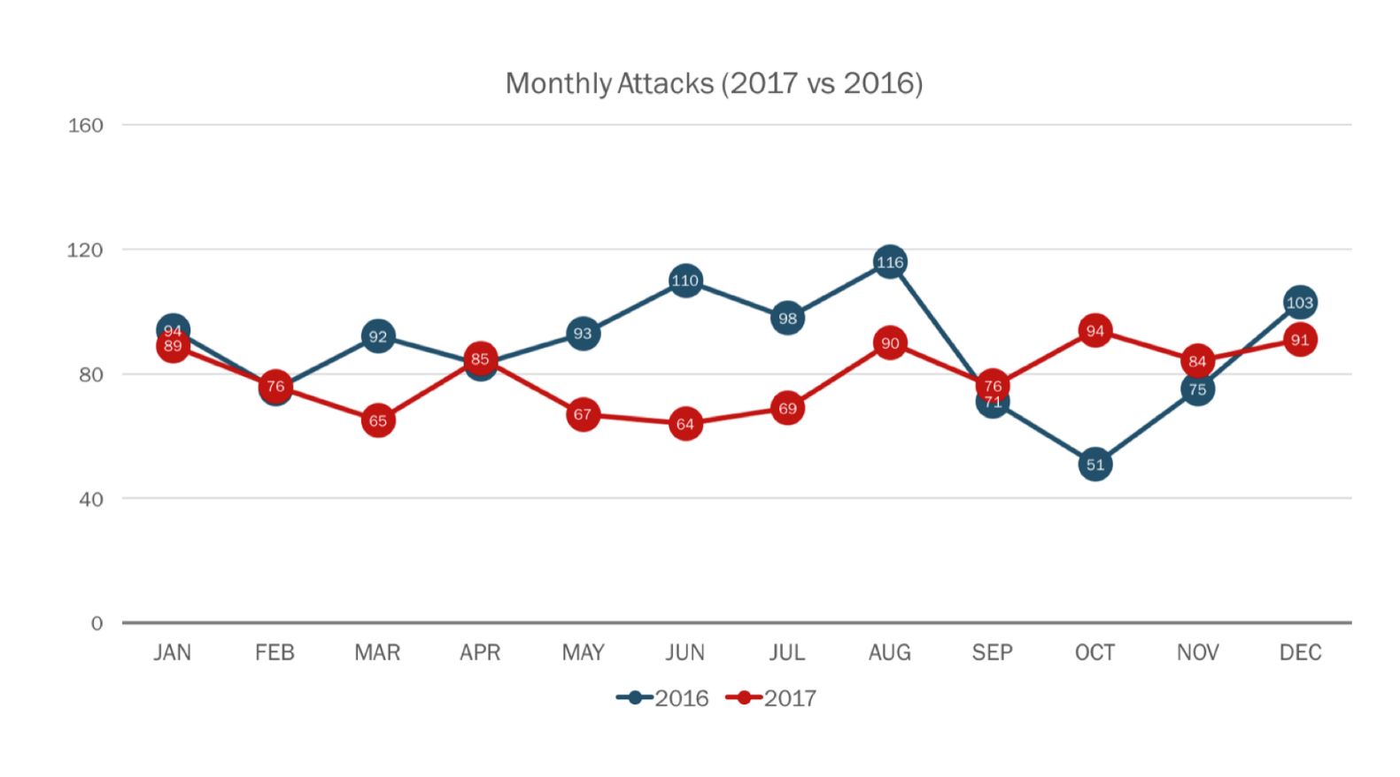

Slide 5
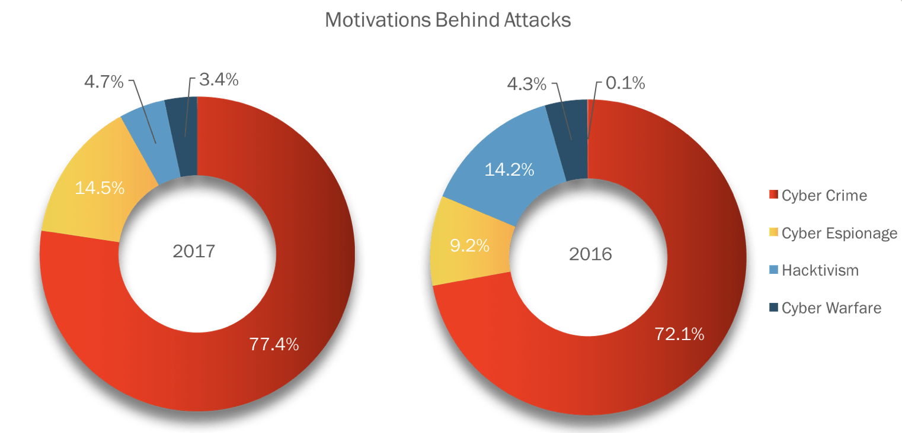

Slide 6
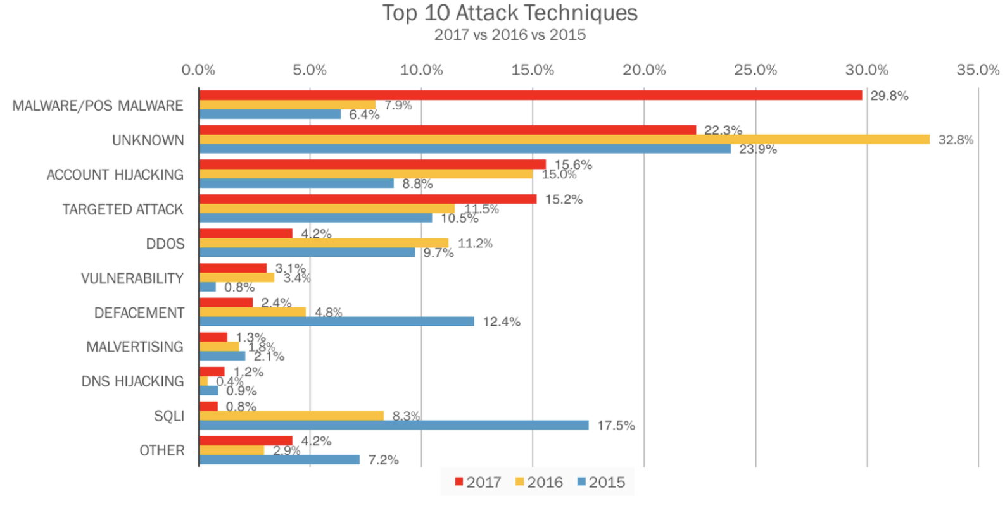

Slide 7
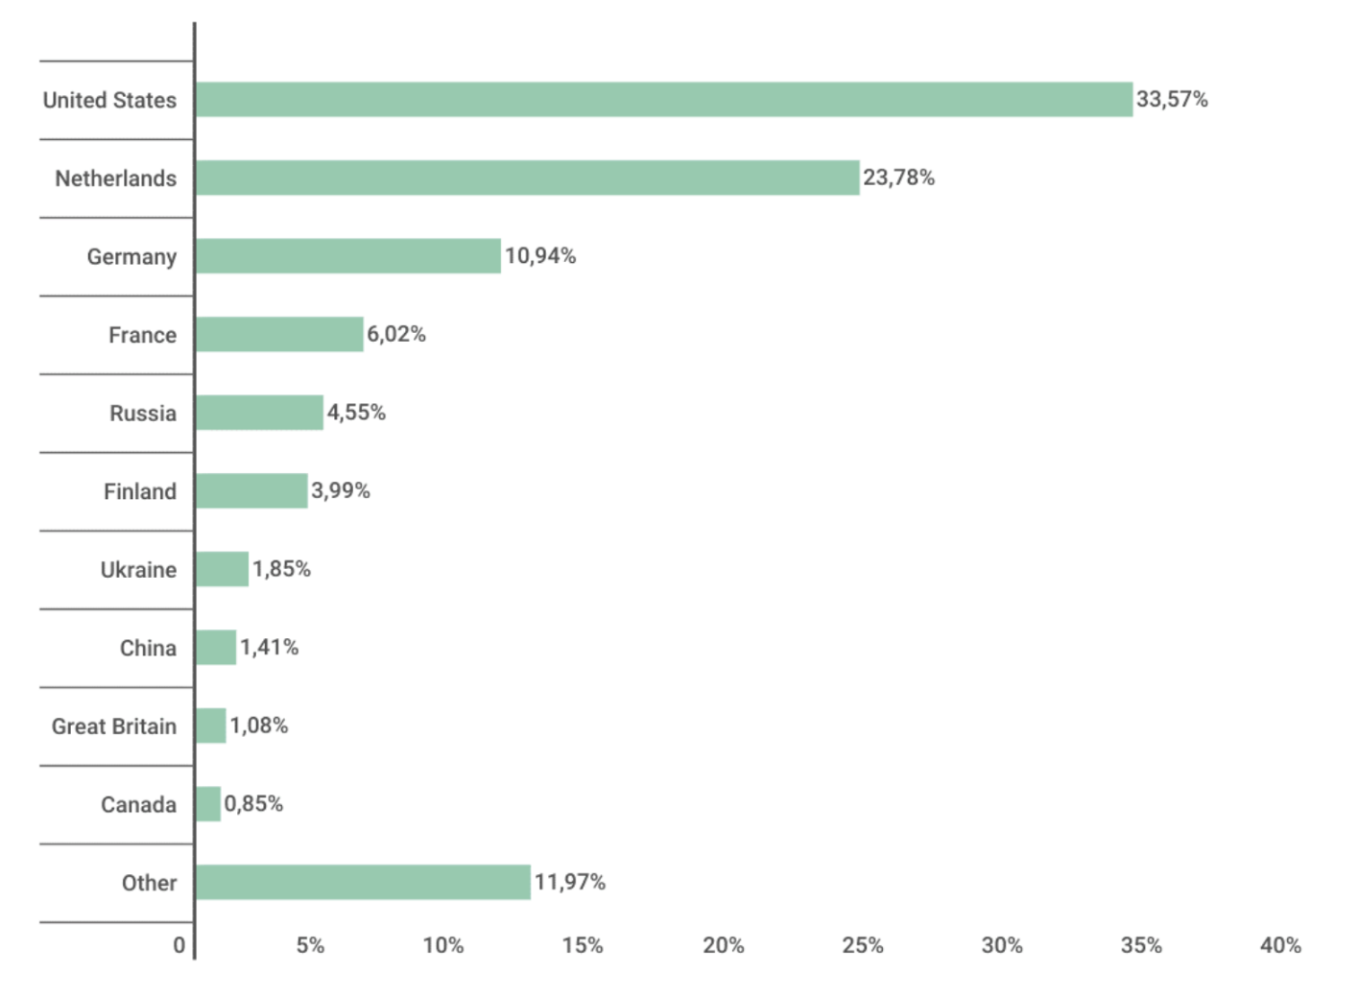
Distribution of web attack sources by country, November 2016 – October 2017

Slide 8
02
What is the project?
Identifying the source of a cyber attack

Slide 9


> Concept
Tools and methods
Goals
Network

Slide 10

Concept
> Tools and methods
Goals
Anomaly
detection
03
01
Apache Hadoop is a collection of open-source software utilities that facilitate using a network of many computers to solve problems involving massive amounts of data and computation.
In data mining, anomaly detection (also outlier detection) is the identification of items, events or observations which do not conform to an expected pattern or other items in a dataset.
01
03
02
KDD Cup Data
Signature-based
detection
04
This database contains a standard set of data to be audited, which includes a wide variety of intrusions simulated in a military network environment.
02
04
Signature-based detection monitors packets in the Network and compares with pre-configured and pre-determined attack patterns known as signatures.
(IP_connection_failed>15)

Slide 11


Concept
Tools and methods
> Goals
90%
Detection Rate > 90%
20s
Response Time < 20 sec
The aim of this project is to design and implement a network forensic analytic system that incorporates various big data analytics tools and platforms for achieving high level scalability, availability, reliability, and performance.

Slide 12
03
Conclusion

Slide 13
Identifying the source of a cyber attack
Solve the network security problem
The aim of this project is to design and implement a network forensic analytic system that incorporates various big data analytics tools and platforms for achieving high level scalability, availability, reliability, and performance.
After the occurrence of a cybercrime incident, there are issues such as the authenticity, validity, and timeliness of the evidence for ex post facto evidence collection. Accurate and timely retrieval of computer evidence from the Internet is the key to combating and deterring cybercrime.
WHAT
WHY

Slide 14
Thank you
References:
Passeri, P 2018, 2017 Cyber Attacks Statistics, HACKMAGEDDON, viewed 7 March 2018, <https://www.hackmageddon.com/2018/01/17/2017-cyber-attacks-statistics/>.
Kaspersky Security Bulletin, 2017, OVERALL STATISTICS FOR 2017, KASPERSKY lab, viewed 7 March 2018, <https://kasperskycontenthub.com/securelist/files/2017/12/KSB_statistics_2017_EN_final.pdf>.

