Slide 1

Development of a Network Forensic
Analytic System
Pitch Presentation Team 19
Client Prof. Ali Babar
Zheng Xu
Junjie Guo

Slide 2

Outline
01
Why is it important?
why does that problem need to be solved?
02
What is the project?
What problem will the project solve?
03
How to accomplish the project?
What are the detailed steps?
04
Conclusion
Answers

Slide 3
01
Why is it important?
It solves network security problems by detecting cyber-attacks

Slide 4
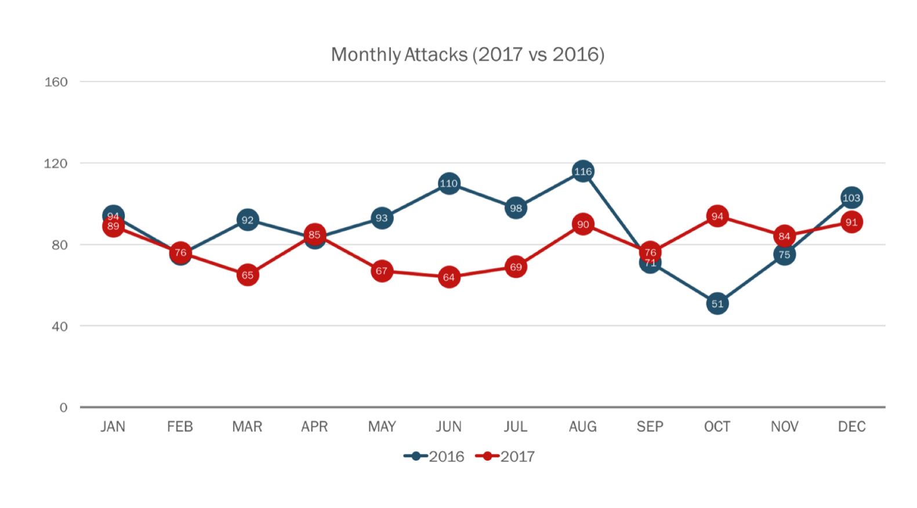
References:
Passeri, P 2018, 2017 Cyber Attacks Statistics, HACKMAGEDDON, viewed 7 March 2018, <https://www.hackmageddon.com/2018/01/17/2017-cyber-attacks-statistics/>.

Slide 5
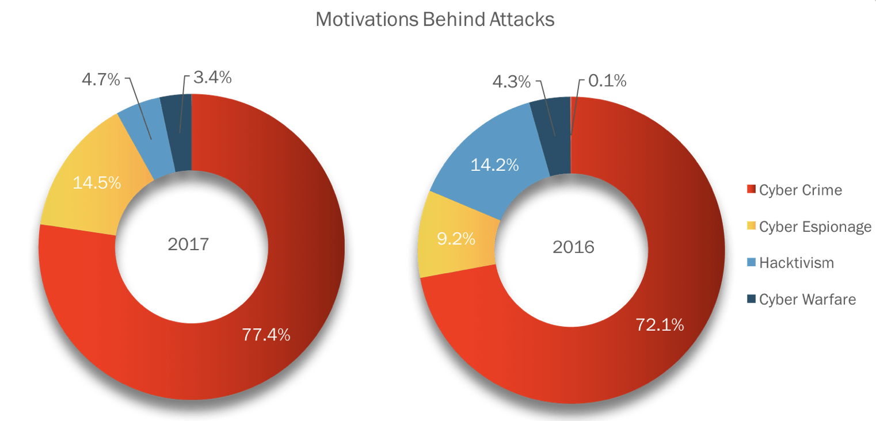
References:
Passeri, P 2018, 2017 Cyber Attacks Statistics, HACKMAGEDDON, viewed 7 March 2018, <https://www.hackmageddon.com/2018/01/17/2017-cyber-attacks-statistics/>.

Slide 6
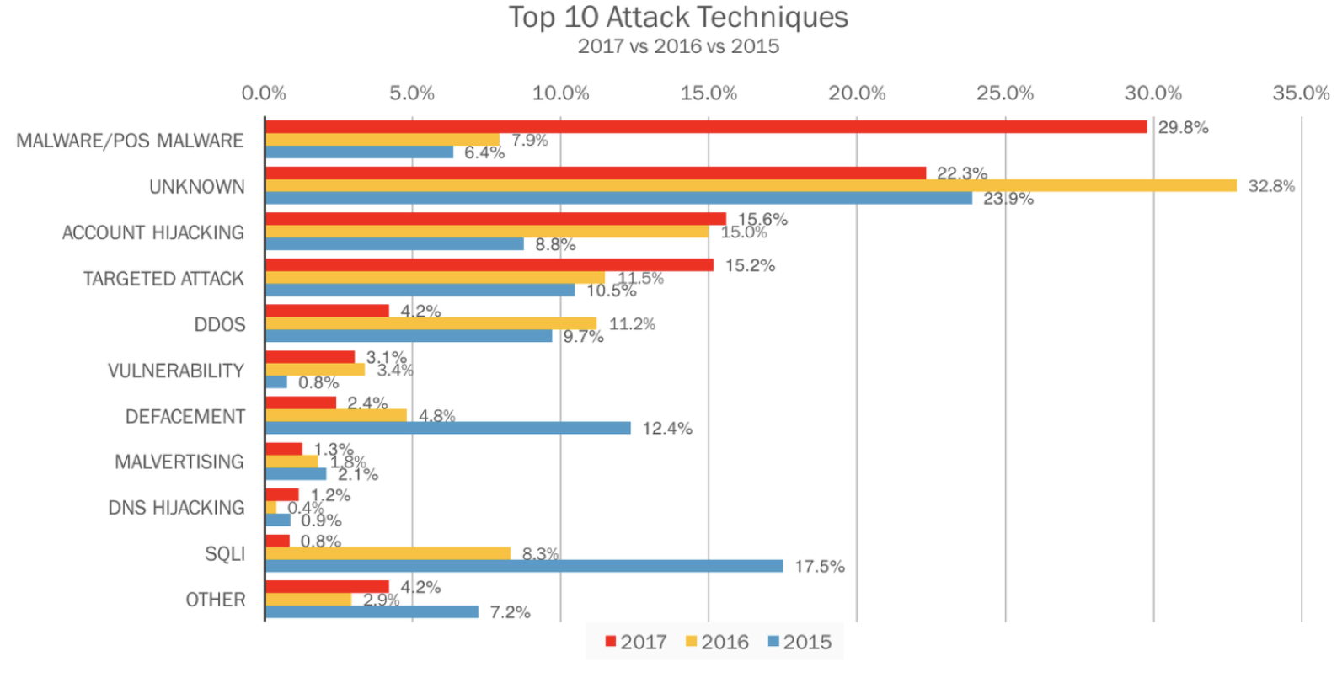
References:
Passeri, P 2018, 2017 Cyber Attacks Statistics, HACKMAGEDDON, viewed 7 March 2018, <https://www.hackmageddon.com/2018/01/17/2017-cyber-attacks-statistics/>.

Slide 7
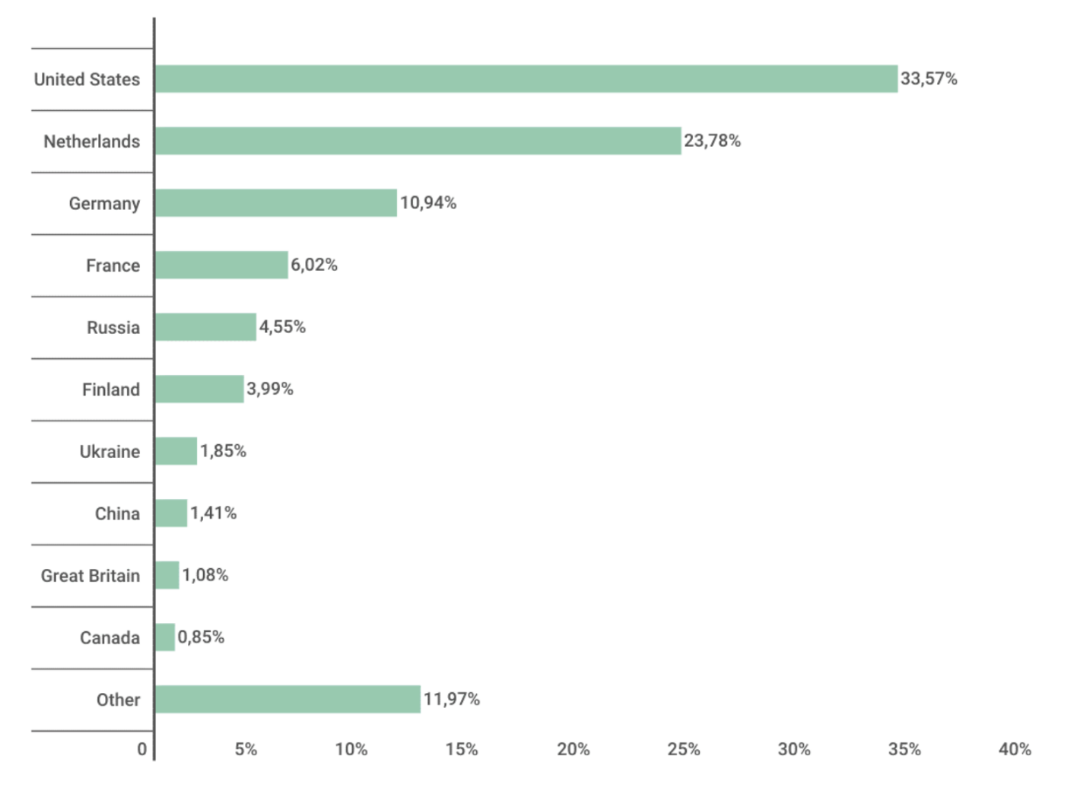
Distribution of web attack sources by country, November 2016 – October 2017
References:
Kaspersky Security Bulletin, 2017, OVERALL STATISTICS FOR 2017, KASPERSKY lab, viewed 7 March 2018, <https://kasperskycontenthub.com/securelist/files/2017/12/KSB_statistics_2017_EN_final.pdf>.

Slide 8
02
What is the project?
Detecting cyber attacks with high accuracy and reliability within short response time

Slide 9


> Concept
Tools and methods
Goals
Network

Slide 10













> Concept
Tools and methods
Goals
Data Source
Visualization
Training Phase
Network Activity
Dashboard
Training Data
Data Preparation
Model Training
Database Activity
Attack
Detection
Model
User
Testing Phase
Report
Application Activity
Testing Data
Data Preparation
Email
Notification
User Activity

Slide 11

Concept
> Tools and methods
Goals
Machine learning
algorithms
01
Apache Hadoop is a collection of open-source software utilities that facilitate using a network of many computers to solve problems involving massive amounts of data and computation.
Apriori
Bottom-up subset exploration finds any maximal subset S only after all 2^|S|-1 of its proper subsets.
ANOVA
No statistical significance
C4.5(decision tree)
Small variation in data can lead to different decision trees (especially when the variables are close to each other in value)
03
01
02
KDD Cup Data
03
This database contains a standard set of data to be audited, which includes a wide variety of intrusions simulated in a military network environment.
02

Slide 12


Concept
Tools and methods
> Goals
90%
Detection Rate > 90%
20s
Response Time < 20 sec
The aim of this project is to design and implement a network security analytic system that incorporates state of the art machine learning algorithm and big data tools for achieving high level scalability, availability, accuracy and response time.

Slide 13
03
How to accomplish the project?

Slide 14
Learn Hadoop/MapReduce
Explore KDD data set
Learn about machine learning algorithm
Implement the system
Train the system with training KDD data set
Test the system with testing KDD data set
Record detection rate, false positive rate, training time, prediction time.

Slide 15
04
Conclusion

Slide 16
Solve the network security problem
Detecting cyber-attacks
After the occurrence of a cyber attack, there are issues such as the authenticity, validity, and timeliness of the evidence for ex post facto evidence collection. Due to the huge amount of network traffic data, it is quite challenging for traditional tools to cope up with the speed and amount of data.
The aim of this project is to design and implement a network security analytic system that incorporates state of the art machine learning algorithm and big data tools for achieving high level scalability, availability, reliability, and response time.
WHY
WHAT

Slide 17
Thank you

