Slide 1

Development of a Network Forensic
Analytic System
Pitch Presentation Team 19
Client Prof. Ali Babar
Zheng Xu
Junjie Guo

Slide 2

Outline
01
Why is it important?
why does that problem need to be solved?
02
What is the project?
What problem will the project solve?
03
How to accomplish the project?
What are the detailed steps?
04
Conclusion
Answers

Slide 3
01
Why is it important?
It solves network security problems

Slide 4
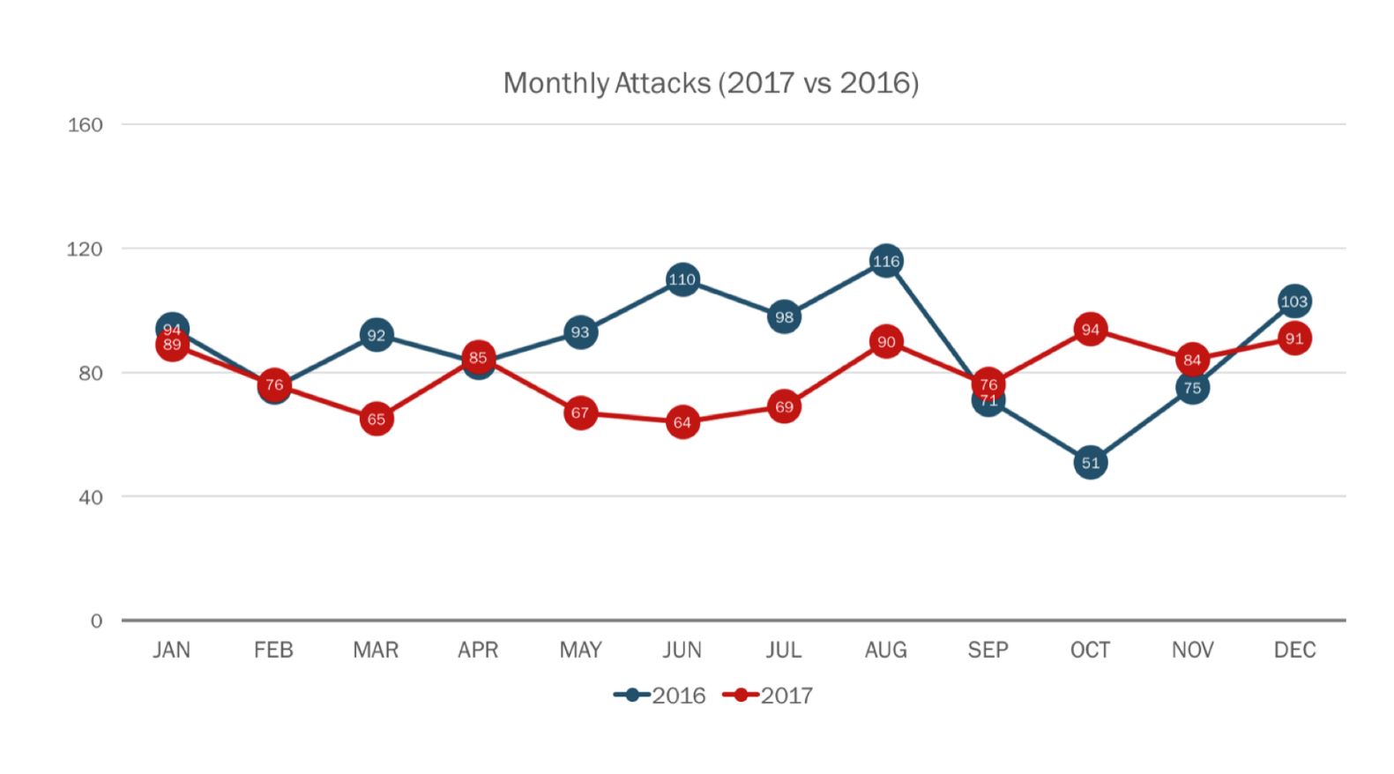
看下reference是不是对的
References:
Passeri, P 2018, 2017 Cyber Attacks Statistics, HACKMAGEDDON, viewed 7 March 2018, <https://www.hackmageddon.com/2018/01/17/2017-cyber-attacks-statistics/>.

Slide 5
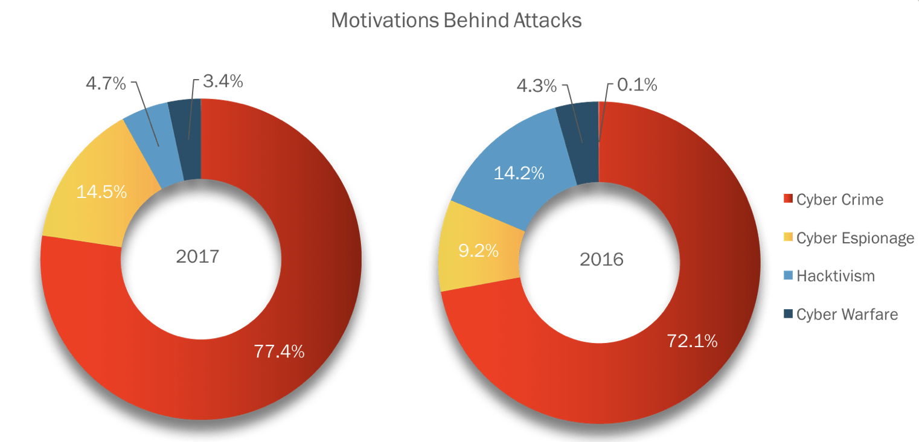
References:
Passeri, P 2018, 2017 Cyber Attacks Statistics, HACKMAGEDDON, viewed 7 March 2018, <https://www.hackmageddon.com/2018/01/17/2017-cyber-attacks-statistics/>.

Slide 6
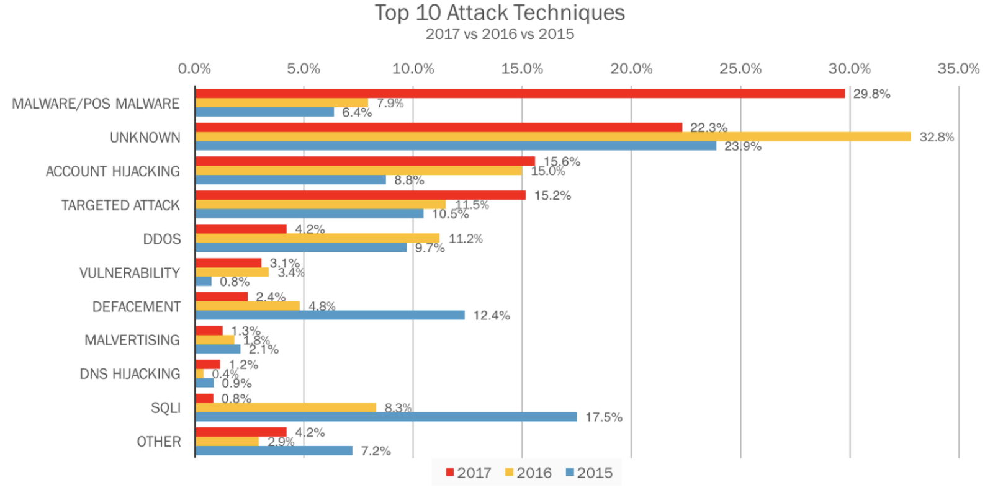
References:
Kaspersky Security Bulletin, 2017, OVERALL STATISTICS FOR 2017, KASPERSKY lab, viewed 7 March 2018, <https://kasperskycontenthub.com/securelist/files/2017/12/KSB_statistics_2017_EN_final.pdf>.

Slide 7
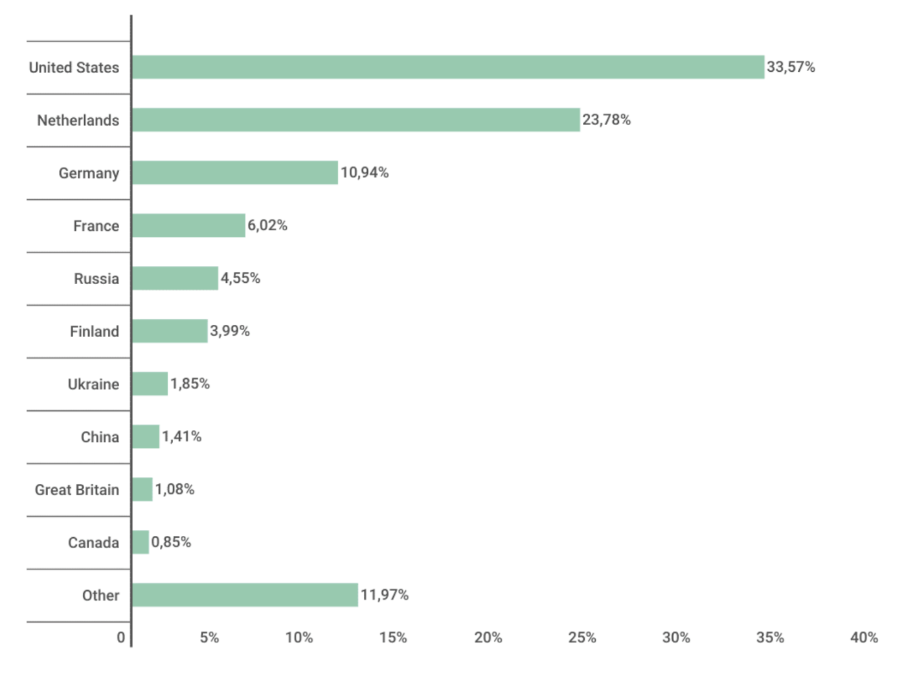
Distribution of web attack sources by country, November 2016 – October 2017
References:
Kaspersky Security Bulletin, 2017, OVERALL STATISTICS FOR 2017, KASPERSKY lab, viewed 7 March 2018, <https://kasperskycontenthub.com/securelist/files/2017/12/KSB_statistics_2017_EN_final.pdf>.

Slide 8
02
What is the project?
Detecting cyber attacks with high accuracy, short response time, and reliability

Slide 9


> Concept
Tools and methods
Goals
Network

Slide 10













> Concept
Tools and methods
Goals
Data Source
Visualization
Training Phase
Network Activity
Dashboard
Training Data
Data Preparation
Model Training
Database Activity
Attack
Detection
Model
User
Testing Phase
Report
Application Activity
Testing Data
Data Preparation
Email
Notification
User Activity

Slide 11

Concept
> Tools and methods
Goals
Machine learning
algorithms
03
01
Apache Hadoop is a collection of open-source software utilities that facilitate using a network of many computers to solve problems involving massive amounts of data and computation.
Apriori
ANOVA
不太记得这里改什么了
01
03
02
KDD Cup Data
Signature-based
detection
04
This database contains a standard set of data to be audited, which includes a wide variety of intrusions simulated in a military network environment.
02
04
(IP_connection_failed>15)
{
System.out.printin(“192…..is an attacker”)
}

Slide 12


Concept
Tools and methods
> Goals
90%
Detection Rate > 90%
20s
Response Time < 20 sec
The aim of this project is to design and implement a network security analytic system that incorporates state of the art machine learning algorithm and big data tools for achieving high level scalability, availability, reliability, and response time.

Slide 13
03
How to accomplish the project?

Slide 14
Learn Hadoop/MapReduce
Explore KDD data set
Learn about machine learning algorithm
Implement the system
Train the system with KDD data set
Test the system with testing KDD data set
Record detection rate, false positive rate, training time, prediction time.

Slide 15
04
Conclusion

Slide 16
看下的他的comment
Solve the network security problem
Detecting cyber-attacks
After the occurrence of a cybercrime incident, there are issues such as the authenticity, validity, and timeliness of the evidence for ex post facto evidence collection. Accurate and timely retrieval of computer evidence from the Internet is the key to combating and deterring cybercrime.
The aim of this project is to design and implement a network security analytic system that incorporates state of the art machine learning algorithm and big data tools for achieving high level scalability, availability, reliability, and response time.
WHY
WHAT

Slide 17
Thank you

