Slide 2
RESOLVER DATA ANALYSIS
AMCI CONNECTED TO EL7211
PRESENTED BY <NAME NAMESON>

Slide 3
Agenda
1 Normal connection
2 Voltage divider on excitation coil
3 Voltage divider on sin and cos coils

Slide 4
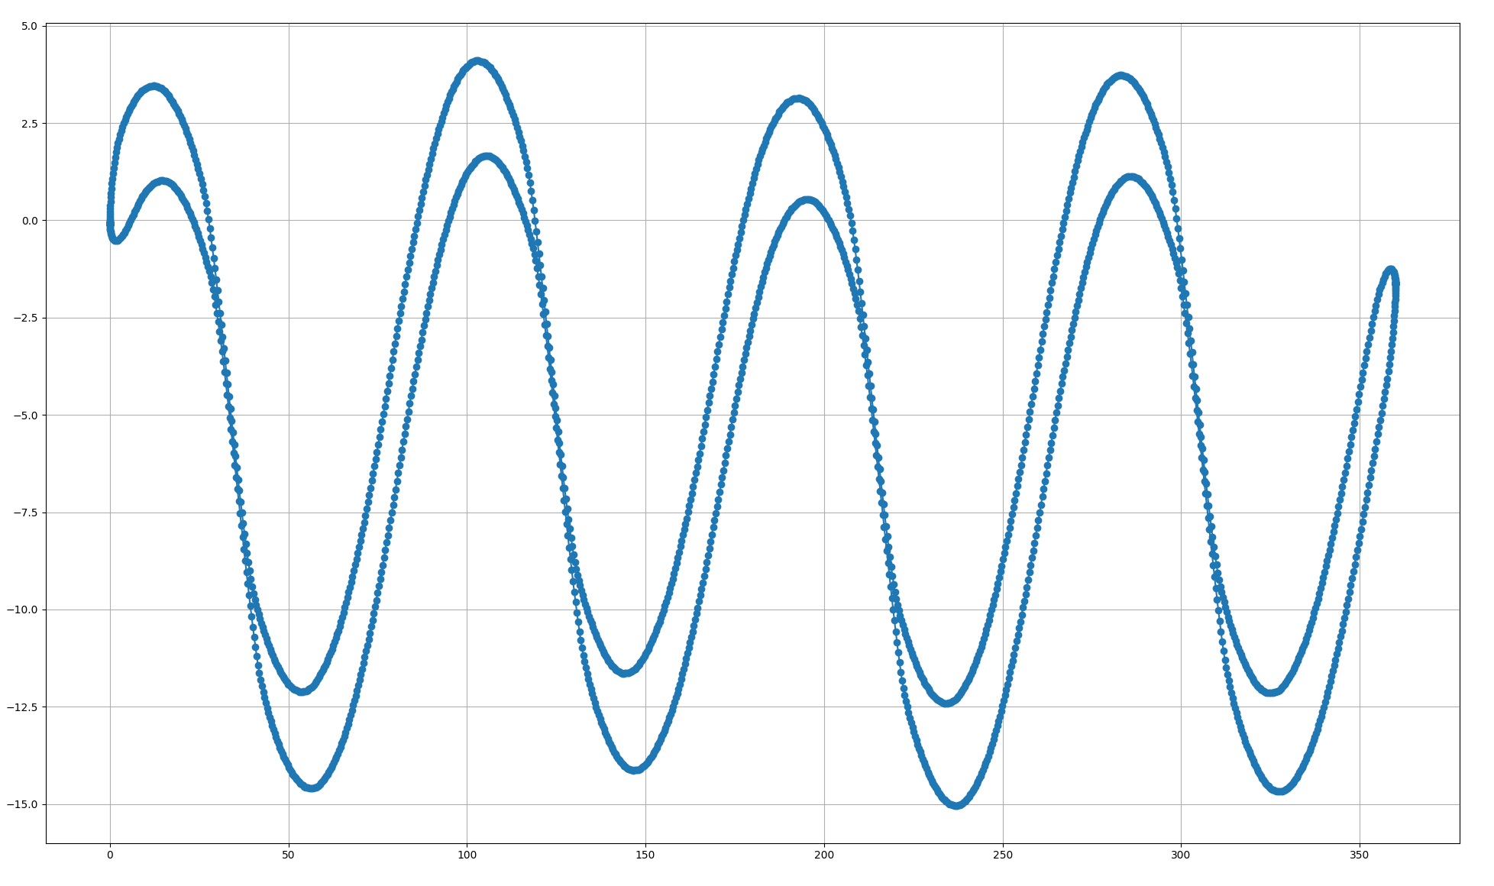
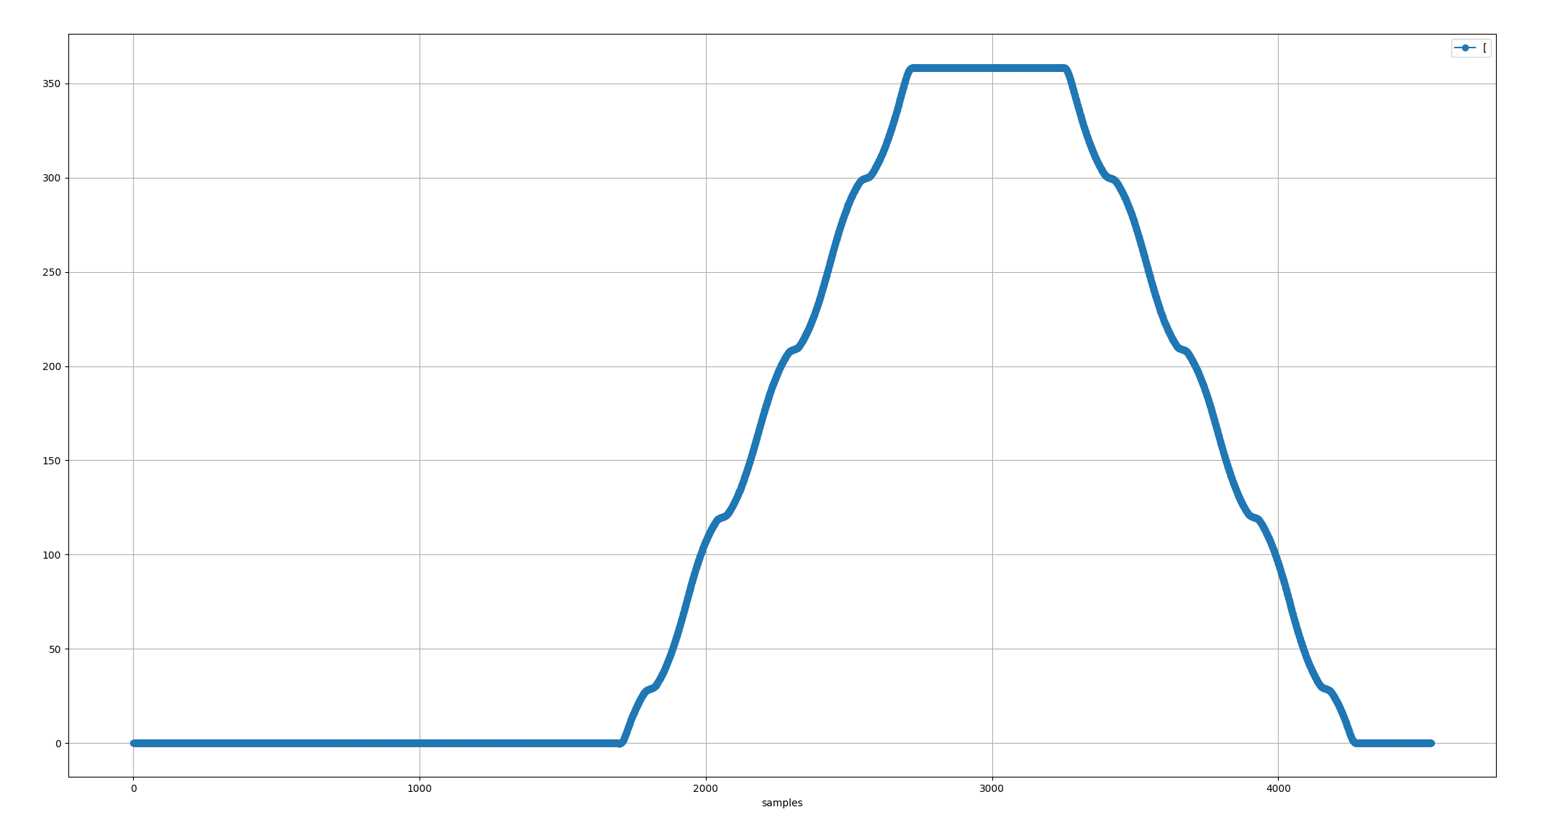
Normal connection
Position error over one revolution in both direction
Error [deg]
Position [deg]

Slide 5
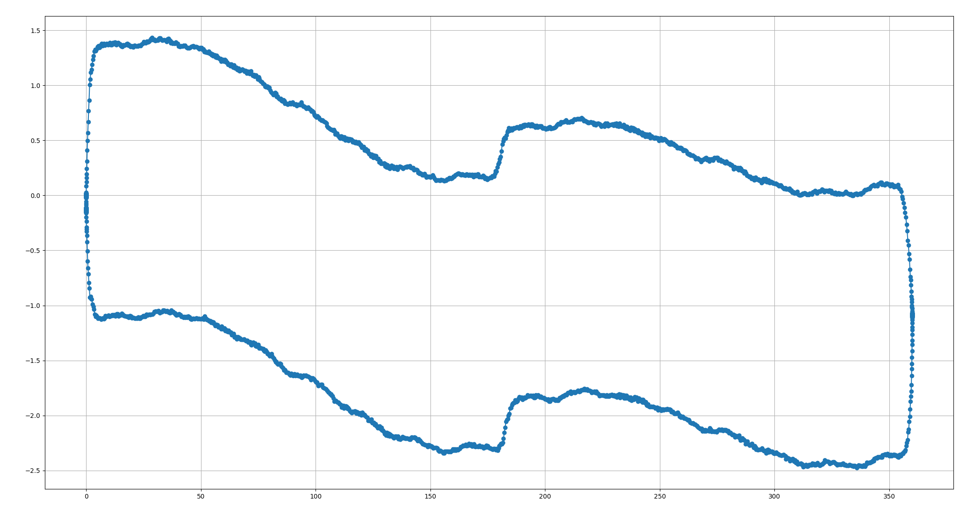
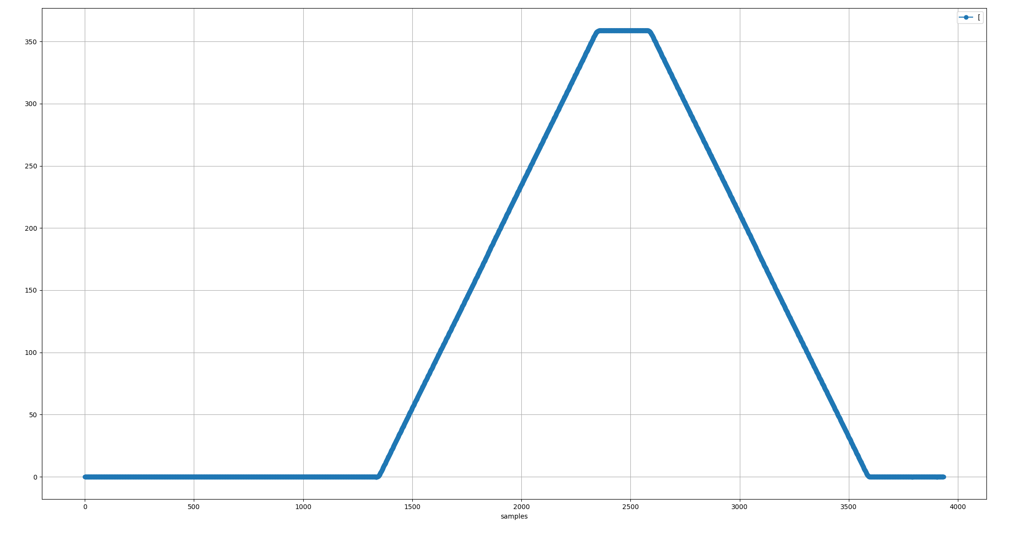
Voltage divider on excitation coil
Position error over one revolution in both direction
Error [deg]
Position [deg]

Slide 6
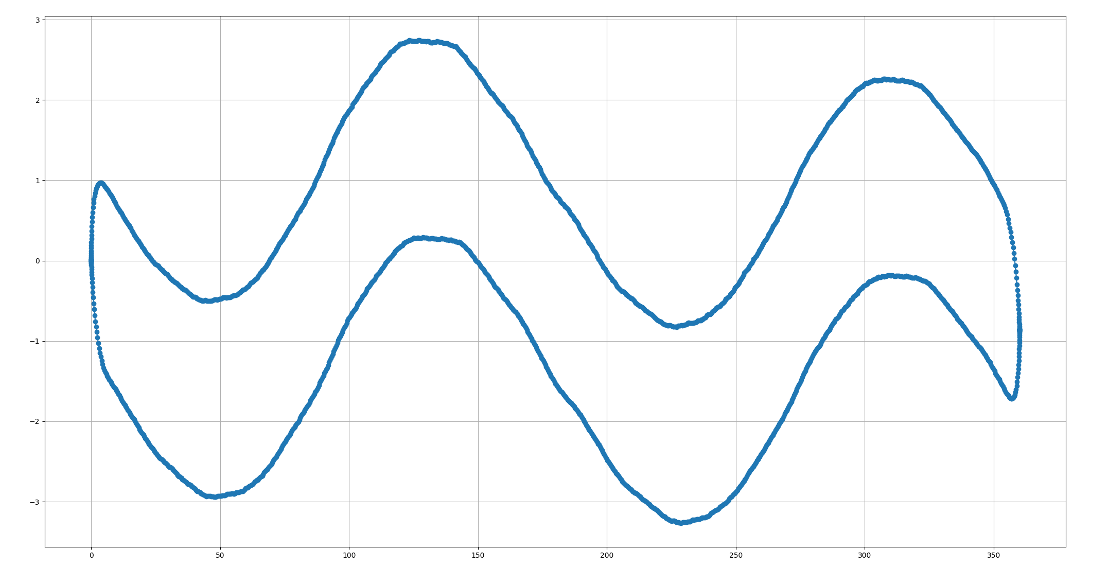
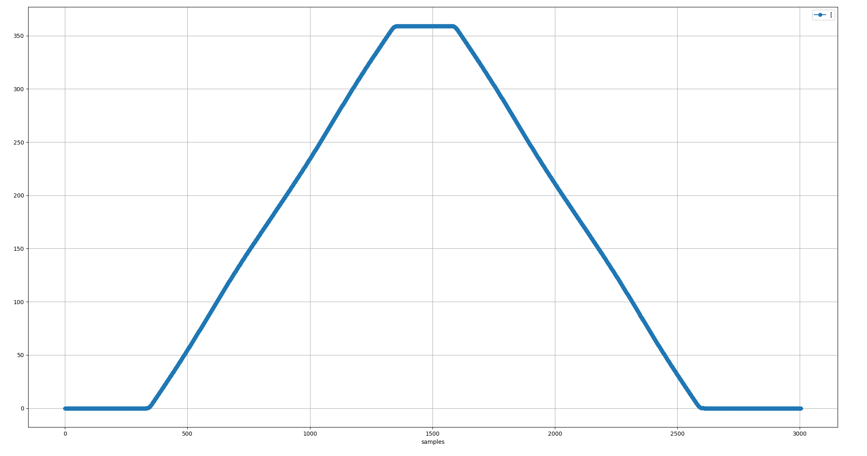
Voltage divider on sin and cos coils
Position error over one revolution in both direction
Error [deg]
Position [deg]

Slide 7
Finish presentation

