Slide 2
RESOLVER DATA ANALYSIS
AMCI CONNECTED TO EL7211
PRESENTED BY

Slide 3
Agenda
1 Normal connection
2 Voltage divider on excitation coil
3 Voltage divider on sin and cos coils

Slide 4
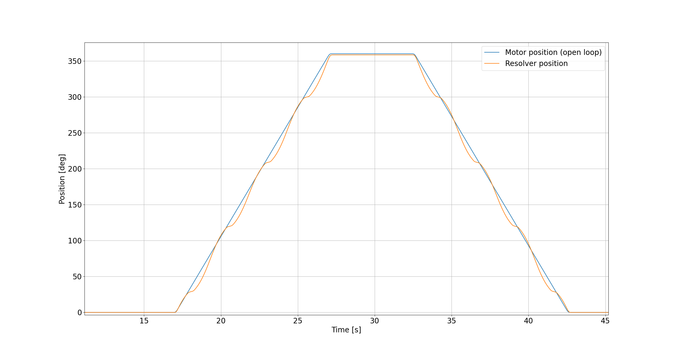
Normal connection
Position error over one revolution in both directions

Slide 5
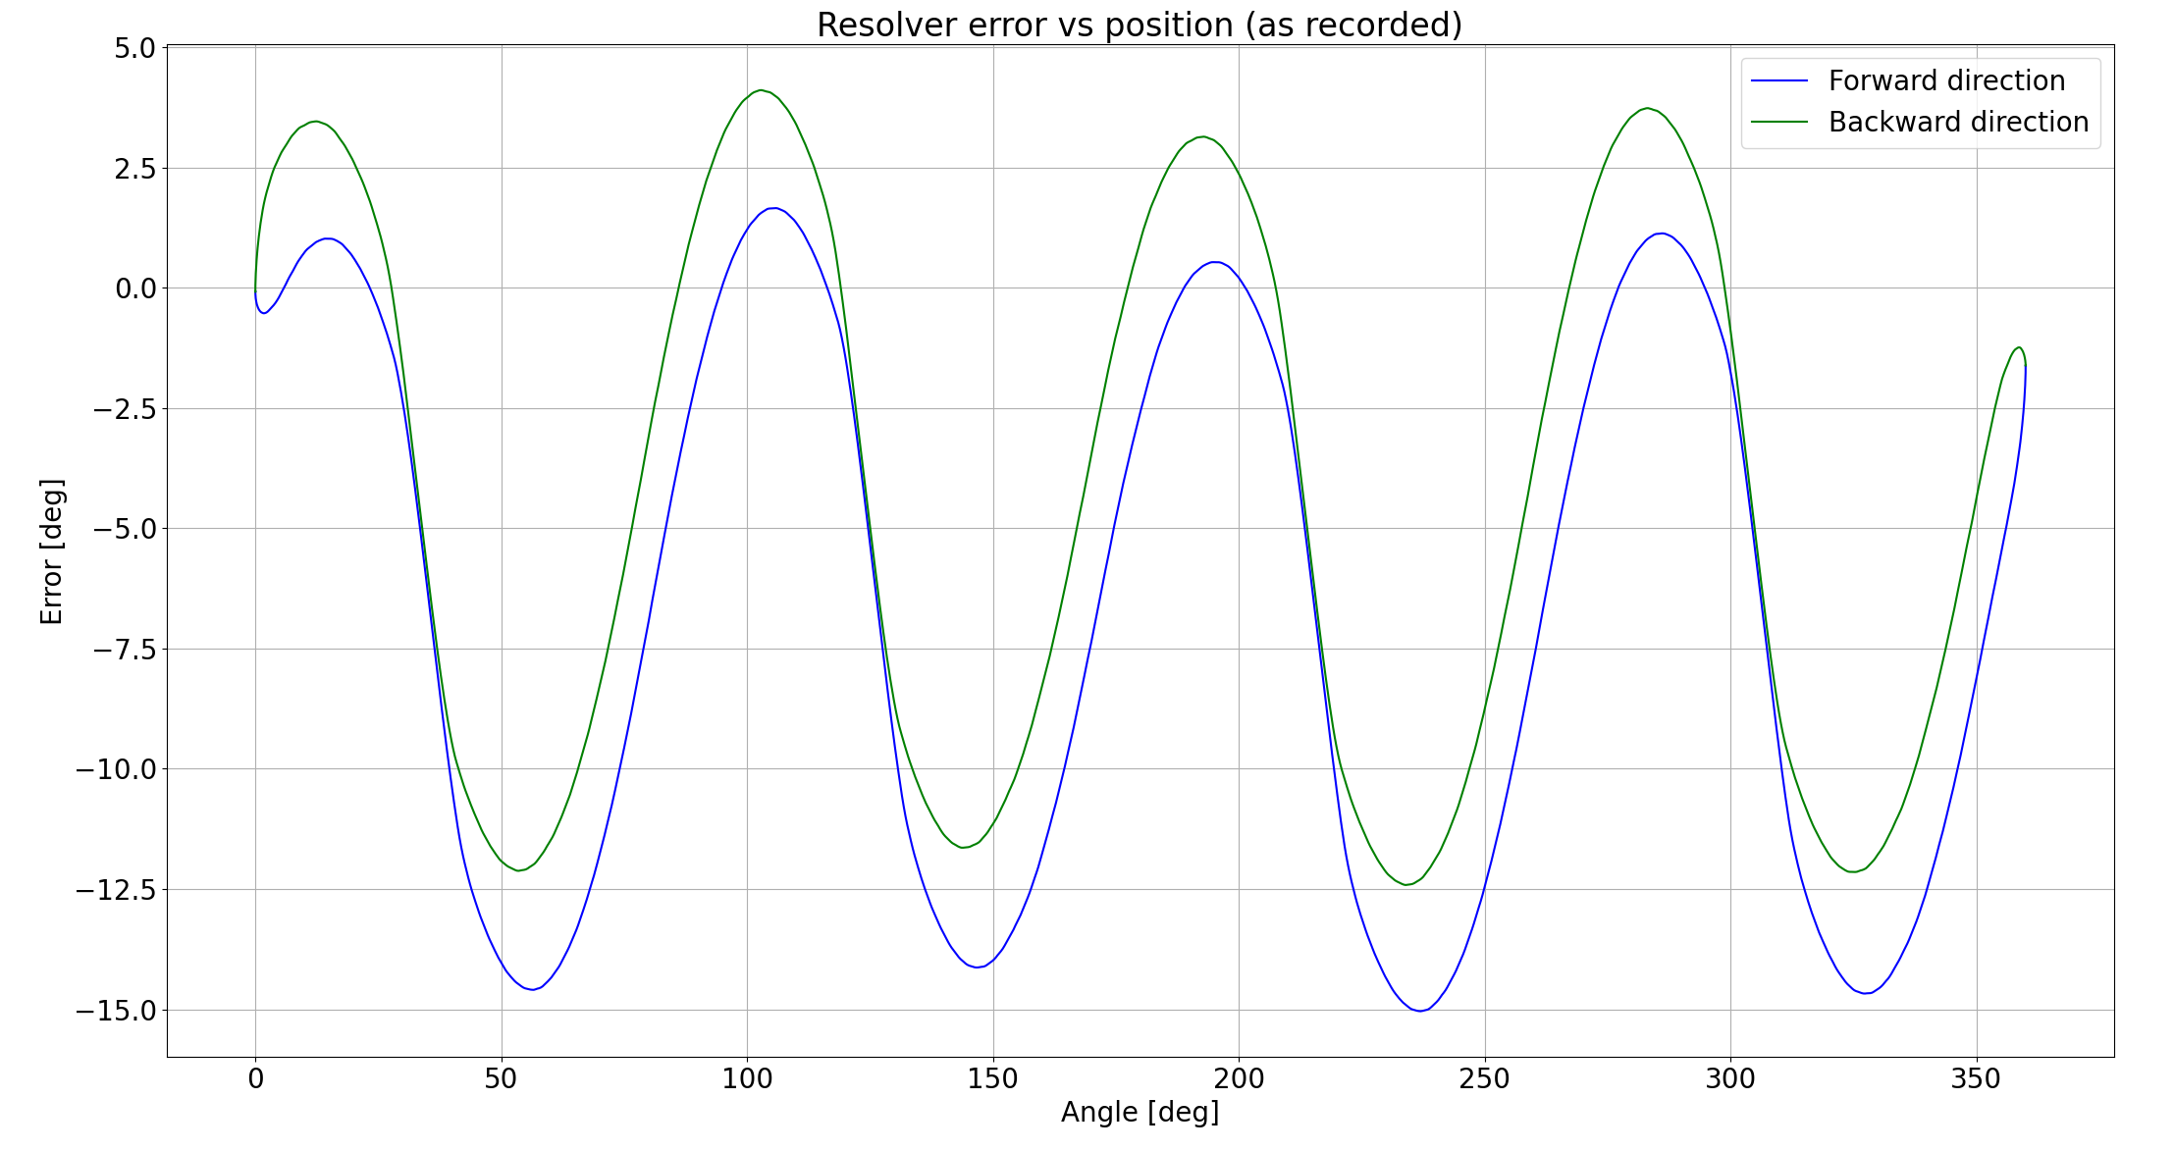
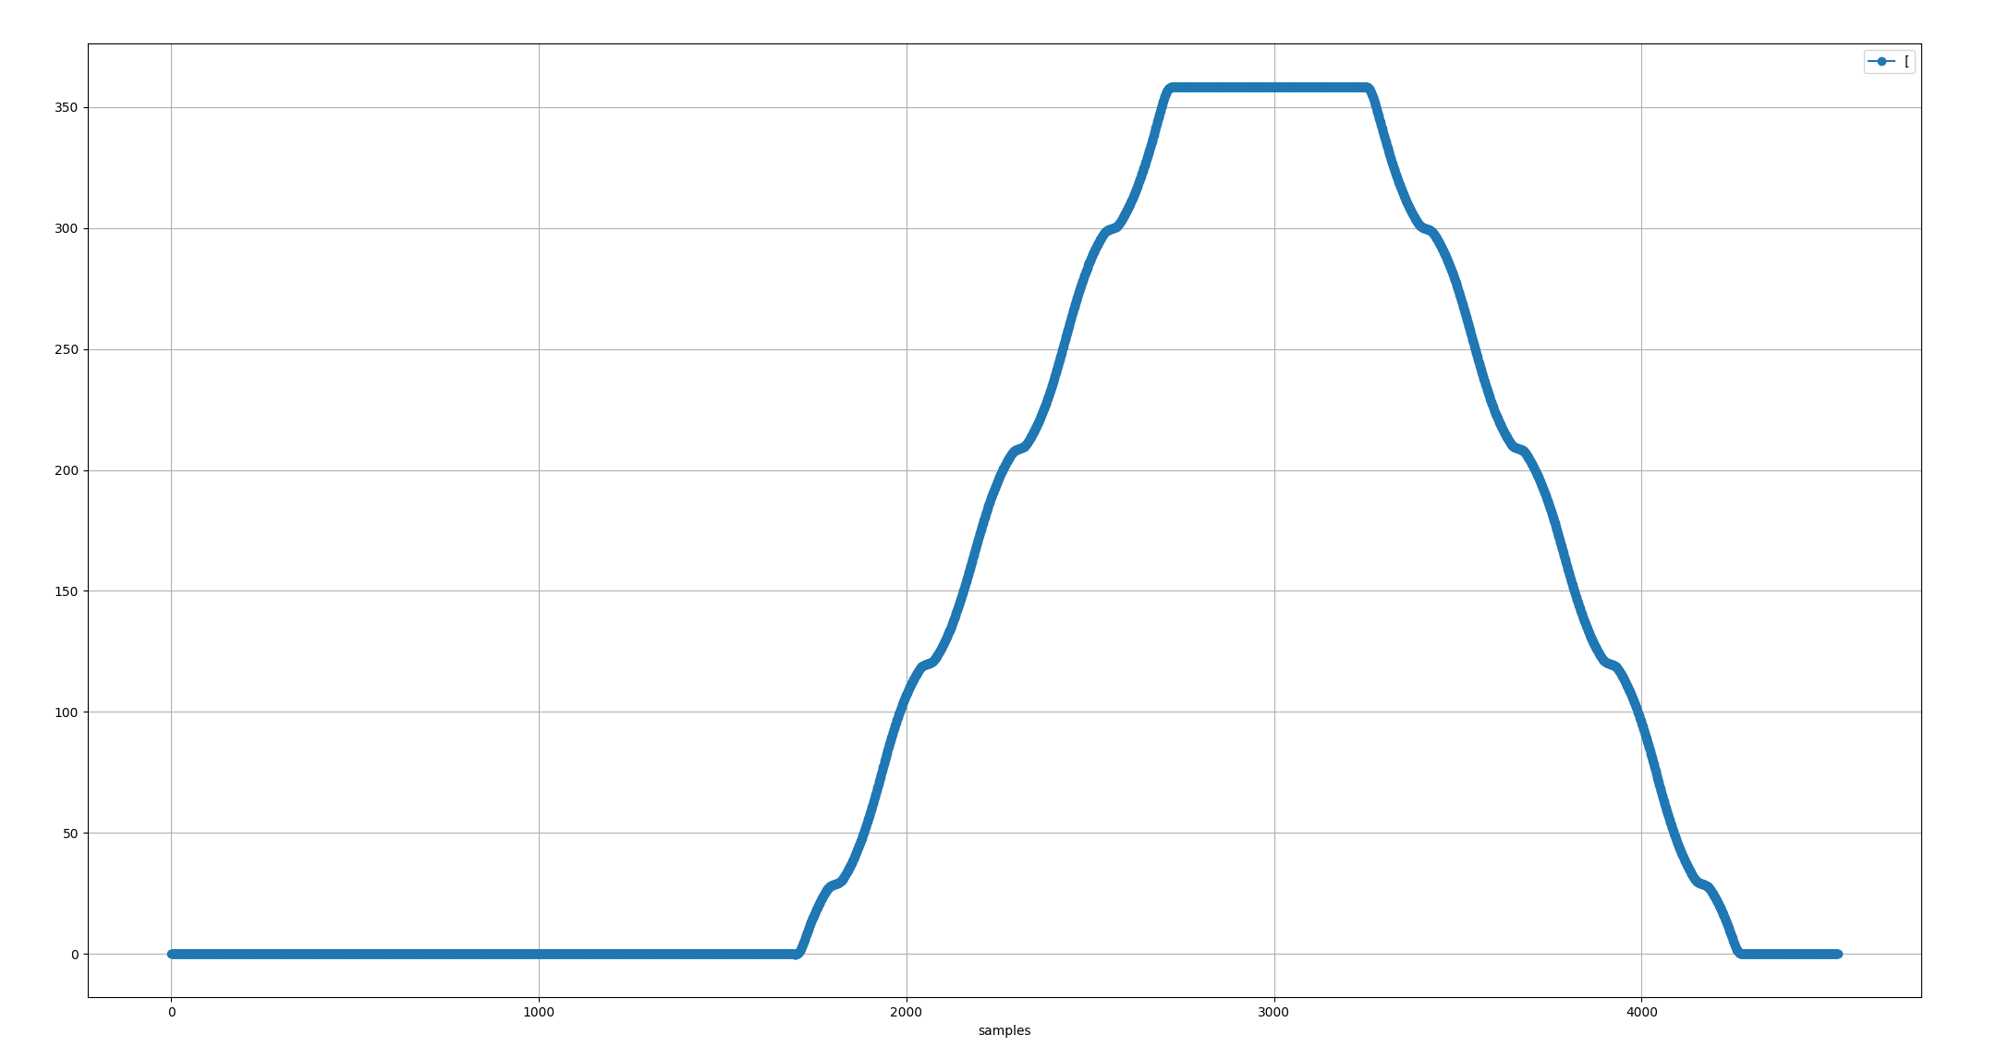
Normal connection
Position error over one revolution in both directions
1. Start
3. End
2. One rev
Error [deg]: -15.05..4.11

Slide 6
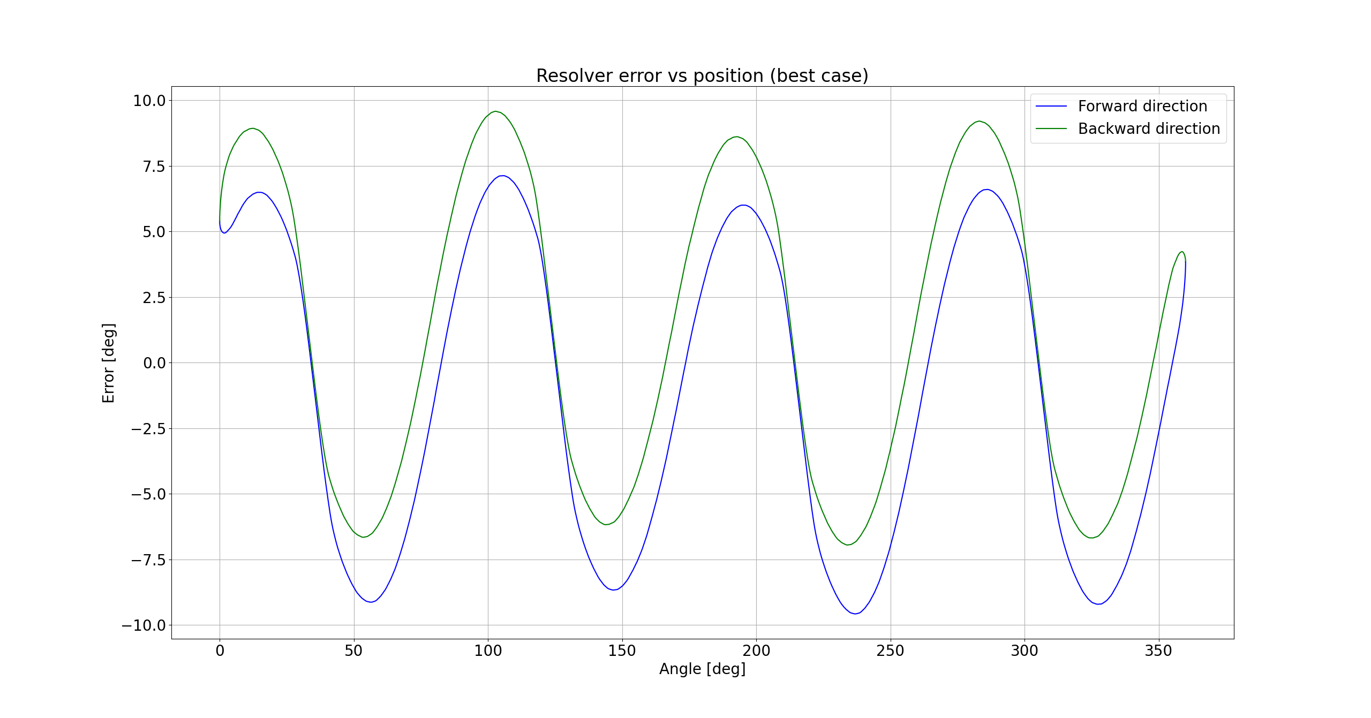
Normal connection
Position error over one revolution in one direction (best case)
Error [deg]: -9.57..9.57

Slide 7
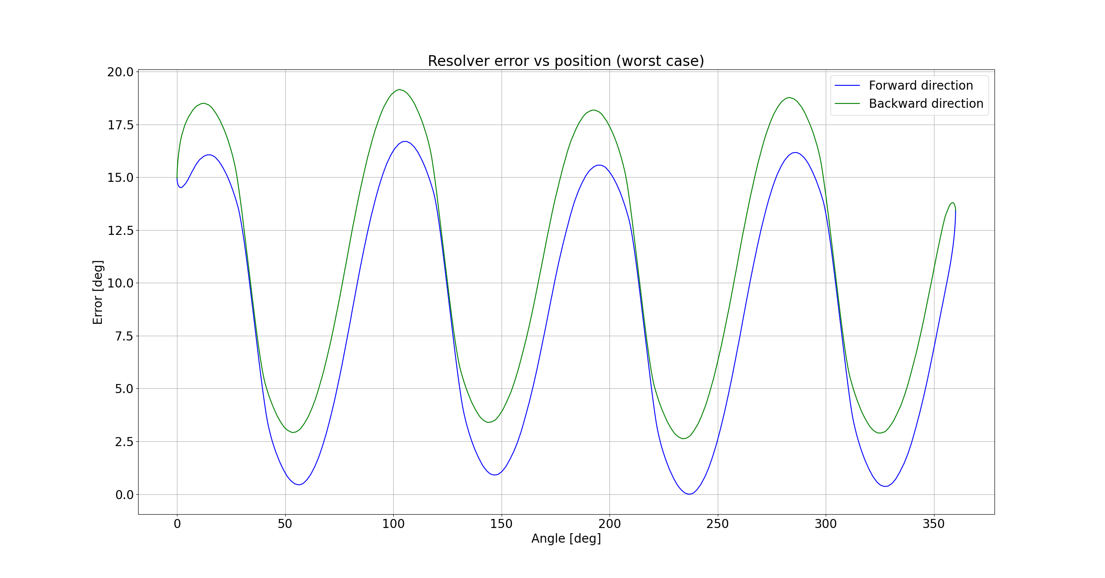
Normal connection
Position error over one revolution in one direction (worst case)
Error [deg]: 0..19.15

Slide 8
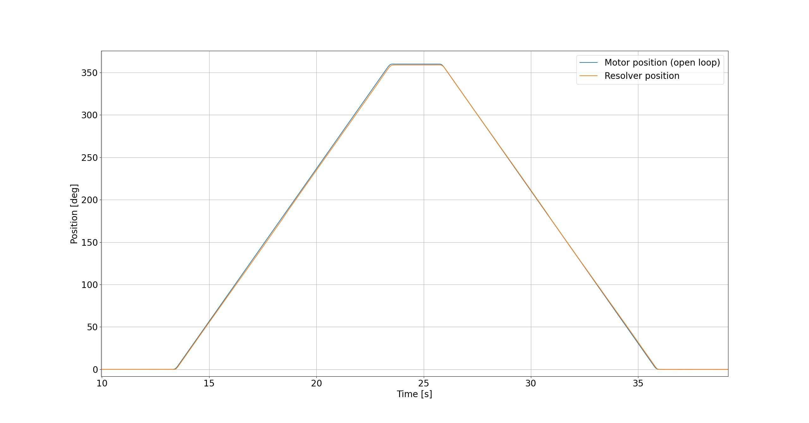
Voltage divider on excitation coil
Position error over one revolution in both directions

Slide 9
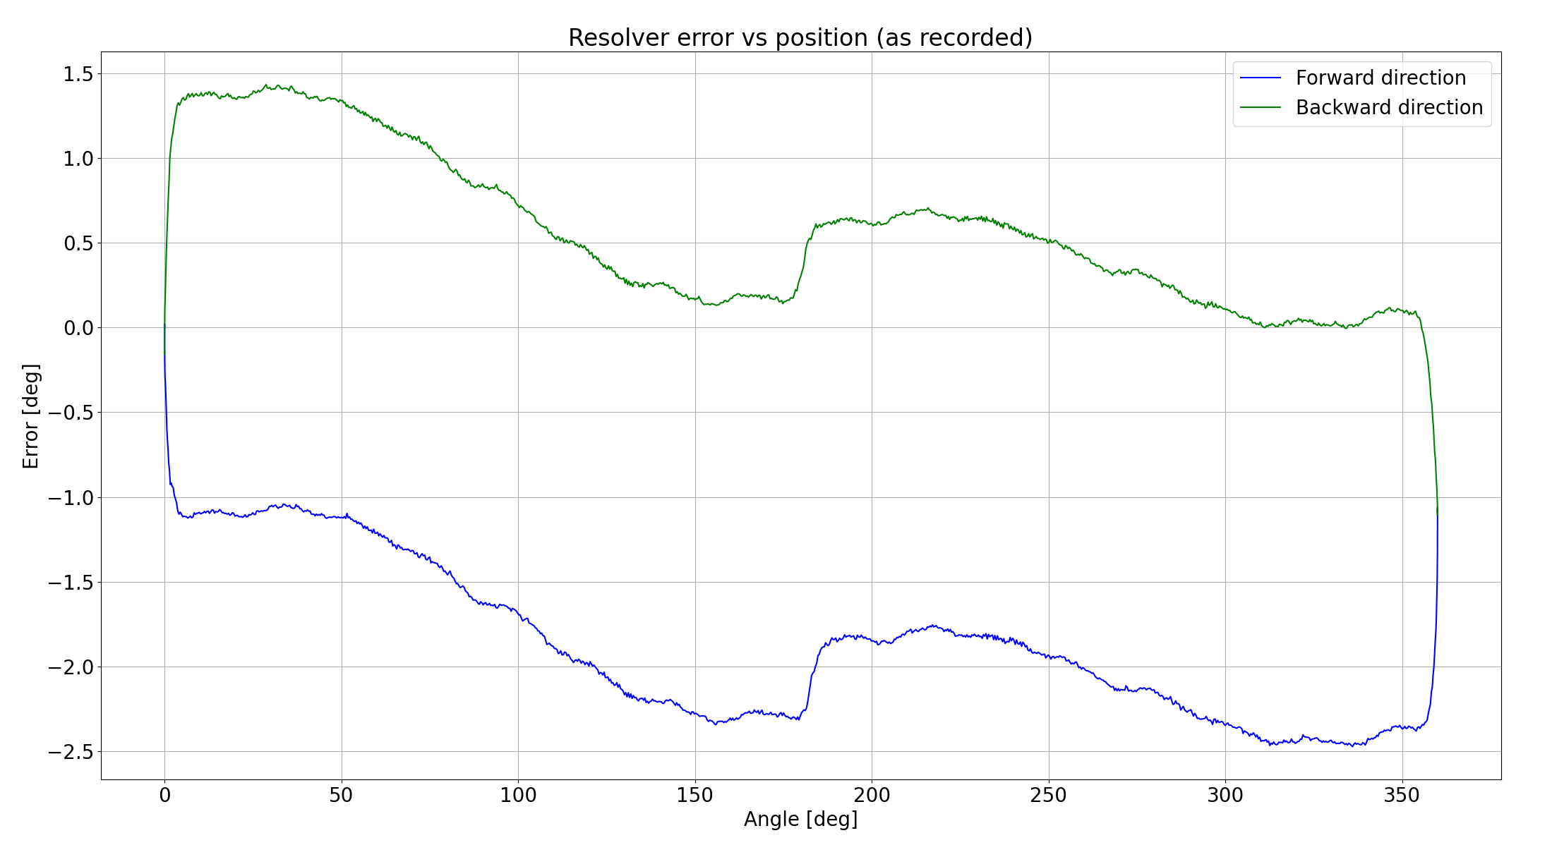
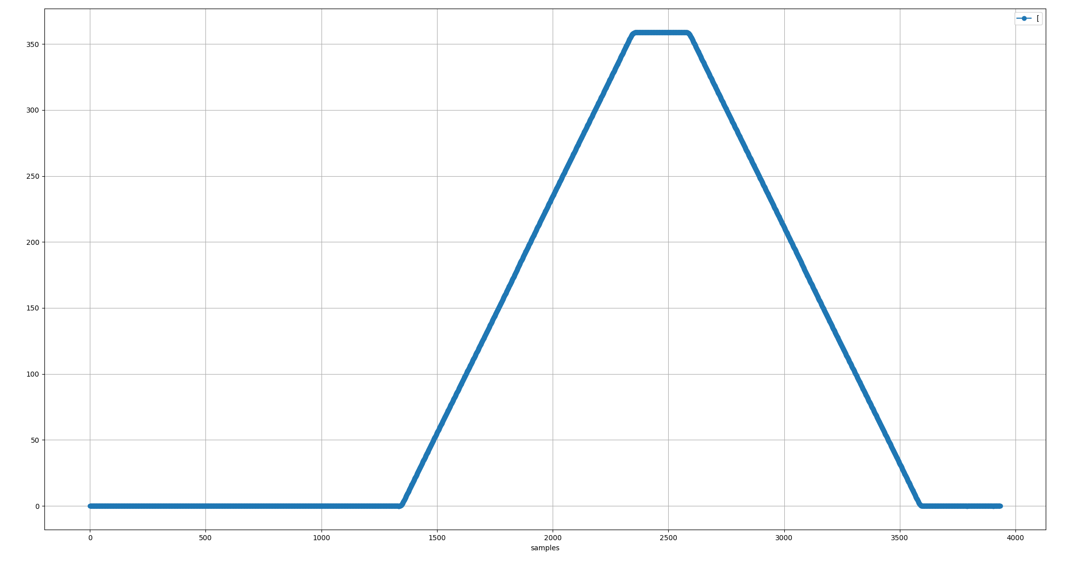
Voltage divider on excitation coil
Position error over one revolution in both directions
Error [deg]: -2.47..1.44

Slide 10

Voltage divider on excitation coil
Position error over one revolution in one direction (best case)
Error [deg]: -1.95..1.95

Slide 11

Voltage divider on excitation coil
Position error over one revolution in one direction (worst case)
Error [deg]: 0..3.91

Slide 12
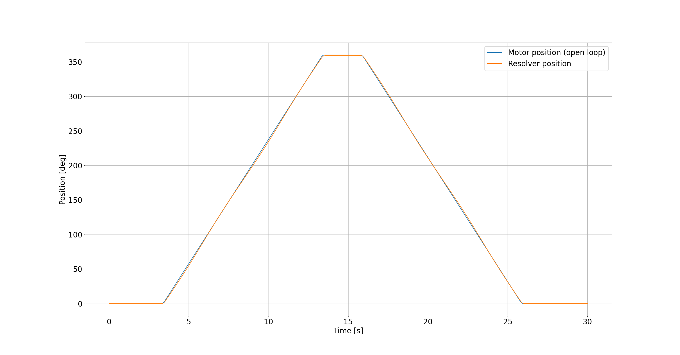
Voltage divider on sin and cos coils
Position error over one revolution in both directions

Slide 13
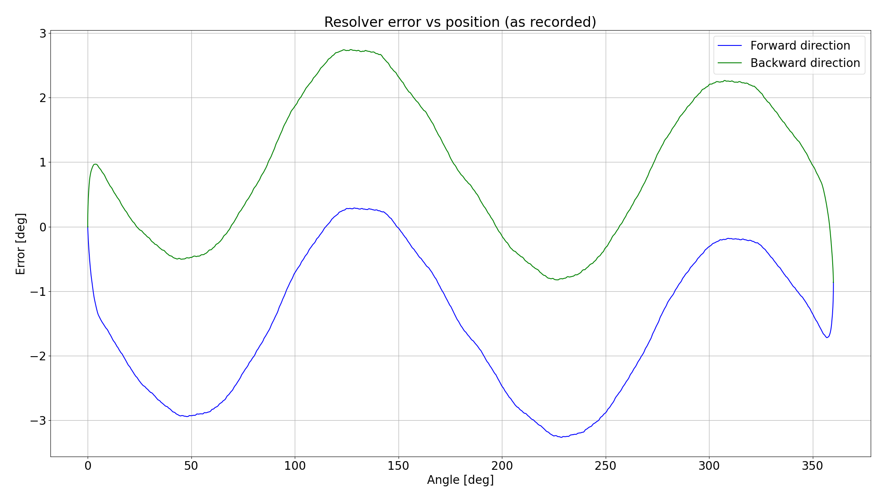
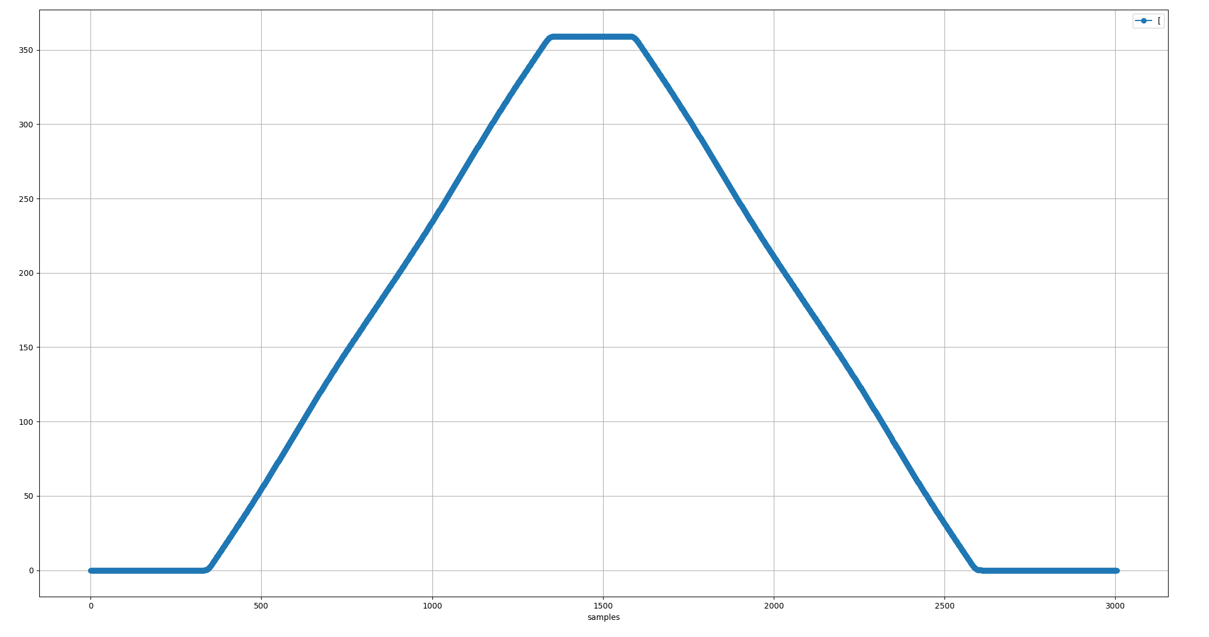
Voltage divider on sin and cos coils
Position error over one revolution in both directions
Error [deg]: -3.27..2.75

Slide 14
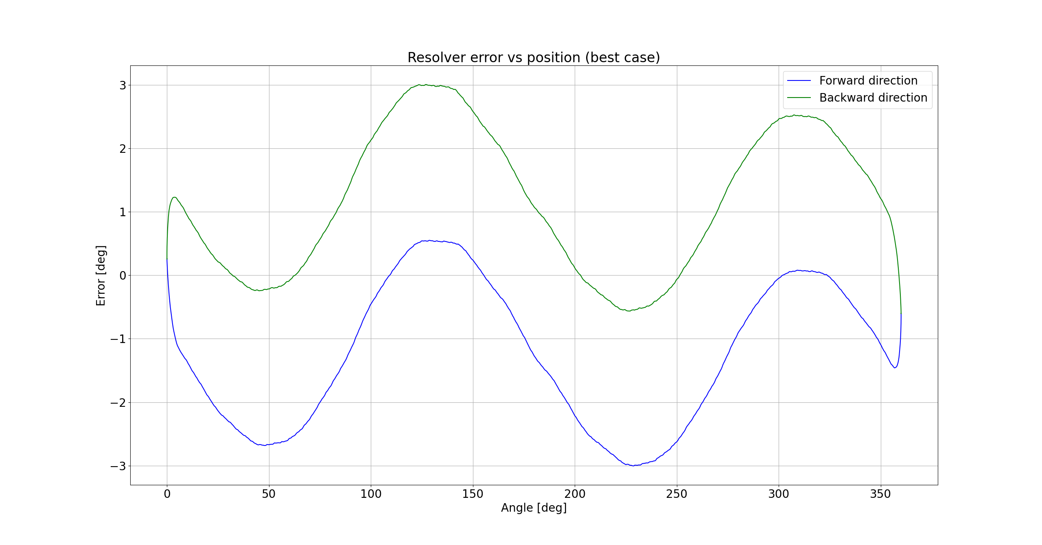
Voltage divider on sin and cos coils
Position error over one revolution in one direction (best case)
Error [deg]: -3.00..3.00

Slide 15
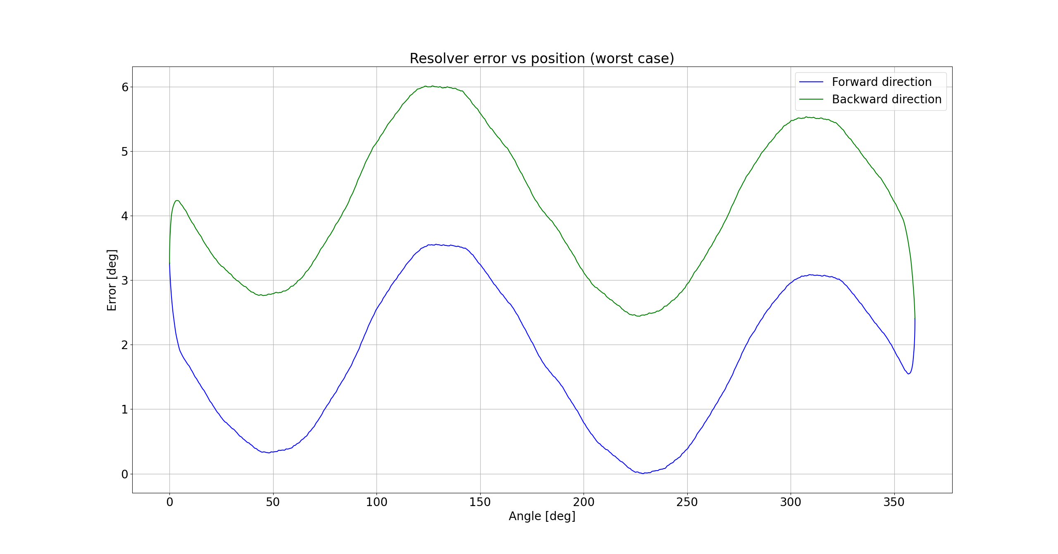
Voltage divider on sin and cos coils
Position error over one revolution in one direction (worst case)
Error [deg]: 0..6.01

Slide 16
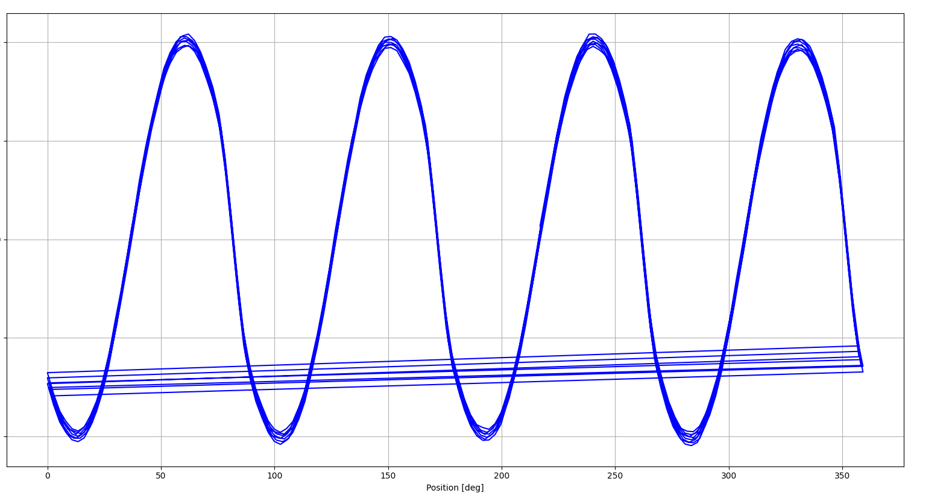
Normal connection (Bifrost data)
Position error over one revolution in one direction
7.2
Error [deg]
-7.2
Position [deg]

