Slide 2
RESOLVER DATA ANALYSIS
AMCI CONNECTED TO EL7211
PRESENTED BY <NAME NAMESON>

Slide 3
Agenda
1 Normal connection
2 Voltage divider on excitation coil
3 Voltage divider on sin and cos coils

Slide 4
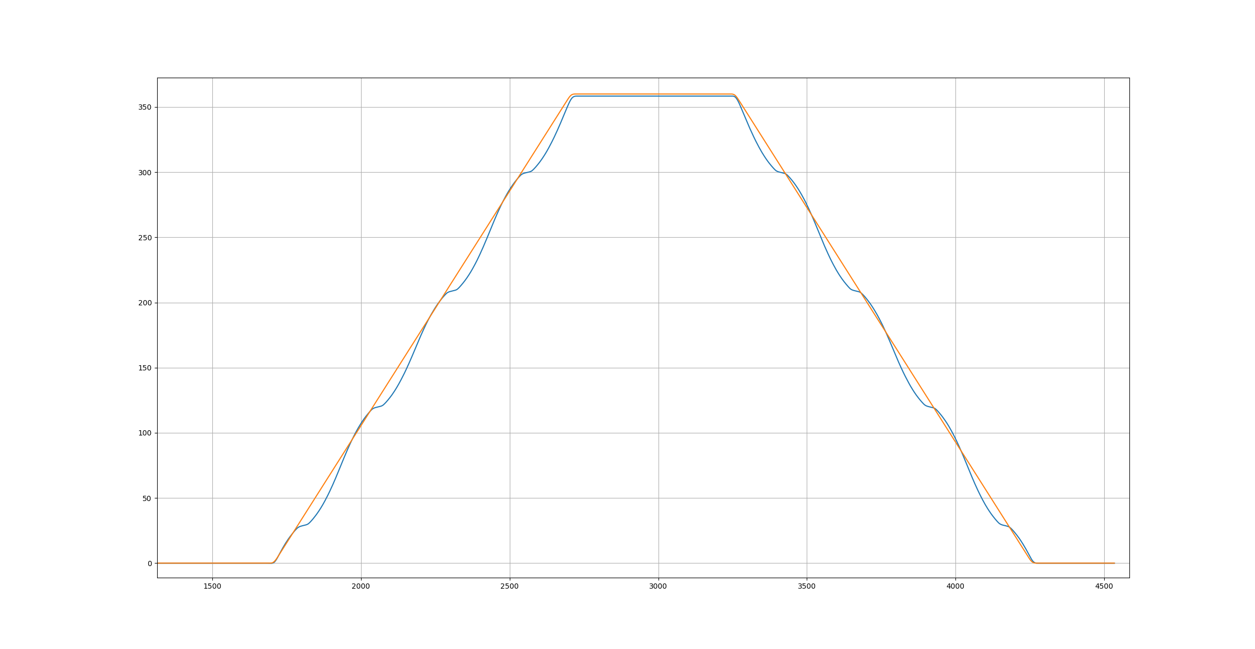
Normal connection
Position error over one revolution in both directions

Slide 5
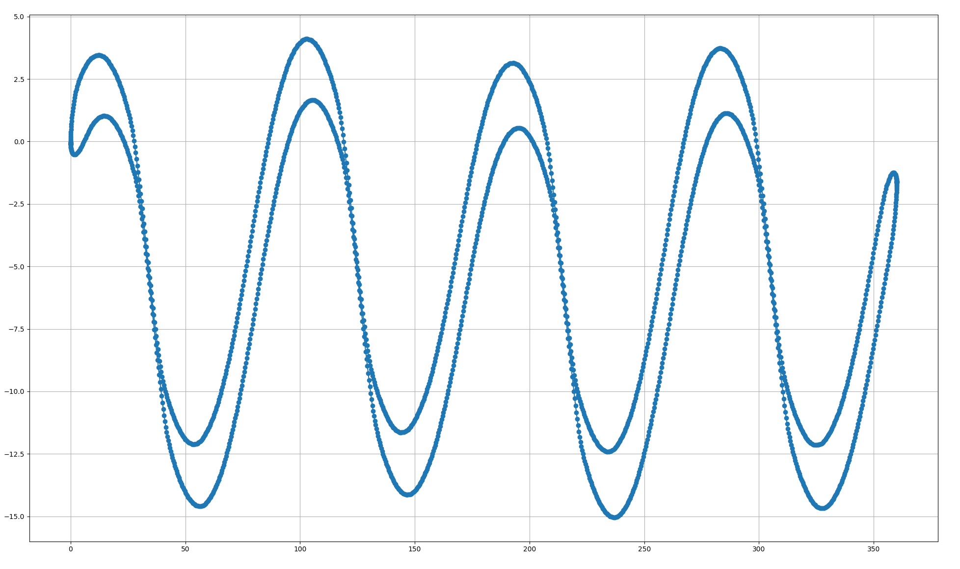
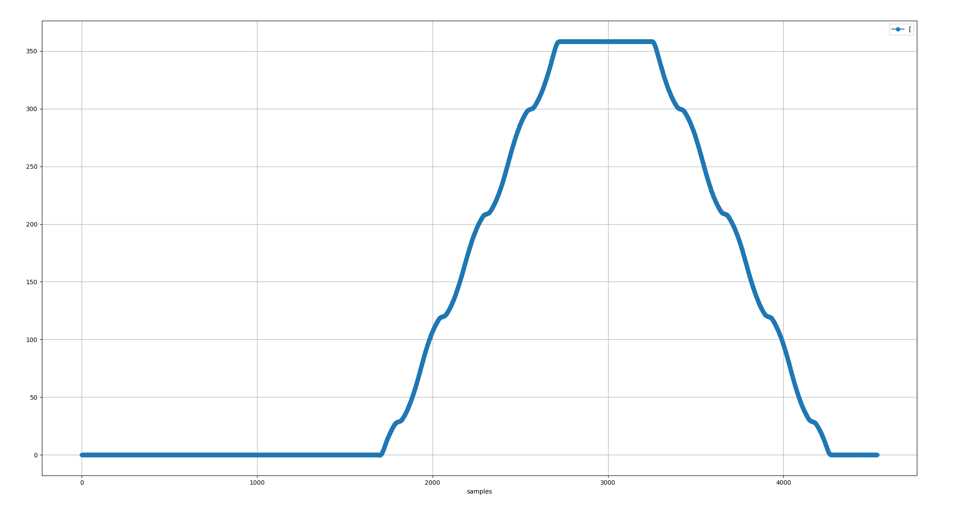
Normal connection
Position error over one revolution in both directions
1. Start
Error [deg]
3. End
Position [deg]
2. One rev

Slide 6
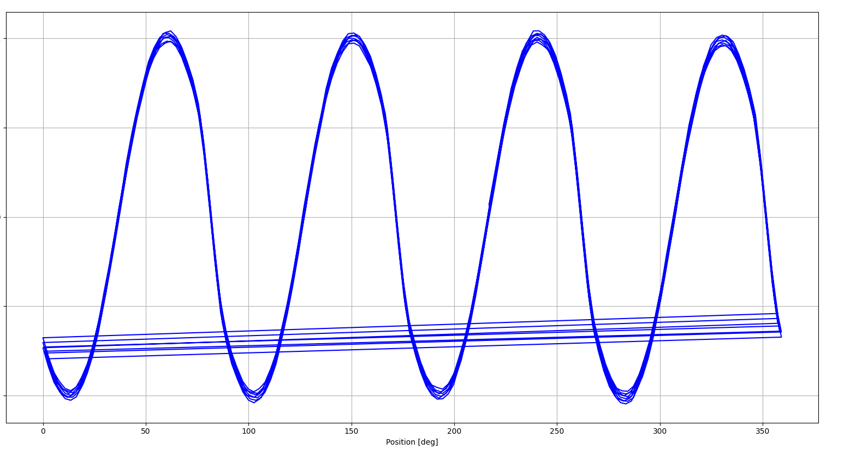
Normal connection (Bifrost data)
Position error over one revolution in one direction
7.2
Error [deg]
-7.2
Position [deg]

Slide 7
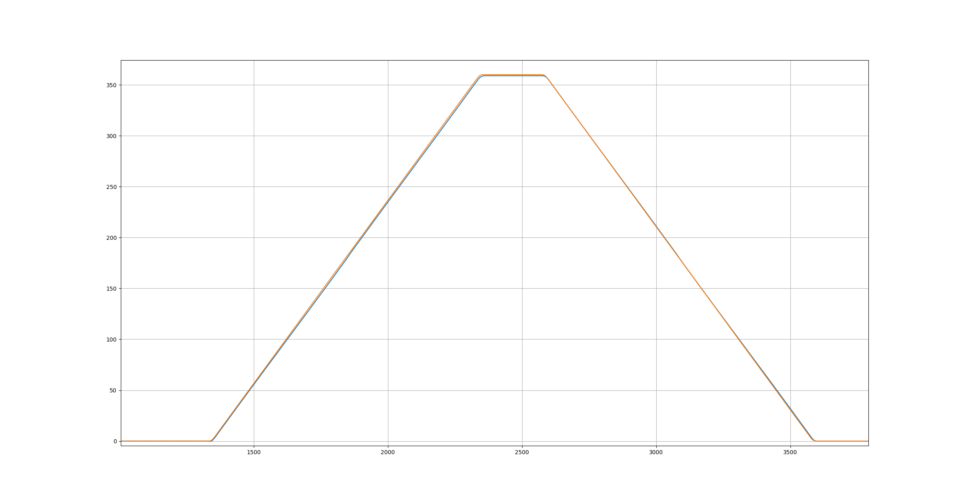
Voltage divider on excitation coil
Position error over one revolution in both directions

Slide 8
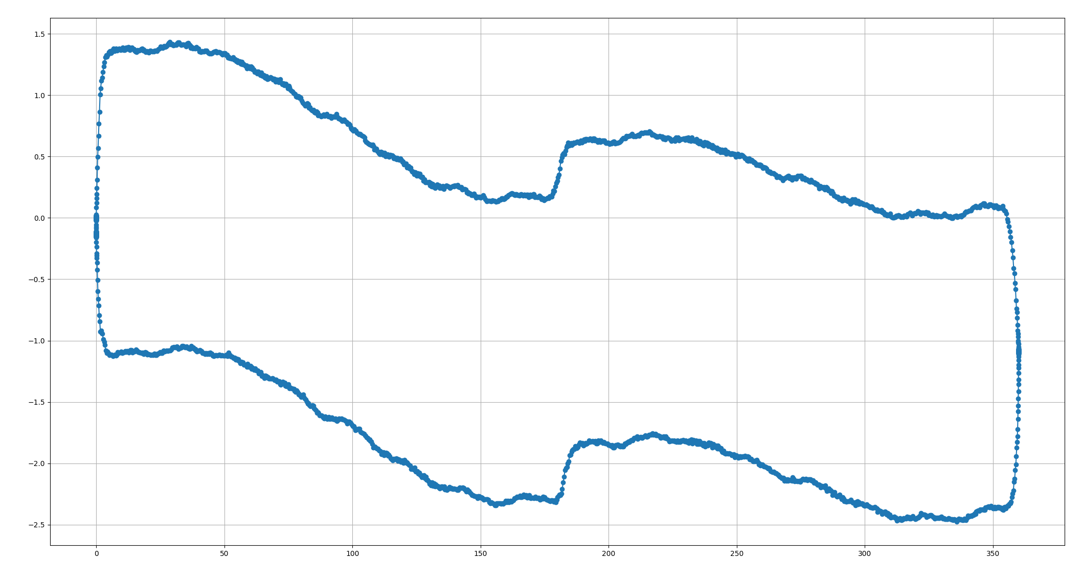
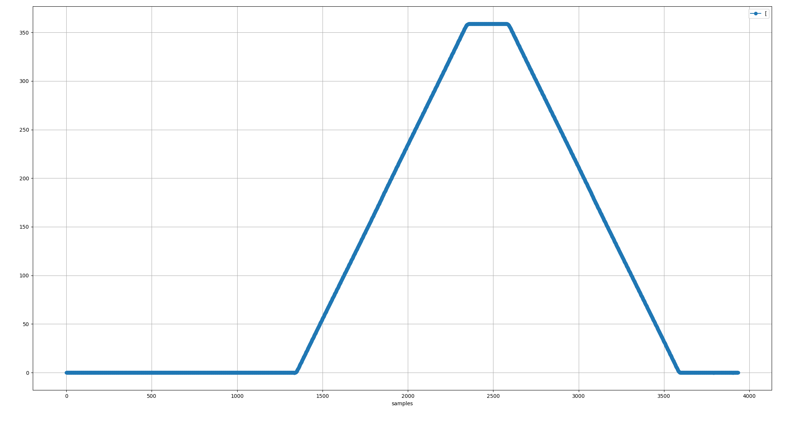
Voltage divider on excitation coil
Position error over one revolution in both directions
Error [deg]
Position [deg]

Slide 9
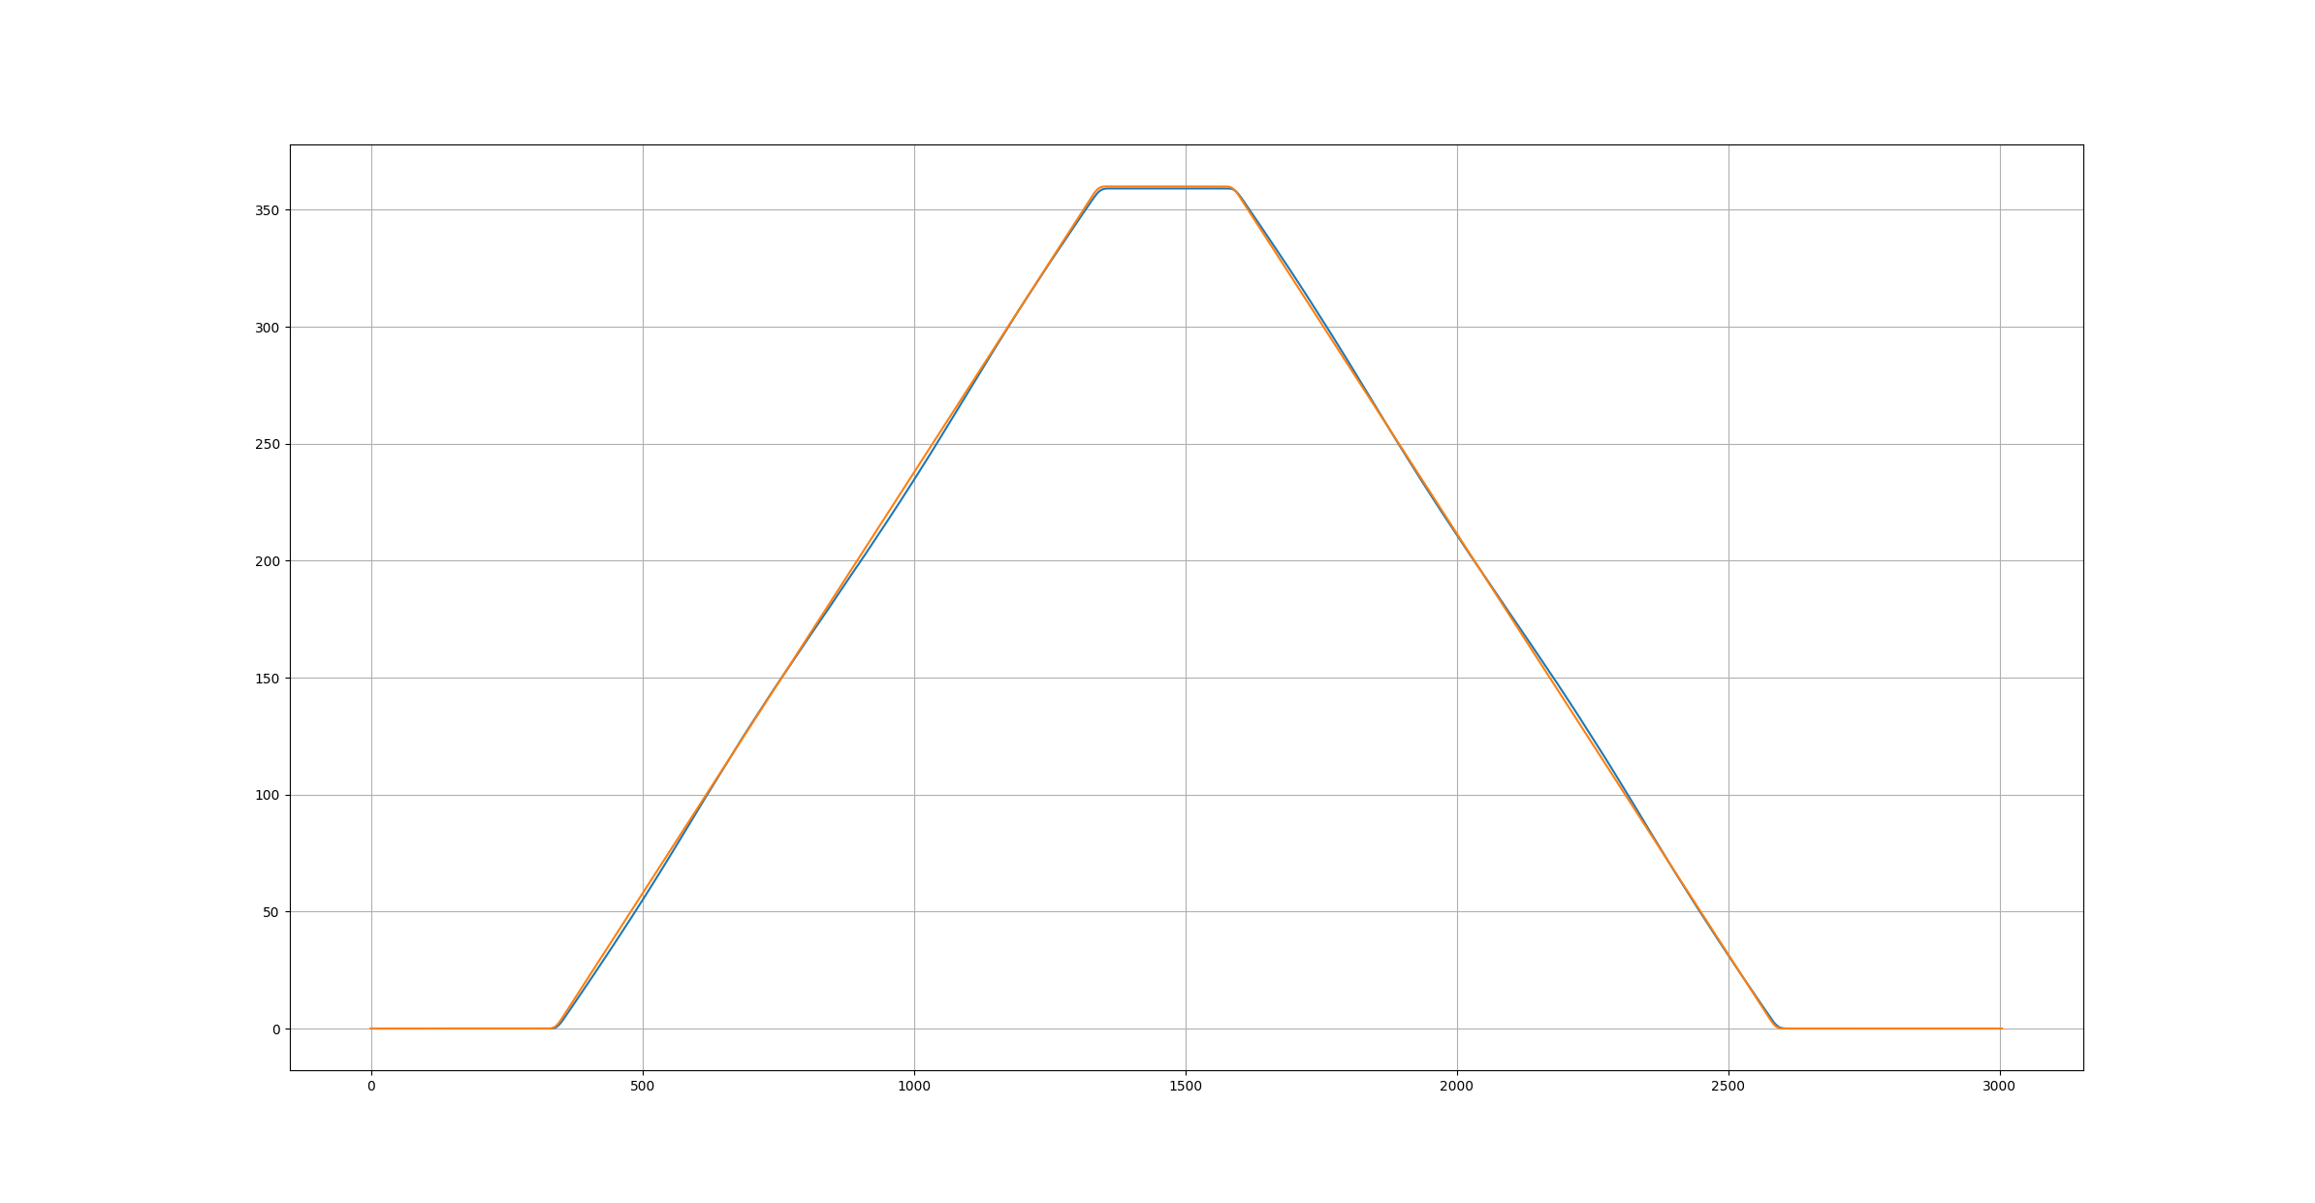
Voltage divider on sin and cos coils
Position error over one revolution in both directions

Slide 10
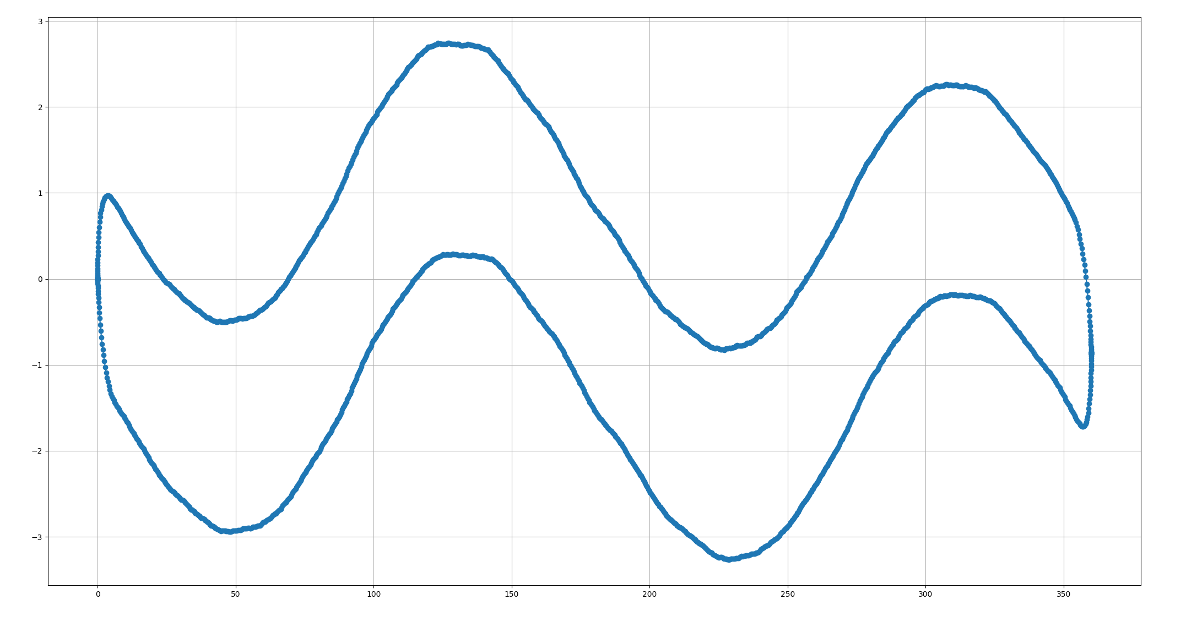
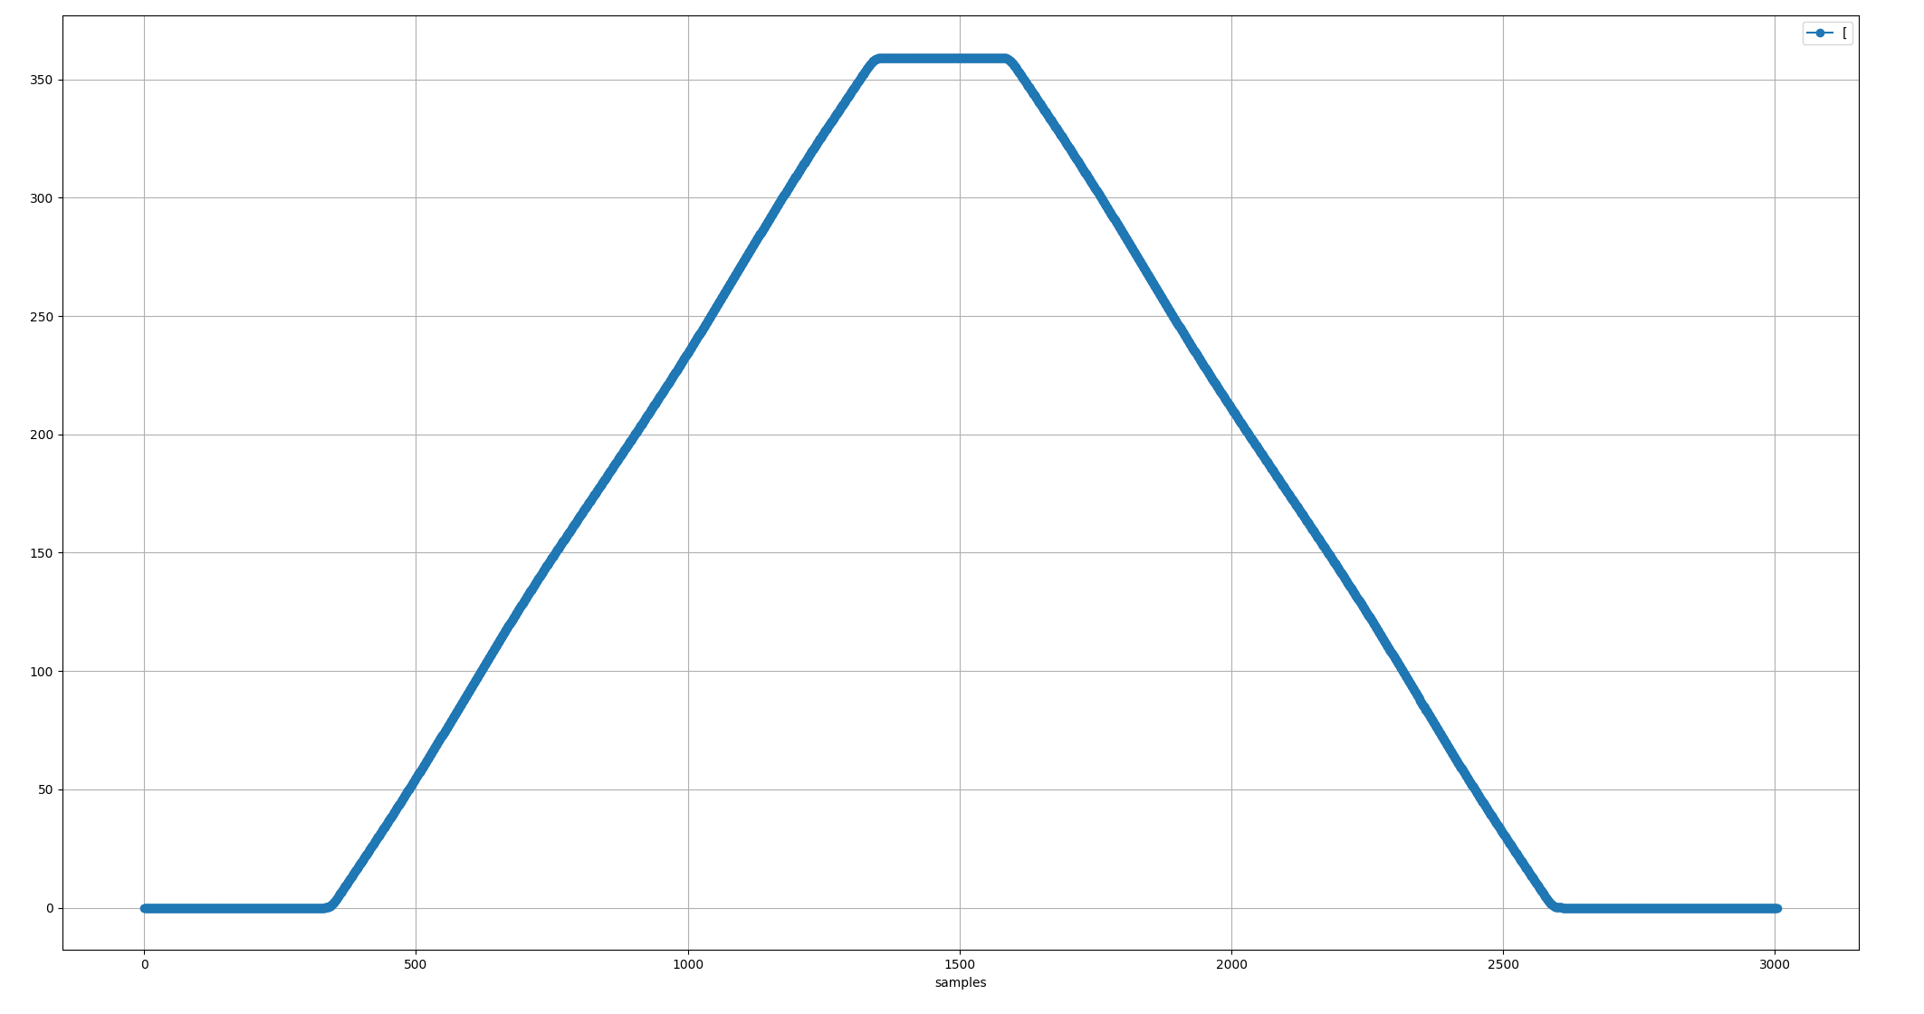
Voltage divider on sin and cos coils
Position error over one revolution in both directions
Error [deg]
Position [deg]

Slide 11
Finish presentation

