Slide 1
Project Presentation · CS 294 Designing Algorithmic Media
Trading Engagement for Sustainability
Carbon-Aware Re-ranking for E-commerce Recommendations
Anders Vestrum
Jørgen Bergh
Noah Lund Syrdal
University of California, Berkeley
April 2026

Slide 2
Carbon-Aware Re-ranking for E-commerce Recommendations
2 / 30
Context and Motivation
Why carbon-aware recommendation now: policy, Scope 3, and algorithmic accountability
Regulation
Climate policy is shifting from operations to products
For e-commerce, emissions are dominated by Scope 3
This makes platforms accountable for what they recommend
Systems roles under the regulations
RECSYSs determine which products users see and therefore shape demand and emissions
But current systems optimize only for engagement
This creates a gap between regulation and algorithms. The DSA requires transparency and control, but current models lack a sustainability dimension.
We address this with a controllable re-ranking mechanism. A single parameter (λ) trades off engagement and carbon without retraining models.
Three pressures converge
1. Regulation
CSRD, DSA, and the Digital Product Passport shift per-item sustainability disclosure from voluntary to mandatory.
2. Scope 3 dominance
Purchased goods and customer use dwarf operational emissions for most retailers, so ranking decisions carry climate weight.
3. Algorithmic accountability
Interventions must be transparent and auditable, not entangled inside opaque ranking models.
Policy → Scope 3 → Recommenders → Need control → Our method
CS 294 DAM · Spring 2026 · UC Berkeley

Slide 3
Carbon-Aware Re-ranking for E-commerce Recommendations
3 / 30
Problem Setting
Sustainability in catalog-scale recommendation
Two-part problem
1. PCF estimation
Infer kg CO₂e per item from product metadata using a small set of LCA-labeled products.
2. Carbon-aware ranking
Incorporate estimated PCF into the ranking stage with a transparent trade-off against predicted engagement.
CS 294 DAM · Spring 2026 · UC Berkeley

Slide 4
Carbon-Aware Re-ranking for E-commerce Recommendations
4 / 30
Research Questions and Contributions
Research questions
Contributions
RQ1
How does carbon-aware re-ranking affect recommendation quality across different recommendation models?
Retrieval-augmented PCF estimation
Transfers supervision from 866 LCA-labeled products to an unlabeled e-commerce catalog.
Multi-model Pareto analysis
Trade-off curves for BPR, NeuMF, and LightGCN across three product categories.
Transparent post-hoc re-ranking
Single explicit parameter λ controls the carbon-vs-engagement trade-off.
RQ2
How much carbon reduction is achievable before recommendation quality degrades?
RQ3
Do different recommendation backbones expose different engagement–carbon trade-offs?
CS 294 DAM · Spring 2026 · UC Berkeley

Slide 5
Carbon-Aware Re-ranking for E-commerce Recommendations
5 / 30
Overall Pipeline
From raw catalog data to carbon-aware Top-k output
PCF estimation
Carbon Catalogue
PCF estimator
PCF(i) for items
866 LCA-labeled products
few-shot retrieval-augmented LLM
kg CO₂e per item
Carbon-aware re-ranker
Recommendation
s = (1−λ)·engagement − λ·carbon
Amazon Reviews
Candidate generator
Top-100 candidates
user–item interactions
BPR · NeuMF · LightGCN
per user
Evaluation
NDCG@10 · AvgPCF@10
Two upstream lanes: PCF estimation and candidate generation, meet at the re-ranker, which produces the Top-k output evaluated on engagement and carbon.
CS 294 DAM · Spring 2026 · UC Berkeley

Slide 6
Carbon-Aware Re-ranking for E-commerce Recommendations
6 / 30
PCF Estimation Method
Transferring sparse LCA supervision to an unlabeled catalog
Setup
Retrieval-augmented estimator
We embed every labeled and unlabeled product into a shared semantic space using all-MiniLM-L6-v2 on concatenated title and category text. For each query item, the k nearest labeled products in the Carbon Catalogue are retrieved and used to produce a PCF estimate.
Query item
(title, category)
k labeled
neighbours
Three estimators are compared:
Few-shot LLM
Neighbour average: mean PCF of k nearest labeled items.
Zero-shot LLM: Llama-3.1-8B asked for a PCF estimate given the product text.
Few-shot retrieval-augmented LLM: same LLM prompted with retrieved labeled neighbours as exemplars.
PCF estimate (kg CO₂e)
CS 294 DAM · Spring 2026 · UC Berkeley

Slide 7
Carbon-Aware Re-ranking for E-commerce Recommendations
7 / 30
PCF Estimation Results
Consumer-scale hold-out intersection, n = 771
Method | RMSE | Mean AE | Median AE | Spearman ρ
Neighbour average | 3,002.0 | 959.4 | 123.3 | 0.728
Zero-shot LLM | 1,712.8 | 790.7 | 93.2 | 0.064
Few-shot LLM | 1,708.6 | 695.1 | 58.6 | 0.518
Interpretation
Few-shot LLM has the lowest absolute-error metrics on the consumer-scale subset.
Neighbour average has the best rank correlation, indicating retrieval alone preserves local ordering.
We use the few-shot signal downstream because re-ranking depends on calibrated absolute PCF, not only rank.
Lower RMSE, MAE, and median absolute error are better; higher Spearman ρ is better. Bold values mark the best per column.
Full 866-item hold-out is dominated by heavy industrial outliers and is reported in the appendix.
CS 294 DAM · Spring 2026 · UC Berkeley

Slide 8
Carbon-Aware Re-ranking for E-commerce Recommendations
8 / 30
Carbon-Aware Re-ranking
A single auditable trade-off parameter
sᵤᵢ = (1 − λ) · engagementᵤᵢ − λ · carbonᵢ
Normalization
Engagement
per-user min–max over the Top-100 candidate pool.
Carbon
global min–max over the catalog; winsorized to reduce heavy-tail dominance.
λ = 0
λ = 1
Engagement-only ranking. Recovers the underlying recommender's top-k.
Carbon-only ranking. Ignores relevance; orders items by ascending PCF.
The method is deliberately simple and auditable. λ is explicit rather than entangled with model training, so the trade-off can be inspected or adjusted without retraining.
CS 294 DAM · Spring 2026 · UC Berkeley

Slide 9
Carbon-Aware Re-ranking for E-commerce Recommendations
9 / 30
Experimental Setup
Data
Models
Evaluation
Dataset
Amazon Reviews (public)
Categories
Electronics
Home and Kitchen
Sports and Outdoors
Sampling
1,000 users per category; leave-one-out split.
Three recommenders
BPR
NeuMF
LightGCN
Pipeline
Top-100 candidate pool from each model.
Re-ranker produces Top-10 output.
Framework
RecBole with matched hyperparameters across models.
Metrics
NDCG@10 (engagement, primary)
AvgPCF@10 (kg CO₂e)
Carbon reduction vs. λ = 0
Sweep
30 values of λ spanning 0 to 1; each model×category curve traced independently.
NDCG@10 is the primary engagement metric: leave-one-out evaluation makes Recall less informative about rank position, and NDCG captures both presence and placement of the held-out item.
CS 294 DAM · Spring 2026 · UC Berkeley

Slide 10
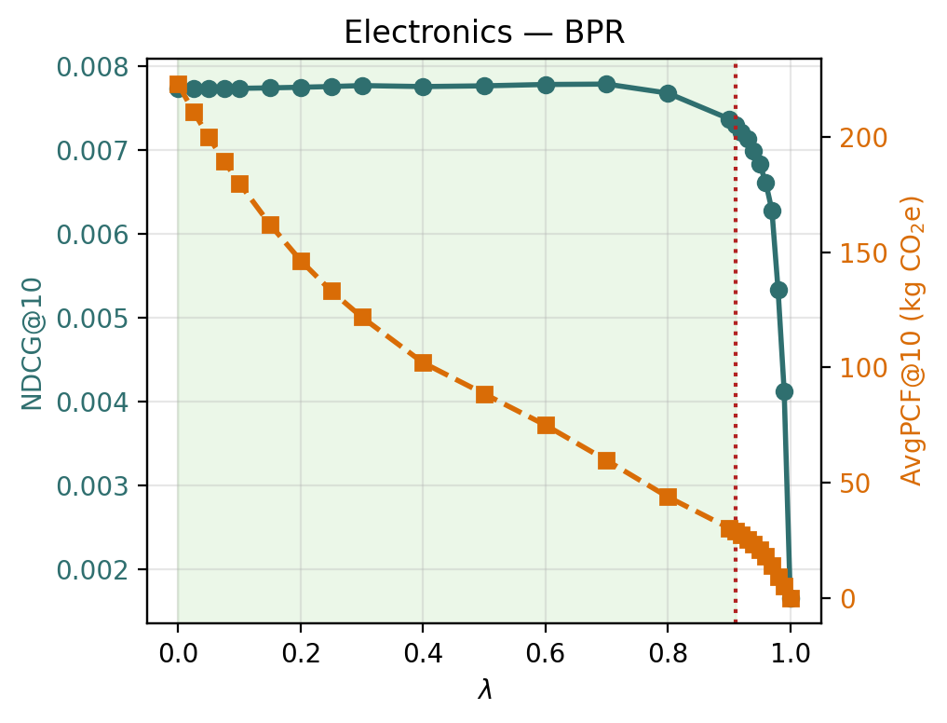
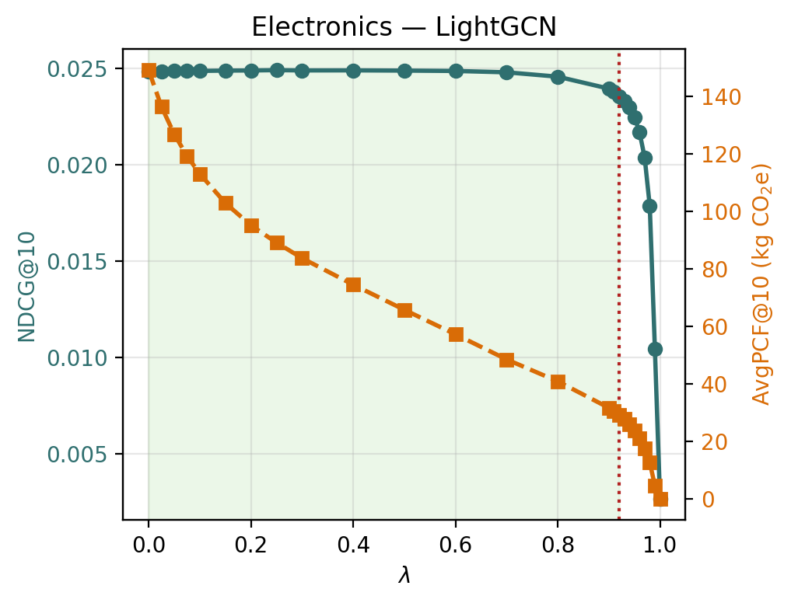
Carbon-Aware Re-ranking for E-commerce Recommendations
10 / 30
Main Trade-off Pattern
Electronics λ-sensitivity: plateau, then cliff
(a) BPR
(b) LightGCN
NDCG@10 is nearly flat across much of the sweep while AvgPCF@10 decreases monotonically. The sharp engagement drop appears only near the carbon-only regime, so substantial carbon savings are typically available before quality collapses.
CS 294 DAM · Spring 2026 · UC Berkeley
Notes:
“This slide shows the cleanest version of the main result.
For Electronics, both BPR and LightGCN have a long plateau where NDCG@10 stays almost flat, while AvgPCF@10 decreases steadily.”
“The green shaded area: engagement-only baseline. This is our practical operating region: carbon is improving and the recommendation quality has not yet degraded much.”
“The important takeaway is not the exact cliff location, but the existence of a wide region where carbon improves before recommendation quality breaks.”

Slide 11
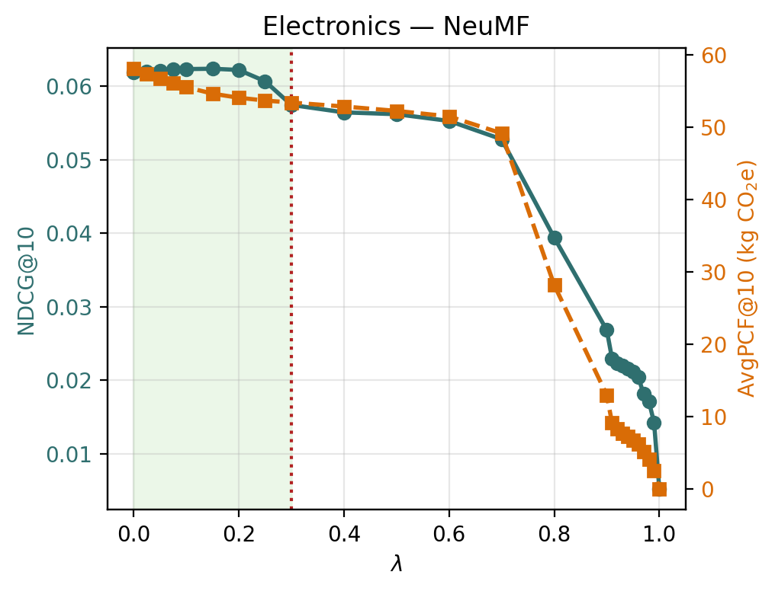
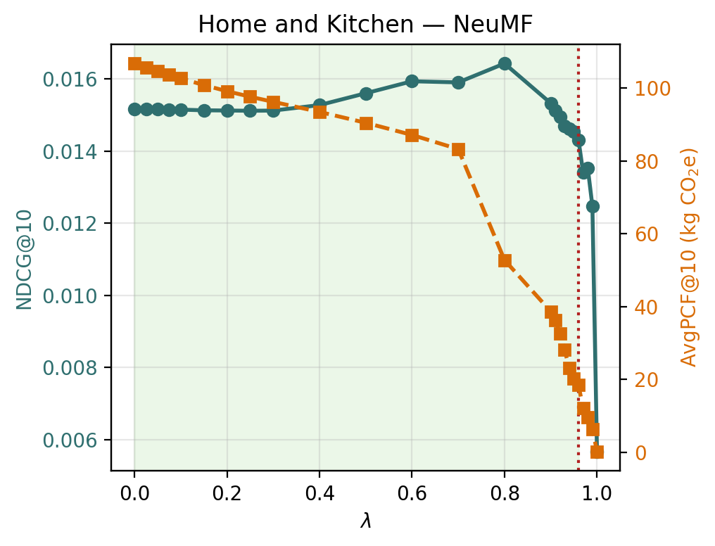
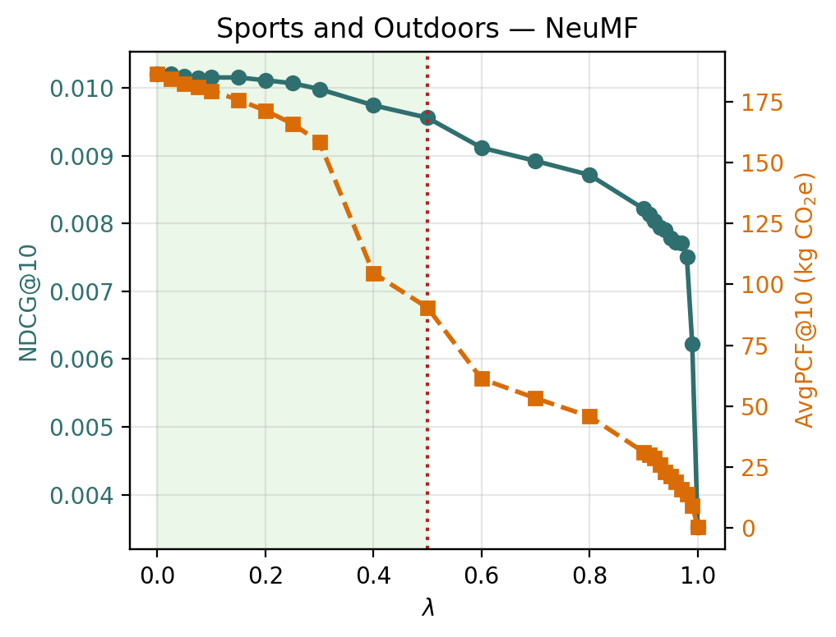
Carbon-Aware Re-ranking for E-commerce Recommendations
11 / 30
NeuMF as the Important Exception
Model-dependent flexibility of the trade-off
(a) NeuMF, Electronics
(b) NeuMF, Home & Kitchen
(c) NeuMF, Sports & Outdoors
NeuMF has the highest absolute baseline NDCG, but its trade-off curve behaves differently across categories. Electronics and Sports & Outdoors follow the expected pattern, accuracy degrades monotonically as the carbon weight grows, while in Home & Kitchen, moderate re-ranking can improve both NDCG and carbon footprint. We present this category-specific behaviour as an empirical exception rather than a general claim.
CS 294 DAM · Spring 2026 · UC Berkeley
Notes:
“NeuMF behaves differently from BPR and LightGCN. It has the highest baseline NDCG, but its trade-off curve is less flexible and more category-dependent.”
“In Electronics, carbon-aware reranking hurts NeuMF earlier. This suggests that NeuMF’s ranking scores are more peaked: the model is more confident about its preferred ordering, so changing that ordering has a larger engagement cost.”
“In Sports & Outdoors, the decline is more gradual, but still follows the expected pattern: more carbon weight eventually reduces NDCG.”
“The unusual case is Home & Kitchen. reranking improves both NDCG and AvgPCF. “We think this is an empirical exception, not a universal claim. The result could also be influenced by the leave-one-out evaluation and top-10 cutoff, so we present it as a category-specific pattern rather than a general property of NeuMF.”
Also:
“Post-hoc reranking can improve NDCG because the base model is not optimized directly for final top-10 NDCG. The reranker can correct local ordering errors within the candidate set.” - we see this as a result of NeuMF being a more sophisticated candidate generator and having more expressive power - we think that this is the reason for it being more category dependent.

Slide 12
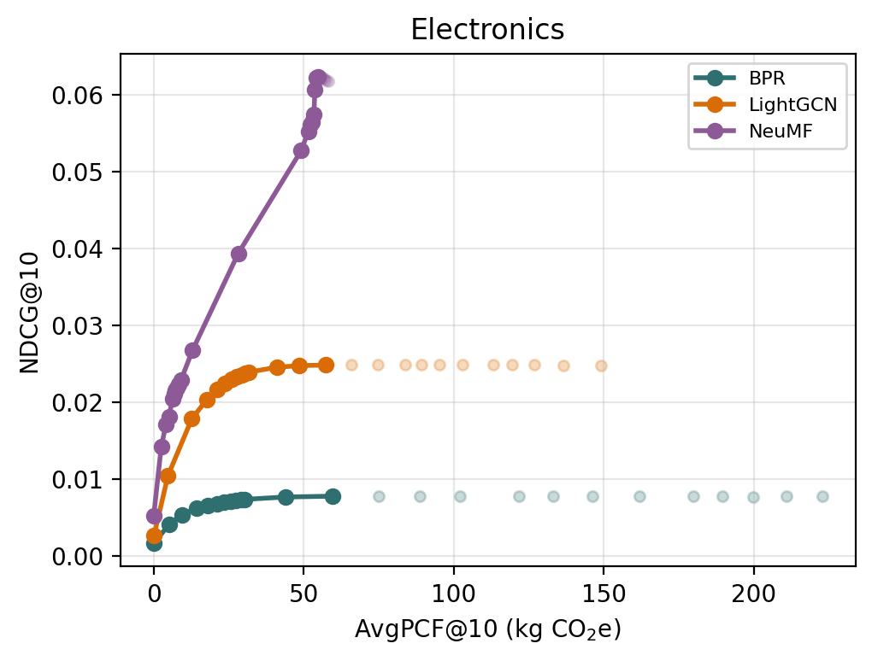
Carbon-Aware Re-ranking for E-commerce Recommendations
12 / 30
Cross-Model Comparison
Pareto frontiers for Electronics
Findings (RQ3)
Choice of backbone determines both baseline quality and carbon flexibility.
NeuMF yields the highest absolute NDCG, but its curve dominates only at higher AvgPCF; reducing carbon costs engagement earlier.
BPR and LightGCN expose more carbon headroom at low engagement cost but start from lower NDCG.
No single backbone dominates across the trade-off; the preferred choice depends on the operating point.
CS 294 DAM · Spring 2026 · UC Berkeley
Notes:
Core message: no model dominates; there is a quality-flexibility trade-off.
Say:
“This Pareto plot compares the operating points across models for Electronics. Points toward the upper-left are better: higher NDCG and lower carbon.”
“NeuMF clearly reaches the highest absolute NDCG. So if the only objective is engagement, NeuMF is the strongest model here.”
“But when NeuMF’s high-quality points are exposed for carbon reduction, engagement degrades fast - its frontier becomes less flexible.”
“BPR and LightGCN start from lower NDCG, but they let us reduce AvgPCF with less immediate engagement loss.”
Address the fault/caveat:
Preferred model depends on the operating point. If the platform cares most about absolute engagement, NeuMF may be preferred. If it cares about low-cost carbon reduction, BPR or LightGCN may be better.”
Good closing line:
“The model is not just a performance choice; it changes the shape of the sustainability trade-off.”

Slide 13
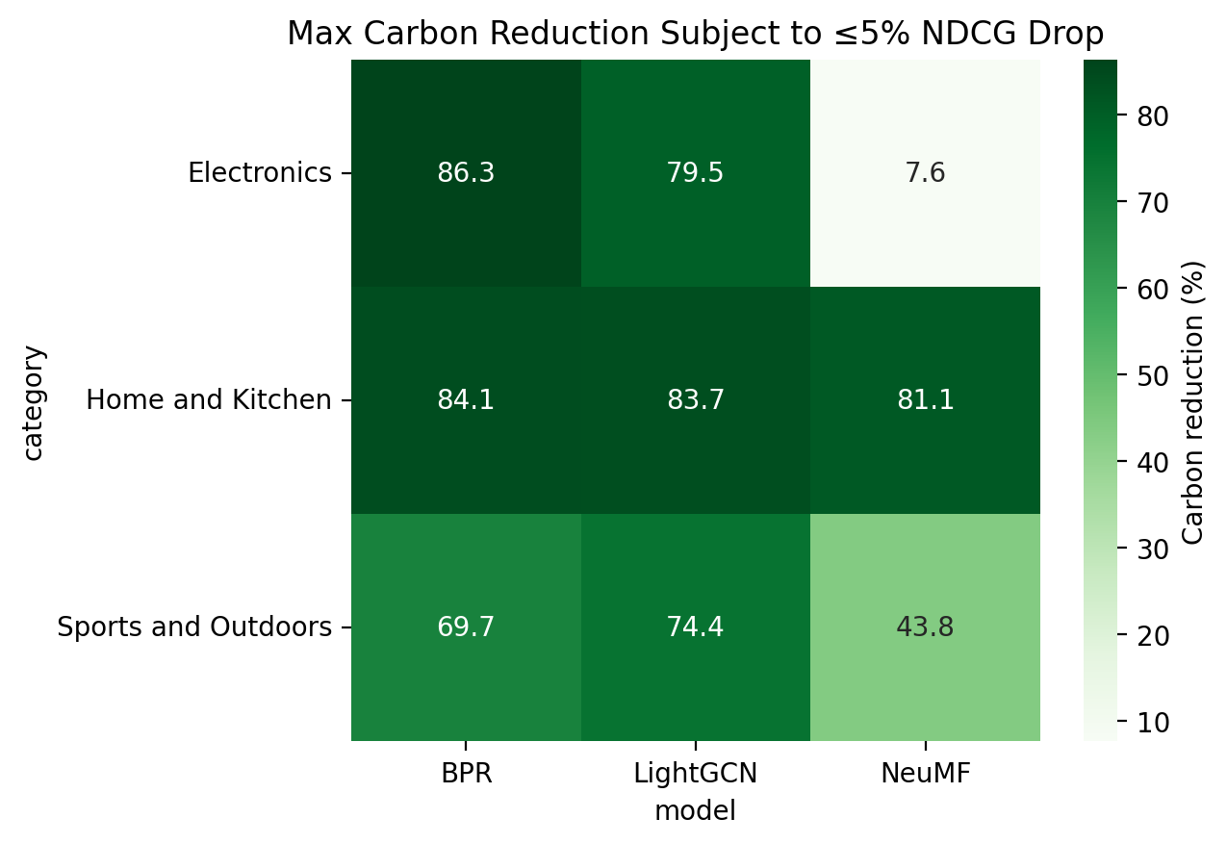
Carbon-Aware Re-ranking for E-commerce Recommendations
13 / 30
Category-Level Variation
Maximum carbon reduction at ≤ 5% NDCG drop
Category effects
Home & Kitchen admits 81–84% carbon reduction across all three models at ≤5% NDCG cost.
Electronics shows the strongest model dependence: 86% for BPR versus 7.6% for NeuMF.
Sports & Outdoors lies in between, with more moderate but still substantial headroom.
Achievable savings depend jointly on model behavior and category-specific PCF structure.
CS 294 DAM · Spring 2026 · UC Berkeley
Notes:
Core message: category matters as much as model.
Say:
“This heatmap summarizes maximum carbon reduction while limiting NDCG degradation to at most 5 percent.”
“The strongest category-level result is Home & Kitchen. All three models achieve above 80 percent estimated carbon reduction within the 5 percent NDCG budget.”
“Electronics is the most model-sensitive category. BPR and LightGCN show large carbon headroom, but NeuMF only reaches 7.6 percent within the same budget.”
“Sports & Outdoors is in between. There is still meaningful carbon reduction, but the achievable reduction is less uniform across models.”
“The main point is that carbon-aware reranking is not one-size-fits-all. The category’s product mix and the recommender’s score structure interact.”
Another caveat:
“The 5 percent threshold is an analytical choice. It is useful for comparing settings, but a real platform would choose the acceptable quality loss based on business or policy constraints.”

Slide 14
Carbon-Aware Re-ranking for E-commerce Recommendations
14 / 30
Summary of Findings
1
PCF estimation is feasible at catalog scale
2
Favorable engagement–carbon trade-offs
Few-shot retrieval-augmented LLM estimation provides a usable downstream carbon signal from only 866 labeled products.
For BPR and LightGCN, large carbon reductions are available before NDCG degrades substantially.
3
Trade-off depends on the model
4
Trade-off depends on the category
NeuMF admits much less low-cost carbon headroom than BPR or LightGCN, especially in Electronics.
Home & Kitchen is the most carbon-flexible category overall; Electronics is the most model-sensitive.
Post-hoc carbon-aware re-ranking is a transparent mechanism for introducing sustainability objectives into an existing recommendation pipeline, with the caveat that the achievable trade-off is governed by both the backbone and the category.
CS 294 DAM · Spring 2026 · UC Berkeley
Notes:
“To summarize, we find four things.
First, catalog-scale PCF estimation is feasible enough to support downstream experiments, though it remains estimated rather than measured.”
“Second, post-hoc reranking can create favorable engagement-carbon trade-offs, especially for BPR and LightGCN.”
“Third, the trade-off is model-dependent. NeuMF gives the strongest engagement baseline, but less low-cost carbon flexibility, especially in Electronics.”
“Fourth, the trade-off is also category-dependent. Home & Kitchen is consistently the most flexible category, while Electronics is the most model-sensitive.”

Slide 15
Carbon-Aware Re-ranking for E-commerce Recommendations
15 / 30
Limitations and Future Work
Limitations
Future work
Review data introduces selection bias and provides no explicit negatives.
PCF values are estimated, not directly measured; errors propagate into the re-ranker.
Offline evaluation cannot capture real user response to a carbon-aware Top-k.
Richer behavioural datasets with explicit clicks, purchases, and timestamps.
Improved PCF estimation using multimodal signals (images, structured attributes) and uncertainty estimates.
End-to-end multi-objective training that jointly optimizes engagement and carbon during model fitting.
Online experiments to measure the causal effect of carbon-aware re-ranking on user behaviour.
Effects of feedback loop
CS 294 DAM · Spring 2026 · UC Berkeley

Slide 16
Questions
Trading Engagement for Sustainability: Carbon-Aware Re-ranking for E-commerce Recommendations
Anders Vestrum · Jørgen Bergh · Noah Lund Syrdal
github.com/andersvestrum/carbon-aware-recsys

Slide 17
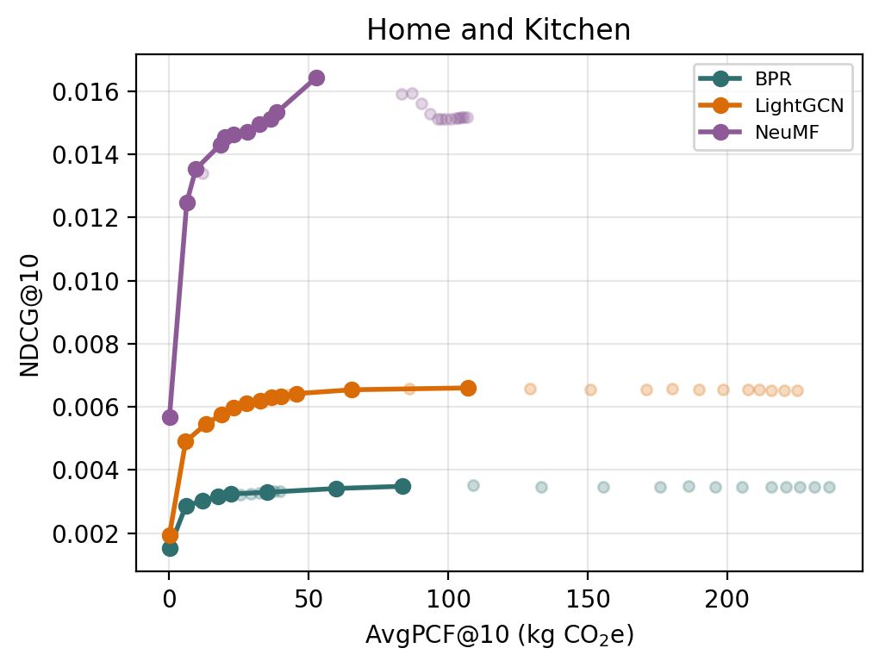
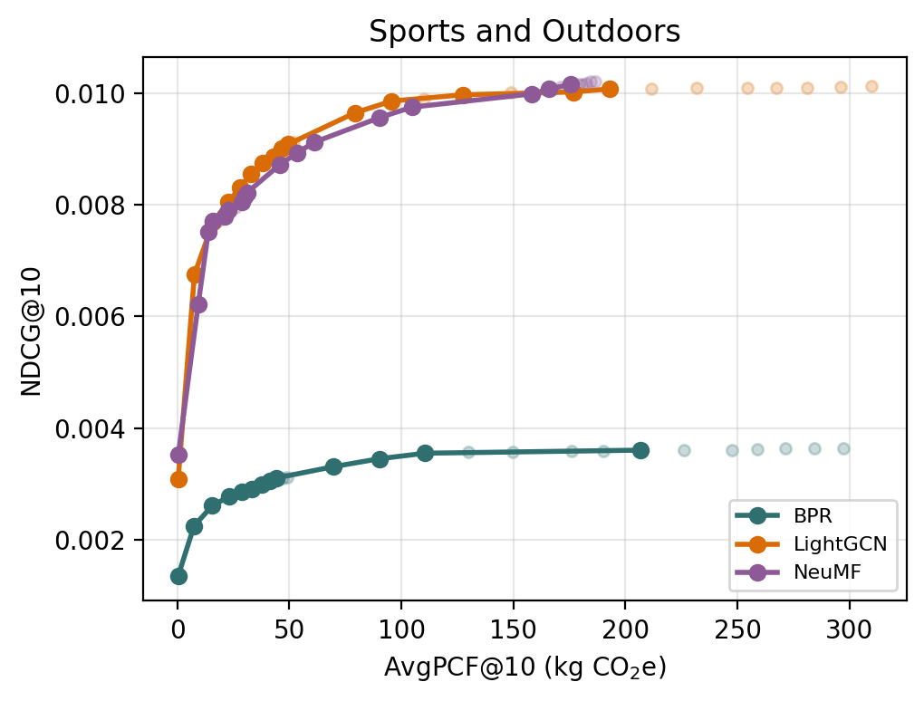
Carbon-Aware Re-ranking for E-commerce Recommendations
16 / 30
Appendix - Full Pareto Frontiers
Engagement–carbon trade-off curves for BPR, NeuMF, and LightGCN across all three categories
(a) Electronics
(b) Home & Kitchen
(c) Sports & Outdoors
Each panel overlays the three candidate generators on a single engagement (NDCG@10) versus carbon (AvgPCF@10) plot. Together the panels cover all nine backbone × category combinations: no single backbone dominates across operating points, and the available trade-off depends jointly on the model and the category.
CS 294 DAM · Spring 2026 · UC Berkeley

Slide 18
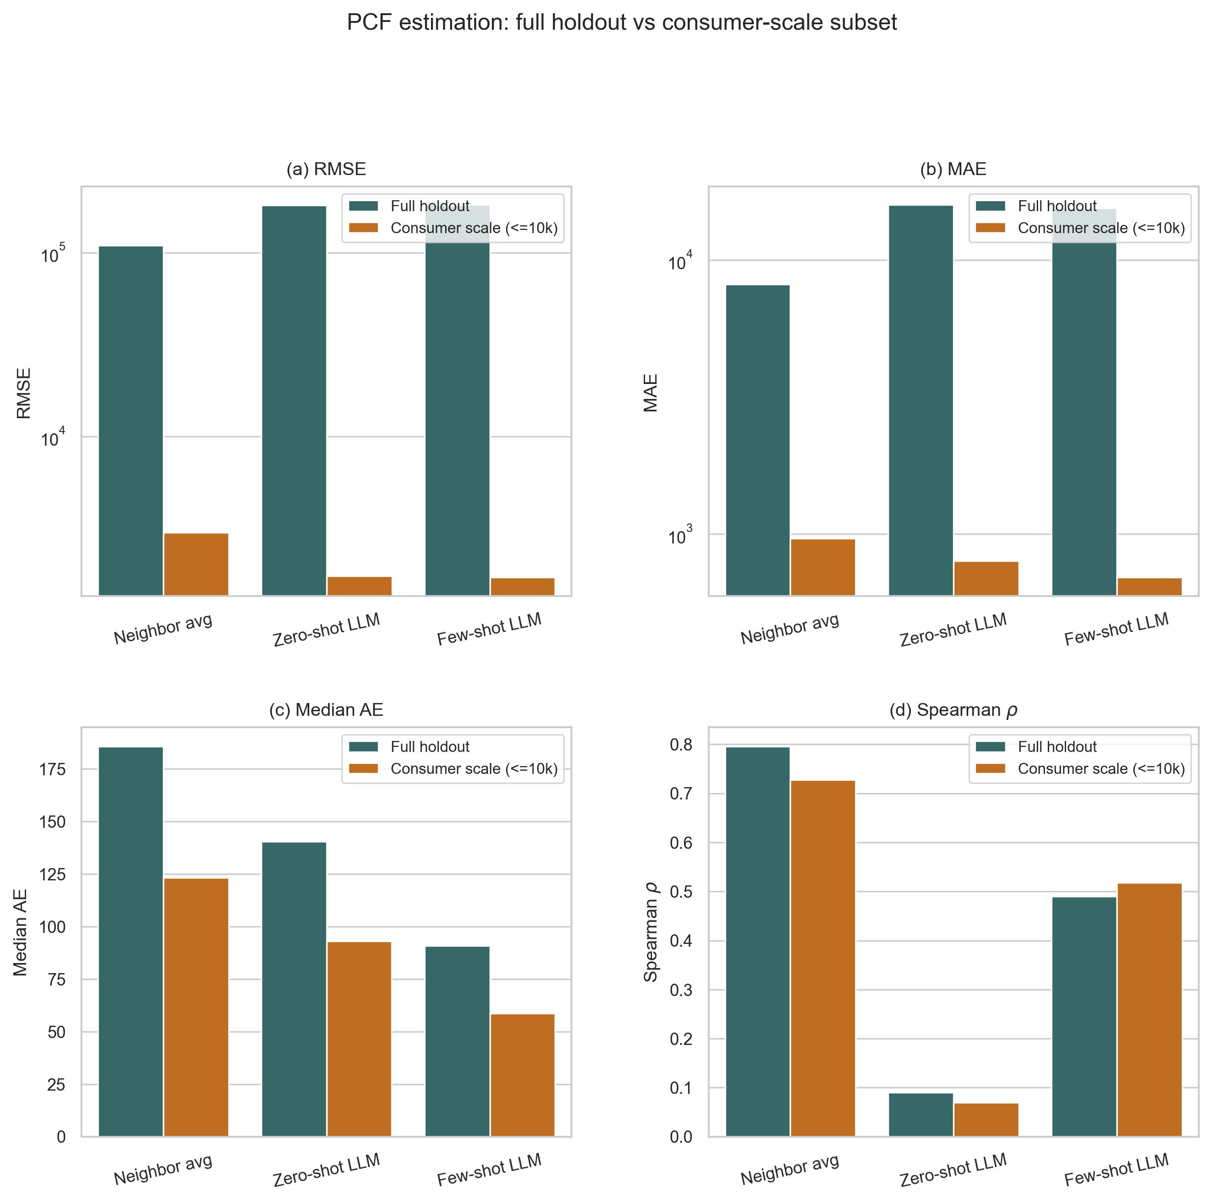
Carbon-Aware Re-ranking for E-commerce Recommendations
18 / 30
Appendix - PCF Consumer-Scale Evaluation Panel
Per-metric comparison on the consumer-scale hold-out intersection (n = 771)
Panels: full hold-out (866 items, teal) versus consumer-scale subset (≤ 10 kg, orange) for each estimator.
CS 294 DAM · Spring 2026 · UC Berkeley

Slide 19
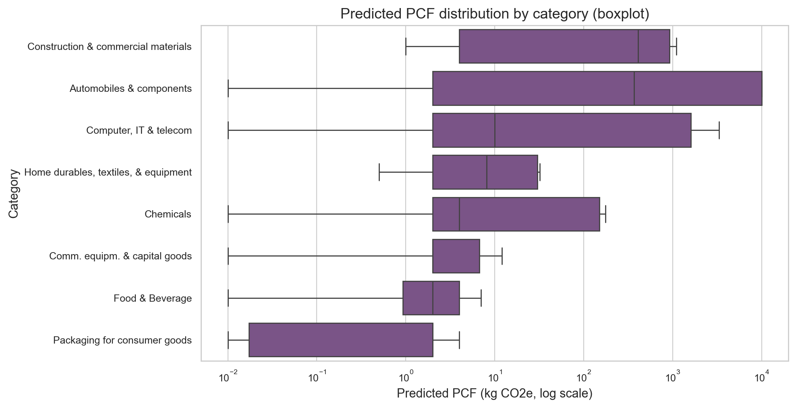
Carbon-Aware Re-ranking for E-commerce Recommendations
20 / 30
Appendix - Carbon Catalogue PCF Distributions
Category-level views of the 866-product labeled corpus
Diagram: PCF distribution by category (least-green)
CS 294 DAM · Spring 2026 · UC Berkeley

Slide 20
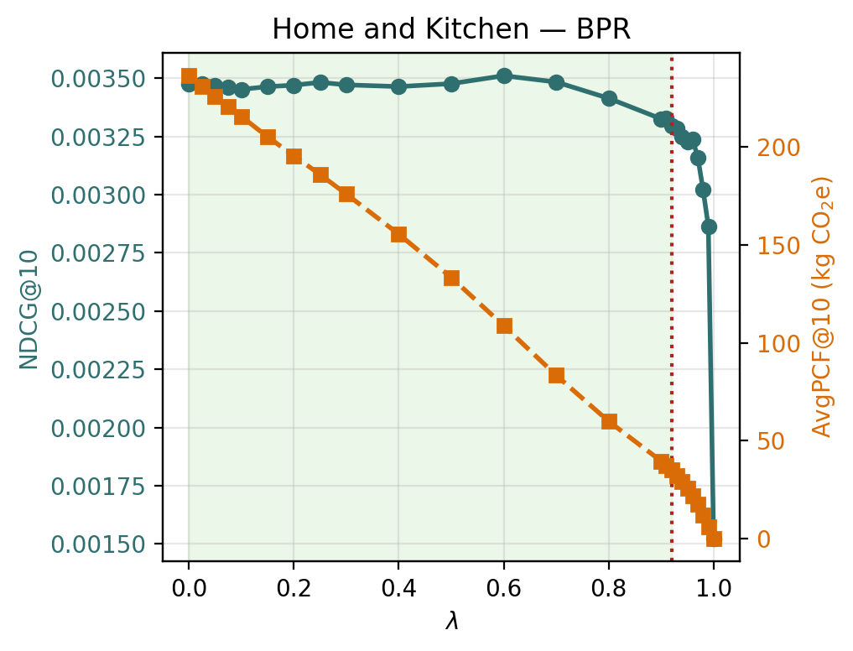
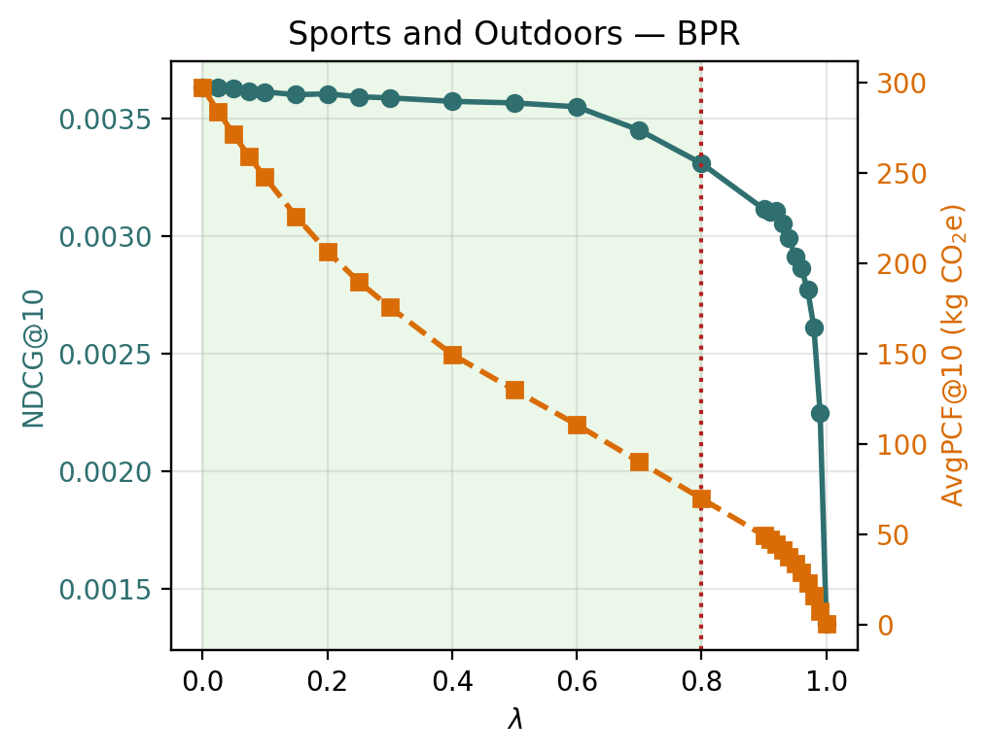
Carbon-Aware Re-ranking for E-commerce Recommendations
21 / 30
Appendix - λ-Sensitivity: BPR
NDCG@10 and AvgPCF@10 as functions of λ for the BPR backbone across all three categories
(a) Electronics
(b) Home & Kitchen
(c) Sports & Outdoors
BPR exhibits the expected plateau-then-cliff structure in every category: NDCG@10 stays near the λ = 0 baseline over a wide range while AvgPCF@10 decreases monotonically, and the engagement cliff appears only close to the carbon-only regime.
CS 294 DAM · Spring 2026 · UC Berkeley

Slide 21
Carbon-Aware Re-ranking for E-commerce Recommendations
22 / 30
Appendix - λ-Sensitivity: NeuMF
Model-specific trade-off curves for NeuMF across all three categories
(a) Electronics
(b) Home & Kitchen
(c) Sports & Outdoors
NeuMF has the highest absolute baseline NDCG but the least carbon headroom in Electronics. In Home & Kitchen, moderate re-ranking improves both engagement and carbon — the only category–model combination where the trade-off is not strictly adversarial.
CS 294 DAM · Spring 2026 · UC Berkeley

Slide 22
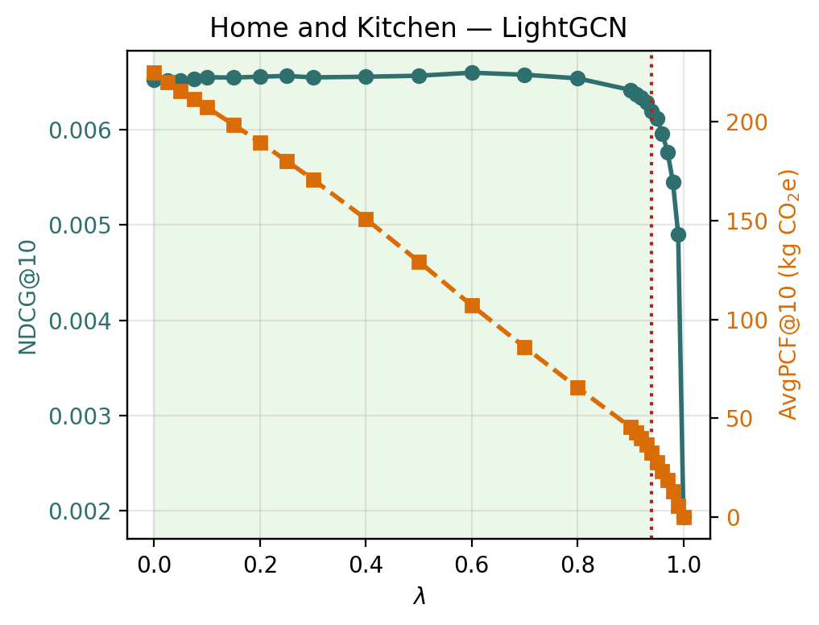
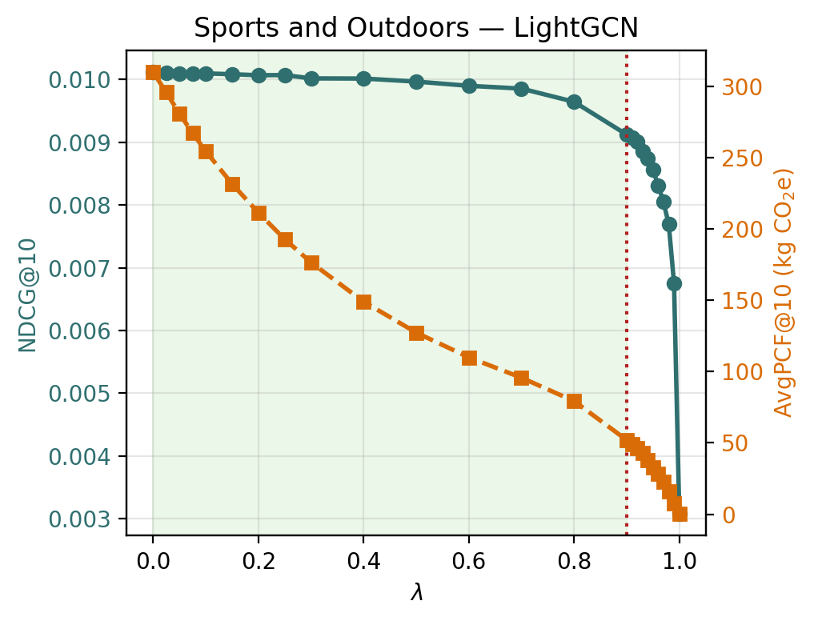
Carbon-Aware Re-ranking for E-commerce Recommendations
23 / 30
Appendix - λ-Sensitivity: LightGCN
NDCG@10 and AvgPCF@10 as functions of λ for the LightGCN backbone across all three categories
(a) Electronics
(b) Home & Kitchen
(c) Sports & Outdoors
LightGCN exposes substantial carbon headroom before engagement degrades: in every category, carbon reductions above 60 % are available at essentially unchanged NDCG.
CS 294 DAM · Spring 2026 · UC Berkeley

