Slide 1
CS294 | UC BERKELEY
Trading Engagement
for Sustainability
Carbon-Aware Re-ranking for E-commerce Recommendations
Can we reduce the carbon footprint of recommendations
without destroying recommendation quality?
Anders Vestrum · Jørgen Bergh · Noah Lund Syrdal
University of California, Berkeley

Slide 2
MOTIVATION
Why Recommenders Should Care About Carbon
$27T
Global e-commerce sales, 2022 (UNCTAD)
The Setup
Recommender systems optimize engagement,
but they also shape what people actually buy.
Product Carbon Footprint (PCF) is a useful sustainability signal — but it is missing for almost all catalog items.
~0%
Catalog items with a Product Carbon Footprint label
2024/825
EU directive mandating environmental transparency at point of purchase
The challenge is not just ranking greener items.
It is first estimating which items are greener at all.
Trading Engagement for Sustainability | CS294
2

Slide 3
THE ASK
Research Questions & Main Idea
RQ1
RQ2
RQ3
How does carbon-aware re-ranking affect recommendation quality?
How much carbon reduction can we get with acceptable engagement loss?
Do different recommendation models expose different trade-offs?
MAIN IDEA
Estimate product carbon footprints, then re-rank recommendation candidates using a tunable trade-off between engagement and carbon.
Trading Engagement for Sustainability | CS294
3

Slide 4
OVERVIEW
End-to-End Pipeline
1
2
3
4
5
Data
PCF Estimation
Candidate Gen.
Re-ranking
Evaluation
Carbon Catalogue
+ Amazon metadata
NN average, zero-shot,
few-shot LLM
RecBole: BPR,
NeuMF, LightGCN
Engagement × Carbon
(tunable λ)
NDCG@10, Recall@10,
AvgPCF@10
Upstream challenge
Downstream knob
Amazon items lack PCF labels, so we first transfer carbon supervision from a small labelled Carbon Catalogue to the large unlabeled catalog.
One explicit parameter λ interpolates between pure engagement (λ = 0) and pure carbon minimization (λ = 1).
Trading Engagement for Sustainability | CS294
4

Slide 5
METHOD, PART 1
Step 1: Estimating Product Carbon Footprint
SUPERVISION
Three estimation strategies
Carbon Catalogue
1
Nearest-neighbour average
866 life-cycle-assessed products
Mean PCF of top-k retrieved labelled products.
TRANSFER
all-MiniLM-L6-v2 embeddings
2
Zero-shot LLM
Amazon items are embedded from title + description; labelled neighbours are retrieved by semantic similarity.
LLM predicts PCF from product text alone.
3
Few-shot retrieval-augmented LLM
LLM conditioned on retrieved labelled exemplars.
Result: full-coverage PCF signal on the catalog.
Trading Engagement for Sustainability | CS294
5

Slide 6
METHOD, PART 2
Step 2: Carbon-Aware Re-ranking
Candidate generators
Sweeping λ traces the frontier
BPR
NeuMF
LightGCN
λ = 0
λ = 1
Pure engagement
Pure carbon minimization
RE-RANKING SCORE
s_{u,i} = (1 − λ) · engagement_{norm} − λ · carbon_{norm}
Why this framing?
One transparent knob. One explicit objective. No hidden retraining.
Post-hoc re-ranking avoids expensive re-training, isolates the trade-off in one parameter, and keeps the engagement model auditable.
Trading Engagement for Sustainability | CS294
6

Slide 7
EVALUATION SCOPE
Experimental Setup
DATASET
Amazon Reviews — three product categories
Electronics
Home & Kitchen
Sports & Outdoors
High-spread catalog
Tight PCF range
Largest carbon headroom
METRICS
NDCG@10
Recall@10
AvgPCF@10
Ranking quality
Coverage of relevant items
Mean carbon footprint of top-10
Evaluated across a sweep of λ ∈ {0.0, 0.1, ..., 1.0} to trace the engagement–carbon frontier.
Trading Engagement for Sustainability | CS294
7

Slide 8
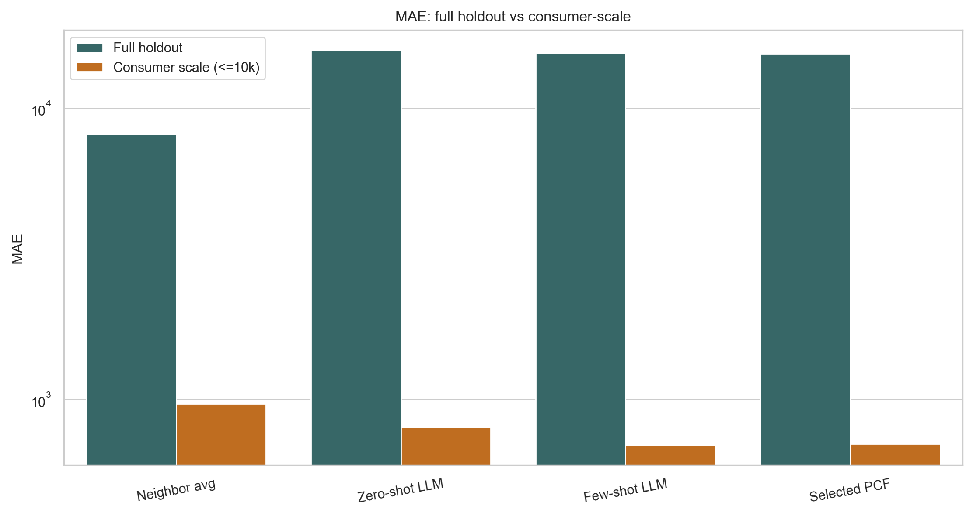
RESULT, UPSTREAM
PCF Estimation: Good Enough to Use
TAKEAWAYS
Few-shot LLM
Best absolute-error metrics on the consumer-scale subset (MAE 695, median AE 59).
Neighbour average
Best rank correlation (Spearman ρ ≈ 0.73) — preserves ordering.
Selected hybrid PCF
Nearly matches few-shot accuracy while keeping full catalog coverage.
Mean absolute error on the consumer-scale holdout.
Trading Engagement for Sustainability | CS294
8

Slide 9
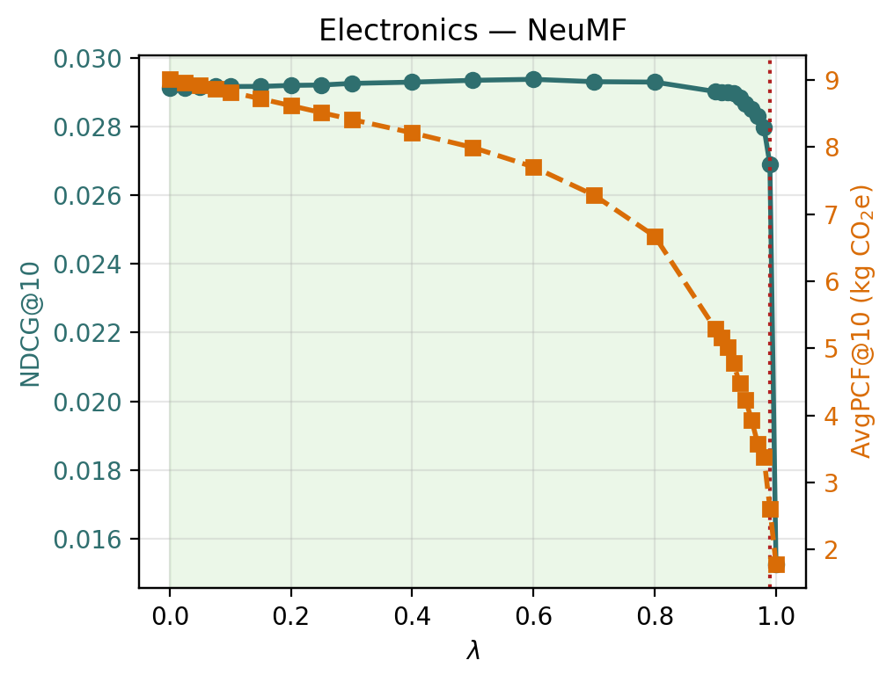
MAIN RESULT
The Central Finding: Plateau, Then Cliff
THE SHAPE
Not a smooth sacrifice curve.
A plateau, then a cliff.
AvgPCF@10 falls steadily as λ grows.
NDCG@10 stays nearly flat across a wide λ range.
Engagement only collapses at λ = 1 — the carbon-only endpoint.
λ-sensitivity, Electronics / NeuMF. NDCG@10 (solid) vs AvgPCF@10 (dashed).
Trading Engagement for Sustainability | CS294
9

Slide 10
RESULT, RQ3
Model Comparison: Which Backbone Wins?
NDCG@10 AT λ*
BPR
LightGCN
NeuMF
Elec.
0.0094
0.0158
0.0289
H & K
0.0115
0.0119
0.0327
S & O
0.0059
0.0139
0.0155
NeuMF has the highest NDCG@10 baseline in all three categories.
NeuMF
LightGCN
BPR
BEST FOR QUALITY
BEST FOR REDUCTION
STRONG BUDGET OPTION
Strongest absolute engagement baseline in every category.
Exposes the most carbon headroom within a 5% NDCG budget (e.g. 66% in Sports & Outdoors).
Large practical carbon cuts at λ = 0.9 when baseline engagement is not the priority.
Trading Engagement for Sustainability | CS294
10

Slide 11
RESULT, CATEGORY EFFECTS
Category Matters: The Trade-off Depends on the Catalog
MAX CARBON REDUCTION WITHIN 5% NDCG BUDGET (%)
BPR
LightGCN
NeuMF
Sports & Outdoors
Electronics
41.9%
45.7%
11.2%
Largest headroom — up to 66.0% reduction (LightGCN) within a 5% NDCG budget.
Home & Kitchen
34.7%
29.8%
38.1%
Electronics
Meaningful room for graph-based models (LightGCN 45.7%, BPR 41.9%).
Sports & Outdoors
64.2%
66.0%
31.3%
Home & Kitchen
Tighter overall, but NeuMF is the notable exception (38.1% at λ = 0.9).
0%
70%
Values from paper, §5.5 & Table 2 (main.tex).
The achievable trade-off is driven jointly by recommendation backbone and category-specific carbon scale.
Trading Engagement for Sustainability | CS294
11

Slide 12
SYNTHESIS
What We Learned
01
02
Substantial carbon reduction is available.
At low engagement cost.
Up to 66% less carbon in the recommended top-10 — before engagement collapses.
For λ up to ~0.6–0.9, NDCG@10 stays essentially flat across nine model–category combinations.
03
04
Transparent post-hoc control.
Operating point is not universal.
A single interpretable parameter — no hidden objective, no retraining of the recommender.
Best λ depends on both the recommendation backbone and the category-specific carbon scale.
Sustainability objectives can be added to existing recommender systems — without retraining everything from scratch.
Trading Engagement for Sustainability | CS294
12

Slide 13
HONEST CAVEATS
Limitations & Next Steps
LIMITATIONS
FUTURE WORK
Predicted PCFs, not true LCAs
Better PCF estimation
Estimation errors propagate into the carbon term.
Structured supply-chain data, domain-specific carbon models.
Offline evaluation only
End-to-end multi-objective training
User response to sustainability-aware rankings is not observed.
Carbon term as a training loss, not only a re-ranking score.
Reviews as engagement proxy
User studies and online A/B tests
Amazon reviews are selection-biased and sparse.
Measure real purchase response, transparency, and explanations.
Trading Engagement for Sustainability | CS294
13

Slide 14
THANK YOU
Questions?
Trading Engagement for Sustainability — Carbon-Aware Re-ranking for E-commerce Recommendations
github.com/andersvestrum/carbon-aware-recsys

