Slide 1

Не синхронный Python

Slide 2
Зачем
Много ввода-вывода
Много вычислений
Фоновая работа

Slide 3
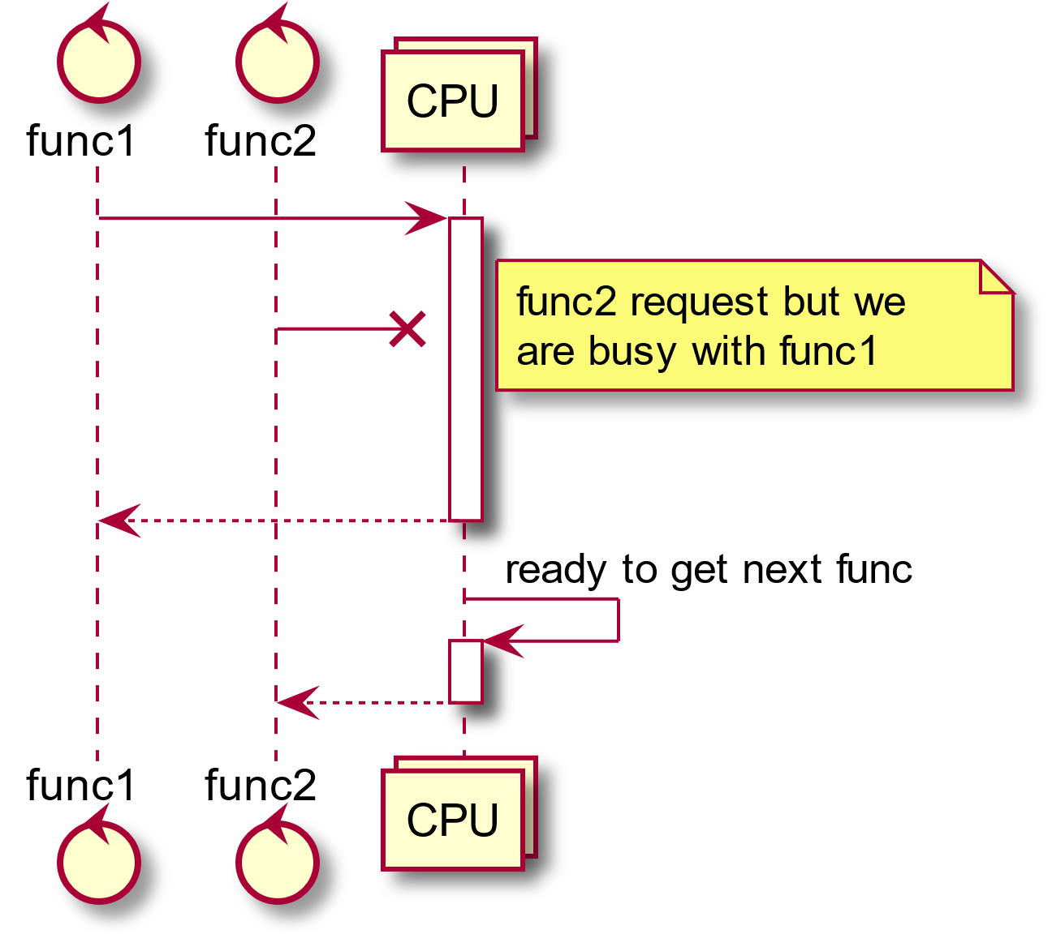
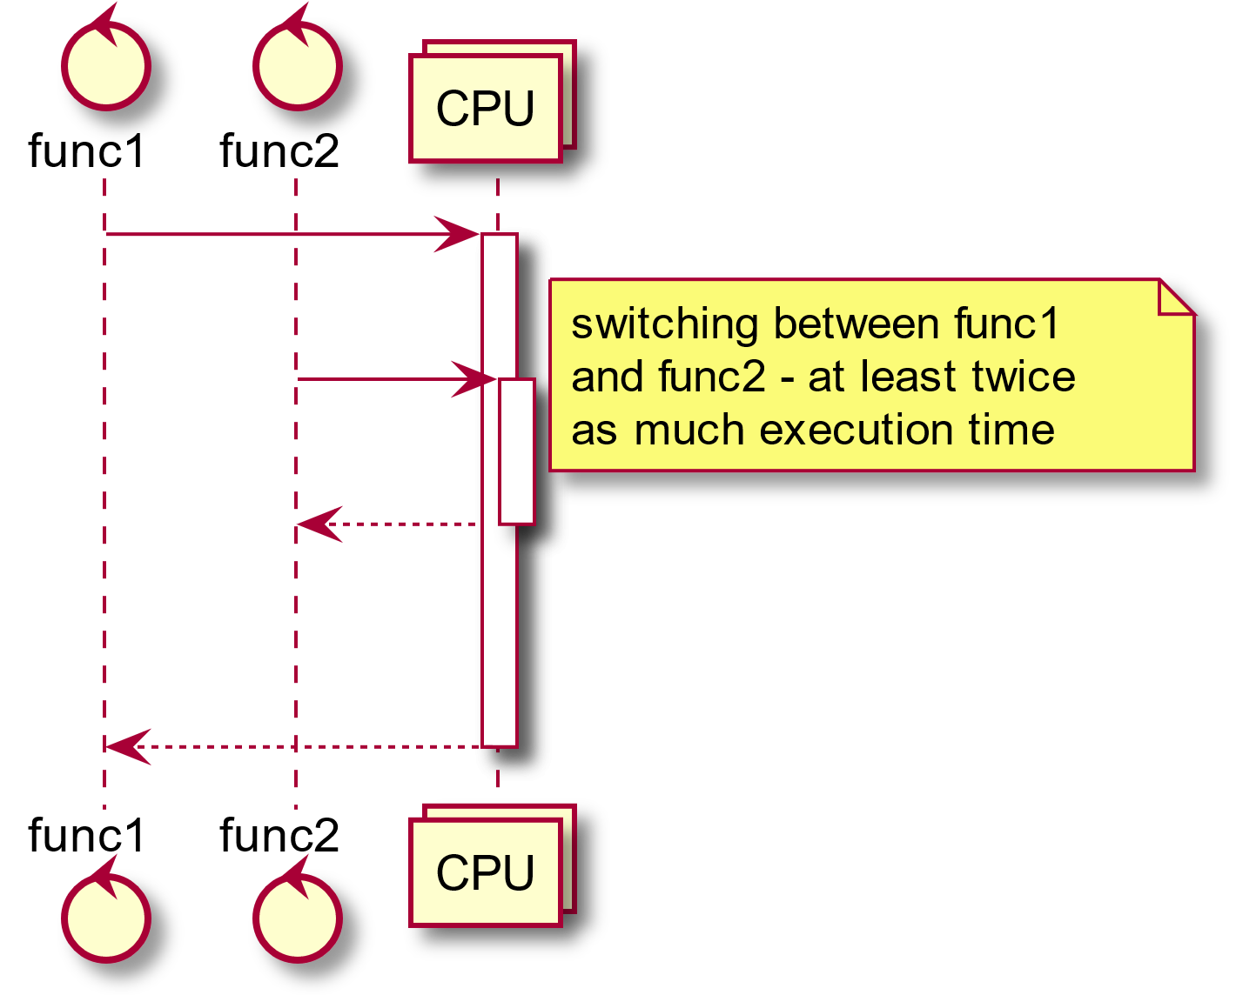
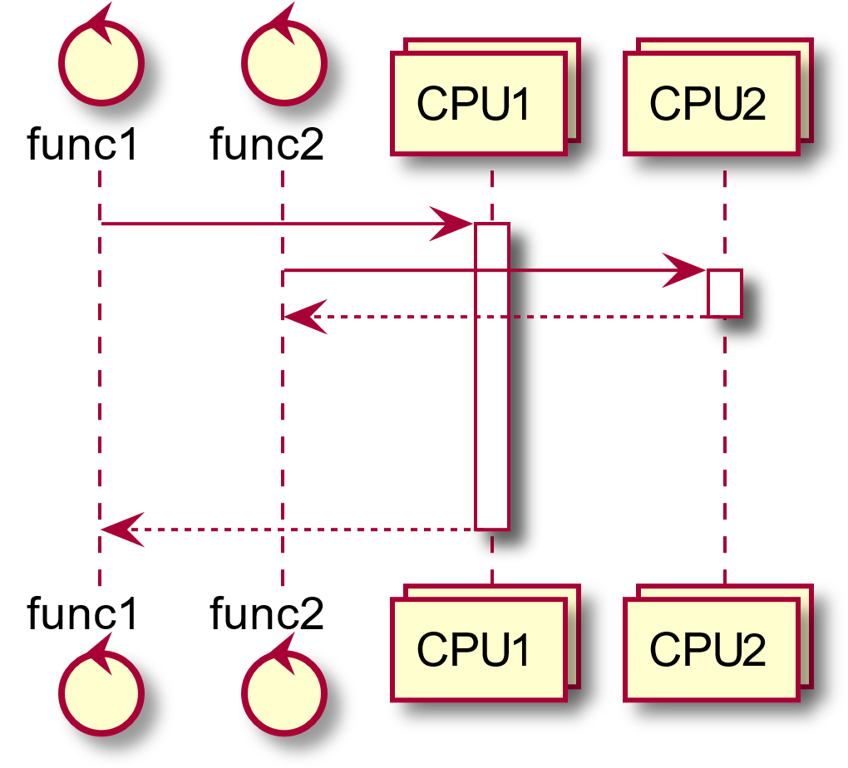
Архитектура

Slide 4
Python GIL
CPython
io
NumPy

Slide 5
Multiprocessing
import multiprocessing as mp
import time
def f(name, timeout, queue):
time.sleep(timeout)
print('hello', name)
queue.put(name + ' done!')
queue = mp.SimpleQueue() # queue for communicating with the processes we will spawn
bob = mp.Process(target=f, args=('bob', 0.3, queue))
bob.start() # start the process
alice = mp.Process(target=f, args=('alice', 0.1, queue))
alice.start() # start the process
# wait for processes to complete
bob.join()
alice.join()
# print results from intercommunication object
for result in iter(queue.get, None):
print(result)

Slide 6
Threading
import threading
import time
import queue
def f(name, timeout, queue):
time.sleep(timeout)
print('hello', name)
queue.put(name + ' done!')
q = queue.Queue() # thread-safe queue
bob = threading.Thread(target=f, args=('bob', 0.3, q))
bob.start() # start the thread
alice = threading.Thread(target=f, args=('alice', 0.1, q))
alice.start() # start the thread
# wait for threads to complete
bob.join()
alice.join()
# print results from intercommunication object
for result in iter(q.get, None):
print(result)

Slide 7
gevent
import gevent
from gevent import monkey; monkey.patch_all()
import time
def f(name, timeout):
time.sleep(timeout)
print('hello', name)
return name + ' done!'
bob = gevent.spawn(f, 'bob', 0.3)
bob.start() # start the greenlet
alice = gevent.spawn(f, 'alice', 0.1)
alice.start() # start the greenlet
# wait for greenlets to complete
bob.join()
alice.join()
# print results
print(bob.value)
print(alice.value)

Slide 8
asyncio
import asyncio
async def f(name, timeout):
await asyncio.sleep(timeout)
print('hello', name)
return name + ' done!'
async def main():
bob = asyncio.create_task(f('bob', 0.3)) # start the coroutine
alice = asyncio.create_task(f('alice', 0.1)) # start the coroutine
# wait for coroutines to complete
print(await bob)
print(await alice)
asyncio.run(main()) # implicitly starts the loop

Slide 9
Callback hell
import asyncio
async def f(name, timeout, on_result):
await asyncio.sleep(timeout)
print('hello', name)
on_result(name + ' done!')
def on_result(msg):
print(msg)
async def main():
bob = asyncio.create_task(f('bob', 0.3, on_result)) # start the coroutine
alice = asyncio.create_task(f('alice', 0.1, on_result)) # start the coroutine
# wait for coroutines to complete
await bob
await alice
asyncio.run(main()) # implicitly starts the loop

