Slide 1























Home
Scope
Investigate
Explore
Optimise
Home
Investigate
Scope
Explore
Optimise
Home
Scope
Investigate
Explore
Optimise
Investigate
Topline Results
Results by Cell
Drivers of performance

Slide 2

Home
Scope
Investigate
Explore
Optimise

Slide 3





Home
Scope
Investigate
Explore
Optimise
Welcome to the global Media Allocation Tool!
Investigation
Asfdskgd+glmsfkvk jkpkmpdsfjjki idjfdjoj o´ksadjfko jokásdjf ko kasdkjf jkksad kjfp km
GsdgsfdAsfdskgd+glmsfkvk jkpkmpdsfjjki idjfdjoj o´ksadjfko jokásdjf ko kasdkjf jkksad kjfp km
Asfdskgd+glmsfkvk jkpkmpdsfjjki idjfdjoj o´ksadjfko jokásdjf ko kasdkjf jkksad kjfp km
Asfdskgd+glmsfkvk jkpkmpdsfjjki idjfdjoj o´ksadjfko jokásdjf ko kasdkjf jkksad kjfp km
Exploration
Asfdskgd+glmsfkvk jkpkmpdsfjjki idjfdjoj o´ksadjfko jokásdjf ko kasdkjf jkksad kjfp km
GsdgsfdAsfdskgd+glmsfkvk jkpkmpdsfjjki idjfdjoj o´ksadjfko jokásdjf ko kasdkjf jkksad kjfp km
Asfdskgd+glmsfkvk jkpkmpdsfjjki idjfdjoj o´ksadjfko jokásdjf ko kasdkjf jkksad kjfp km
Asfdskgd+glmsfkvk jkpkmpdsfjjki idjfdjoj o´ksadjfko jokásdjf ko kasdkjf jkksad kjfp km
Optimization
Asfdskgd+glmsfkvk jkpkmpdsfjjki idjfdjoj o´ksadjfko jokásdjf ko kasdkjf jkksad kjfp km
GsdgsfdAsfdskgd+glmsfkvk jkpkmpdsfjjki idjfdjoj o´ksadjfko jokásdjf ko kasdkjf jkksad kjfp km
Asfdskgd+glmsfkvk jkpkmpdsfjjki idjfdjoj o´ksadjfko jokásdjf ko kasdkjf jkksad kjfp km
Asfdskgd+glmsfkvk jkpkmpdsfjjki idjfdjoj o´ksadjfko jokásdjf ko kasdkjf jkksad kjfp km

Slide 4

Home
Scope
Investigate
Explore
Optimise

Slide 5

Back to Home
Scope

Slide 6

Back to Home
Investigate

Slide 7

Back to Home
Explore

Slide 8

Back to Home
Optimise
#BFBFBF
#FFC000
#024B76
#007DBB
Propuesta para las graficas de pie

Slide 9
Back to Home
Optimise
#5B9BD5
#A9D18E
#002060
#FFC000
#F4B183
#71C5E8
#7F7F7F
Propuesta para las graficas de pie

Slide 10
PALETA DE COLORES
#00B389
#71C5E8
#CDCD29
#005EB8
#EC8B24
#00A9E0
#9C2744
#00B2A9
#6BA443
#004976
#E2E01C

Slide 11
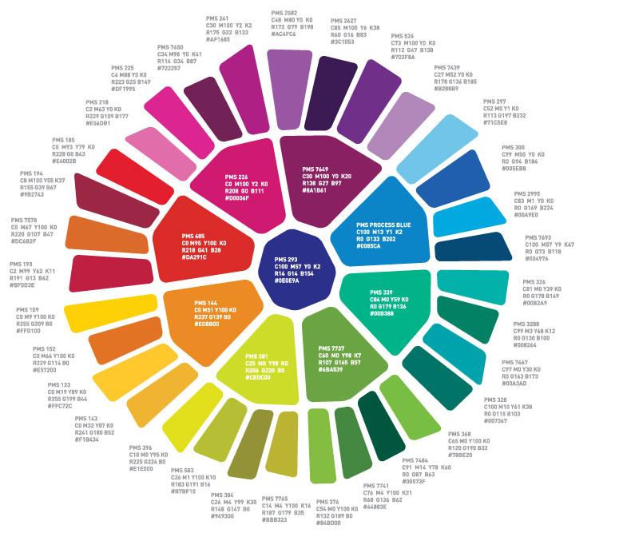
#004976

