Slide 1
Database Systems Term Project
111221007
POREDDY CHANDRAMOHAN REDDY

Slide 2

MIK – Mayur Indian Kitchen E-commerce groceries store
Mayur Indian Kitchen have a chain of Indian restaurants in Taiwan.
They’re already in offline Indian grocery business where people visit MIK stores to buy groceries.
Now the business wants to go online with an E-commerce website and mobile applications.
→ http://www.cmrlabs.com
To achieve this business goal, we need a database where we can manage products, customers, orders, payments etc.,

Slide 3
MIK – Mayur Indian Kitchen E-commerce groceries store
It’s an E-commerce platform where Seller can list their product.
Products listed will be showed on the website and mobile app.
Buyer can register in this website.
Buyer can place orders.
Buyer can pay for the orders.
Buyer can cancel the orders.
Products can be managed by the Seller.
Orders can be managed by the Buyer.

Slide 4
Important data & relationship between data
Merchants
We have merchant details.
Merchant can list products that they want to sell.
Merchant can add/update/delete products.
Products
Customers can place orders from the list of products.
Customers can pay for the orders that are placed.
Customers
Customers can place orders.
Customers can pay for the orders that are placed.
Orders
List of orders placed by customers will be in the orders table.
Customers can pay for the orders that are placed.

Slide 5
Important data & relationship between data
Payments
Customer can pay for their orders.
Order_details
List of products ordered by the customers.
Details of the orders will be under order details table.

Slide 6
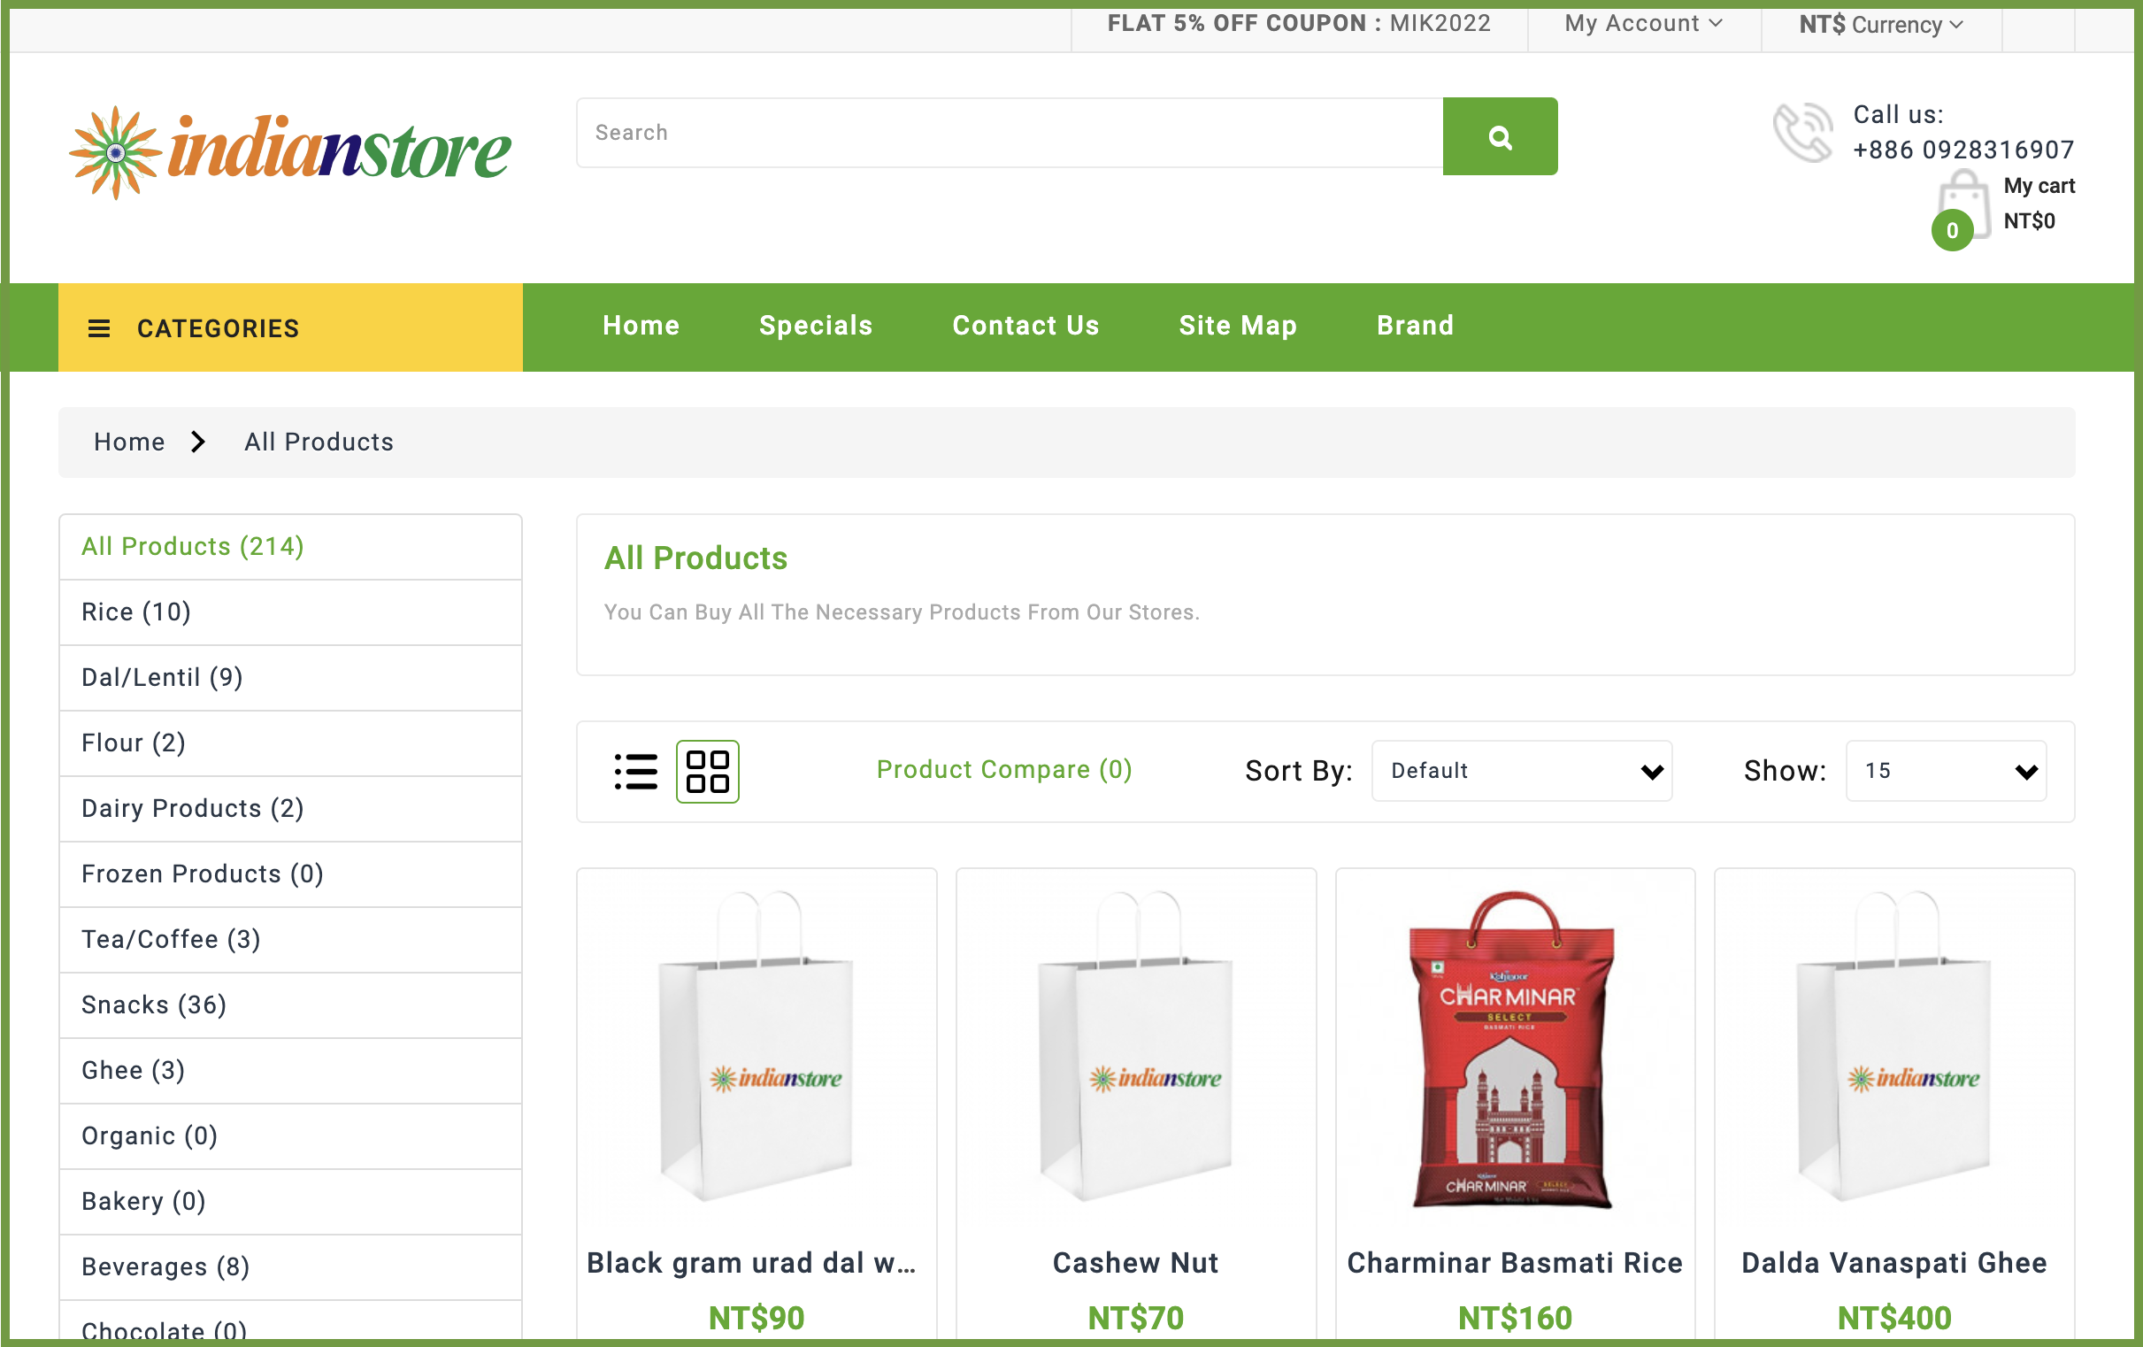
Possible uses of the database
http://www.cmrlabs.com/

Slide 7
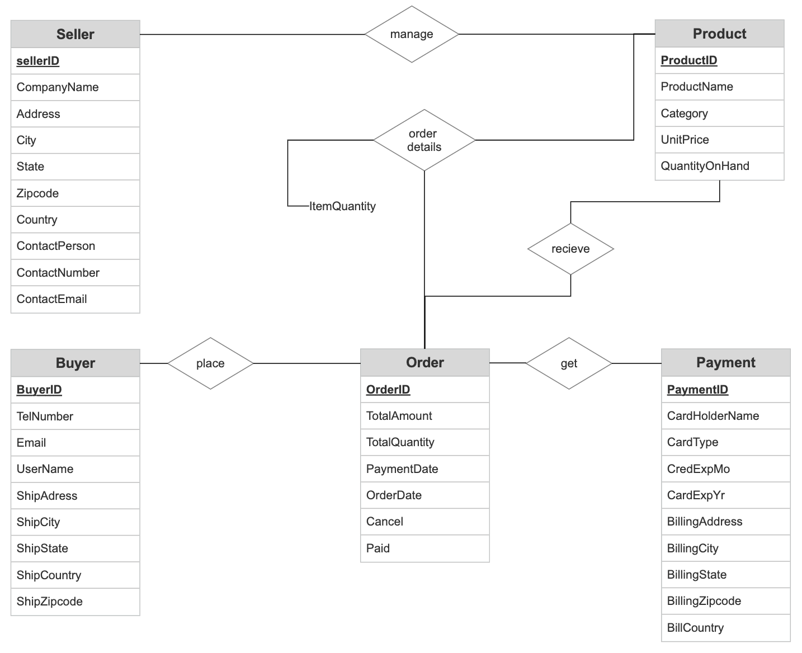
ER Diagram

Slide 8
ER Diagram
contactPerson
Category
country
ProductName
UnitPrice
contactNumber
zipcode
QuantityOnHand
ItmeQuantity
state
contactEmail
ProductID
BillingZipcode
city
BillingCountry
address
Product
Order_Detail
CompanName
BillingState
SellerID
BillingCity
Seller
add
receive
BillingAddress
Buyer
place
Order
get
Payment
BuyerID
TelNumber
TotalAmount
PaymentID
ShipAddress
Email
zipcode
TotalQuantity
ShipDate
CardType
city
UserName
country
CreditCard
state
PaymentDate
Paid
cardHolderName
CredExpYr
OrdertDate
Cancel
CredExpMo

Slide 9
Seller
Seller (SellerID, CompanyName, Address, City, State, Zipcode, Country, ContactPerson, ContactNumber, ContactEmail)
SellerID → CompanyName, Address, City, State, Zipcode, Country, ContactPerson, ContactNumber, ContactEmail

Slide 10
Product
Product (ProductID, ProductName, SellerID, Category, UnitPrice, Color, QuantityOnHand)
ProductID → ProductName, Category, UnitPrice, Color, QuantityOnHand
SellerID → Foreign Key

Slide 11
Buyer
Buyer (BuyerID, TelNumber, Email, UserName, ShipAdress, ShipCity, ShipState, ShipCountry, ShipZipcode)
BuyerID → TelNumber, Email, UserName, ShipAdress, ShipCity, ShipState, ShipCountry, ShipZipcode

Slide 12
Orders
Orders (OrderID, BuyerID, TotalAmount, TotalQuantity, PaymentID, PaymentDate, OrderDate, Cancel, Paid, ShippingID)
OrderID → TotalAmount, TotalQuantity, PaymentDate, OrderDate, Cancel, Paid
BuyerID → Foreign Key
PaymentID → Foreign Key
ShippingID → Foreign Key

Slide 13
Payment
Payment (PaymentID, CardHolderName, CardType, CreditCard, CredExpMo, CardExpYr, BillingAddress, BillingCity, BillingState, BillingZipcode, BillCountry)
PaymentID → CardHolderName, CardType, CreditCard, CredExpMo, CardExpYr, BillingAddress, BillingCity, BillingState, BillingZipcode, BillCountry

Slide 14
Order_Details
Order_Details (OrderID, ProductID, ItemQuantity)
OrderID, ProductID → ItemQuantity

Slide 15
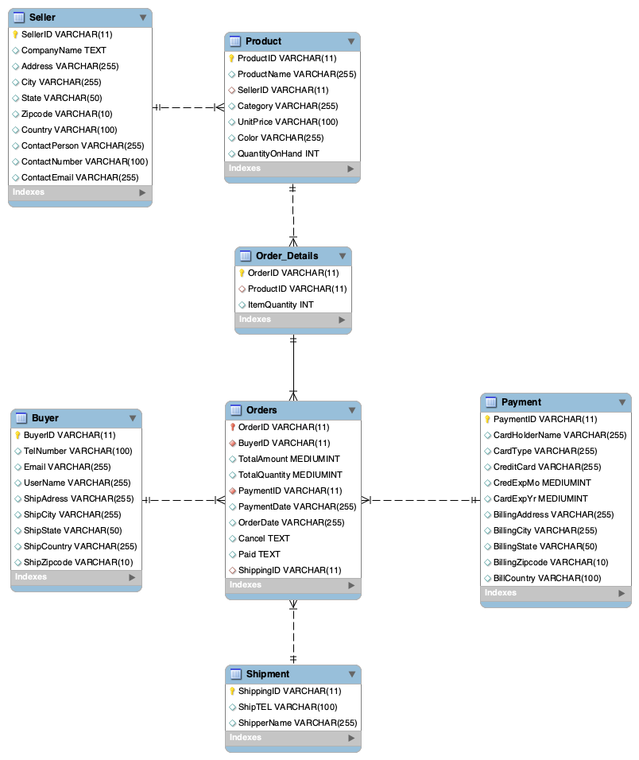

Slide 16
Non-trivial queries
Sum of total sales in a city (Ex.Bengaluru) on each day in the 2nd Quarter of 2022 in descending order.
Find the BuyerName, ProductName, OrderQuantity using orderID (Ex. 89878325779)?
Finding the buyers whose credit card is expiring this year [2022].
Find the address of a buyer based on the shippingID.

Slide 17
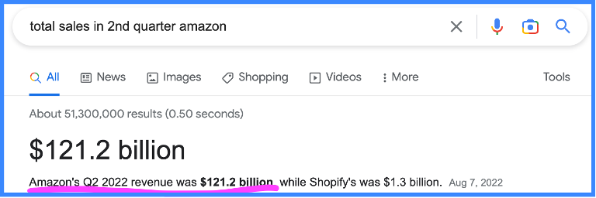
Non-trivial queries – cont..
Sum of total sales in a city (Ex.Bengaluru) on each day in the 2nd Quarter of 2022 in descending order.
SELECT buyer.shipCity, SUM(total_amount), orders.orderDate FROM orders, buyer WHERE orders.OrderDate BETWEEN '2022-04-01' AND '2022-06-30' AND buyer.ShipCity ='Bengaluru' GROUP BY OrderDate ORDER BY OrderDate DESC;

Slide 18
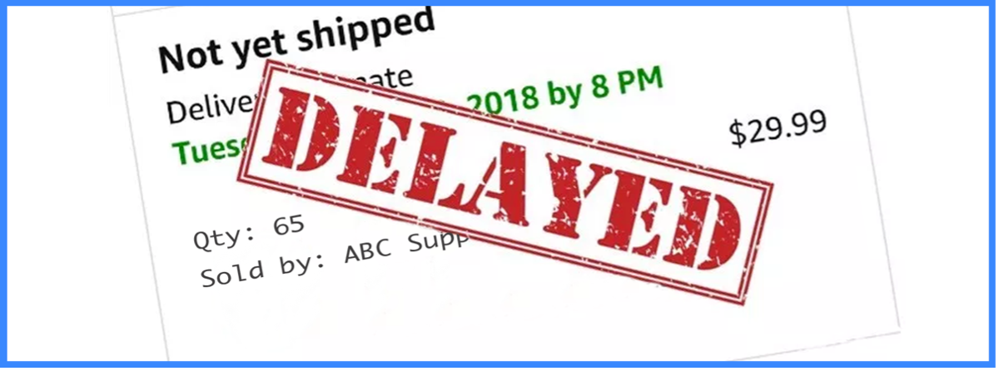
Non-trivial queries – cont..
Find the BuyerName, ProductName, OrderQuantity using orderID (Ex. 89878325779)?
SELECT Buyer.UserName, Products.ProductName FROM Buyer LEFT JOIN Orders ON Buyer.BuyerID = Orders.BuyerID LEFT JOIN Order_Details ON Orders.OrderID = Order_Details.OrderID LEFT JOIN Products ON Order_Details.ProductID = Products.ProductID WHERE Orders.OrderID = '89878325779';

Slide 19
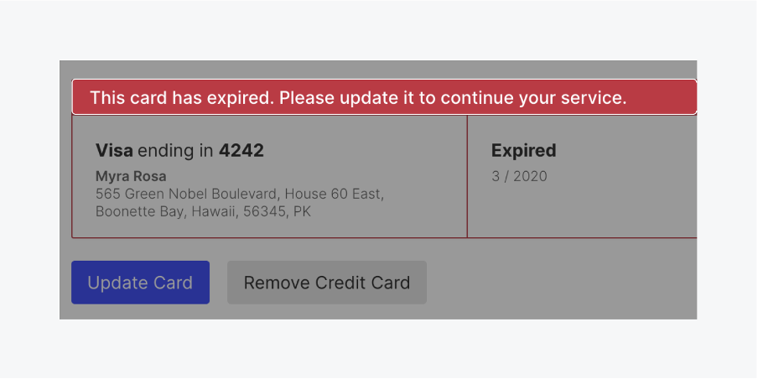
Non-trivial queries – cont..
Finding the buyers whose credit card is expiring this year [2022].
SELECT UserName, Email FROM BUYER LEFT JOIN ORDERS ON BUYER.BUYERID = ORDERS.BUYERID LEFT JOIN PAYMENT ON PAYMENT.PaymentID = ORDERS.PAYMENTID WHERE Payment.CardExpYr <= YEAR(CURDATE());

Slide 20
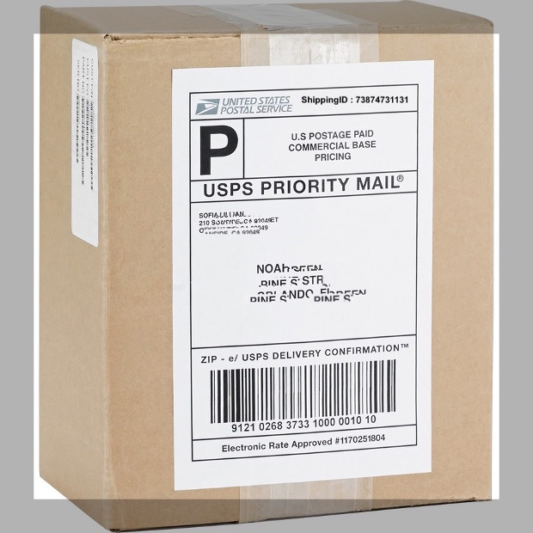
Non-trivial queries – cont..
Find the address of a buyer based on the shippingID.
SELECT UserName,TelNumber, ShipAdress, ShipCity, ShipZipcode FROM Buyer RIGHT JOIN ORDERS ON Buyer.BuyerID = Orders.BuyerID RIGHT JOIN Shipment ON Orders.ShippingID = Shipment.ShippingID WHERE Shipment.ShippingID = '73874731131';

Slide 22
END

Slide 23
Procedure
1.Select a suitable application, identify the important data and relationships among data, and specify possible uses of the database.
2.Draw an ER diagram to design the conceptual schema.
3.Transform the conceptual schema into relational schemas.
4.Present the results on 12/5/2022(including 1, 2, and 3).
5.Find a DBMS to use and create a database based on the relational schemas from Step 3.
6.Run at least 3non-trivial queries in SQL to show that your design does fulfill the possible uses of the database stated in Step 1.
7.Present and demo your project on 1/9/2023.

