Slide 2
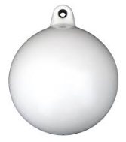
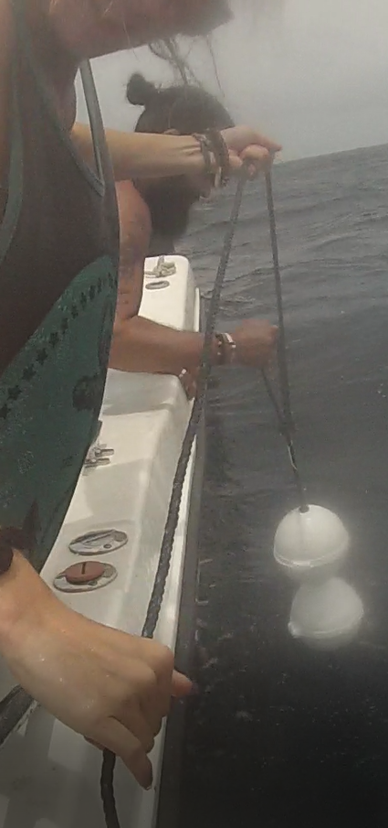

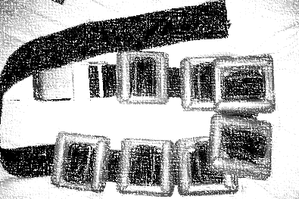
Methods – Reef Scale
Drop Camera
50 m
Drive boat to center of cell and drift 0 – 25m
Deployed 100 drops on calm days (usually one recovery on SCUBA)
September 2016, November 2016, March 2017
3m

