Slide 1
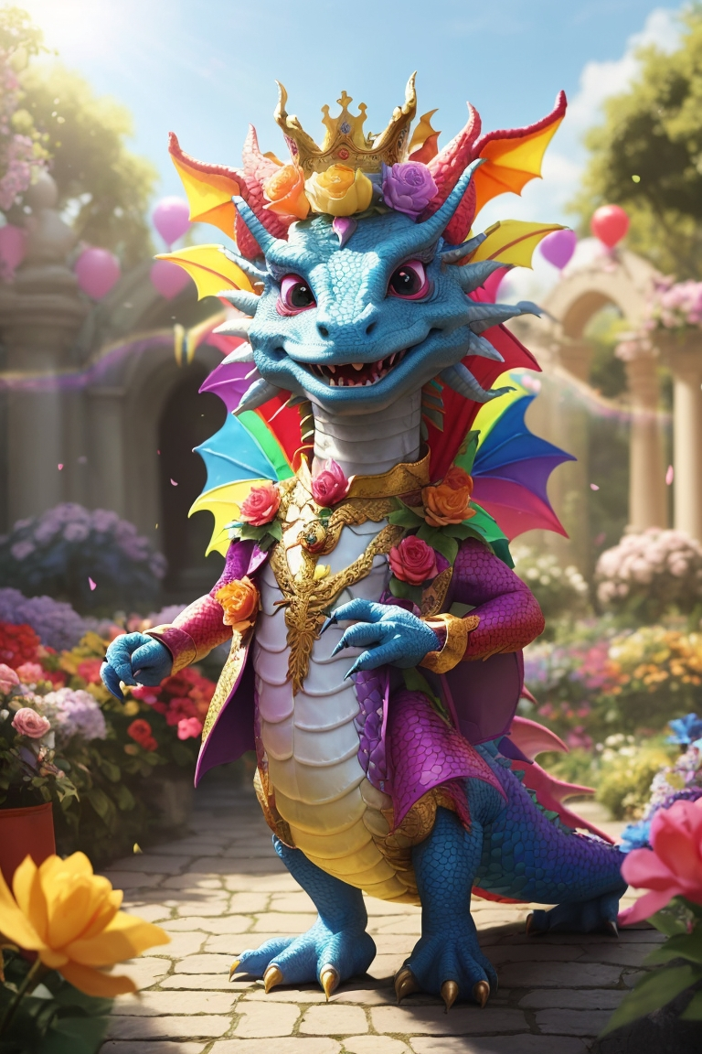
FantasyQuest Worldwalker Battles
App und Praesentation
von
Alfred Narjes

Slide 2



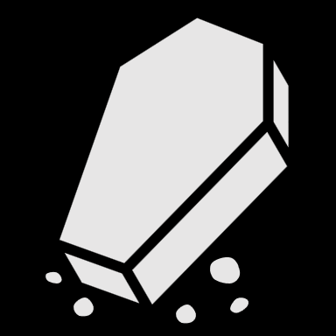

















Features
Login / Register
Bewegen auf der Map
Registrieren
Username, Key, Passwort
Login
Username, Passwort
Spieler bewegt sich auf der Map, dadurch wird ein Kampf ausgelöst
Charaktere auswählen
Kampf und Kampfsystem
Bereits erstellte Charaktere auswählen
Kampfsystem, Schwierigkeit
und Workarounds
Charaktere erstellen
Inventar / Ausrüstung
Neuen Level Eins Charakter erstellen
Zugang, Ansicht und
Zukünftige implementation

Slide 3
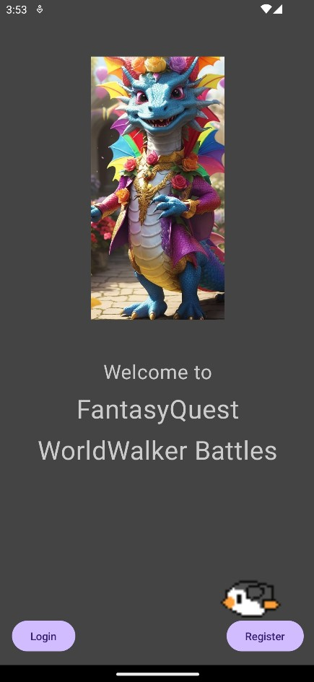
Version 0.9.1
Zukünftig:
Statt E-Mail einen limitierten Key
Spielprinzip wird Roguelike bzw. Roguelite
Hosting mittels Firebase
Authentifizierung
Möglichkeit Feedback abzuschicken
Balancing
Items und Ausrüstung
Release im PlayStore

Slide 4
Ablauf
01
02
03
04
Live Demo
Map
Battle
Musik
App in Aktion
Einbindung von Mapbox
Kampfsystem und Trigger
Verwendung des Media Players

Slide 5
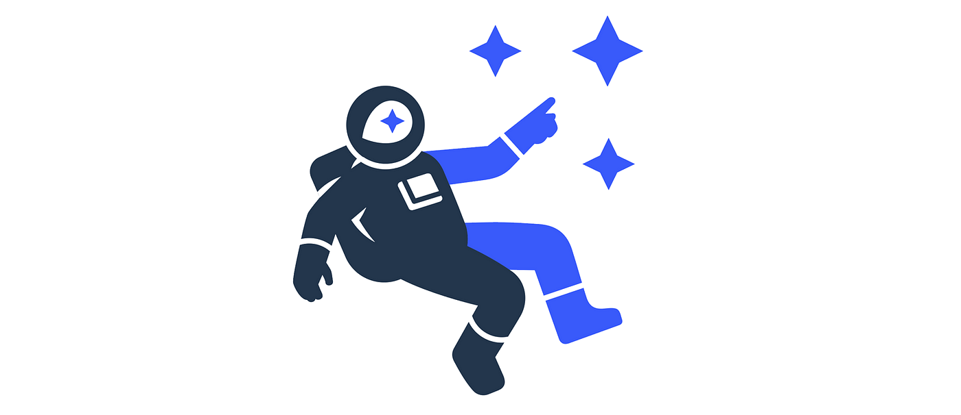
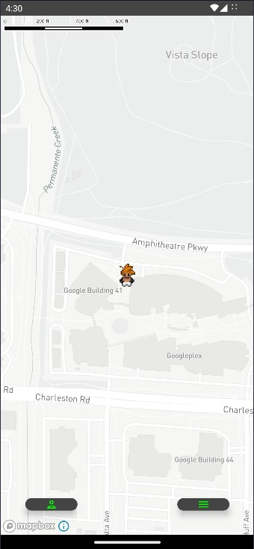
Map
Mapbox
bzw.
OpenStreetmaps

Slide 6
Screen
LaunchedEffect(true) { locationProvider.requestLocationUpdates( LocationRequest.Builder(1000).build(), object : LocationCallback() {
@SuppressLint("MissingPermission") override fun onLocationResult(result: LocationResult) { locationProvider.lastLocation.addOnSuccessListener { vm.setPoint(Point.fromLngLat(it.longitude, it.latitude))
if (!GlobalData.beforePointHasSet) { vm.setBeforeLon(it.longitude) vm.setBeforeLat(it.latitude) vm.setLaterLon(it.longitude) vm.setLaterLat(it.latitude) GlobalData.beforePointHasSet = true } else { vm.setLaterLon(it.longitude) vm.setLaterLat(it.latitude) } } } }, Looper.getMainLooper() ) }
val context = LocalContext.current val locationProvider = remember { LocationServices.getFusedLocationProviderClient(context) }
Übergeordetes
Compose
OverworldMap( vm = vm, point = vm.state.point, modifier = Modifier.fillMaxSize(), goBattle = goBattle, goBack = goBack, goProfile = goProfile, goBackpack = goBackpack )

Slide 7
Map
Box(modifier = modifier) { AndroidView( factory = { com.mapbox.maps.MapView(it).apply { getMapboxMap().loadStyleUri(mapStyle) manager = annotations.createPointAnnotationManager() } }, update = { manager?.apply { deleteAll() create( PointAnnotationOptions() .withPoint(point) .withIconImage(marker) ) it.getMapboxMap() .flyTo(CameraOptions.Builder().zoom(16.0).center(point).build()) } NoOpUpdate }, modifier = modifier )
val context = LocalContext.current var manager: PointAnnotationManager? by remember { mutableStateOf(null) }
Untergeordetes
Compose

Slide 8
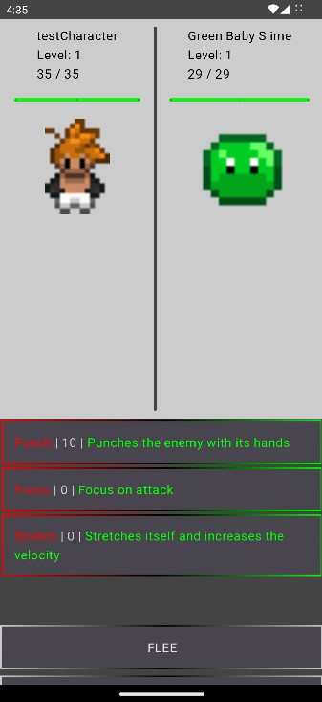
Kampfsystem
Genialität
oder
Wahnsinn?

Slide 9
Triggern
if (vm.state.beforeLat == 0.0){ vm.setBeforeLat(vm.state.laterLat) vm.setBeforeLon(vm.state.laterLon) }
fun calc(): Double { var a = state.beforeLat - state.laterLat a *= a var b = state.beforeLon - state.laterLon b *= b var c = sqrt(a + b) if (c == 0.0) { c = sqrt((a + 0.00000000001) + (b + 0.00000000001)) } return c * 110930.91183254558 }
if (GlobalData.beforePointHasSet){ if (vm.calc().toInt() >= vm.state.metersToGo){ vm.setBeforeLat(vm.state.laterLat) vm.setBeforeLon(vm.state.laterLon) vm.state.mediaPlayer?.release() vm.setMediaPlayer(null) runBlocking { vm.loadMob() goBattle() } } }
if (!GlobalData.beforePointHasSet) { vm.setBeforeLon(it.longitude) vm.setBeforeLat(it.latitude) vm.setLaterLon(it.longitude) vm.setLaterLat(it.latitude) GlobalData.beforePointHasSet = true } else { vm.setLaterLon(it.longitude) vm.setLaterLat(it.latitude) }
Wie ein Kampf
Zustande
kommt

Slide 10
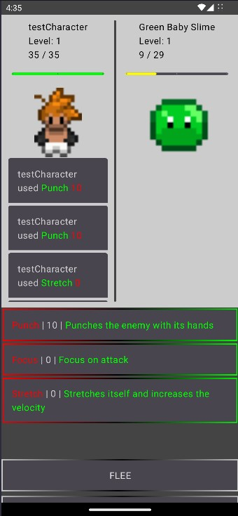
Nicht rundenbasiert
Wenn doppelt so schnell
Zweimal angreifen

Slide 11
Kampf
BattleState( mob, user, user.velocity, mob.velocity, user.velocity, mob.velocity, turnUser = true, // Player always beginns turnMob = false, userLifePoints = user.lifePoints.toFloat(), mobLifePoints = mob.lifePoints.toFloat(), maxUserLifePoints = user.lifePoints.toFloat(), maxMobLifePoints = mob.lifePoints.toFloat(), user.attack, user.defense, user.mageAttack, user.mageDefense, "", "", mutableListOf(""), mutableListOf(""), defeat = false, won = false, user.characterId, mob.exp, null, 0, launchWinMusic = false, launchDefeatMusic = false, launchBattleMusic = true, launchWin = true, launchDef = true )
fun calculateAttack(): Boolean { if (state.calculateVelocityUser - state.calculateVelocityMob <= 0 && state.calculateVelocityMob - state.calculateVelocityUser <= 0) { setUserCalculateVelocity(state.calculateVelocityUser + state.baseVelocityUser) setMobCalculateVelocity(state.calculateVelocityMob + state.baseVelocityMob) }
if (state.calculateVelocityUser > state.calculateVelocityMob) { state.turnUser = true return false } else if (state.calculateVelocityMob > state.calculateVelocityUser) { state.turnMob = true return true } else { state.calculateVelocityUser += 1 state.turnUser = true return false } }
Wie das
Kampfsystem
funktioniert

Slide 12
Musik
if (vm.state.won) { if (vm.state.launchWin){ vm.state.mediaPlayer?.isLooping = false vm.state.mediaPlayer?.stop() vm.state.mediaPlayer?.release() vm.setMediaPlayer(null) }
LaunchedEffect(key1 = vm.state.launch) { if (vm.state.launchBattleMusic) { vm.setMediaPlayer(MediaPlayer.create(context, R.raw.audio_battle)) vm.state.mediaPlayer?.isLooping = true vm.state.mediaPlayer?.start() vm.setLaunchBattleMusic(false) } else if (vm.state.launchWinMusic) { vm.state.mediaPlayer?.release() vm.setMediaPlayer(null) vm.setMediaPlayer(MediaPlayer.create(context, R.raw.audio_win)) vm.state.mediaPlayer?.isLooping = true vm.state.mediaPlayer?.start() vm.setLaunchWinMusic(false) }else if (vm.state.launchDefeatMusic) { vm.state.mediaPlayer?.release() vm.setMediaPlayer(null) vm.setMediaPlayer(MediaPlayer.create(context, R.raw.audio_choose_character)) vm.state.mediaPlayer?.isLooping = true vm.state.mediaPlayer?.start() } }
if (vm.state.launchWin){ vm.setLaunchWinMusic(true) vm.incrementLaunch() vm.setLaunchWin(false) }
Android
MediaPlayer

Slide 13

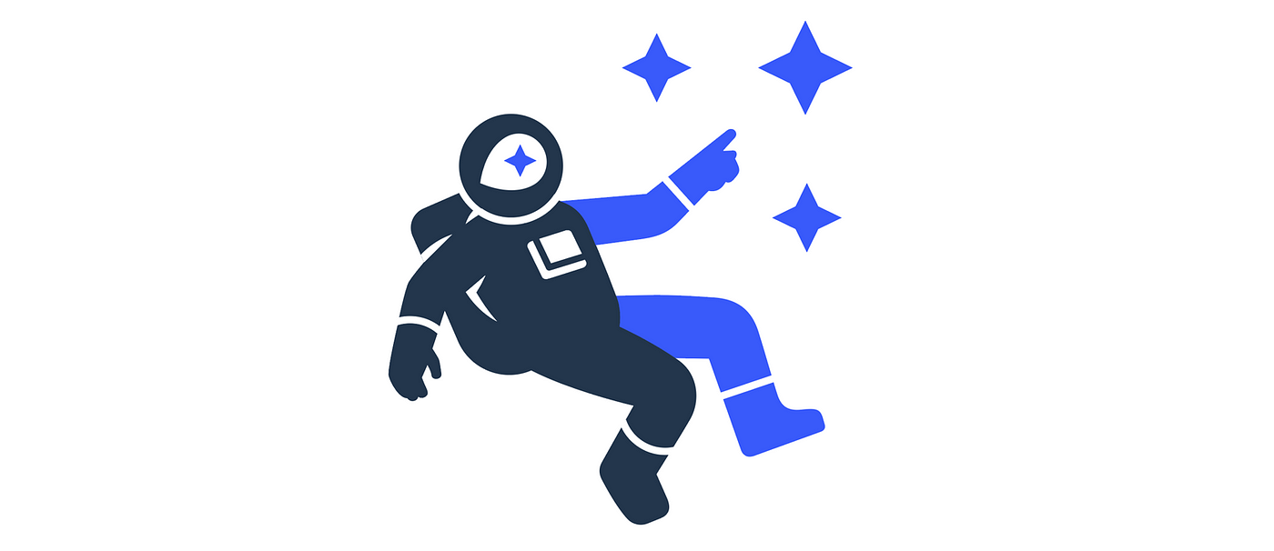











Techstack

Slide 14

Inhalte

Slide 15
Smartphone Infographics
Mars
Despite being red, Mars is a cold place. The planet is full of iron oxide dust
Mercury
Mercury is the closest planet to the Sun and the smallest one in the Solar System
Venus
Venus has a beautiful name and is the second planet from the Sun. It’s terribly hot
Neptune
Neptune is the farthest planet in the Solar System. It’s the fourth-largest by diameter

Slide 16
FantasyQuest Worldwalker Battles
App und Praesentation
von
Alfred Narjes

Slide 17
Smartphone Infographics
01
02
03
04
Mars
Mercury
Neptune
Saturn
Despite being red, Mars is a cold place
Mercury is the closest planet to the Sun
Neptune is the farthest planet from the Sun
Saturn is the ringed one and a gas giant

Slide 18
Smartphone Infographics
Mars
Despite being red, Mars is a cold place. The planet is full of iron oxide dust
Mercury
Mercury is the closest planet to the Sun and the smallest one in the Solar System
Venus
Venus has a beautiful name and is the second planet from the Sun. It’s terribly hot
Neptune
Neptune is the farthest planet in the Solar System. It’s the fourth-largest by diameter

Slide 19
Smartphone Infographics
Venus
Mars
Venus has a beautiful name and it’s terribly hot
Mars is a cold place and is full of iron oxide dust
Neptune
Saturn
Neptune is the farthest planet in the Solar System
Saturn is the ringed one. It’s a gas giant, composed of helium

Slide 20
Smartphone Infographics
Mercury
Mars
Mercury is the closest planet to the Sun and the smallest one in the Solar System
Despite being red, Mars is a cold place. The planet is full of iron oxide dust
Neptune
Saturn
Neptune is the farthest planet in the Solar System. It’s the fourth-largest one
Saturn is the ringed one. It’s a gas giant, composed mostly of hydrogen and helium

Slide 21
Smartphone Infographics
Venus
Mars
Venus has a beautiful name and it’s terribly hot
Mars is a cold place and is full of iron oxide dust
32%
21%
18%
Neptune
14%
Saturn
Neptune is the farthest planet in the Solar System
It’s the ringed one. It’s a gas giant, composed of helium

Slide 22
Smartphone Infographics
Despite being red, Mars is a cold place and is full of iron oxide
Mars
Mercury is the closest planet to the Sun and the smallest one
Mercury
Venus has a beautiful name and is the second planet from the Sun
Venus
Neptune is the farthest planet in the Solar System
Neptune

Slide 23
Smartphone Infographics
Venus
Mars
Venus has a beautiful name and it’s terribly hot
Mars is a cold place and is full of iron oxide dust
Neptune
Saturn
Neptune is the farthest planet in the Solar System
Saturn is the ringed one. It’s a gas giant, composed of helium

Slide 24
Smartphone Infographics
Saturn is the ringed one. It’s a gas giant, composed mostly of hydrogen
Neptune is the farthest planet from the Sun. It’s the fourth-largest by diameter
Despite being red, Mars is a cold place. The planet is full of iron oxide dust

Slide 25
Smartphone Infographics
Venus
Mars
Venus has a beautiful name and it’s terribly hot
Mars is a cold place and is full of iron oxide dust
Neptune
Saturn
Neptune is the farthest planet in the Solar System
it’s the ringed one. It’s a gas giant, composed of helium
Mercury
Jupiter
Mercury is the smallest planet in the Solar System
Jupiter is the biggest planet in the entire Solar System

Slide 26
Smartphone Infographics
Mars
Despite being red, Mars is a cold place. The planet is full of iron oxide dust
Mercury
Mercury is the closest planet to the Sun and the smallest one in the Solar System
Venus
Venus has a beautiful name and is the second planet from the Sun. It’s terribly hot
Neptune
Neptune is the farthest planet in the Solar System. It’s the fourth-largest by diameter
Saturn
Saturn is the ringed one. It’s a gas giant, composed of helium and hydrogen

Slide 27
Smartphone Infographics
Mercury
Mars
Mercury is the closest planet to the Sun and the smallest one in the Solar System
Despite being red, Mars is a cold place. The planet is full of iron oxide dust
Jupiter
Venus
Jupiter is the fourth-brightest object in the sky, and the biggest planet in Solar System
Venus has a beautiful name and is the second planet from the Sun, but it’s terribly hot
Neptune
Saturn
Neptune is the farthest planet in the Solar System. It’s the fourth-largest by diameter
Saturn is the ringed one. It’s a gas giant, composed mostly of hydrogen and helium

Slide 28
Smartphone Infographics
Mercury
Jupiter
Mercury is the closest planet to the Sun
It’s the biggest planet in the Solar System
01
04
Neptune
Saturn
Is the farthest planet in the Solar System
Saturn is the ringed one and a gas giant
02
05
Mars
Venus
Mars is a cold place and is full of iron oxide dust
Venus Is the second planet from the Sun
03
06

Slide 29
Smartphone Infographics
Mercury
Neptune
Mars
Saturn
Is the closest planet and the smallest in the Solar System
Neptune is the farthest planet in the Solar System
Mars is a cold place and is full of iron oxide dust
It’s a gas giant, composed mostly of hydrogen and helium
01
02
03
04

Slide 30
Smartphone Infographics
Venus
Mars
Venus has a beautiful name and it’s terribly hot
Mars is a cold place. The planet is full of iron oxide dust
Neptune
Saturn
Neptune is the farthest planet in the Solar System
Saturn is the ringed one. It’s a gas giant, composed of helium

Slide 31
Smartphone Infographics
01
03
Mercury
Neptune
Mercury is the closest planet to the Sun and the smallest one in the Solar System
Neptune is the farthest planet in the Solar System. It’s the fourth-largest by diameter
02
04
Jupiter
Venus
Jupiter is the fourth-brightest object in the sky and the biggest planet in our Solar System
Venus has a beautiful name and is the second planet from the Sun. It’s terribly hot

Slide 32
Smartphone Infographics
50%
Mars
Despite being red, Mars is a cold place
90%
Mercury
Mercury is the closest planet to the Sun
75%
Neptune
Neptune is the farthest planet from the Sun
20%
Saturn
Saturn is the ringed one and a gas giant

Slide 33
Smartphone Infographics
Mercury
Mars
Is the closest planet and the smallest in the Solar System
Mars is a cold place and is full of iron oxide dust
Neptune
Saturn
Neptune is the farthest planet in the Solar System
It’s a gas giant, composed mostly of hydrogen

Slide 34
Smartphone Infographics
Mercury
70%
35%
Mars
Is the closest planet and the smallest in the Solar System
Mars is a cold place and is full of iron oxide dust
Neptune
35%
50%
Jupiter
Neptune is the farthest planet in the Solar System
Jupiter is the fourth-brightest object in the sky
Venus
50%
25%
Saturn
It’s the second planet from the Sun, but it’s terribly hot
It’s a gas giant, composed mostly of hydrogen and helium

Slide 35
Smartphone Infographics
Mars
Mars is a cold place and is full of iron oxide dust
90%
Jupiter
It’s the biggest planet in the Solar System
60%
Venus
Venus is the second planet from the Sun
75%
Neptune
Neptune is the farthest planet in the Solar System
85%

Slide 36
Smartphone Infographics
15%
30%
22%
43%
Mars
Neptune
Mercury
Saturn
Despite being red, Mars is a cold place
Neptune is the farthest planet from the Sun
Mercury is the closest planet to the Sun
Saturn is the ringed one and a gas giant

Slide 37
Smartphone Infographics
Mercury
Neptune
Saturn
Mercury is the closest planet to the Sun
Neptune is the farthest planet from the Sun
Saturn is the ringed one and a gas giant
01
02
03

Slide 38
Smartphone Infographics
Mars
Neptune
Despite being red, Mars is a cold place
01
03
Neptune is the farthest planet from the Sun
Mercury
Saturn
Mercury is the closest planet to the Sun
02
04
Saturn is the ringed one and a gas giant

Slide 39
Smartphone Infographics
Mars is a cold place and is full of iron oxide dust
Neptune is the farthest planet in the Solar System
Mars
Neptune
Mercury
Saturn
Is the closest planet in the Solar System
Saturn is the ringed one and a gas giant

Slide 40
Smartphone Infographics
Mercury
Mars
Is the closest planet and the smallest in the Solar System
Mars is a cold place and is full of iron oxide dust
Neptune
Saturn
Neptune is the farthest planet in the Solar System
It’s a gas giant, composed mostly of hydrogen and helium

Slide 41
Smartphone Infographics
Mercury
01
Mars
03
Mercury is the closest planet to the Sun
Despite being red, Mars is a cold place
Saturn
02
Neptune
04
Saturn is the ringed one and a gas giant
Is the farthest planet in the Solar System

Slide 42
Smartphone Infographics
Mercury
Mars
Saturn
Neptune
Is the closest planet and the smallest in the Solar System
Mars is a cold place and is full of iron oxide dust
It’s a gas giant, composed mostly of hydrogen and helium
Neptune is the farthest planet in the Solar System

Slide 43
Smartphone Infographics
50%
35%
Mercury
Neptune
Mercury is the closest planet to the Sun and the smallest one in the Solar System
Neptune is the farthest planet in the Solar System. It’s the fourth-largest one

Slide 44
Smartphone Infographics
Mercury
Saturn
Is the closest planet and the smallest in the Solar System
2001
It’s a gas giant, composed mostly of hydrogen and helium
2010
Mars
Neptune
1999
Mars is a cold place and is full of iron oxide dust
2005
Neptune is the farthest planet in the Solar System

Slide 45
Smartphone Infographics
Mercury
Mars
Is the closest planet and the smallest in the Solar System
Mars is a cold place and full of iron oxide dust. Despite being
Neptune
Saturn
Is the farthest planet in the Solar System and the fourth-largest
It’s a gas giant, composed mostly of hydrogen and helium

Slide 46
Smartphone Infographics
01
Mars
Despite being red, Mars is a cold place. The planet is full of iron oxide dust
02
Venus
Mercury is the closest planet to the Sun and the smallest one in the Solar System
03
Jupiter
Venus has a beautiful name and is the second planet from the Sun

Slide 47
Smartphone Infographics
01
02
03
04
Mercury
Mars
Saturn
Neptune
Is the closest planet in the Solar System
Mars is a cold place and is full of iron
Saturn is the ringed one and a gas
Is the farthest planet in the Solar System

Slide 48
Instructions for use (free users)
In order to use this template, you must credit Slidesgo by keeping the Thanks slide.
You are allowed to:
Modify this template.
Use it for both personal and commercial purposes.
You are not allowed to:
Sublicense, sell or rent any of Slidesgo Content (or a modified version of Slidesgo Content).
Distribute this Slidesgo Template (or a modified version of this Slidesgo Template) or include it in a database or in any other product or service that offers downloadable images, icons or presentations that may be subject to distribution or resale.
Use any of the elements that are part of this Slidesgo Template in an isolated and separated way from this Template.
Delete the “Thanks” or “Credits” slide.
Register any of the elements that are part of this template as a trademark or logo, or register it as a work in an intellectual property registry or similar.
For more information about editing slides, please read our FAQs or visit Slidesgo School:
https://slidesgo.com/faqs and https://slidesgo.com/slidesgo-school

Slide 49
Instructions for use (premium users)
In order to use this template, you must be a Premium user on Slidesgo.
You are allowed to:
Modify this template.
Use it for both personal and commercial purposes.
Hide or delete the “Thanks” slide and the mention to Slidesgo in the credits.
Share this template in an editable format with people who are not part of your team.
You are not allowed to:
Sublicense, sell or rent this Slidesgo Template (or a modified version of this Slidesgo Template).
Distribute this Slidesgo Template (or a modified version of this Slidesgo Template) or include it in a database or in any other product or service that offers downloadable images, icons or presentations that may be subject to distribution or resale.
Use any of the elements that are part of this Slidesgo Template in an isolated and separated way from this Template.
Register any of the elements that are part of this template as a trademark or logo, or register it as a work in an intellectual property registry or similar.
For more information about editing slides, please read our FAQs or visit Slidesgo School:
https://slidesgo.com/faqs and https://slidesgo.com/slidesgo-school

Slide 50
Infographics
You can add and edit some infographics to your presentation to show your data in a visual way.
Choose your favourite infographic and insert it in your presentation using Ctrl C + Ctrl V or Cmd C + Cmd V in Mac.
Select one of the parts and ungroup it by right-clicking and choosing “Ungroup”.
Change the color by clicking on the paint bucket.
Then resize the element by clicking and dragging one of the square-shaped points of its bounding box (the cursor should look like a double-headed arrow). Remember to hold Shift while dragging to keep the proportions.
Group the elements again by selecting them, right-clicking and choosing “Group”.
Repeat the steps above with the other parts and when you’re done editing, copy the end result and paste it into your presentation.
Remember to choose the “Keep source formatting” option so that it keeps the design. For more info, please visit Slidesgo School.

