Slide 1
Natural Language API-Driven Scheduling Agent
for workforce management
Presented By: Andie Andrews
Notes:
Hi I’m Andie Andrews and I’m going to demonstrate a Natural Language API-Driven Scheduling Agent
built for workforce management.

Slide 2




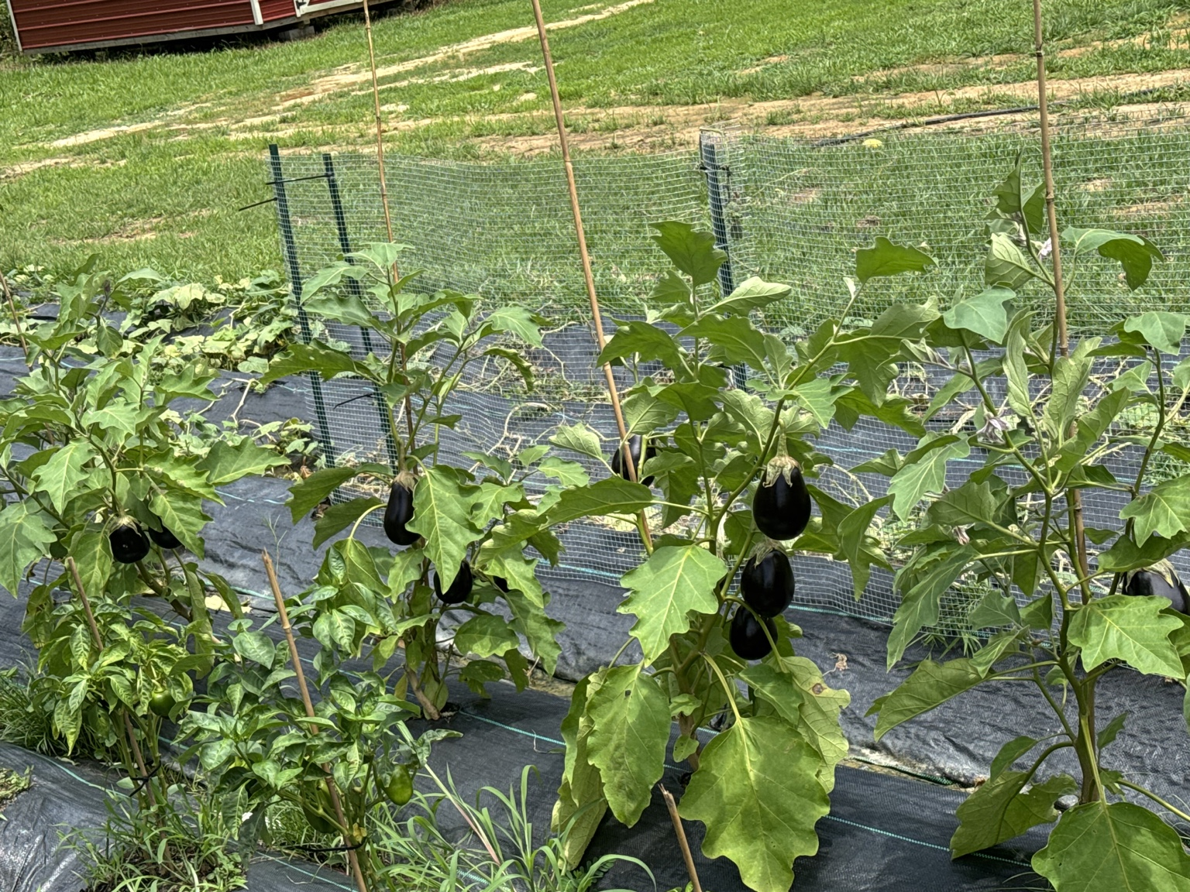
All about me!
Andie Andrews Staff Software Engineer – Paylocity
📧 Andie.Andrews@outlook.com 🔗 linkedin.com/in/andie-andrews-mcp
🔗 github.com/andie-andrews
Fullstack software engineer for 20+ years
Specialized in system designs, scalable systems, APIs, microservices, backend services, and system integrations
Excited about learning and applying AI to solve real-world business problems with AI Powered systems
Notes:
A little about me
I’m a mom of for 4 and I love gardening.
For my other hobby I’m a fullstack Staff Software Engineer at Paylocity. I’ve been at Paylocity for 9 years now and I have been developing software for over 20 years.
Even though I’m fullstack engineer, I specialize in system designs, scalable systems, API’s, backend services and system integrations.
I’m super excited to be learning how to implement and integrate AI into software to solve real world business problem.

Slide 3
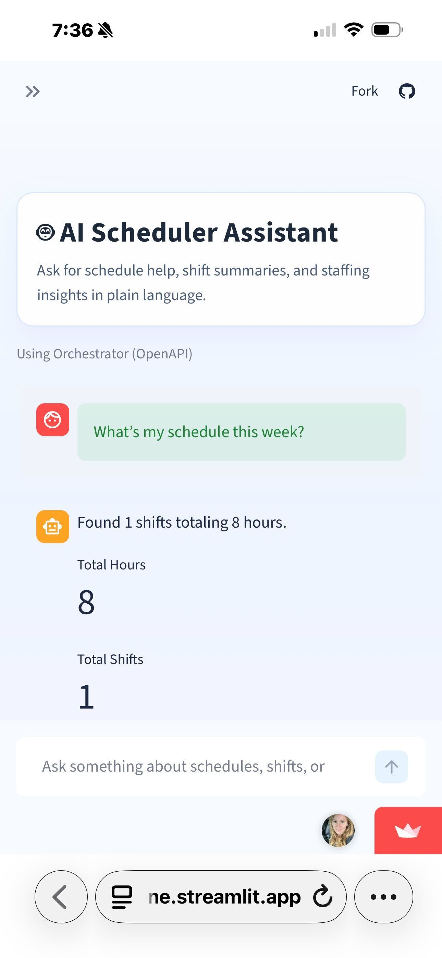
Scheduler Pro – A Natural Language Scheduling Agent
What This Is
A scheduling application with an AI-powered scheduling assistant using natural language
Translates user requests into real API actions
Built on OpenAPI Specifications (OAS) -driven orchestration
What It Solves
Eliminates complex UI navigation
Reduces time to create and manage schedules
Makes scheduling accessible for both managers and employees
Notes:
What I am going to demo today is Scheduler Pro, which is a web scheduling application with a built in AI agent that supports natural language and translates it into real API CRUD actions. It’s built with an orchestration layer using OpenAPI Specifications to perform actions against API calls to meet the user's intent.
This aims to eliminate complex UI navigation, reduce management time in scheduling while easing accessibility for both manager and employees to get information about their schedules.

Slide 4
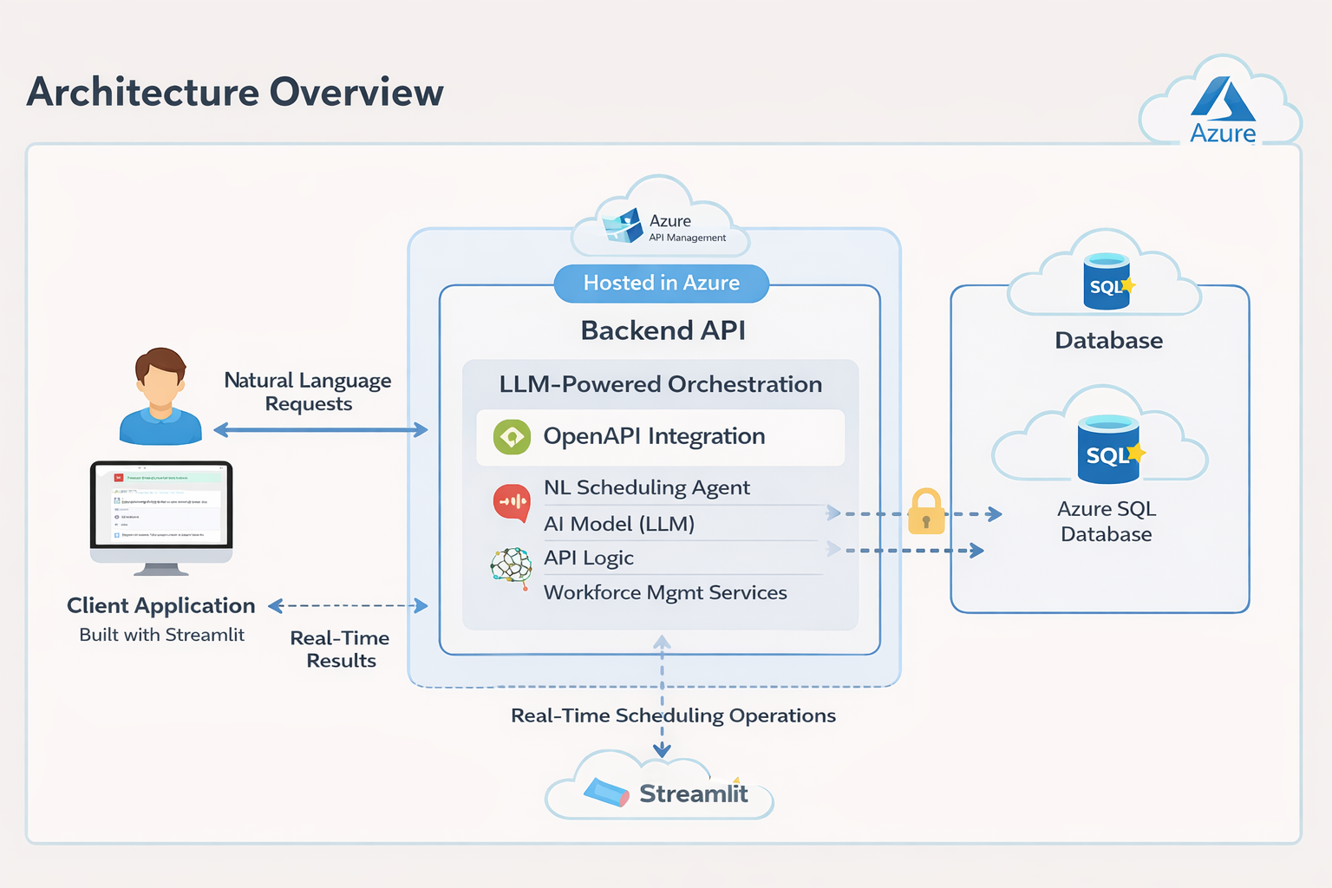
Notes:
The UI and AI Agent is built in Python using Streamlit The backend is fully API driven and hosted in Azure and persists to an Azure SQL Database.

Slide 5
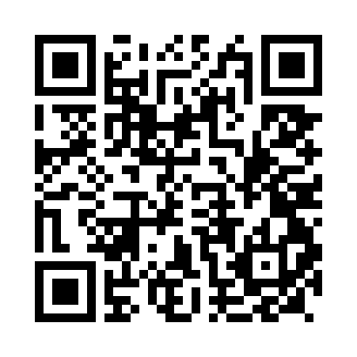
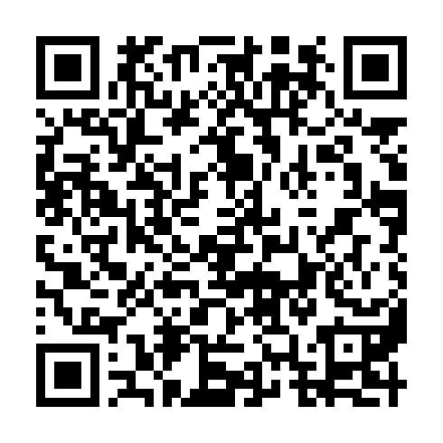

Schedule Pro UI
Scheduler API Swagger
Schedule Pro UI

Slide 6
What’s next?
Integrate MCP with orchestrator
Schedule recommendations
Explore if LangChain could aide with conversation state and improver ochestration
Possibly a scheduling orchestration framework

