Slide 1

Challenge name
Category
Current Vs Benchmark
Assessment
Time
00:00:00 VS 00:00:00
10% better
Moves
0 VS 0
10% better
Streaks
0 VS 0
80%
-10% worse
Better!!
Exit
Replay

Slide 2
Challenge name
Time
00:00:00
Moves
0
Info
Streaks
0
Play
Challenge name
Time
00:00:00
Moves
0
0
Info
Streaks
Play

Slide 3


Awesome! 5 match streaks1

Slide 4
-20%
80%
Better!!
Worse!!

Slide 5


Options
Time: 00:00:00
Moves: 0
Benchmark
Home
Time:
00:00:00
1
2
3
4
Info
5
6
7
8
Moves:
0
Pause
9
10
11
12
Streaks:
0
Reshuffle
13
14
15

Slide 6
Pattern
Stats
x
Play count: 0
1
2
3
4
Play time: 00:00:00
Challenge name
Wins: 0
5
6
7
8
loses: 0
9
10
11
12
13
14
15
Return

Slide 7


Slide 8



Slide 9
Challenge Name
Time: 00:00:00
Moves: 0
Streaks: 0
Challenge Name
Time: 00:00:00
Moves: 0
Streaks: 0
Challenge Name
Time: 00:00:00
Moves: 0
Streaks: 0
Challenge Name
Time: 00:00:00
Moves: 0
Streaks: 0

Slide 10
Puzzled
Created by Andrew Mfune

Slide 11
Challenge name assessment:
Benchmark vs Current Assessment
Time:
00:00:00
00:00:00
0% Better
Moves
0
0
0% Better
Streaks
0
0
0% Better
Overall Assessment: 0% Better!!

Slide 12
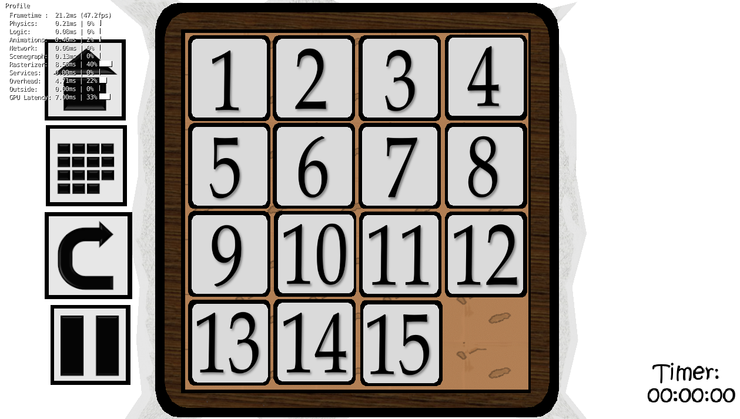
Awesome! 3 match streaks
s
Notification Title
Are you sure you want to continue?

