Slide 1
F P G A - M A X 1 0
Dr. Andreas Eppinger

Slide 2
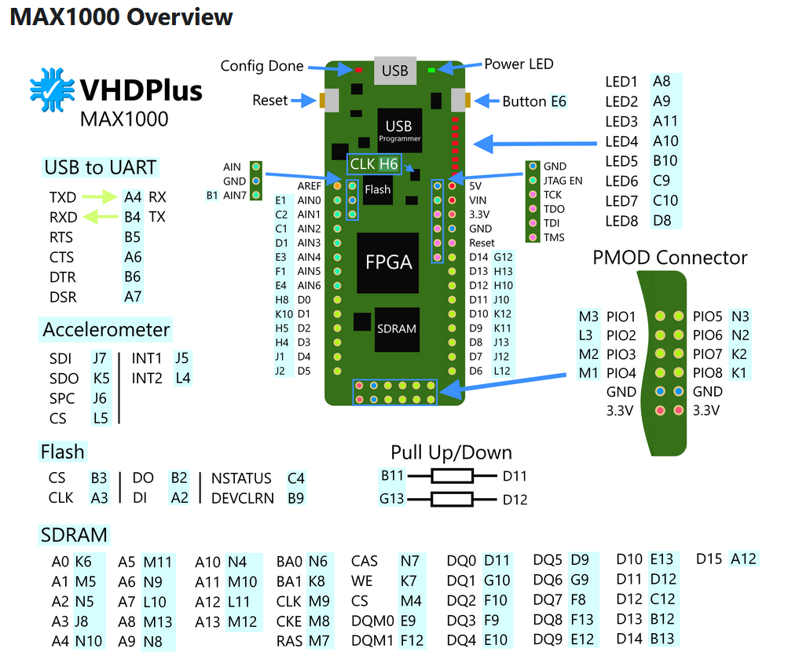
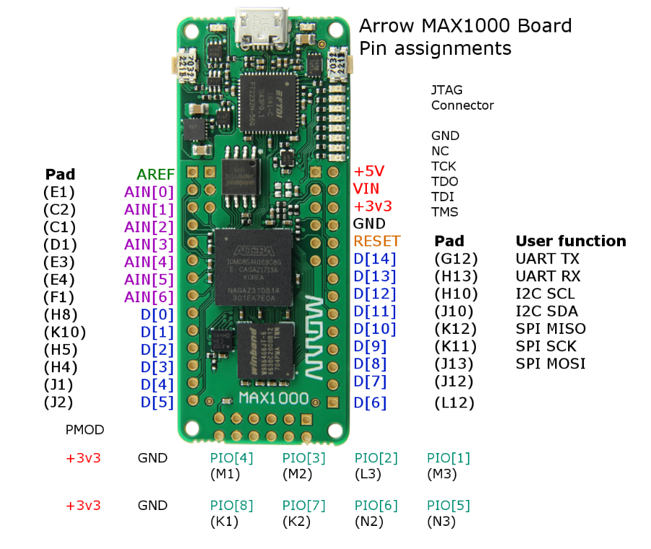
MAX10 – MAX1000 Board
Pinout

Slide 3

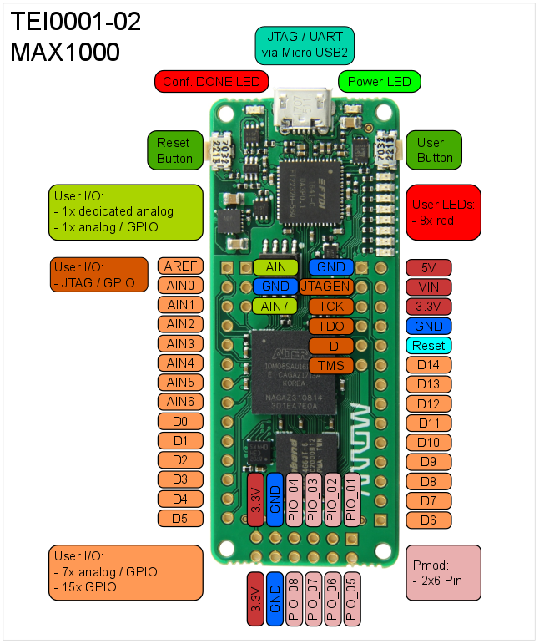
MAX10 – MAX1000 Board
Pinout

Slide 4
MAX10 – MAX1000 Board
Test Environment
LEDs connected to D3, D4, D5 with 1KOhm resistor to GND.
Button connected to D6 with 1KOhm pull-up to 3.3V
Poti to provide variable voltage on AIN3

Slide 5
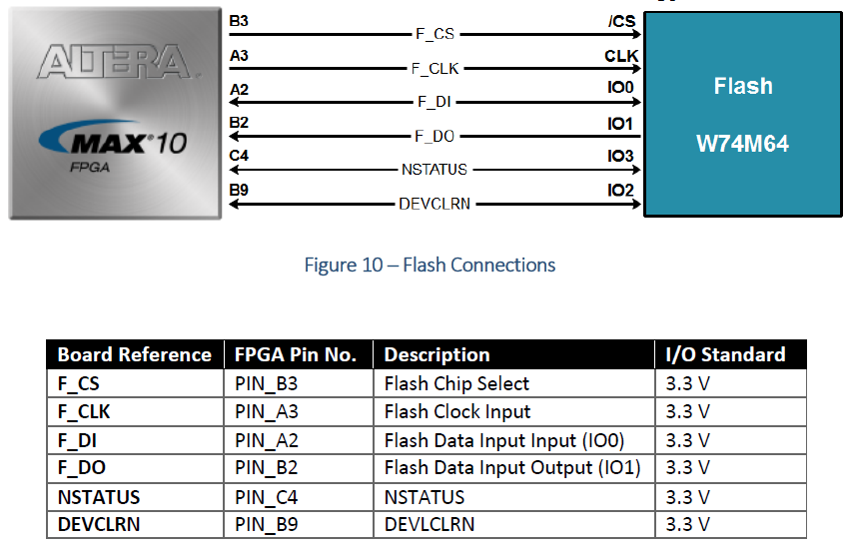
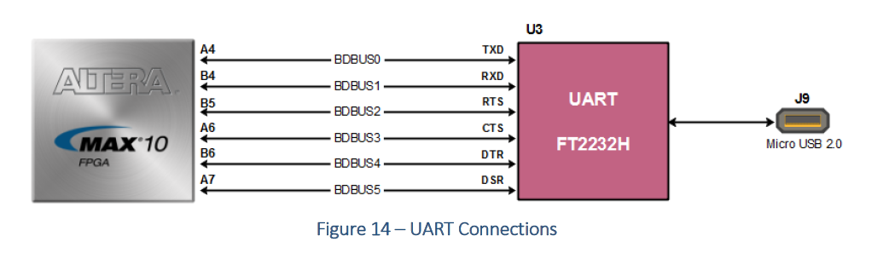
MAX10 – MAX1000 Board
Baugruppen
Flash
UART

Slide 6
MAX10 – MAX1000 Board
Acoustic Box
  Acoustic Foam 25mm
  Net space: 550mm x 350mm x 270mm
Fixation
  xxx
Stimulus
  xxx
Sensors
  Xxx
Manipulators
  Robot-Arm
Interface(s)
  xxx
Control- & Measurement-Software
  xxx

Slide 7
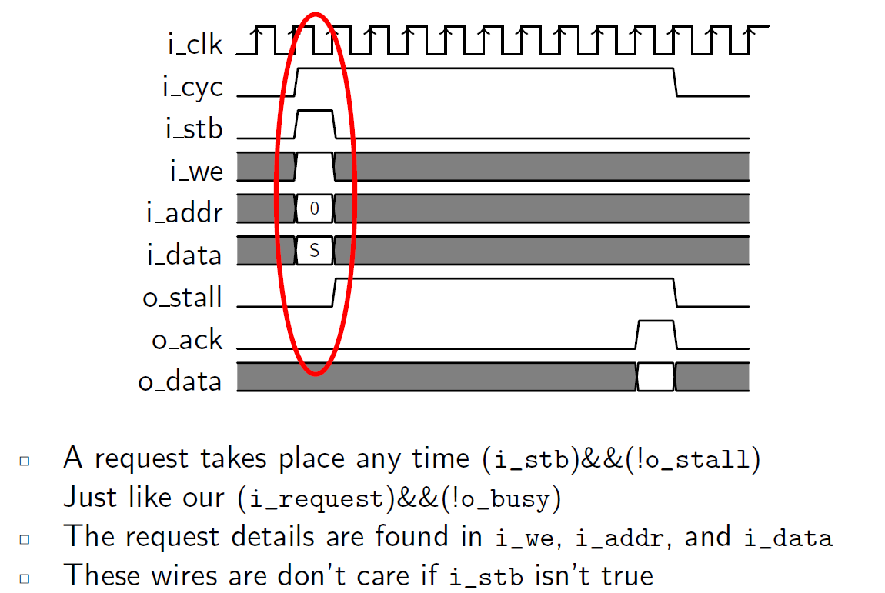
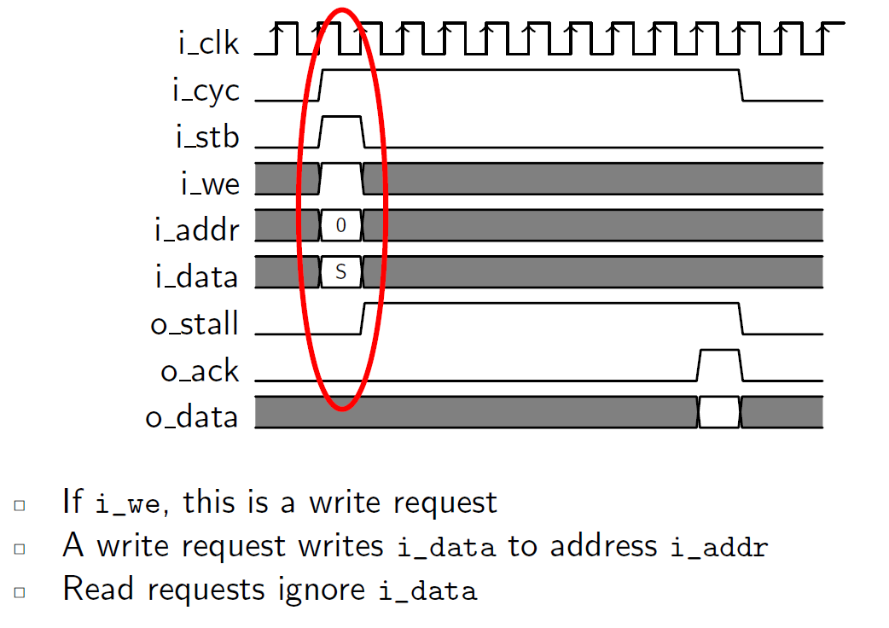
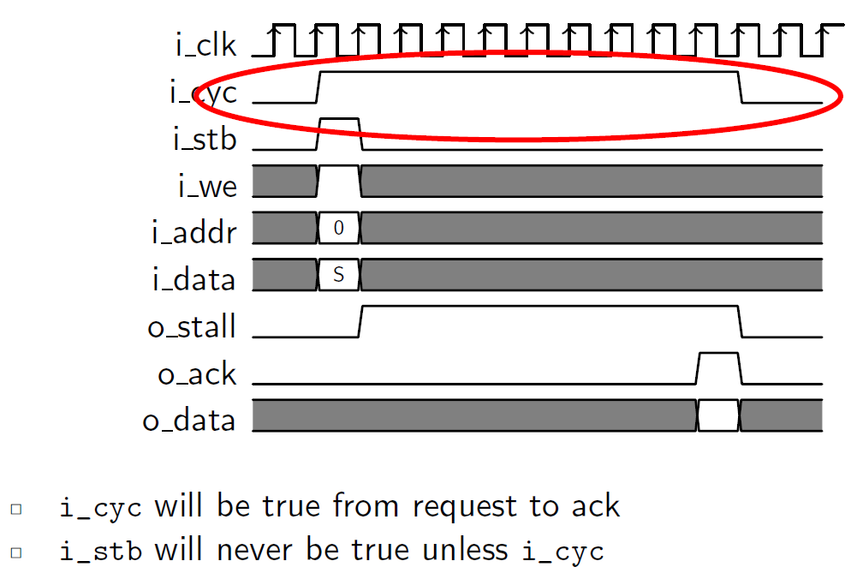
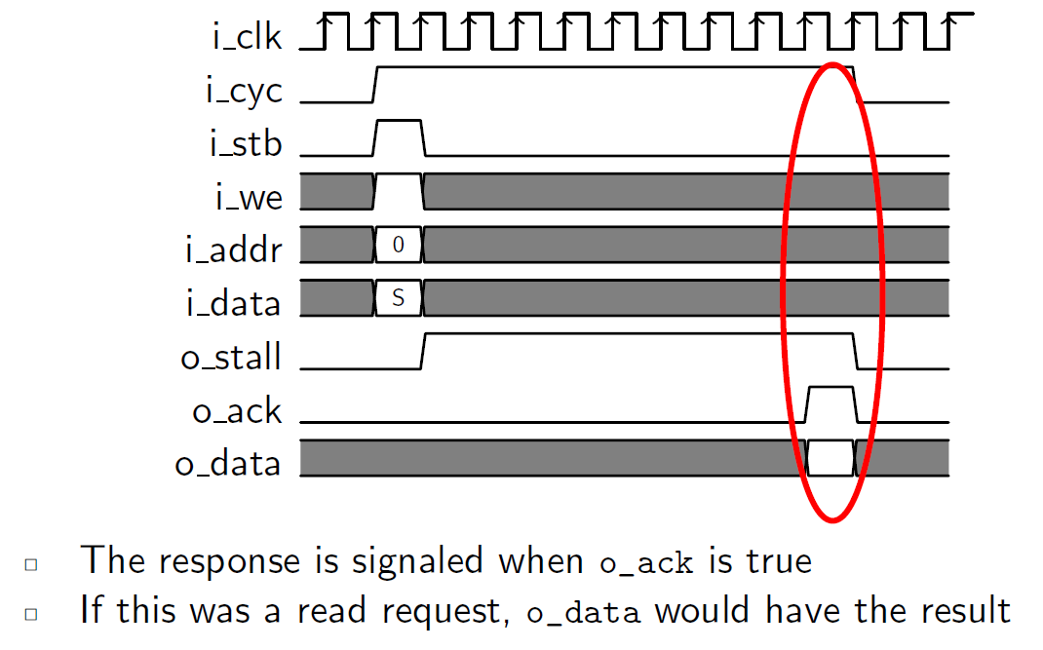
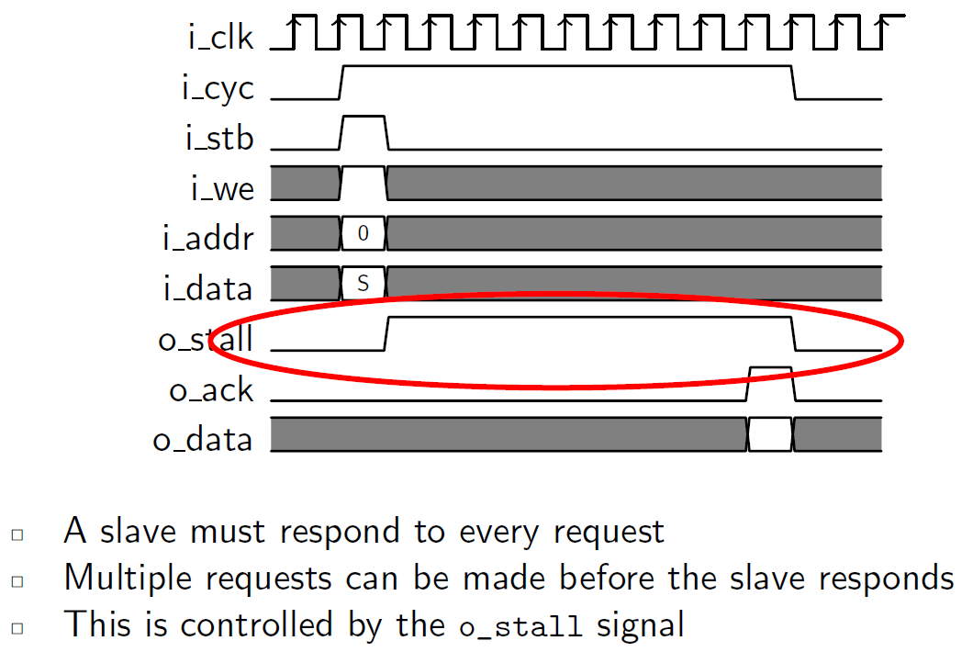
Wishbone Bus

