Slide 1
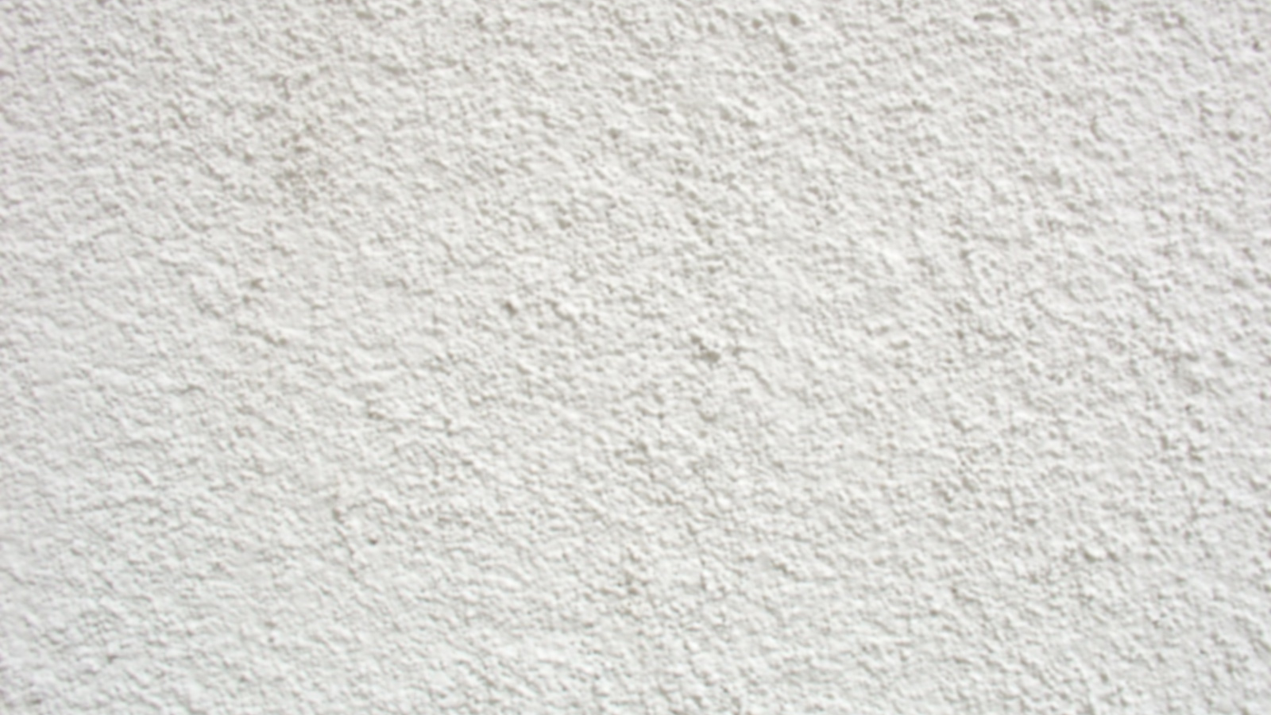


Exploring the Feasibility to make a “Paint Battery”
Andreas Grasser, 26.07.2021

Slide 2

Motivation
Battery production has many steps
In-situ production often impossible
More steps → more expensive
Reduction of production steps can lead to lower prices and broader applications

Slide 3
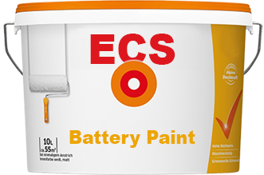
Final goal
One paint that produces the three layers of a battery by itself:
cathode
gel electrolyte / seperator
anode
“Wall paint that forms a battery”
https://www.obi.de

Slide 4
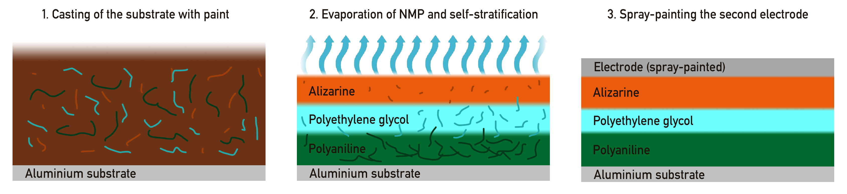
Final goal

Slide 5
Possible steps
Solvability experiments with the components
Simple phase separation experiments
Manually assembled battery using spin-coating etc. for benchmark
“Hybrid” battery with self-stratification of two layers + one spin-coated layer
Complete battery using self stratification
Further improvements
Reality: not that straight forward

Slide 6
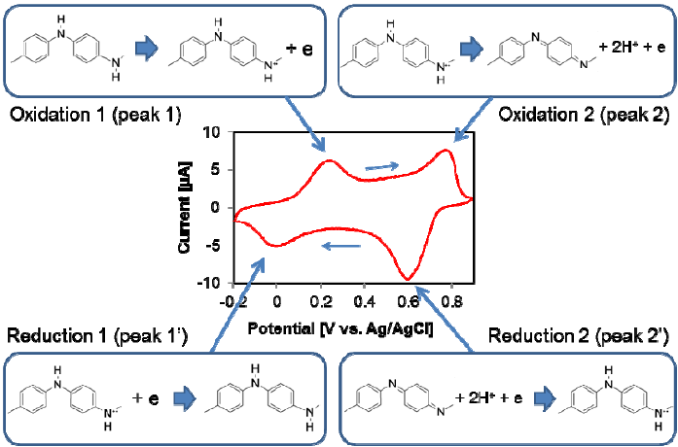
Polyaniline reduction / oxidation
Song, Edward & Choi, Jin-Woo. (2013). Conducting Polyaniline Nanowire and Its Applications in Chemiresistive Sensing. Nanomaterials. 3. 498-523. 10.3390/nano3030498.

Slide 7
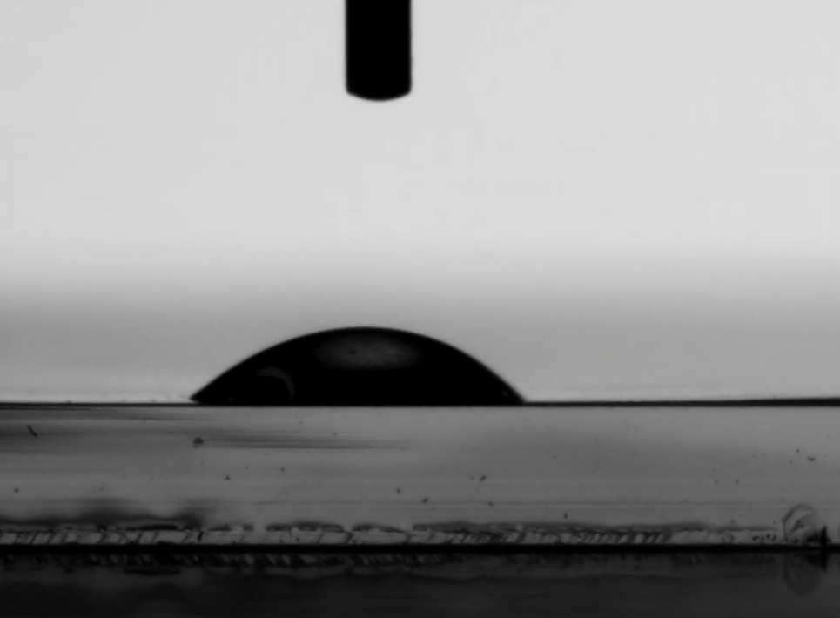
Contact angle measurements
Measure hydrophility of surface
→ possible test for a successful stratification
→ with different liquids: measurement of free surface energy possible
+ Very fast and easy
Many error sources
(soaking into PANI, dirt on surface, different film thickness, …)

Slide 8
Contact angle measurements
Compare contact angle of different samples:
Polyaniline
PVA/PEG
Polyaniline + PVA/PEG
For a successful stratification: contact angle of mixture should show strong tendency towards one of the single components

Slide 9
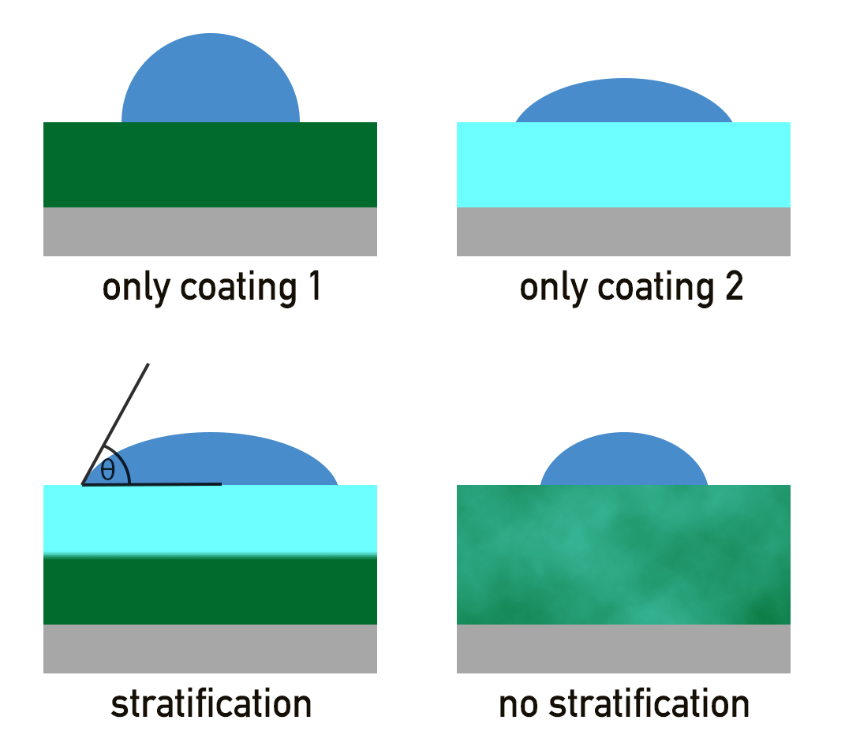
Contact angle measurements

Slide 10
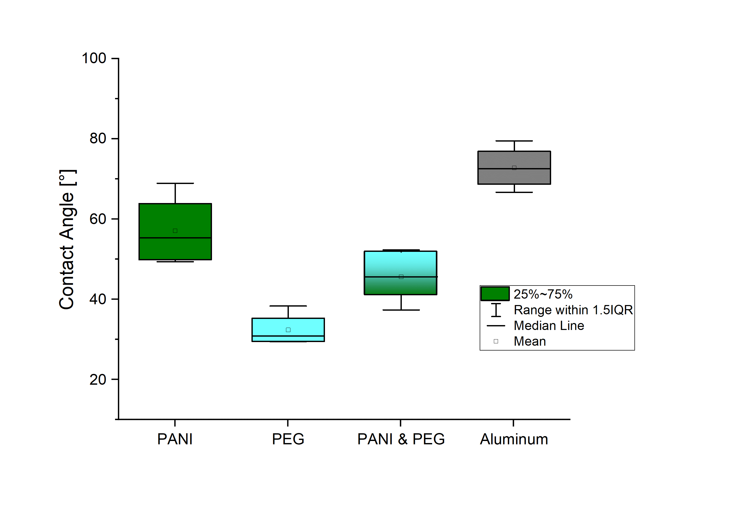
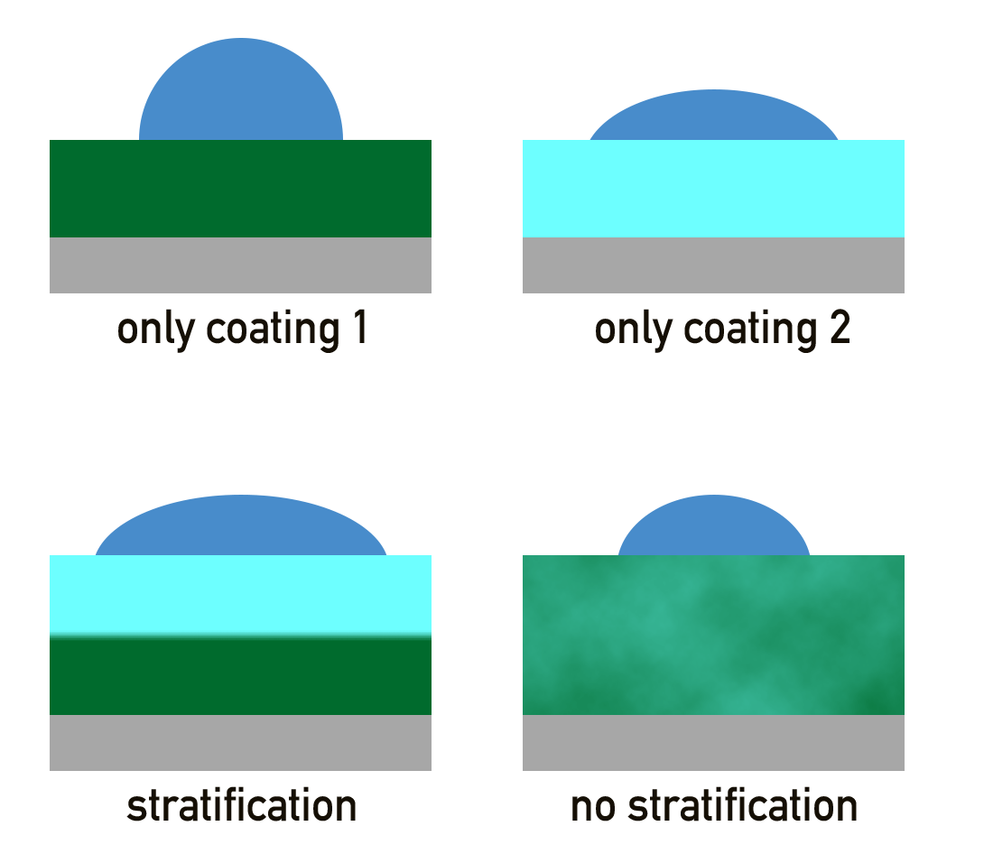
Battery with two layer stratification
No stratification signs for PEG

Slide 11
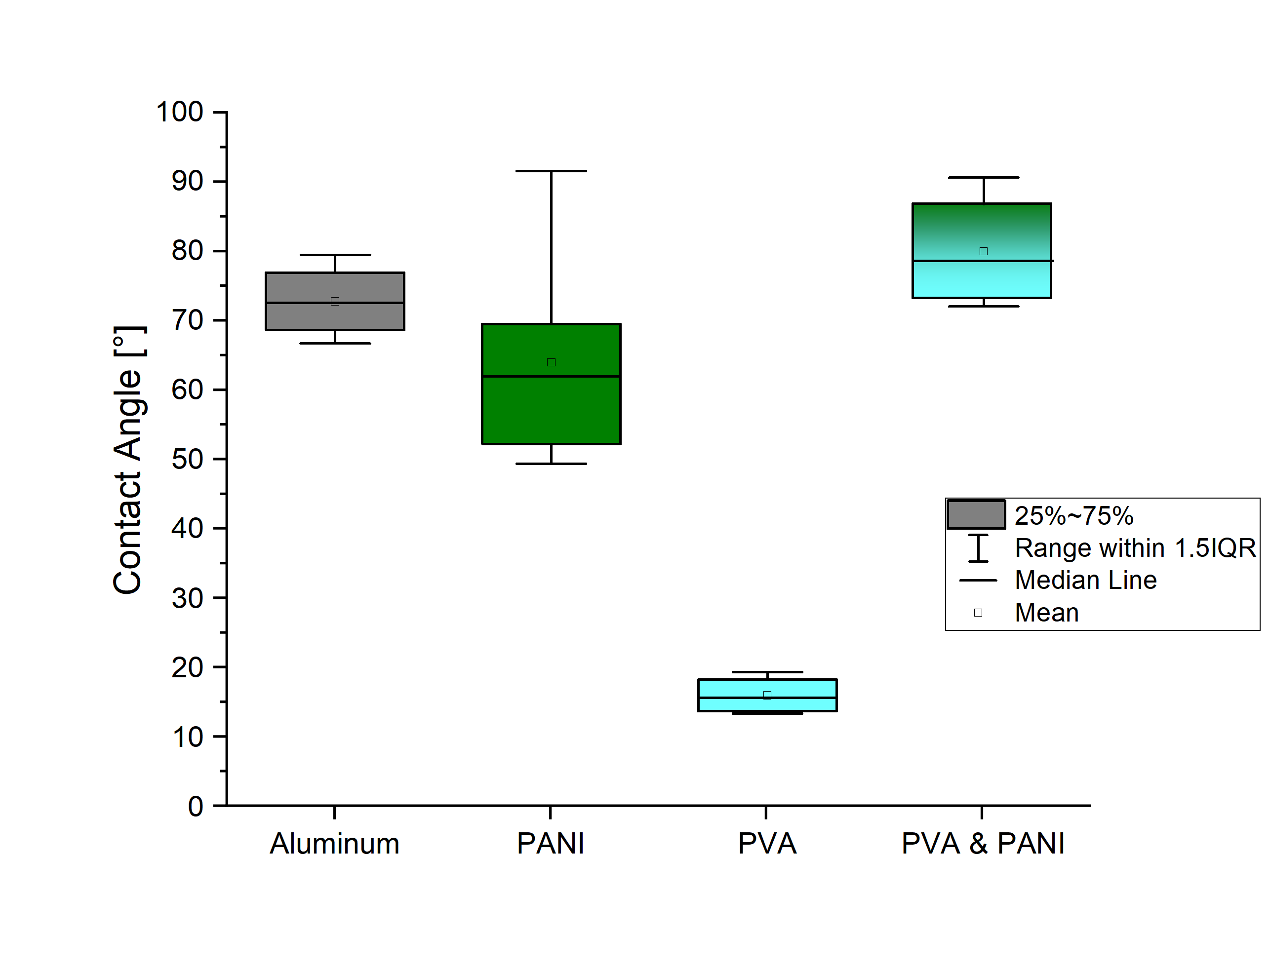
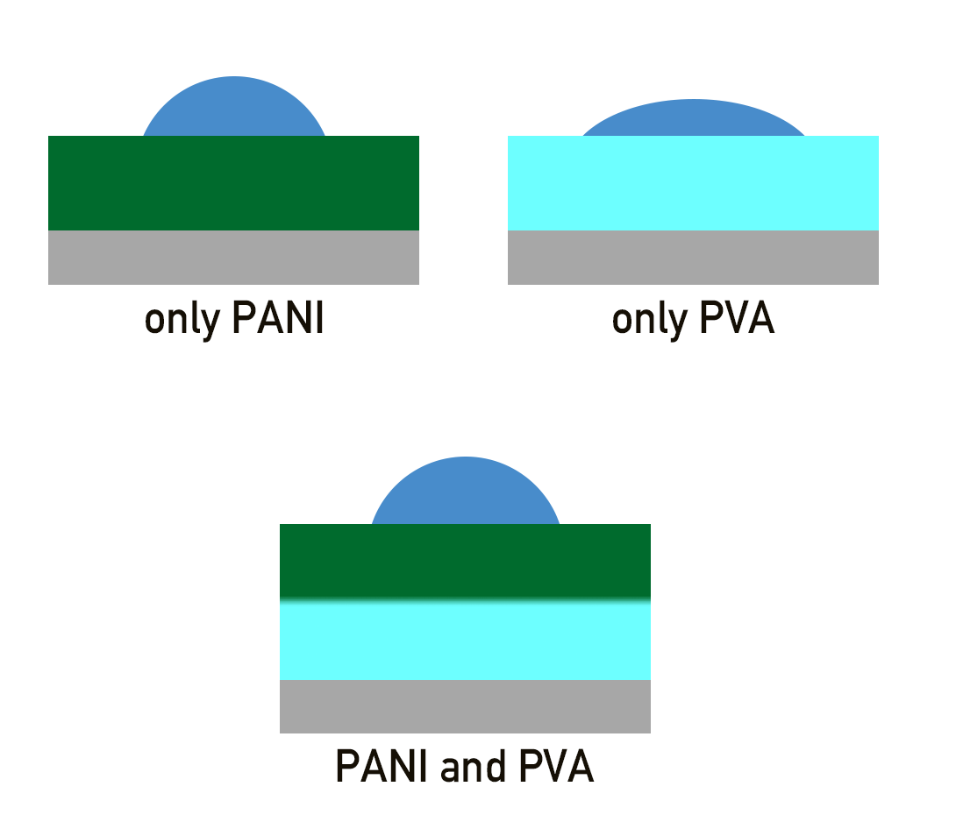
Battery with two layer stratification
Stratification of Polyaniline + PVA on Aluminum foil?

Slide 12
Battery with two layer stratification
Big problem: how to add third layer beneath the coating to electrochemically test the coating?
?

Slide 13
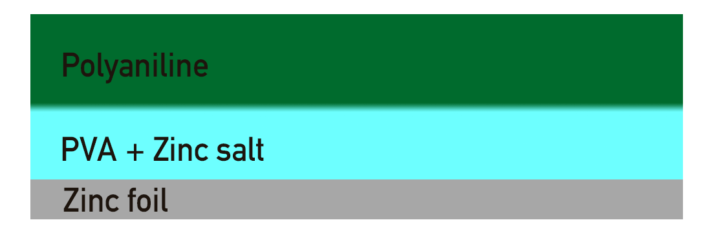
Battery with two layer stratification
→ Using a zinc substrate as anode and Zinc Chloride as conducting salt
Possible difficulties:
Zinc has different surface energy than Aluminum
Zn²⁺ instead of Na⁺ ions

Slide 14
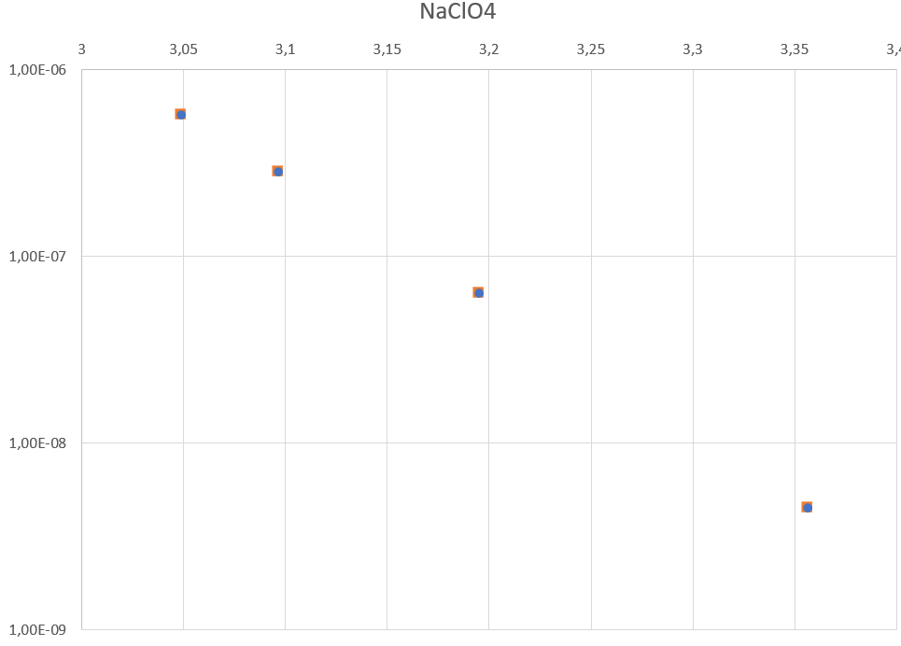
PVA-NaClO4 solid electrolyte

Slide 15
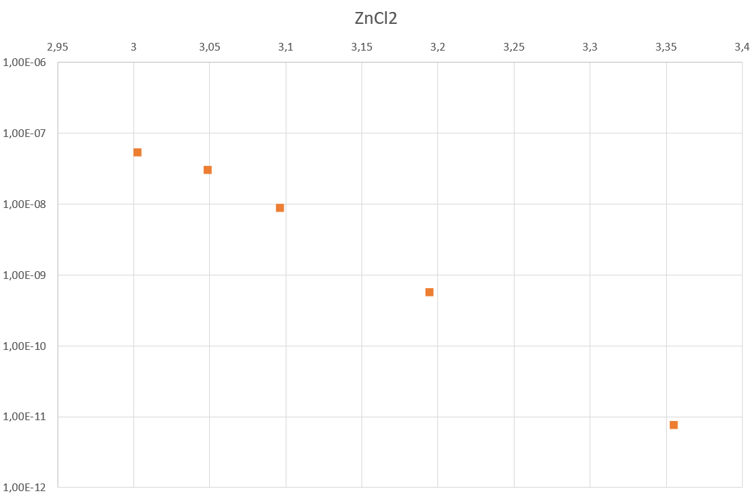
PVA-ZnCl2 solid electrolyte

Slide 16
XRD measurements

