Slide 2
Fractal Visualization Mandelbrot Set
Andreas Hofstadler (K12224237) Parallel and Asynchronous Programming with .NET Dietrich Birngruber

Slide 3
Overview
Mandelbrot Set
WPF – Application
Async & Parallel

Slide 4
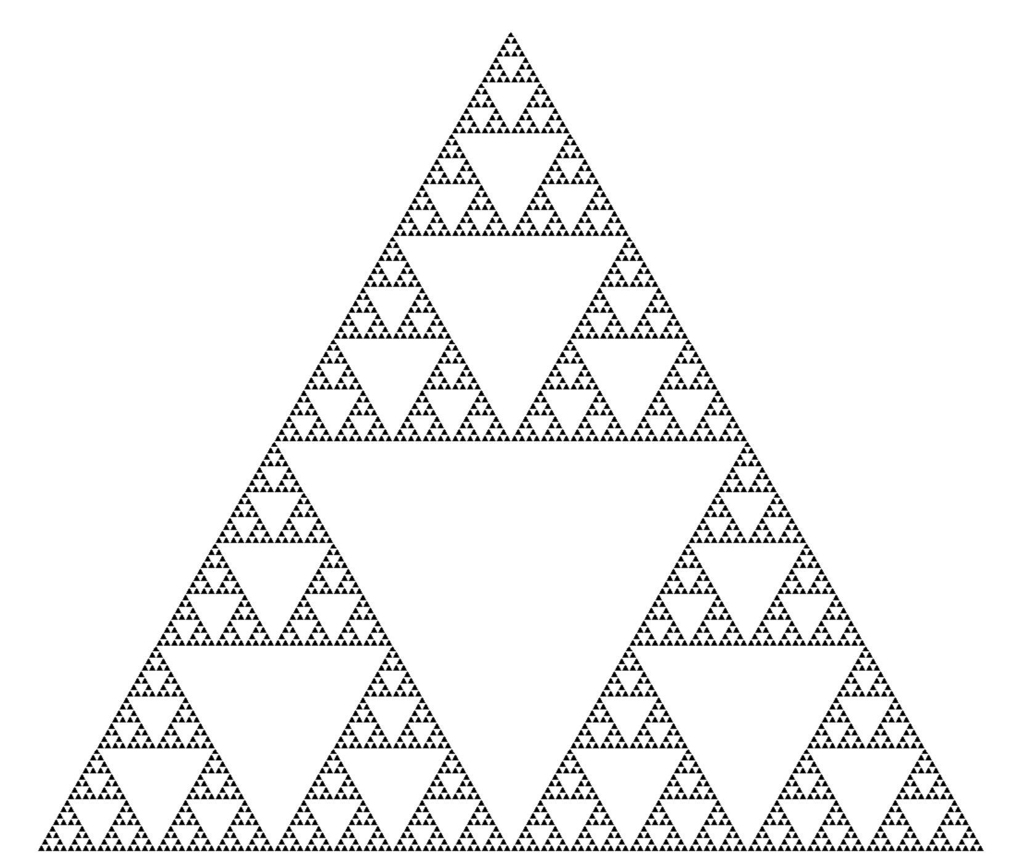
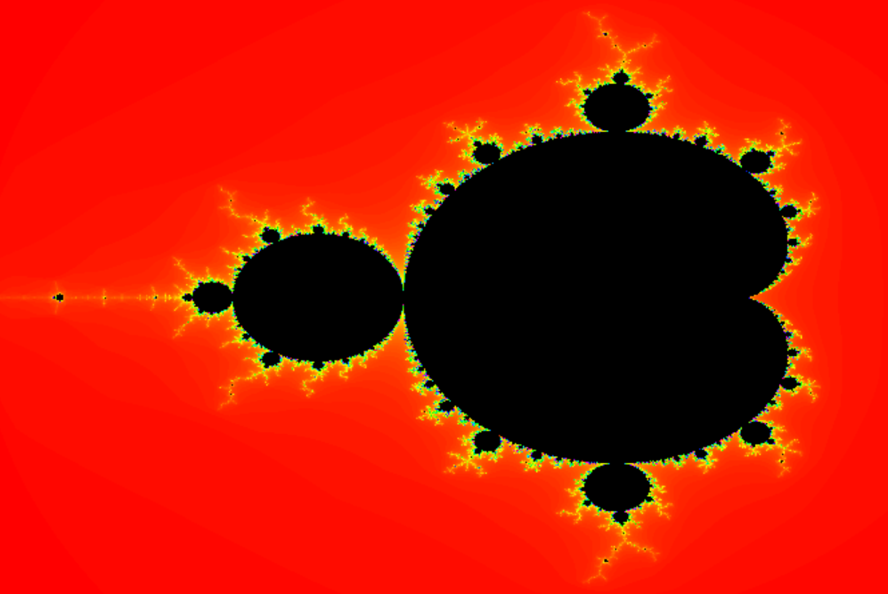
Mandelbrot Set
Fractal
Geometric shape
Self-similar
Mandelbrot Set
Infinite set of values
z --> z² + c
z = 0
c = 1 ; {0,1,2,5,26…} -> unbounded
c = -1 ; {0, -1, 0, -1, …} -> bounded
Escape time algorithm
Max. Iterations
Black if bounded
Color depending on iterations

Slide 5
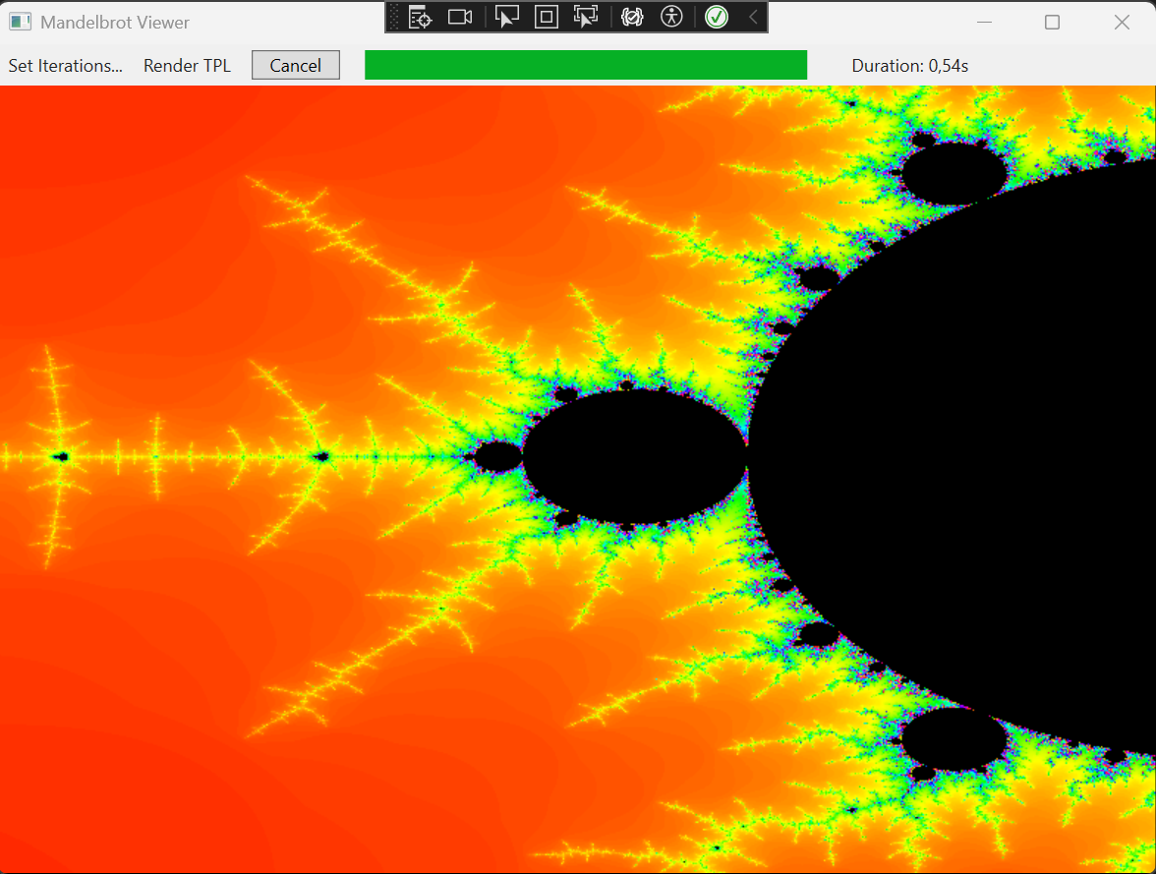
WPF Appliaction
Mandelbrot Viewer
Set max. Iterations
Render method
Progress bar
Timer
Drag & Drop zoom
Move with arrows
Reset with “r”

Slide 6
Async & Parallel
await Task.Run(() =>
{
_cancellationTokenSource = new CancellationTokenSource();
_cancellationToken = _cancellationTokenSource.Token;
RenderParallel(width, height, pixels, stride);
})
Async
Responsive UI
Parallel
Each pixel independent
Multiple calculations
E.g., line wise
Cancelation
private void RenderParallel(int width, int height, byte[] pixels, int stride)
{
// Hier wird die parallele Berechnung verwendet
int progrss = 0;
Parallel.For(0, height, y =>
{
for (int x = 0; x < width; x++)
{
if (_cancellationToken.IsCancellationRequested)
return;
calculateFractal(x, y, width, height, pixels, stride);
}
DrawLine(y, width, pixels, stride);
UpdateProgress(++progrss, height);
});
}

Slide 7
Demo time ….

