Slide 1
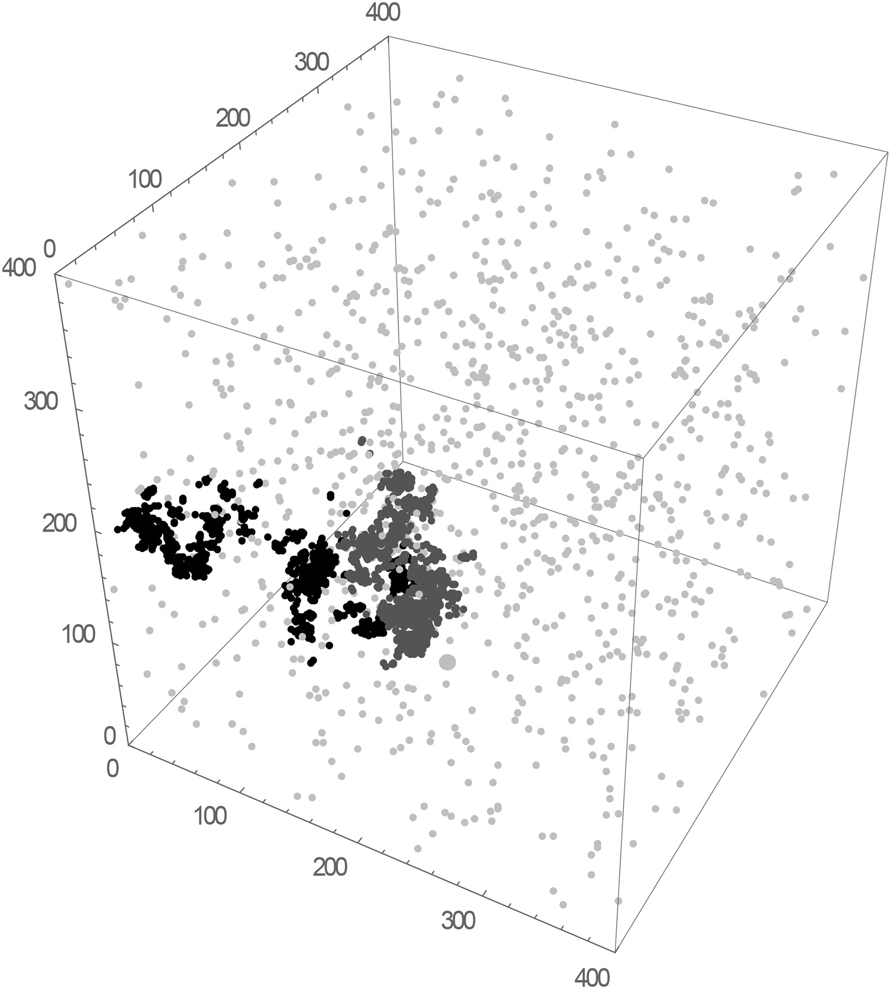


Fission Matrix Acceleration in Monte Carlo Simulations and Its Impact on Neutron Clustering
NE MPhil Research Project and Dissertation, Phase 1 Presentation by Andy Zhang
Notes:
Start MC transport
Clustering
Solution: FM acceleration
Methodology
Plan

Slide 2









Neutron Interactions (Monoenenergetic)
$${}_{0}^{1}n$$
$${}_{0}^{1}n$$
$${}_{0}^{1}n$$
$${}_{92}^{235}U$$
$${}_{0}^{1}n$$
$${}_{1}^{1}H$$
$${}_{1}^{1}H$$
$${}_{0}^{1}n$$
$${}_{0}^{1}n$$
Scatter
Capture
Fission

Slide 3



Monte Carlo Cycle
$$Σ_{s},Σ_{c},Σ_{f}$$
$${}_{0}^{1}n$$
$${}_{0}^{1}n$$

Slide 4

Monte Carlo Cycle
$$Σ_{s},Σ_{c},Σ_{f}$$
$${}_{0}^{1}n$$
$${}_{0}^{1}n$$

Slide 5


Monte Carlo Cycle
$$Σ_{s},Σ_{c},Σ_{f}$$
$${}_{0}^{1}n$$
$$Σ_{s}$$
$${}_{0}^{1}n$$

Slide 6


Monte Carlo Cycle
$$Σ_{s},Σ_{c},Σ_{f}$$
$$Σ_{s}$$
$${}_{0}^{1}n$$
$${}_{0}^{1}n$$
$$Σ_{c}$$

Slide 7







Monte Carlo Cycle
$$Σ_{s},Σ_{c},Σ_{f}$$
$$Σ_{s}$$
$$Σ_{s}$$
$${}_{0}^{1}n$$
$${}_{0}^{1}n$$
$${}_{0}^{1}n$$
$${}_{0}^{1}n$$
$$Σ_{c}$$
$$\text{Generation}\text{:} n$$
Fission Bank
$$\text{Generation}\text{:} n+1$$

Slide 8







Monte Carlo Cycle
$$Σ_{s},Σ_{c},Σ_{f}$$
$$Σ_{s}$$
$$Σ_{s}$$
$${}_{0}^{1}n$$
$$Σ_{c}$$
$$Σ_{f}$$
$$\text{Generation}\text{:} n$$
Fission Bank
$${}_{0}^{1}n$$
$${}_{0}^{1}n$$
$${}_{0}^{1}n$$
$$\text{Generation}\text{:} n+1$$

Slide 9

Monte Carlo Cycle
$$Σ_{s},Σ_{c},Σ_{f}$$
$$\text{Generation}\text{:} n$$
2 Neutrons
Fission Bank
$${}_{0}^{1}n$$
$${}_{0}^{1}n$$
$${}_{0}^{1}n$$
3 Neutrons
$$\text{Generation}\text{:} n+1$$
2 Neutrons

Slide 10




Monte Carlo Cycle
Fission Bank
$$Σ_{s},Σ_{c},Σ_{f}$$
$${}_{0}^{1}n$$
$${}_{0}^{1}n$$
$$\text{Generation}\text{:} n+1$$
2 Neutrons
$$\text{Generation}\text{:} n+1$$
2 Neutrons

Slide 11
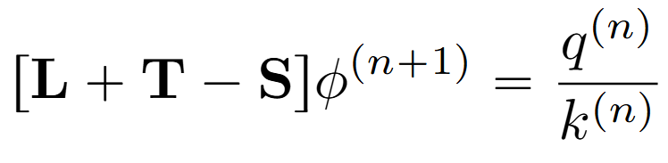
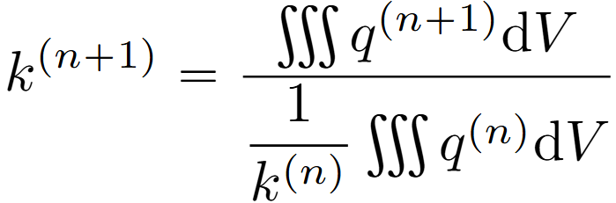


Monte Carlo Cycle
$$Σ_{s},Σ_{c},Σ_{f}$$
$${}_{0}^{1}n$$
$${}_{0}^{1}n$$
$$\text{Generation}\text{:} n+1$$
2 Neutrons
Fission Bank
$$\text{Generation}\text{:} n+2$$
0 Neutrons

Slide 12

Neutron Clustering
$${}_{0}^{1}n$$
$${}_{0}^{1}n$$
$$\text{Generation}\text{:} n$$
Distributed evenly

Slide 13

Neutron Clustering
Removal is uniform
$$Σ_{s}$$
$$Σ_{s}$$
$$Σ_{c}$$
$$Σ_{f}$$
Creation happens near other neutrons
$$\text{Generation}\text{:} n$$
Normalization
$${}_{0}^{1}n$$
Clustered!
$${}_{0}^{1}n$$
$$\text{Generation}\text{:} n+1$$

Slide 14
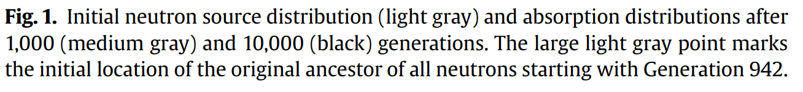
Consequences of Clustering
Only a problem when:
Fixation > Dispersion
Neutron density is low
Slower fission source convergence
More computation time
More uncertainty
Does NOT effect final outcome
Lower entropy
False impression of convergence
Useful for measurements
Sutton, T. M. & Mittal (2017)

Slide 15
Fission Matrix Acceleration
Fissile
Absorbing
Fissile

Slide 16
Fission Matrix Acceleration
Fissile
Absorbing
Fissile

Slide 17
Fission Matrix Acceleration
Fissile
Absorbing
Fissile

Slide 18

Fission Matrix Acceleration
Fissile
Absorbing
Fissile
How many daughter neutrons are produced per neutron on average?
From: Left Right
Left
Right
1.9
.1
1
1
To:
= 2
.1
1.9
1
1
Fission Matrix
Coarse estimation of $k_{0}q_{0}$

Slide 19
Fission Matrix Acceleration
Fissile
Absorbing
Fissile
Cluster has been removed!
1
1

Slide 20
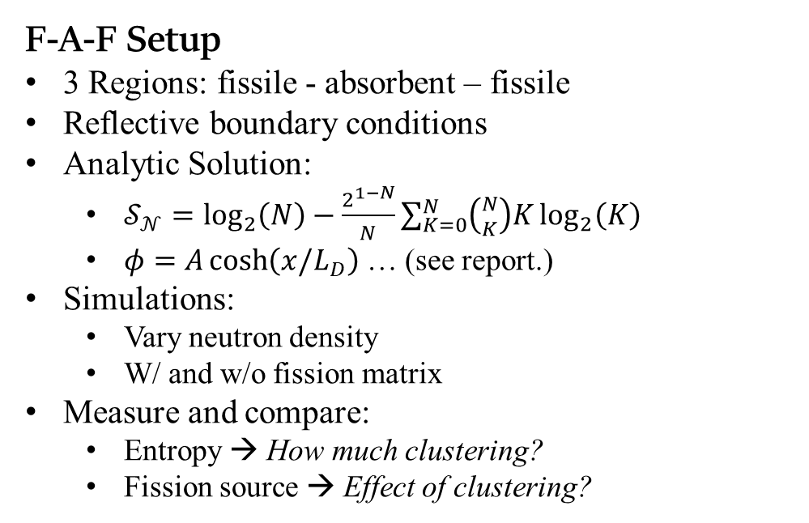
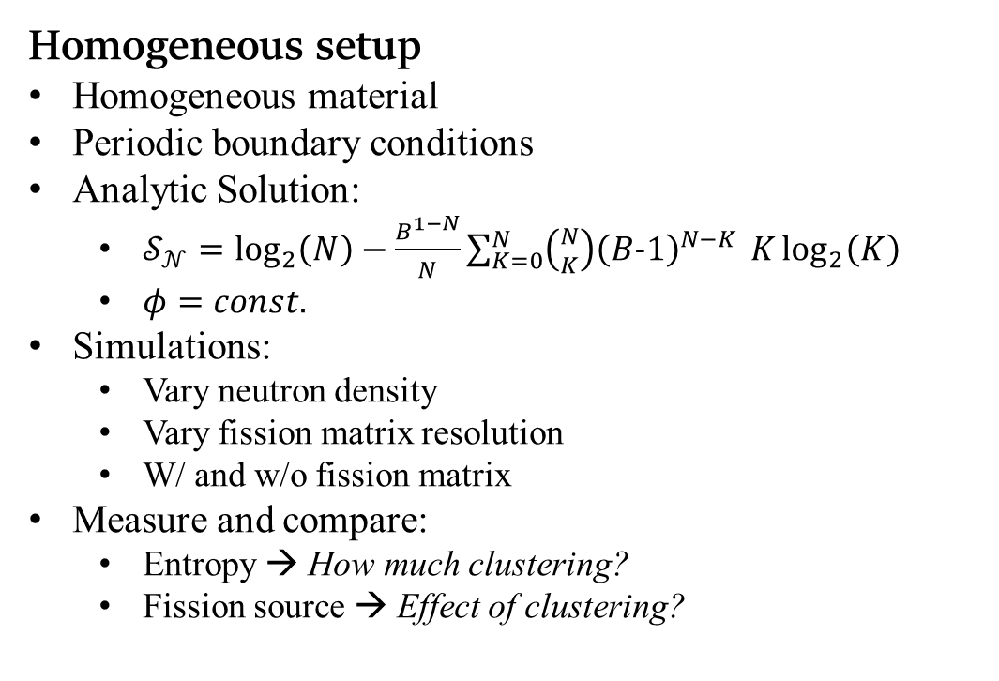
Methodology: Simulations
Can the fission matrix be used to reduce neutron clustering, and if so, what parameters are ideal?
F-A-F Setup
3 Regions: fissile - absorbent – fissile
Reflective boundary conditions
Analytic Solution:
$𝒮_{𝒩}=\log_{2}\left(N\right)−\frac{2^{1−N}}{N}\sum_{K=0}^{N}{\left({N \atop K}\right)K}\log_{2}\left(K\right)$
$φ=A\cosh\left(x/L_{D}\right)$ … (see report.)
Simulations:
Vary neutron density
W/ and w/o fission matrix
Measure and compare:
Entropy → How much clustering?
Fission source → Effect of clustering?
Homogeneous setup
Homogeneous material
Periodic boundary conditions
Analytic Solution:
$𝒮_{𝒩}=\log_{2}\left(N\right)−\frac{B^{1−N}}{N}\sum_{K=0}^{N}{\left({N \atop K}\right){\left(B−1\right)}^{N−K}} K\log_{2}\left(K\right)$
$φ=const.$
Simulations:
Vary neutron density
Vary fission matrix resolution
W/ and w/o fission matrix
Measure and compare:
Entropy → How much clustering?
Fission source → Effect of clustering?

Slide 21
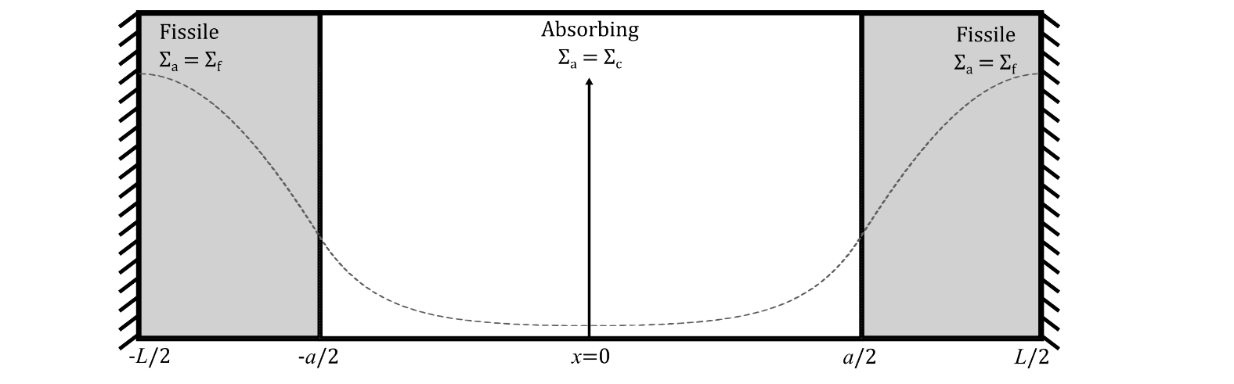
Methodology: Code and Extensions
Numerical simulations using SCONE
Monoenergetic neutrons
Isotropic scattering
1D slab geometry
Extensions:
Theoretically derive observations
Extra simulations: vary size, cross-sections, number of fissile regions…

Slide 22
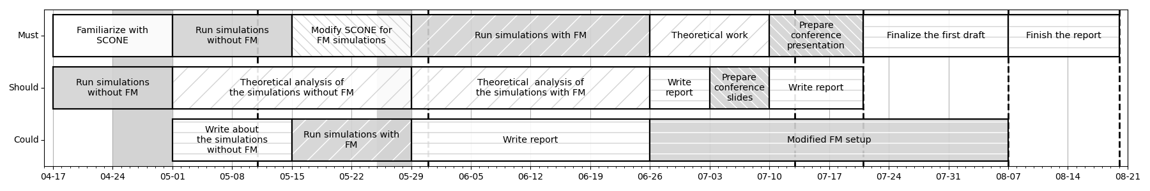
Planning
Start Easter Term
Dissertation Conference
NE 3 Exam
Presentation Abstract Deadline
Submit First Draft
NE5 & NE7 Coursework deadlines
University of Pavia trip
Exams
Final Dissertation Deadline: 20 August 2026 12:00

Slide 23
Thank you for your attention. Any questions?
Notes:
Start MC transport
Clustering
Solution: FM acceleration
Methodology
Plan

Slide 24
The following slides are identical to the ones before, except the animations have been removed. They will be used for answering questions.
Notes:
Start MC transport
Clustering
Solution: FM acceleration
Methodology
Plan

Slide 25





Neutron Interactions
$${}_{0}^{1}n$$
$${}_{0}^{1}n$$
$${}_{0}^{1}n$$
$${}_{0}^{1}n$$
$${}_{1}^{1}H$$
$${}_{1}^{1}H$$
$${}_{0}^{1}n$$
Scatter
Capture
Fission

Slide 26


Monte Carlo Cycle
$$Σ_{s},Σ_{c},Σ_{f}$$
$$Σ_{s}$$
$$Σ_{s}$$
$$Σ_{c}$$
$$Σ_{f}$$
$$\text{Generation}\text{:} n$$
Fission Bank
$${}_{0}^{1}n$$
$${}_{0}^{1}n$$
$${}_{0}^{1}n$$
$$\text{Generation}\text{:} n+1$$

Slide 27
Monte Carlo Cycle
$$Σ_{s},Σ_{c},Σ_{f}$$
$${}_{0}^{1}n$$
$${}_{0}^{1}n$$
$$\text{Generation}\text{:} n+1$$
2 Neutrons
Fission Bank
$$\text{Generation}\text{:} n+2$$
0 Neutrons

Slide 28
Neutron Clustering
Removal is uniform
$$Σ_{s}$$
$$Σ_{s}$$
$$Σ_{c}$$
$$Σ_{f}$$
Creation must happen near a ‘parent’
$$\text{Generation}\text{:} n$$
Normalization
$${}_{0}^{1}n$$
Clustered!
$${}_{0}^{1}n$$
$$\text{Generation}\text{:} n+1$$

Slide 29
Consequences of Clustering
Only a problem when:
Fixation > Dispersion
Neutron density is low
Slower fission source convergence
More computation time
More uncertainty
Does NOT effect final outcome
Lower entropy
False impression of convergence
Useful for measurements
Sutton, T. M. & Mittal (2017)

Slide 30
Fission Matrix Acceleration
Fissile
Absorbing
Fissile
How many daughter neutrons are produced per neutron on average?
From: Left Right
Left
Right
1.9
.1
1
1
To:
= 2
.1
1.9
1
1
Fission Matrix
Coarse estimation of $k_{0}q_{0}$

Slide 31
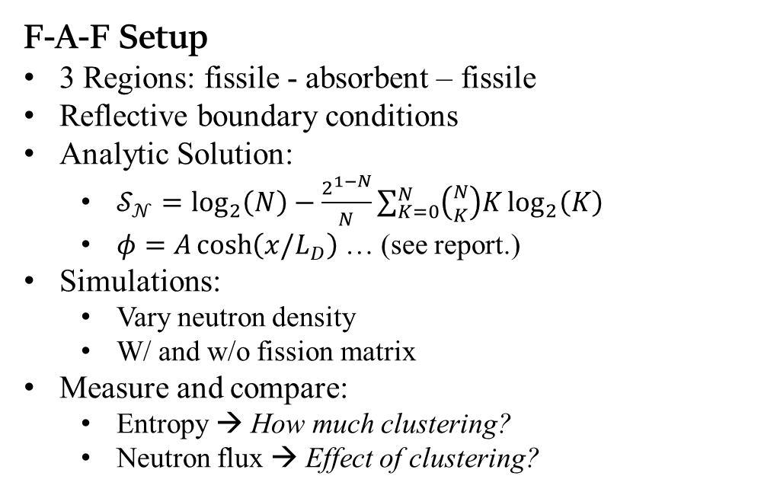
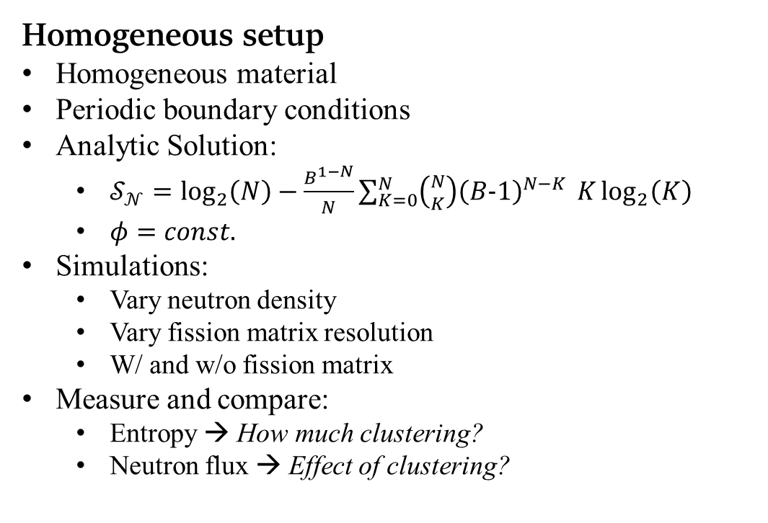
Methodology: Simulations
Can the fission matrix be used to reduce neutron clustering, and if so, what parameters are ideal?
F-A-F Setup
3 Regions: fissile - absorbent – fissile
Reflective boundary conditions
Analytic Solution:
$𝒮_{𝒩}=\log_{2}\left(N\right)−\frac{2^{1−N}}{N}\sum_{K=0}^{N}{\left({N \atop K}\right)K}\log_{2}\left(K\right)$
$φ=A\cosh\left(x/L_{D}\right)$ … (see report.)
Simulations:
Vary neutron density
W/ and w/o fission matrix
Measure and compare:
Entropy → How much clustering?
Neutron flux → Effect of clustering?
Homogeneous setup
Homogeneous material
Periodic boundary conditions
Analytic Solution:
$𝒮_{𝒩}=\log_{2}\left(N\right)−\frac{B^{1−N}}{N}\sum_{K=0}^{N}{\left({N \atop K}\right){\left(B−1\right)}^{N−K}} K\log_{2}\left(K\right)$
$φ=const.$
Simulations:
Vary neutron density
Vary fission matrix resolution
W/ and w/o fission matrix
Measure and compare:
Entropy → How much clustering?
Neutron flux → Effect of clustering?

Slide 32
Methodology: Code and Extensions
Numerical simulations using SCONE
Monoenergetic neutrons
Isotropic scattering
1D slab geometry
Extensions:
Theoretically derive observations
Extra simulations: vary size, cross-sections, number of fissile regions…

Slide 33
Planning
Start Easter Term
Dissertation Conference
NE 3 Exam
Presentation Abstract Deadline
Submit First Draft
NE5 & NE7 Coursework deadlines
University of Pavia trip
Exams
Final Dissertation Deadline: 20 August 2026 12:00

