Slide 1
Bal(l)ancing Ball
KEMPERLE Andreas
NEUHOLD Michaela
SOUKUP Jakob
WINKLER Andreas

Slide 2
Ball
I‘m just a dumb ball. I‘m not doing anything.
Stupid
position_
velocity_
get/set_position()
get/set_velocity()
push(left/right, velocity)

Slide 3
Beam
limiting itself in angle and angular velocity
angle_
ang_velocity_
get_lenght()
get/set_angle(desired_angle, time_elapsed)

Slide 4

Problems
Data needed, that didn‘t exist yet

Slide 5
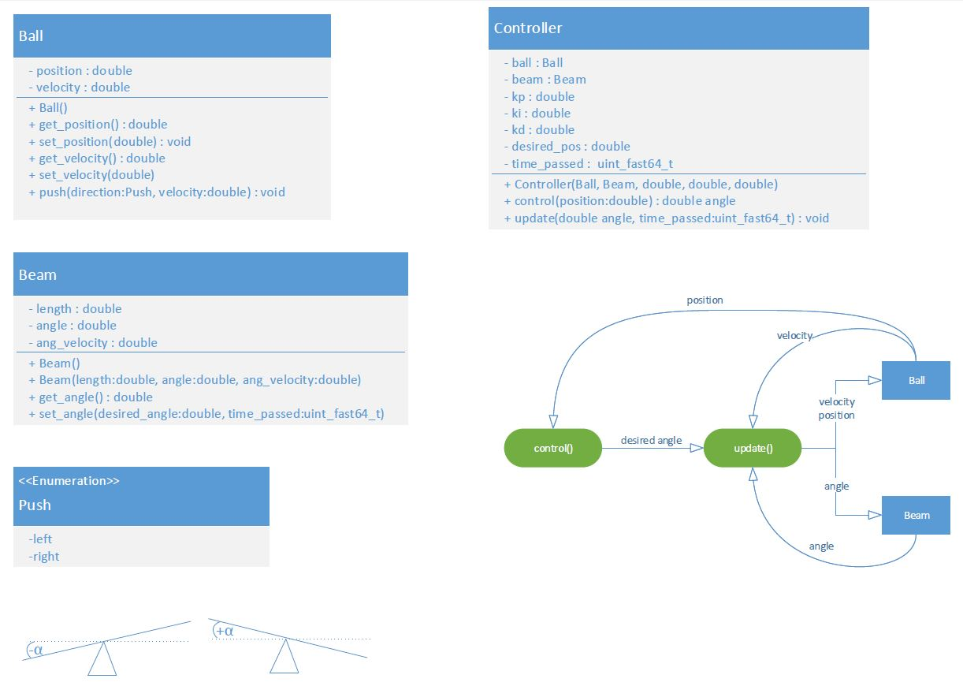
Class diagram
Controller

Slide 6

Teamwork

