Slide 1
Artificial Intelligence: An Overview (2)
Jiun-Wei Liou
Ming-Chi University of Technology

Slide 2
Outline
Categories of AI introduction
Data science
Machine Learning
Deep Learning
Future thoughts of AI
Warnings
Promises
Online AI materials

Slide 3
Data Science
Overview
Process stages
Methods
Applications

Slide 4
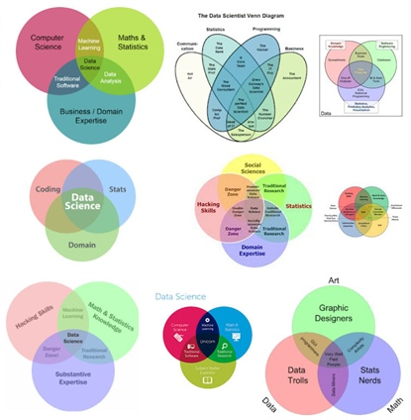
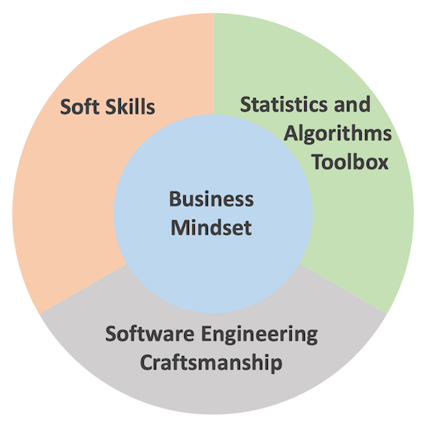
Data Science Overview
Venn diagram and wave of data science

Slide 5
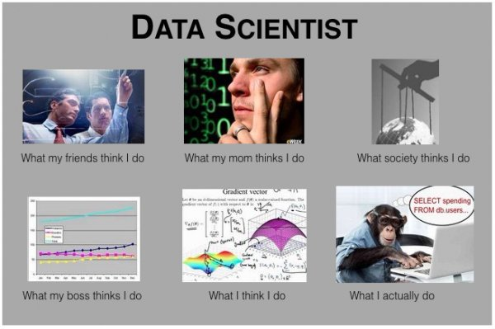
What Data Scientist Do
Conventional opinions

Slide 6
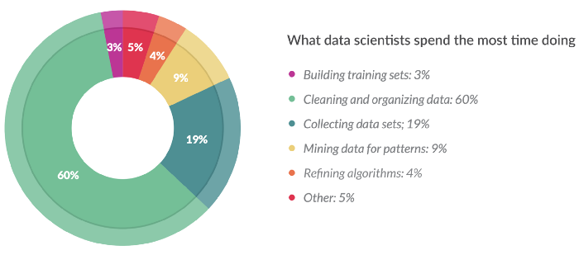
What Data Scientist Do
By survey
Data related: 82%, Program related: 13%, Other: 5%.

Slide 7
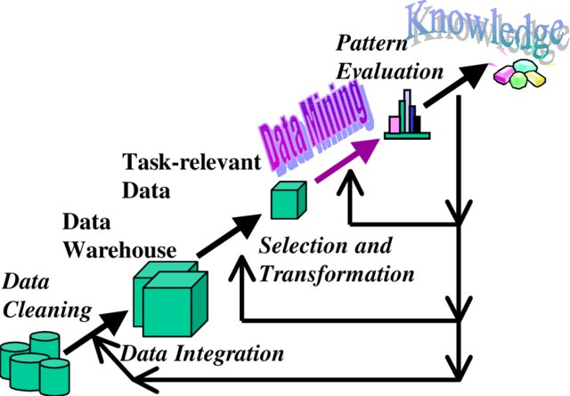
Data science via data mining
Process of Data mining
Data cleaning
Data selection
Data transformation
Data mining == ML/AI tools kicks in.
Pattern Evaluation
Result Interpretation

Slide 8
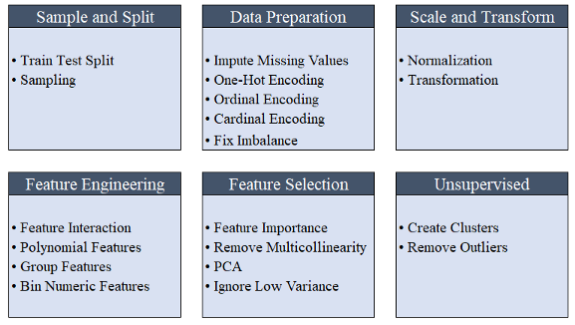
Data preprocessing (Step 1-3)
Example: PyCaret Preprocessing

Slide 9
Data science Methods (Step 4-5)
Categorization of Analysis Methods

Slide 10
Data science Methods (Step 4-5)
Difference from Classification and Clustering
Clustering | Classification
Unsupervised data | Supervised data
Does not highly value training sets | Does highly value training sets
Works solely with unlabeled data | Involves both unlabeled and labeled data
Aims to identify similarities among data | Aims to verify where a datum belongs to
Specifies required change | Does not specify required improvement
Has a single phase | Has two phases
Determining boundary conditions is not paramount | Identifying the boundary conditions is essential in executing the phases
Does not generally deal with prediction | Deals with prediction
Mainly employs two algorithms | Has a number of probable algorithms to use
Process is less complex | Process is more complex

Slide 11
Data science Methods (Step 4-5)
Detail methods for each category:
Association Rules: A priori algorithm, Sequential Pattern Mining, etc.
Classification: Decision Tree, k-Nearest Neighbors, SVM, ANN, etc.
Clustering: k-Means, Hierarchical Clustering, Expectation Maximization, etc.
Regression: Linear Regression, Logistic Regression, etc.

Slide 12
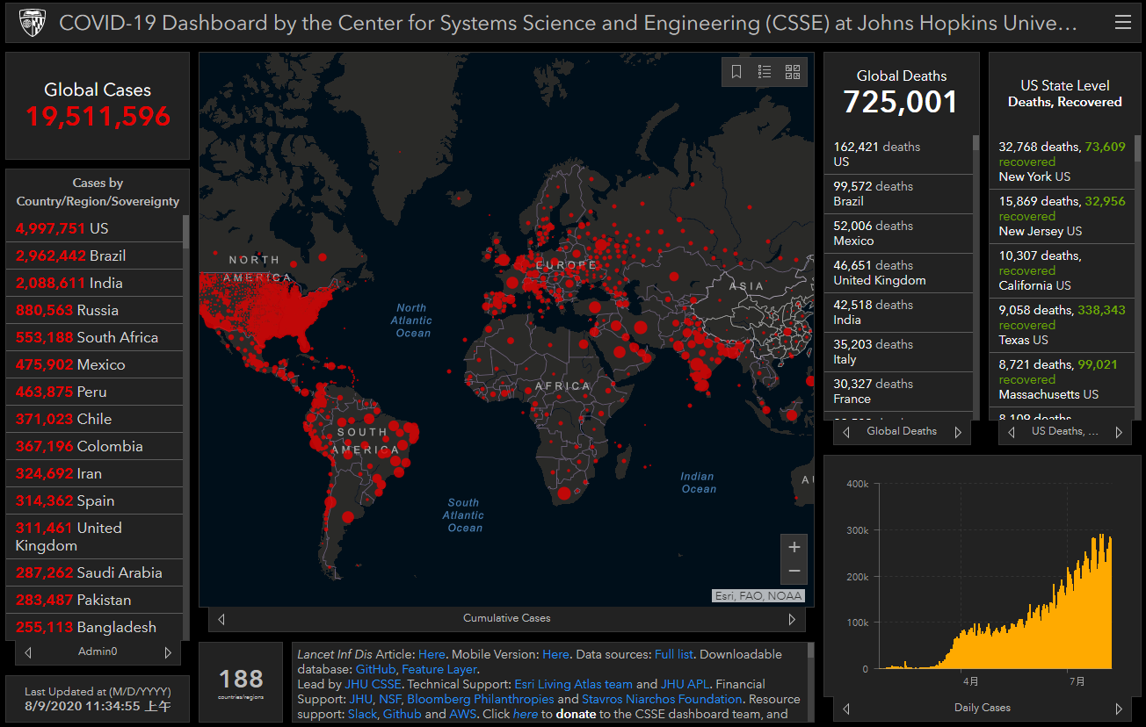
Data Visualization (Step 6)
Visualization as result interpretation

Slide 13
Data Science Applications
Recommendation System for Website or Products
Prediction of Behavior
Diagnosis of Disease
Credit Prediction
Social Network Analysis

