Slide 1
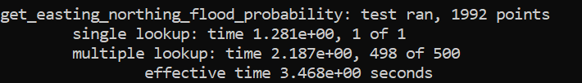
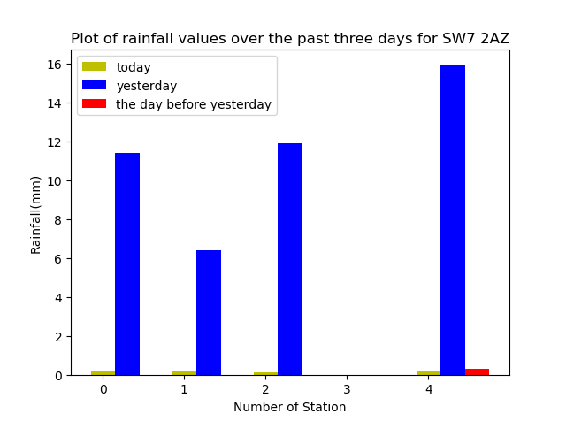
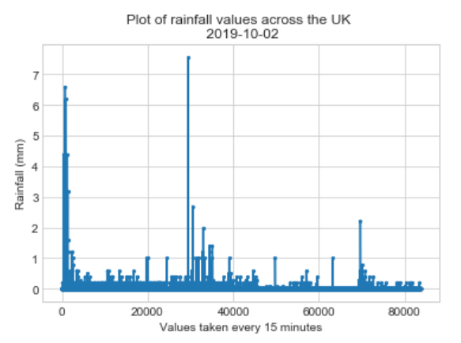
Team Derwent
Team new to coding
Good use of the API
Use of a second API to look-up values
Flood Risk Alert: post code: Average rain over 5 days
50 mm and £10k ALERT
VERY fast look-up times:
KDTree: Simulate circle with query radius
SW7 2AZ

