Slide 1

HTML2PDF.JS
Client-side HTML-to-PDF rendering using pure JS.

Slide 2
WHAT & WHY IS HTML2PDF.JS
WHAT?
html2pdf.js converts any webpage or element into a printable PDF entirely client-side using html2canvas and jsPDF.
WHY?
It's very easy to implement and doesn't require a lot of setup.
html2pdf.js is suitable for forms, invoice, and etc that print directly via browser.
Browser compatibility. The library should work fine on the following browsers (with Promise polyfill):
Firefox 3.5+
Google Chrome
Opera 12+
IE9+
Edge
Safari 6+

Slide 3
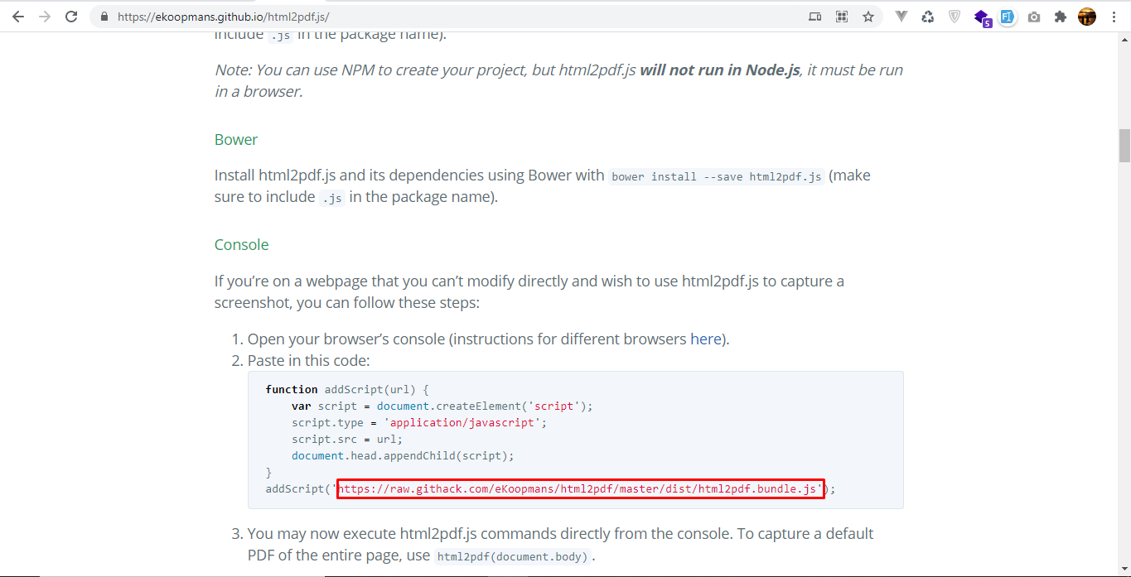
INSTALLATION
1. GO TO https://ekoopmans.github.io/html2pdf.js/ and for the documentation visit the link page that embedded.

Slide 4
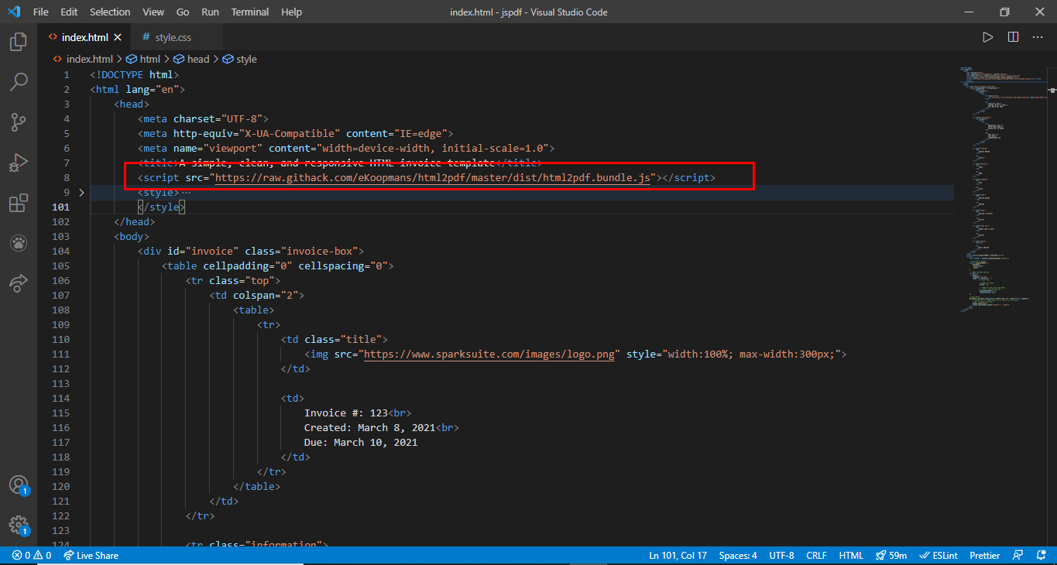
INSTALLATION
2. PASTE THE SCRIPT INTO YOUR HEADER

Slide 5
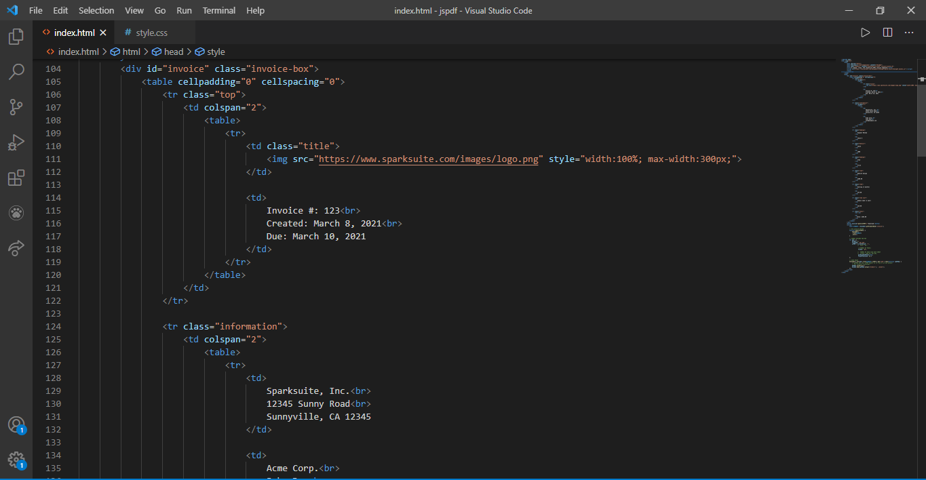
INSTALLATION
3. CREATE YOUR OWN HTML THEN CONVERT IT USING html2pdf FUNCTION.

Slide 6
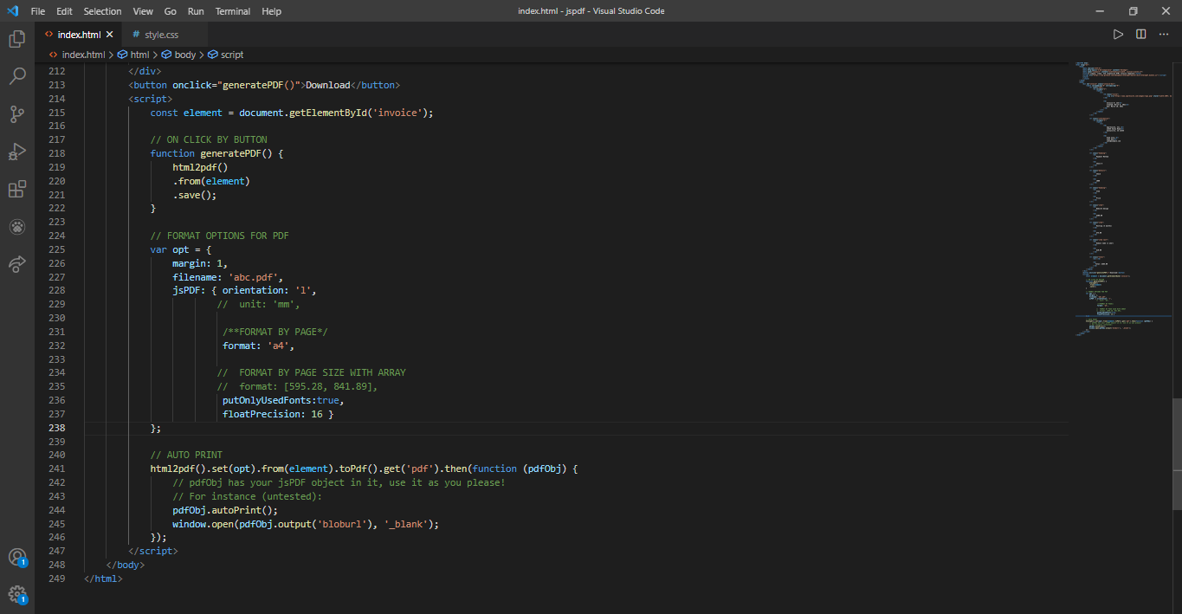
INSTALLATION
4. CREATE SCRIPT TAG ABOVE CLOSING BODY TAG.
CREATE A OR SOME FUNCTION IN THAT SCRIPT TAG

Slide 7
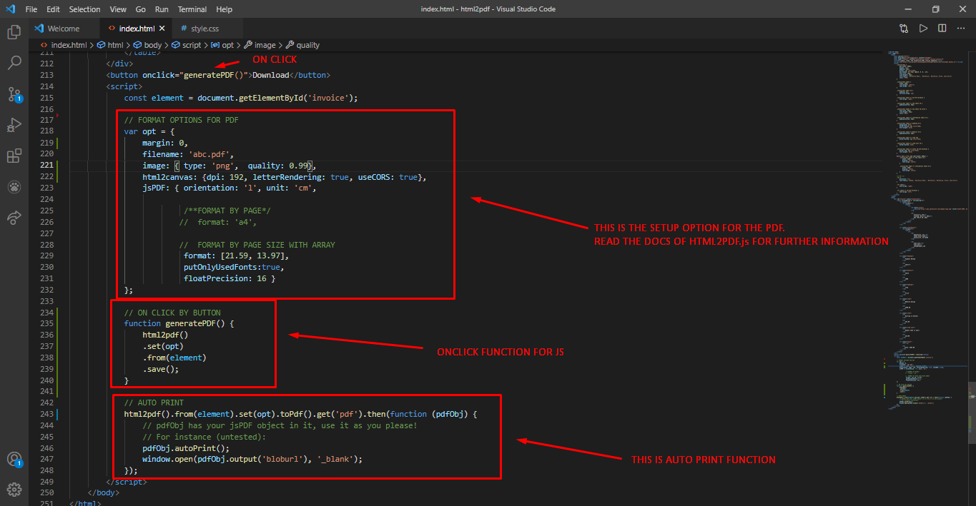
INSTALLATION
5. IMPLEMENTATION FUNCTION IN SCRIPT TAG

Slide 8
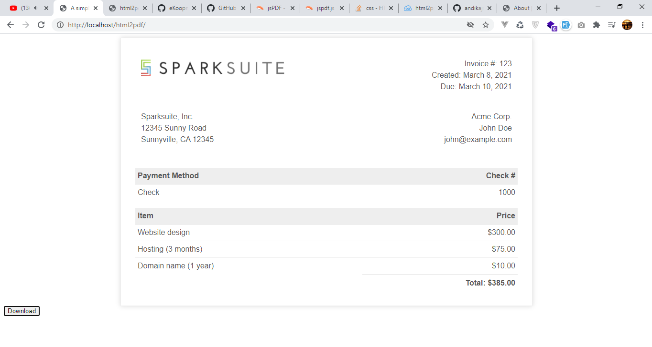
INSTALLATION
6. AN EXAMPLE OF HTML THAT I WANT TO CONVERT INTO PDF FILE

Slide 9
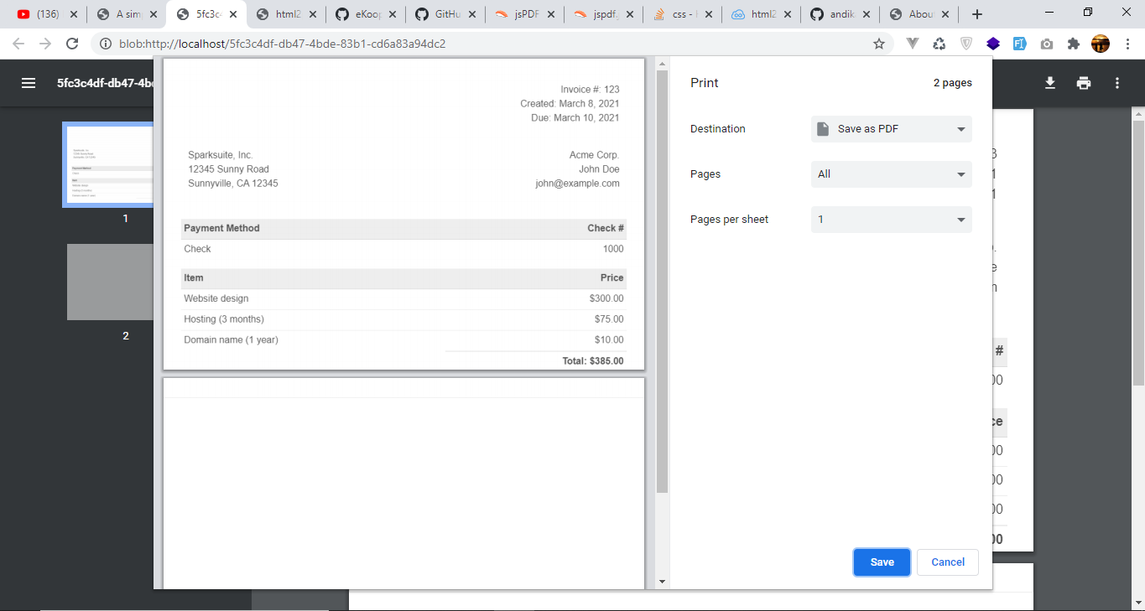
INSTALLATION
7. THIS IS A POP UP OF AUTO PRINT FUNCTION IN HTML2PDF.JS (CHROME)

Slide 10
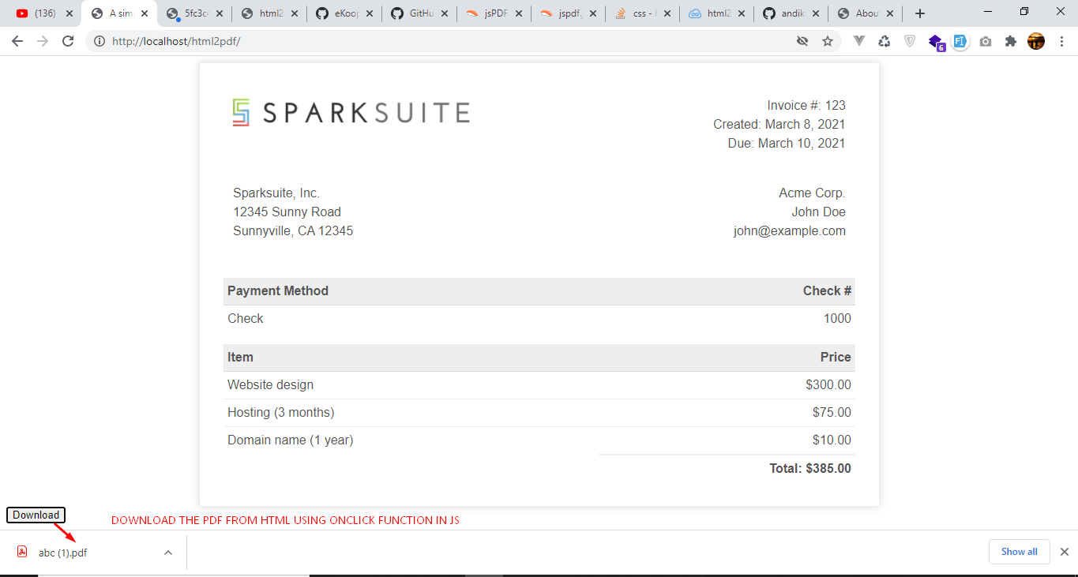
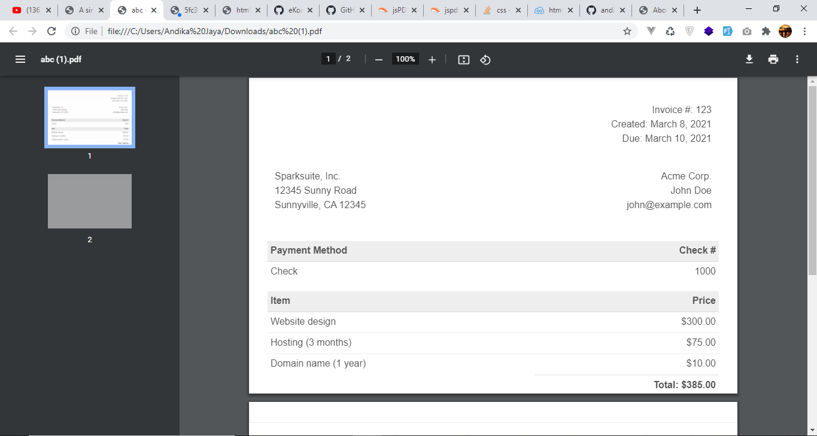
INSTALLATION
STILL LOOKING FOR THE ALTERNATIVE WAYS FOR SHOWING THE IMAGE FROM HTML TO PDF
8. DOWNLOAD THE RESULT OF HTML2PDF CONVERT

Slide 11
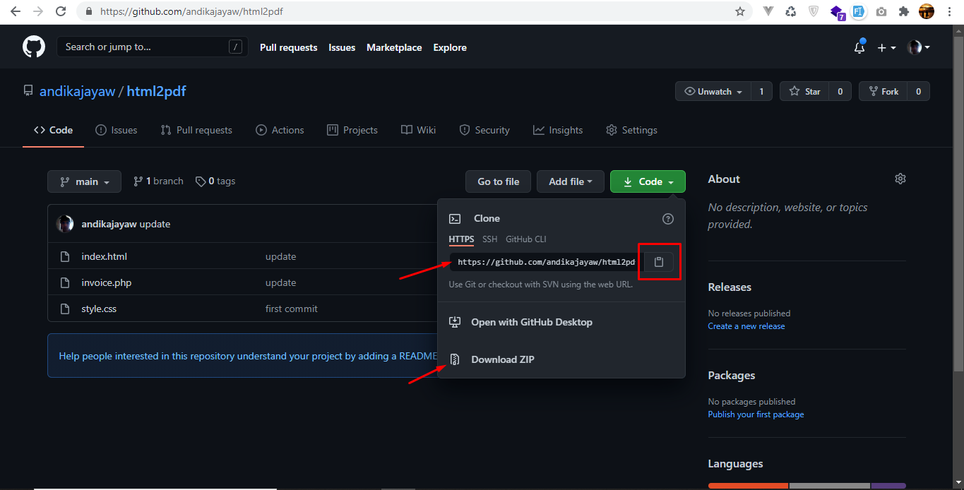
CLONE THE REPOSITORY FOR TESTING
Go to https://github.com/andikajayaw/html2pdf to clone using HTTPS or download the zip
Clone the repository from your terminal copy and paste this url clone `git clone https://github.com/andikajayaw/html2pdf.git`
After clone process is finish check your local clone and run the index file in your favourite browser.

Slide 12


Slide 13


