Slide 1
Error Function
Dennis A. Christie
Machine Learning Course

Slide 2
Mengenal Error Function
Apa dan Bagaimana?

Slide 3
Apa itu Error Function
Mengenal EF
Function yang menunjukkan seberapa buruk performa kita.
Contoh:
Saya mau pergi ke meja terdekat
Error function saya = Jarak posisi saya ke posisi meja.
Setelah mengetahui Error Function:
Setelah mengetahui bahwa posisi saya jauh, saya melihat sekitar untuk mengetahui arah mana yang terbaik menuju posisi meja.
Saya ambil langkah untuk bergerak mendekati meja.

Slide 4



Illustrasi Error Function
Mengenal EF
Error Function
=
Ketinggian

Slide 5
Permasalahan Error Function
Mengenal EF
Jumlah error = 2
Kudu piye...

Slide 6

Diskrit vs Kontinyu
Mengenal EF
99
101
2
2
95
92
87
2
2

Slide 7


















Error Function Kontinyu
Mengenal EF
$$E=$$
$$+$$
$$+$$
$$+$$
$$+$$
$$+$$
$$E=$$
$$+$$
$$+$$
$$+$$
$$+$$
$$+$$
$$E=$$
$$+$$
$$+$$
$$+$$
$$+$$
$$+$$

Slide 8
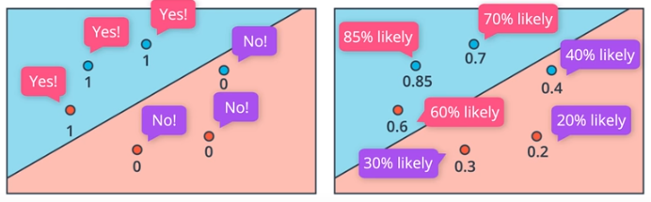
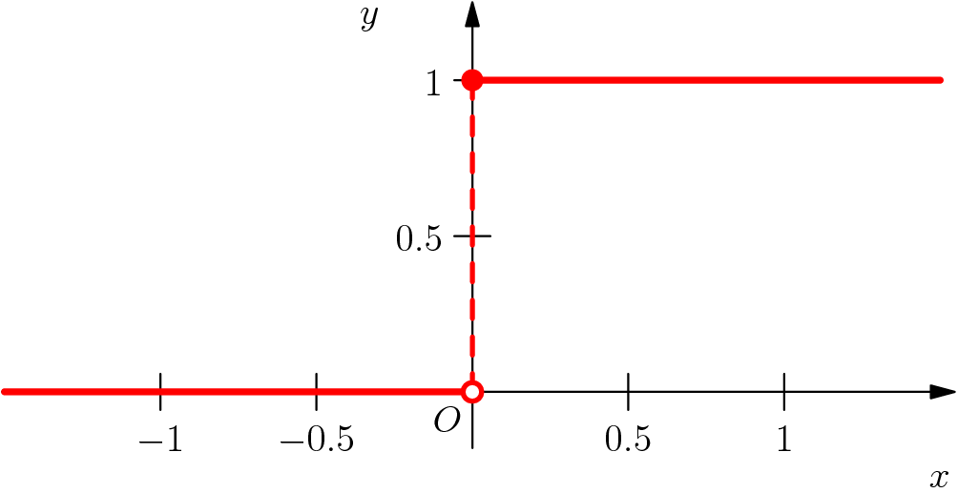
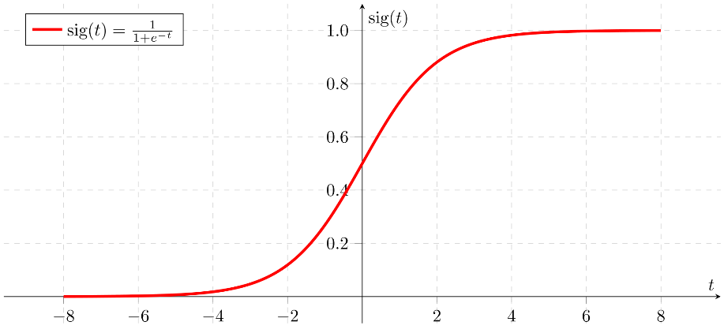
Error Function Kontinyu
Mengenal EF
Step Function
Sigmoid Function

Slide 9
Error Function Kontinyu
Mengenal EF

Slide 10
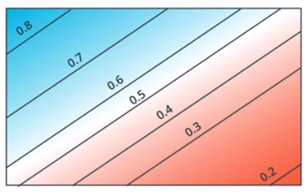
Pemetaan Nilai Error
Mengenal EF

Slide 11


Perubahan Perceptron
Mengenal EF
X₁
X₁
w₁
w₁
X₂
w₂
X₂
w₂
0.9
0.7
0.3
0.1
1
0
w_{n}
w_{n}
X_{n}
X_{n}
b
b
1
1
$$\text{step}(\text{Wx}+b)$$
$$σ(\text{Wx}+b)$$

Slide 12
Klasifikasi Multi-class
Dari Binary Classifier menjadi Multi-class Classifier

Slide 13





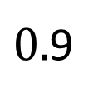


Ringkasan Sejauh Ini
Multi-Class
Date-able?
Total = 1
Berat Badan
$$x_{1}$$
Date-able
Score
Probabilitas
$$0.1$$
$$w_{1}x_{1}+w_{2}x_{2}+b$$
$$σ(\text{Wx}+b)$$
Tinggi Badan
$$x_{2}$$
$$\text{W}\text{x}+b$$
Non-date-able
$0.$9
$$1−0.1$$

Slide 14












Klasifikasi Multiclass
Multi-Class
Ikan Paus?
Ayam?
Rubah?
Total = 1
Score
Probabilitas
$${\text{W}}_{1}\text{x}+b$$
$$?({\text{W}}_{1}\text{x}+b)$$
$$0.1$$
Ukuran Badan
$$x_{1}$$
Lokasi tinggal
$$x_{2}$$
$${\text{W}}_{2}\text{x}+b$$
$$?({\text{W}}_{1}\text{x}+b)$$
$$0.7$$
...
$${\text{W}}_{3}\text{x}+b$$
$$?({\text{W}}_{1}\text{x}+b)$$
$$0.2$$

Slide 15
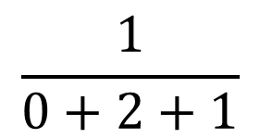

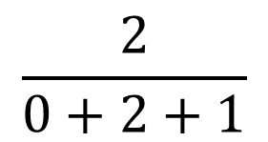
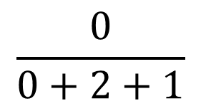



Klasifikasi Multiclass
Multi-Class
Bermasalah
pada saat
$$\frac{0}{0+2+1}$$
$$0$$
$$\frac{1}{1+0+(−1)}$$
$$\frac{2}{0+2+1}$$
$$2$$
Fungsi yang
selalu memberikan
hasil positif?
Sin
Cos
Log
Exp
$$\frac{1}{0+2+1}$$
$$1$$

Slide 16
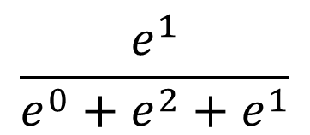
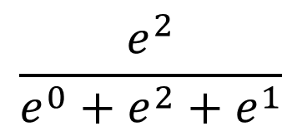
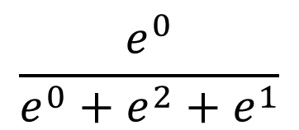



Klasifikasi Multiclass
Multi-Class
Total = 1
$$\frac{e^{0}}{e^{0}+e^{2}+e^{1}}$$
$$0$$
$$0.09$$
$$\frac{e^{2}}{e^{0}+e^{2}+e^{1}}$$
$$0.24$$
$$2$$
$$\frac{e^{1}}{e^{0}+e^{2}+e^{1}}$$
$$0.67$$
$$1$$

Slide 17


Sigmoid dan Softmax
Multi-Class
Sigmoid Function (Binary)
Softmax Function (Multiclass)
$$σ\left(\hat{y}\right)=\frac{1}{1+e^{−\hat{y}}}$$
$$S\left({\hat{y}}_{i}\right)=\frac{e^{{\hat{y}}_{i}}}{\sum_{j}{e^{{\hat{y}}_{j}}}}$$

Slide 18
Maximum Likelihood
Memberi tahu komputer model yang baik dan buruk.

Slide 19
Error Function?
Maximum Likelihood
$$E=$$
$$+$$
$$+$$
$$+$$
$$+$$
$$+$$
$$E=$$
$$+$$
$$+$$
$$+$$
$$+$$
$$+$$
$$E=$$
$$+$$
$$+$$
$$+$$
$$+$$
$$+$$
Maksudnya apa coba? Sangat tidak spesifik bagi komputer.

Slide 20
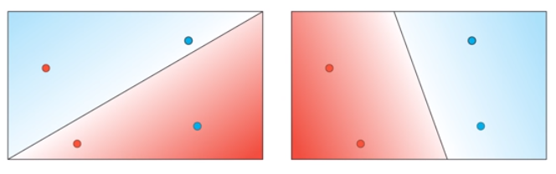
Menentukan Model yang Baik dan Buruk
Maximum Likelihood
Yang ini buruk!
Tapi bagaimana cara kita memberitahu
komputer bahwa ini model yang buruk?

Slide 21
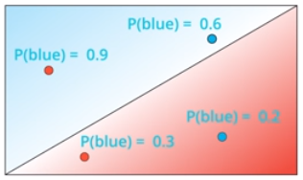
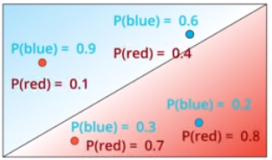
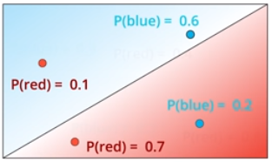
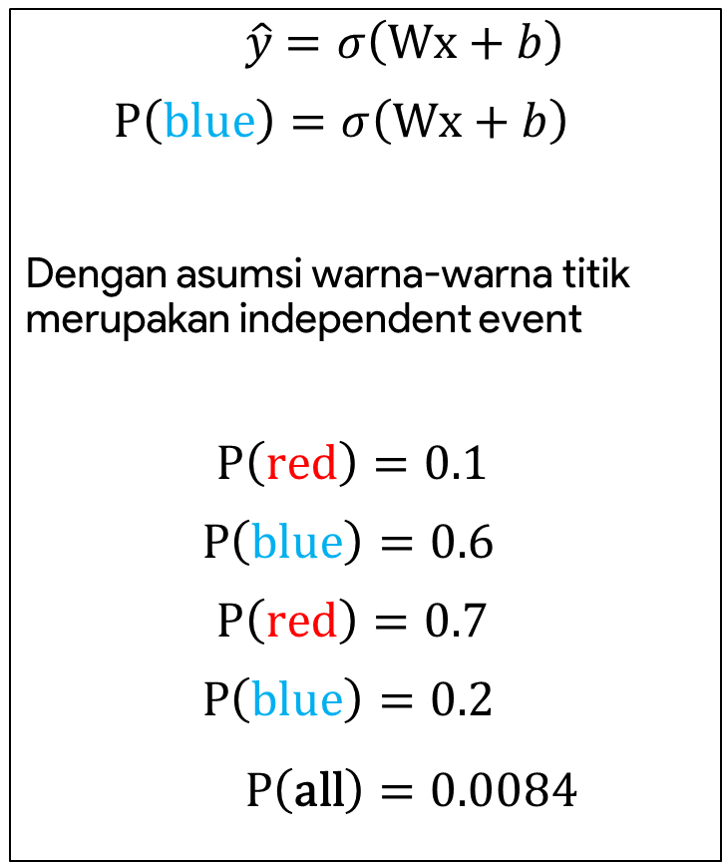

Menentukan Model yang Baik dan Buruk
Maximum Likelihood
$\hat{y}$ $=σ\left(\text{Wx}+b\right)$
$$\text{P}\left(\text{blue}\right)=σ\left(\text{Wx}+b\right)$$
Dengan asumsi warna-warna titik merupakan independent event
$$\text{P}\left(\text{red}\right)=0.1$$
$$\text{P}\left(\text{blue}\right)=0.6$$
$$\text{P}\left(\text{red}\right)=0.7$$
$$\text{P}\left(\text{blue}\right)=0.2$$
$$\text{P}\left(\text{all}\right)=0.0084$$
$$×$$

Slide 22
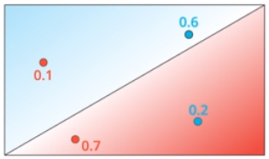
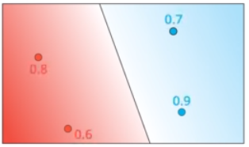


Menentukan Model yang Baik dan Buruk
Maximum Likelihood
$$0.1×0.6×0.7×0.2=0.0084$$
$$0.8×0.7×0.9×0.6=0.3024$$
Spesifik dan mudah dimengerti komputer
Penentuan ini disebut dengan Maximum Likelihood

Slide 23
Menentukan Model yang Baik dan Buruk
Maximum Likelihood
$$0.1×0.6×0.7×0.2=0.0084$$
$$0.8×0.7×0.9×0.6=0.3024$$
Sekarang kita tahu bahwa grafik kiri lebih buruk dari kanan berdarkan operasi product seluruh probabilitas point terklasifikasi sesuai warnanya.
Semakin besar probabilitasnya semakin bagus model kita.
Apakah kita berhasil menemukan Error Function yang kita cari?

Slide 24

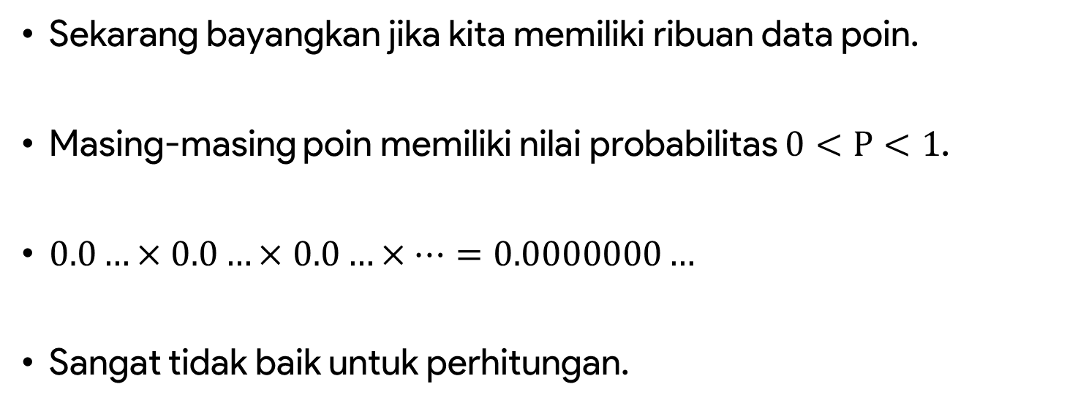

Kelemahan Maximum Likelihood
Maximum Likelihood
$$0.1×0.6×0.7×0.2=0.0084$$
$$0.8×0.7×0.9×0.6=0.3024$$
Sekarang bayangkan jika kita memiliki ribuan data poin.
Masing-masing poin memiliki nilai probabilitas $0<\text{P}<1$.
$0.0…×0.0…×$ $0.0…×…=0.0000000…$
Sangat tidak baik untuk perhitungan.

Slide 25
Cross Entropy
Error Function yang Sebenarnya

Slide 26
























Formulasi Error Function
Cross Entropy
$$0.1×0.6×0.7×0.2=0.0084$$
$$0.8×0.7×0.9×0.6=0.3024$$
$$\ln{(0.1)}+\ln{(0.6)}+\ln{(0.7)}+\ln{(0.2)}$$
$$\ln{(0.8)}+\ln{(0.7)}+\ln{(0.9)}+\ln{(0.6)}$$
$$−2.3$$
$$−0.51$$
$$−0.36$$
$$−1.61$$
$$−0.22$$
$$−0.36$$
$$−0.1$$
$$−0.51$$
$$−\ln{(0.1)}−\ln\left(0.6\right)−\ln\left(0.7\right)−\ln{(0.2)}$$
$$−ln{(0.8)}−\ln\left(0.7\right)−\ln{(0.9)}−ln{(0.6)}$$
$$2.3$$
$$+0.51$$
$$+0.36$$
$$+1.61$$
$$0.22$$
$$+0.36$$
$$+0.1$$
$$+0.51$$
$$4.8$$
$$1.2$$

Slide 27
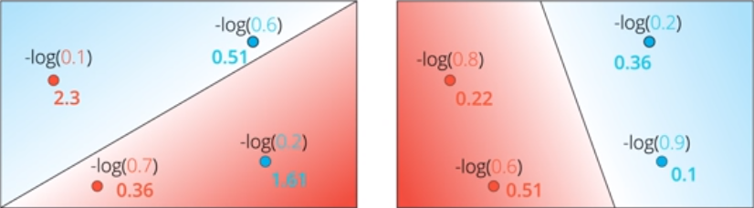




Formulasi Error Function
Cross Entropy
$$0.1×0.6×0.7×0.2=0.0084$$
$$0.8×0.7×0.9×0.6=0.3024$$
$$−\ln{(0.1)}−\ln\left(0.6\right)−\ln\left(0.7\right)−\ln{(0.2)}$$
$$−ln{(0.8)}−\ln\left(0.7\right)−\ln{(0.9)}−ln{(0.6)}$$
$$4.8$$
Cross Entropy
$$1.2$$

Slide 28






Formulasi Error Function
Cross Entropy
0.8
0.7
0.1

Slide 29




Formulasi Error Function
Cross Entropy
0.8
0.7
0.1
$$\text{P}\text{(}\text{Gift}\text{)}$$
0.2
0.3
0.9
$$\text{P}\text{(}\text{No}\text{−}\text{gift}\text{)}$$

Slide 30



Formulasi Error Function
Cross Entropy
Probabilitas
-ln(Probabilitas)
0.8
0.7
0.1
0.0568
2.88
0.8
0.7
0.9
0.504
0.69
0.8
0.3
0.1
0.024
3.73
0.2
0.7
0.1
0.014
4.27
0.8
0.3
0.9
0.216
1.53
0.2
0.7
0.9
0.126
2.07
0.2
0.3
0.1
0.006
5.12
0.2
0.3
0.9
0.054
2.92

Slide 31













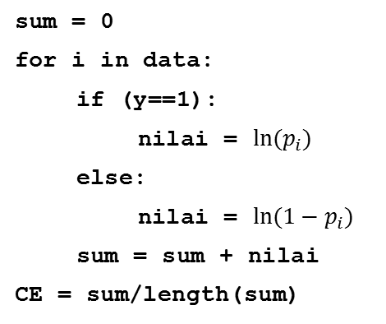



Formulasi Error Function
Cross Entropy
$$p_{1}=0.8$$
$$p_{2}=0.7$$
Cross Entropy
$$p_{3}=0.1$$
$$0.7$$
$$0.9$$
$$0.8$$
$$−\ln{(0.8)}−\ln\left(0.7\right)−\ln\left(0.9\right)$$
$$p_{1}$$
$$p_{2}$$
$${1−p}_{3}$$
Label
$$y_{i}$$
$$y_{i}=1$$
$$y_{i}=1$$
$$y_{i}=0$$
sum = 0
for i in data:
if (y==1):
nilai = $\ln{{(p}_{i})}$
else:
nilai = $\ln{(1−p_{i})}$
sum = sum + nilai
CE = sum/length(sum)

Slide 32






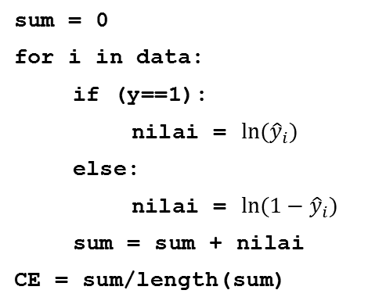
Formulasi Error Function
Cross Entropy
$$p_{1}=0.8$$
$$p_{2}=0.7$$
Cross Entropy
$$p_{3}=0.1$$
$$0.7$$
$$0.9$$
$$0.8$$
$$−\ln{(0.8)}−\ln\left(0.7\right)−\ln\left(0.9\right)$$
$${\hat{y}}_{1}$$
$${\hat{y}}_{2}$$
$${1−\hat{y}}_{3}$$
$$p_{1}$$
$$p_{2}$$
$${1−p}_{3}$$
Label
$$y_{i}$$
$$y_{1}=1$$
$$y_{2}=1$$
$$y_{3}=0$$
sum = 0
for i in data:
if (y==1):
nilai = $\ln{({\hat{y}}_{i})}$
else:
nilai = $\ln{(1−{\hat{y}}_{i})}$
sum = sum + nilai
CE = sum/length(sum)

Slide 33


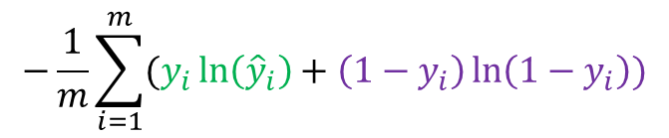
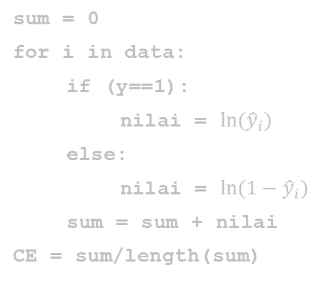
Formulasi Error Function
Cross Entropy
$$p_{1}=0.8$$
$$p_{2}=0.7$$
Cross Entropy
$$p_{3}=0.1$$
$$0.7$$
$$0.8$$
$$0.9$$
$$−\ln{(0.8)}−\ln\left(0.7\right)−\ln\left(0.9\right)$$
$${\hat{y}}_{1}$$
$${\hat{y}}_{2}$$
$${1−\hat{y}}_{3}$$
Label
$$y_{i}$$
$$y_{1}=1$$
$$y_{2}=1$$
$$y_{3}=0$$
sum = 0
for i in data:
if (y==1):
nilai = $\ln{{(\hat{y}}_{i})}$
else:
nilai = $\ln{(1−{\hat{y}}_{i})}$
sum = sum + nilai
CE = sum/length(sum)
Formula Cross Entropy
$$−\frac{1}{m}\sum_{i=1}^{m}{(y_{i}\ln\left({\hat{y}}_{i}\right)+\left(1−y_{i}\right)\ln\left(1−y_{i}\right))}$$

Slide 34

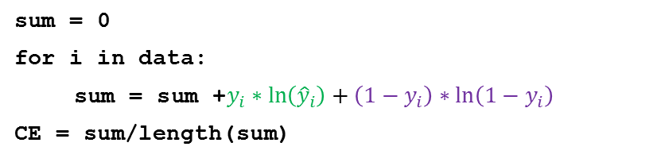
Formulasi Error Function
Cross Entropy
$$p_{1}=0.8$$
$$p_{2}=0.7$$
Cross Entropy
$$p_{3}=0.1$$
$$0.7$$
$$0.8$$
$$0.9$$
$$−\ln{(0.8)}−\ln\left(0.7\right)−\ln\left(0.9\right)$$
$$p_{1}$$
$$p_{2}$$
$${1−p}_{13}$$
Label
$$y_{i}$$
$$y_{i}=1$$
$$y_{i}=1$$
$$y_{i}=0$$
Formula Cross Entropy
sum = 0
for i in data:
sum = sum +$y_{i}∗\ln\left({\hat{y}}_{i}\right)+\left(1−y_{i}\right)∗\ln\left(1−y_{i}\right)$
CE = sum/length(sum)
$$−\frac{1}{m}\sum_{i=1}^{m}{(y_{i}\ln\left({\hat{y}}_{i}\right)+\left(1−y_{i}\right)\ln\left(1−y_{i}\right))}$$

