Slide 1
Forward Backward Propagation
Dennis A. Christie
Machine Learning Course

Slide 2
Ide Melatih ANN
Forward Backward

Slide 3
Feedforward Propagation
Tahap Pertama dalam ANN Traning

Slide 4









Neural Network
Feed-forward
$$x_{1}$$
$$w_{1}$$
Melihat dari model yang buruk
Nilai prediksi pasti kecil
$$x=(x_{1},x_{2})$$
$$(x_{1},x_{2})$$
$$\hat{y}$$
$$y=1$$
$$w_{2}$$
$$w_{1}x_{1}+w_{2}x_{2}+b$$
$$x_{2}$$

Slide 5








Neural Network
Feed-forward
Model yang buruk!
Nilai prediksi juga pasti kecil
$$(x_{1},x_{2})$$
$$x_{1}$$
$$x=(x_{1},x_{2})$$
$$(x_{1},x_{2})$$
$$\hat{y}$$
$$y=1$$
$$(x_{1},x_{2})$$
$$x_{2}$$

Slide 6



















Forward Propagation
Feed-forward
$$W_{11}^{(1)}$$
$$x_{1}$$
$$W_{12}^{(1)}$$
$$W_{11}^{(2)}$$
$$W_{21}^{(1)}$$
$$σ\left({\left[\begin{matrix}W_{11}^{(1)} \\ W_{21}^{(2)} \\ W_{31}^{(3)}\end{matrix}\right]}^{\text{T}}σ\left({\left[\begin{matrix}W_{11}^{(1)} & W_{12}^{(1)} \\ W_{21}^{(1)} & W_{22}^{(1)} \\ W_{31}^{(1)} & W_{32}^{(1)} \end{matrix}\right]}^{\text{T}}\left[\begin{matrix}x_{1} \\ x_{2} \\ 1\end{matrix}\right]\right)\right)$$
$${\left[\begin{matrix}W_{11}^{(1)} & W_{12}^{(1)} \\ W_{21}^{(1)} & W_{22}^{(1)} \\ W_{31}^{(1)} & W_{32}^{(1)} \end{matrix}\right]}^{\text{T}}$$
$${\left[\begin{matrix}W_{11}^{(1)} \\ W_{21}^{(2)} \\ W_{31}^{(3)}\end{matrix}\right]}^{\text{T}}$$
$$σ\left({\left[\begin{matrix}W_{11}^{(1)} & W_{12}^{(1)} \\ W_{21}^{(1)} & W_{22}^{(1)} \\ W_{31}^{(1)} & W_{32}^{(1)} \end{matrix}\right]}^{\text{T}}\left[\begin{matrix}x_{1} \\ x_{2} \\ 1\end{matrix}\right]\right)$$
$$W_{22}^{(1)}$$
$$W_{21}^{(2)}$$
$$\left[\begin{matrix}x_{1} \\ x_{2} \\ 1\end{matrix}\right]$$
$$x_{2}$$
$$W_{31}^{(2)}$$
$$W_{31}^{(1)}$$
$$W_{32}^{(1)}$$
$$1$$
$$1$$
$$\hat{y}=σ∘W^{(2)}∘σ∘W^{(1)}∘x$$

Slide 7









Feedforward 1 Layer
Feed-forward
Prediction
$$\hat{y}=σ\left(\text{Wx}+b\right)$$
Error Function
$$E(W)=−\frac{1}{m}\sum_{i=1}^{m}{(y_{i}\ln\left({\hat{y}}_{i}\right)+\left(1−y_{i}\right)\ln\left(1−y_{i}\right))}$$
Illustrasi
$$x_{1}$$
$$W_{1}$$
$$x_{2}$$
$$W_{2}$$
$$W_{3}$$
$$x_{n}$$
$$b$$
$$1$$

Slide 8














Feedforward Multi-Layer
Feed-forward
Prediction
$$\hat{y}=σ∘W^{(2)}∘σ∘W^{(1)}∘x$$
Error Function
$$E(W)=−\frac{1}{m}\sum_{i=1}^{m}{(y_{i}\ln\left({\hat{y}}_{i}\right)+\left(1−y_{i}\right)\ln\left(1−y_{i}\right))}$$
Illustrasi
$$W_{11}^{(1)}$$
$$x_{1}$$
$$W_{12}^{(1)}$$
$$W_{11}^{(2)}$$
$$W_{21}^{(1)}$$
$$W_{22}^{(1)}$$
$$W_{21}^{(2)}$$
$$x_{2}$$
$$W_{31}^{(2)}$$
$$W_{31}^{(1)}$$
$$W_{32}^{(1)}$$
$$1$$
$$1$$

Slide 9
Backward Propagation
Tahap Kedua dalam ANN Traning

Slide 10








Feedforward vs Backpropagate
Back-propagate
$$W_{11}^{(1)}$$
$$x_{1}$$
$$W_{12}^{(1)}$$
$$W_{11}^{(2)}$$
$$W_{21}^{(1)}$$
$$W_{22}^{(1)}$$
$$W_{21}^{(2)}$$
$$x_{2}$$
$$W_{31}^{(2)}$$
$$W_{31}^{(1)}$$
$$W_{32}^{(1)}$$
$$1$$
$$1$$

Slide 11
Feedforward vs Backpropagate
Back-propagate
$$W_{11}^{(1)}$$
$$x_{1}$$
$$W_{12}^{(1)}$$
$$W_{11}^{(2)}$$
$$W_{21}^{(1)}$$
$$W_{22}^{(1)}$$
$$W_{21}^{(2)}$$
$$x_{2}$$
$$W_{31}^{(2)}$$
$$W_{31}^{(1)}$$
$$W_{32}^{(1)}$$
$$1$$
$$1$$

Slide 12

Ide dibalik Backpropagate
Back-propagate
Karena model yang ini
Jadi memperburuk arsitektur secara keseluruhan
Kita perbesar
weight yang ini
Model yang buruk!
Nilai prediksi juga pasti kecil
$$(x_{1},x_{2})$$
$$x_{1}$$
Kita perkecil
weight yang ini
$$x=(x_{1},x_{2})$$
$$(x_{1},x_{2})$$
$$\hat{y}$$
$$y=1$$
$$(x_{1},x_{2})$$
Kita perbesar
weight yang ini
$$x_{2}$$
Kita perbesar
weight yang ini

Slide 13
Ide dibalik Backpropagate
Back-propagate
Kita perbesar
weight yang ini
$$(x_{1},x_{2})$$
$$x_{1}$$
Kita perkecil
weight yang ini
$$x=(x_{1},x_{2})$$
$$(x_{1},x_{2})$$
$$\hat{y}$$
$$y=1$$
$$(x_{1},x_{2})$$
Kita perbesar
weight yang ini
$$x_{2}$$
Kita perbesar
weight yang ini

Slide 14


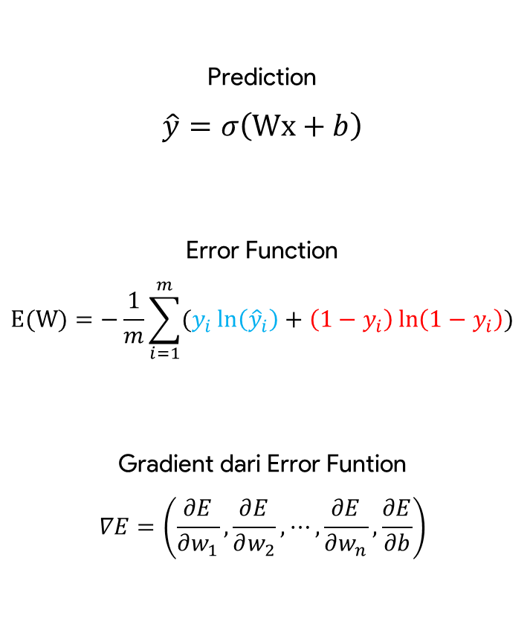


Back-propagation 1 Layer
Back-propagate
Prediction
$$\hat{y}=σ\left(\text{Wx}+b\right)$$
Error Function
$$E(W)=−\frac{1}{m}\sum_{i=1}^{m}{(y_{i}\ln\left({\hat{y}}_{i}\right)+\left(1−y_{i}\right)\ln\left(1−y_{i}\right))}$$
Gradient dari Error Funtion
$$∇E=\left(\frac{∂E}{∂w_{1}},\frac{∂E}{∂w_{2}},⋯,\frac{∂E}{∂w_{n}},\frac{∂E}{∂b}\right)$$
$$x_{1}$$
$$W_{1}$$
$$x_{2}$$
$$W_{2}$$
$$W_{3}$$
$$x_{n}$$
$$b$$
$$1$$
$$\frac{∂E}{∂w_{1}}$$
$$\frac{∂E}{∂w_{2}}$$
$$\frac{∂E}{∂w_{n}}$$
$$\frac{∂E}{∂b}$$

Slide 15
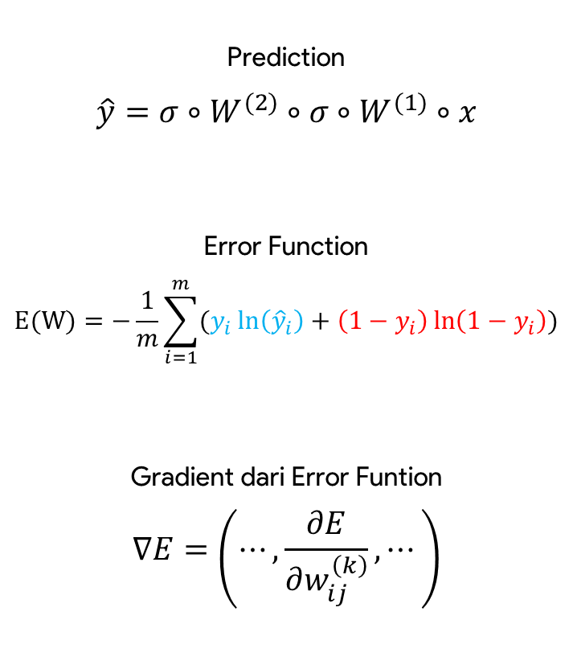
Back-propagation n-Layer
Back-propagate
Prediction
$$\hat{y}=σ∘W^{(2)}∘σ∘W^{(1)}∘x$$
Error Function
$$E(W)=−\frac{1}{m}\sum_{i=1}^{m}{(y_{i}\ln\left({\hat{y}}_{i}\right)+\left(1−y_{i}\right)\ln\left(1−y_{i}\right))}$$
Gradient dari Error Funtion
$$∇E=\left(⋯,\frac{∂E}{∂w_{ij}^{\left(k\right)}},⋯\right)$$
$$W_{11}^{(1)}$$
$$x_{1}$$
$$W_{12}^{(1)}$$
$$W_{11}^{(2)}$$
$$W_{21}^{(1)}$$
$$W_{22}^{(1)}$$
$$W_{21}^{(2)}$$
$$x_{2}$$
$$W_{31}^{(2)}$$
$$W_{31}^{(1)}$$
$$W_{32}^{(1)}$$
$$1$$
$$1$$

Slide 16


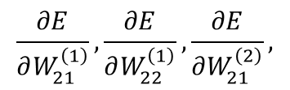

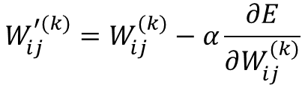


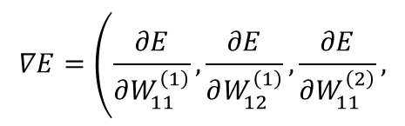

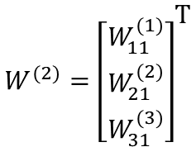





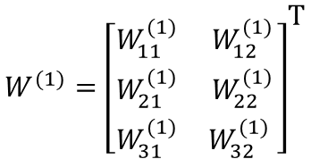










Back-propagation n-Layer
Back-propagate
Bagaimana cara melakukan
partial derivative $E$ terhadap $W_{11}^{(1)}$ ?
$$\hat{y}=σ∘W^{(2)}∘σ∘W^{(1)}∘x$$
$$W_{11}^{(1)}$$
$${W^{(2)}=\left[\begin{matrix}W_{11}^{(1)} \\ W_{21}^{(2)} \\ W_{31}^{(3)}\end{matrix}\right]}^{\text{T}}$$
$${W^{(1)}=\left[\begin{matrix}W_{11}^{(1)} & W_{12}^{(1)} \\ W_{21}^{(1)} & W_{22}^{(1)} \\ W_{31}^{(1)} & W_{32}^{(1)} \end{matrix}\right]}^{\text{T}}$$
$$x_{1}$$
$$W_{12}^{(1)}$$
$$W_{11}^{(2)}$$
$$W_{21}^{(1)}$$
$$∇E=\left(\frac{∂E}{∂W_{11}^{\left(1\right)}},\frac{∂E}{∂W_{12}^{\left(1\right)}},\frac{∂E}{∂W_{11}^{\left(2\right)}}\right.,$$
$$\frac{∂E}{∂W_{11}^{\left(1\right)}}$$
$$\frac{∂E}{∂W_{12}^{\left(1\right)}}$$
$$\frac{∂E}{∂W_{11}^{\left(2\right)}}$$
$$x_{2}$$
$$W_{22}^{(1)}$$
$$W_{21}^{(2)}$$
$$\frac{∂E}{∂W_{21}^{\left(1\right)}},\frac{∂E}{∂W_{22}^{\left(1\right)}},\frac{∂E}{∂W_{21}^{\left(2\right)}},$$
$$\frac{∂E}{∂W_{21}^{\left(1\right)}}$$
$$\frac{∂E}{∂W_{22}^{\left(1\right)}}$$
$$\frac{∂E}{∂W_{21}^{\left(2\right)}}$$
$$W_{31}^{(1)}$$
$$W_{31}^{(2)}$$
$$\left.\frac{∂E}{∂W_{31}^{\left(1\right)}},\frac{∂E}{∂W_{32}^{\left(1\right)}},\frac{∂E}{∂W_{31}^{\left(2\right)}}\right)$$
$$W_{32}^{(1)}$$
$$\frac{∂E}{∂W_{31}^{\left(1\right)}}$$
$$\frac{∂E}{∂W_{32}^{\left(1\right)}}$$
$$\frac{∂E}{∂W_{31}^{\left(2\right)}}$$
$$1$$
$$1$$
$$W_{ij}^{′(k)}=W_{ij}^{(k)}−α\frac{∂E}{∂W_{ij}^{(k)}}$$

Slide 17











Chain Rule
Back-propagate
$$\frac{∂B}{∂x}$$
$$f$$
$$g$$
$$x$$
$$A$$
$$B$$
$$\frac{∂A}{∂x}$$
$$\frac{∂B}{∂A}$$
$$A=f(x)$$
$$B=g∘f(x)$$
Melakukan partial derivatif B terhadap x
Bisa melalui A terlebih dahulu
$$=$$

Slide 18













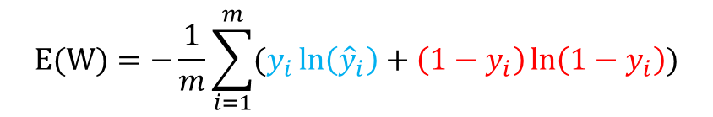



Ringkasan Algoritma
Back-Propagate
$$h_{1}^{(1)}=W_{11}^{(1)}x_{1}+W_{21}^{(1)}x_{1}+W_{31}^{(1)}$$
$$W_{11}^{(1)}$$
$$h_{1}^{(1)}$$
$$h_{2}^{(1)}=W_{12}^{(1)}x_{1}+W_{22}^{(1)}x_{1}+W_{32}^{(1)}$$
$$x_{1}$$
$$h_{1}^{(1)}$$
$$x_{1}$$
$$x_{1}$$
$$W_{12}^{(1)}$$
$$W_{11}^{(2)}$$
$$h_{1}^{(2)}=W_{11}^{\left(2\right)}σ(h_{1}^{(1)})+W_{21}^{(2)}σ(h_{2}^{(1)})+W_{31}^{(2)}$$
$$W_{21}^{(1)}$$
$$W_{22}^{(1)}$$
$$h_{2}^{(1)}$$
$$W_{21}^{(2)}$$
$$h_{2}^{(1)}$$
$$h_{1}^{(2)}$$
$$x_{2}$$
$$h_{1}^{(2)}$$
$$\hat{y}$$
$$x_{2}$$
$$x_{2}$$
$$\hat{y}=σ(h_{1}^{(2)})$$
$$W_{31}^{(1)}$$
$$W_{31}^{(2)}$$
$$\hat{y}=σ∘W^{(2)}∘σ∘W^{(1)}∘x$$
$$W_{32}^{(1)}$$
$$1$$
$$1$$
$$1$$
$$1$$
$$1$$
$$E(W)=−\frac{1}{m}\sum_{i=1}^{m}{(y_{i}\ln\left({\hat{y}}_{i}\right)+\left(1−y_{i}\right)\ln\left(1−y_{i}\right))}$$

Slide 19

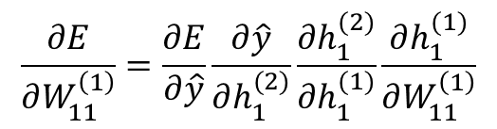


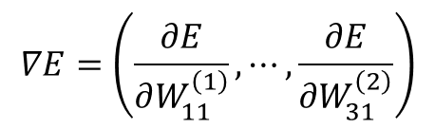


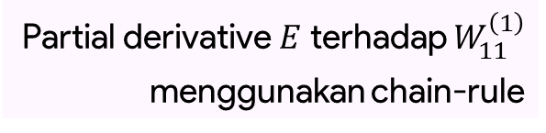
Ringkasan Algoritma
Back-propagate
$$E(W)=−\frac{1}{m}\sum_{i=1}^{m}{(y_{i}\ln\left({\hat{y}}_{i}\right)+\left(1−y_{i}\right)\ln\left(1−y_{i}\right))}$$
$$W_{11}^{(1)}$$
$$h_{1}^{(1)}$$
$$x_{1}$$
$$∇E=\left(\frac{∂E}{∂W_{11}^{\left(1\right)}},⋯,\frac{∂E}{∂W_{31}^{\left(2\right)}}\right)$$
$$W_{12}^{(1)}$$
$$W_{11}^{(2)}$$
$$W_{21}^{(1)}$$
$$W_{22}^{(1)}$$
$$h_{2}^{(1)}$$
$$W_{21}^{(2)}$$
$$h_{1}^{(2)}$$
$$x_{2}$$
$$\hat{y}$$
$$W_{31}^{(2)}$$
$$W_{31}^{(1)}$$
Partial derivative $E$ terhadap $W_{11}^{\left(1\right)}$
menggunakan chain-rule
$$W_{32}^{(1)}$$
$$1$$
$$1$$
$$\frac{∂E}{∂W_{11}^{\left(1\right)}}=\frac{∂E}{∂\hat{y}}\frac{∂\hat{y}}{∂h_{1}^{(2)}}\frac{∂h_{1}^{(2)}}{∂h_{1}^{(1)}}\frac{∂h_{1}^{(1)}}{∂W_{11}^{\left(1\right)}}$$

