Slide 1
Research Report I
ANDI MUHAMMAD NUR FITRAH SYAMSUL
424DE01
Material Science, Faculty of Engineering, Mie University
Nakamura-Nawa Group

Slide 2
Progress Summary
Neural Networks script from scratch
Exchange correlation feature script

Slide 3
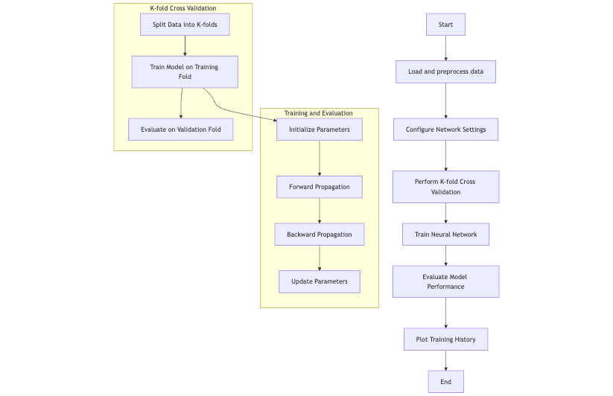
Neural Networks

Slide 4
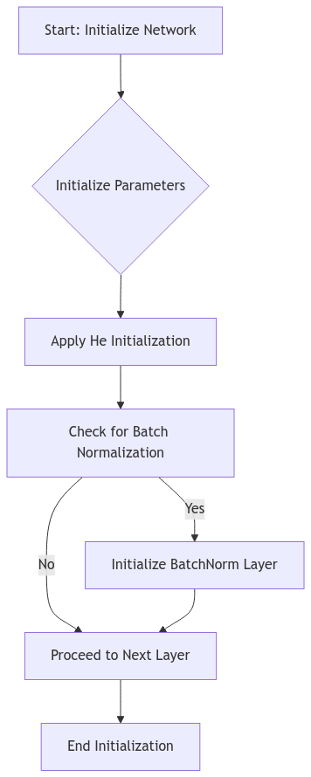
Part 1: Initialization and Parameter Setup

Slide 5
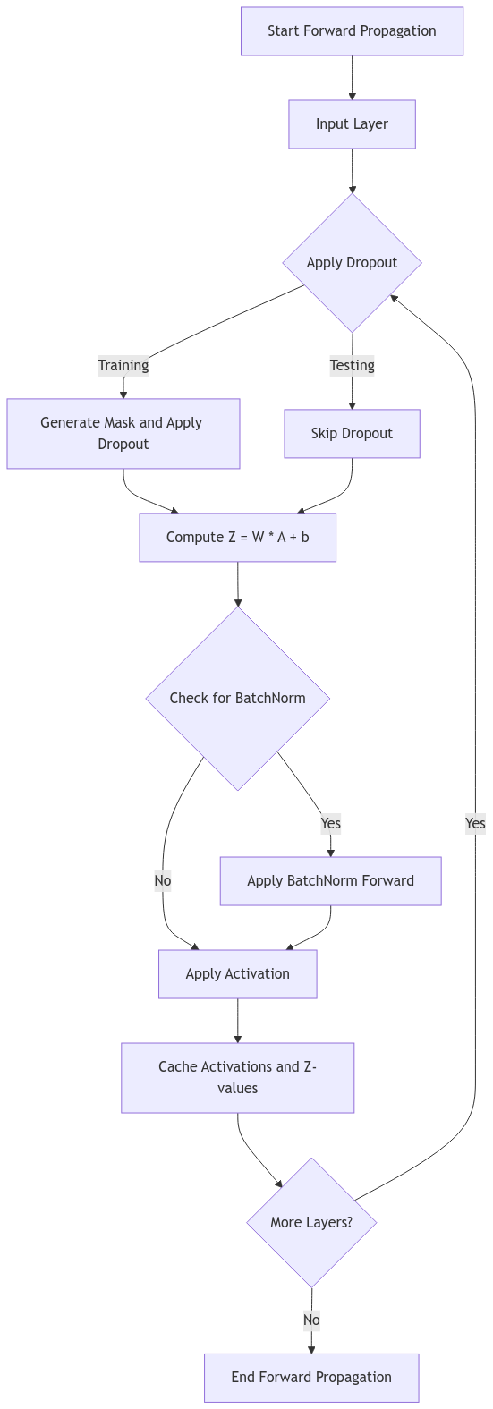
Part 2: Forward Propagation

Slide 6
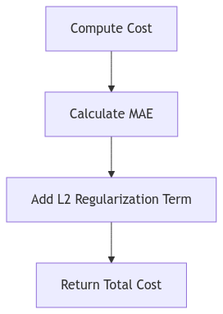
Part 3: Cost Calculation

Slide 7
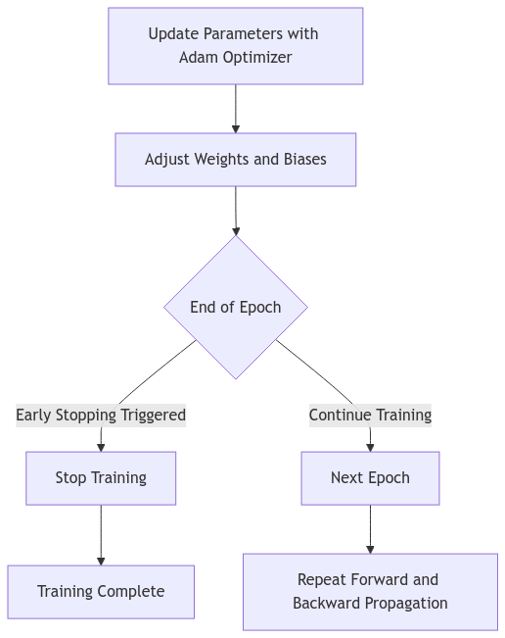
Part 5: Parameter Update and Training Loop

Slide 8
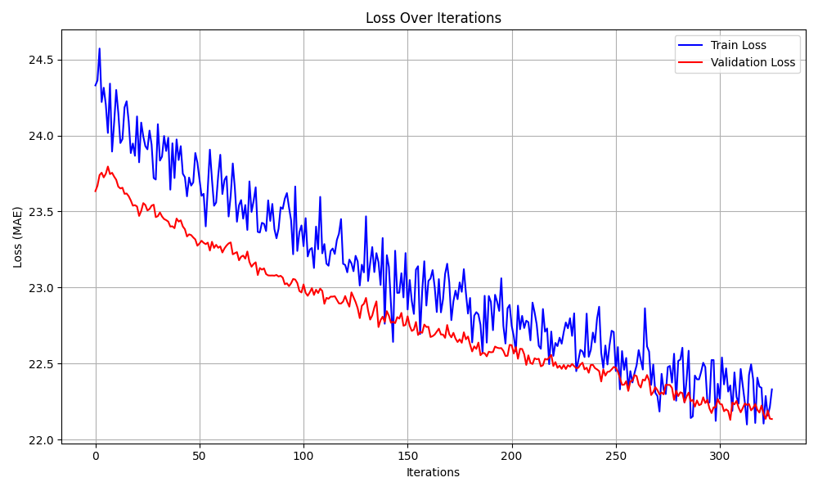
ML Performance

Slide 9
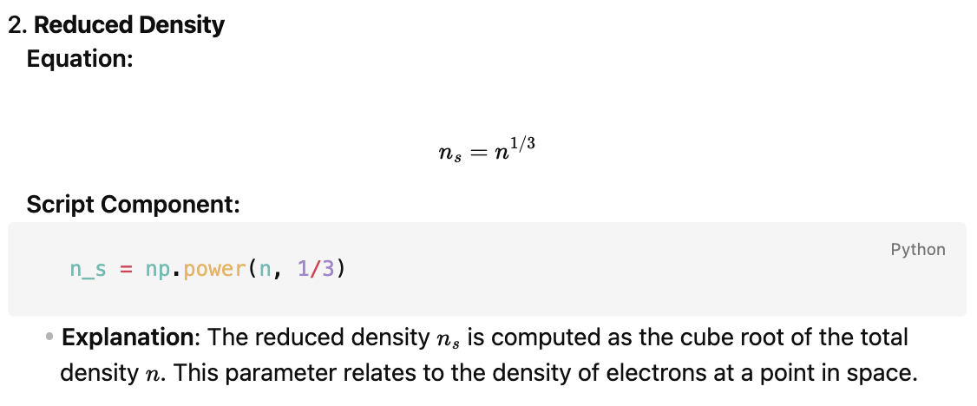
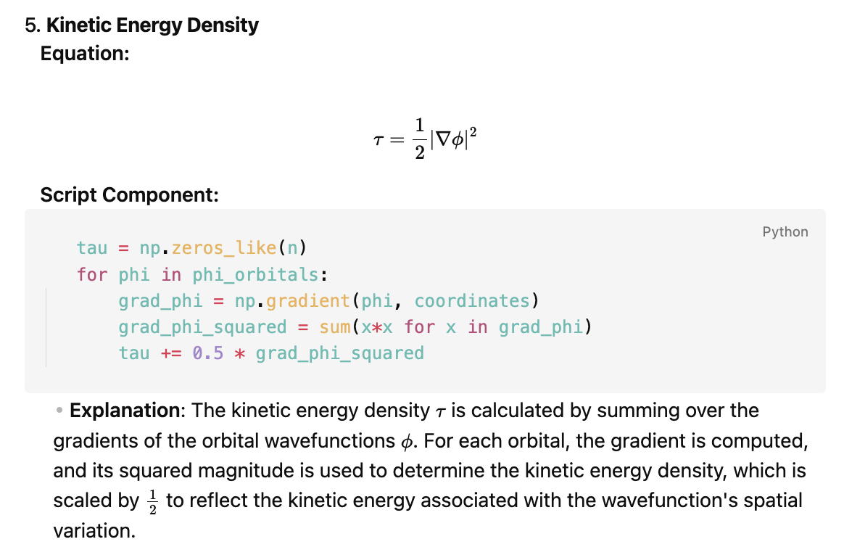
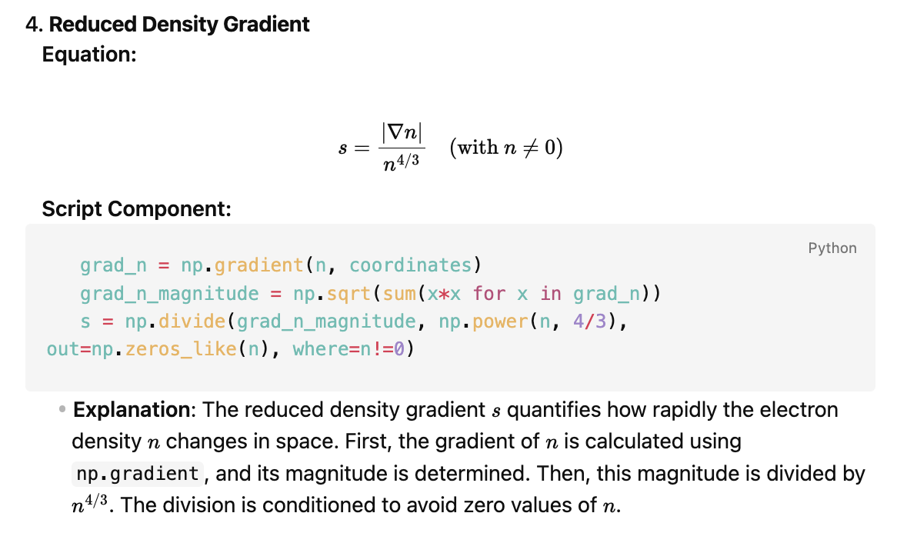
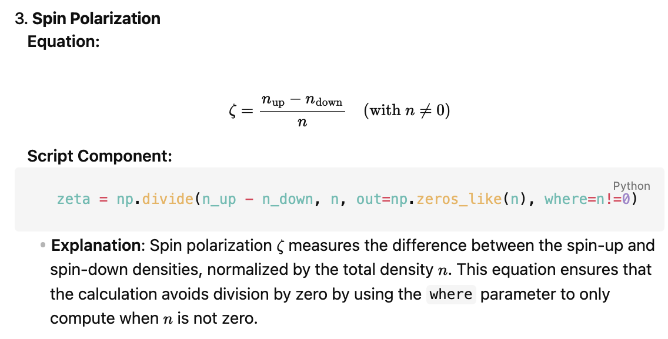
Exchange Correlation Feature Extraction Scripts in Python

Slide 10
Future Plan
Calculating MgO and its combinations to enhance the understanding of FLAPW
Exchange Correlation Research
Prepared datasets for training exchange-correlation models, specifically for LDA and GGA.
Trained an LDA+Delta ML model for exchange-correlation analysis.
Investigated the atomic structure of highly correlated MgO-based systems using machine learning.
Preparing dataset of MgO-based structure with its energy and force.
Prepared a dataset of MgO-based structures, including their energy and force properties.
Trained a machine learning model to optimize atomic structures using the energy and force dataset.

Slide 11
Future Plan
Calculating MgO and its combinations to enhance the understanding of FLAPW
Exchange Correlation Research
Prepared datasets for training exchange-correlation models, specifically for LDA and GGA.
Trained an LDA+Delta ML model for exchange-correlation analysis.
Investigated the atomic structure of highly correlated MgO-based systems using machine learning.
Preparing dataset of MgO-based structure with its energy and force.
Prepared a dataset of MgO-based structures, including their energy and force properties.
Trained a machine learning model to optimize atomic structures using the energy and force dataset.

Slide 12
Calendar
November
 |  |  | Now | Dataset and Research Plan Finalization
Data Collection
Training
Results Preparation
December

