Slide 2
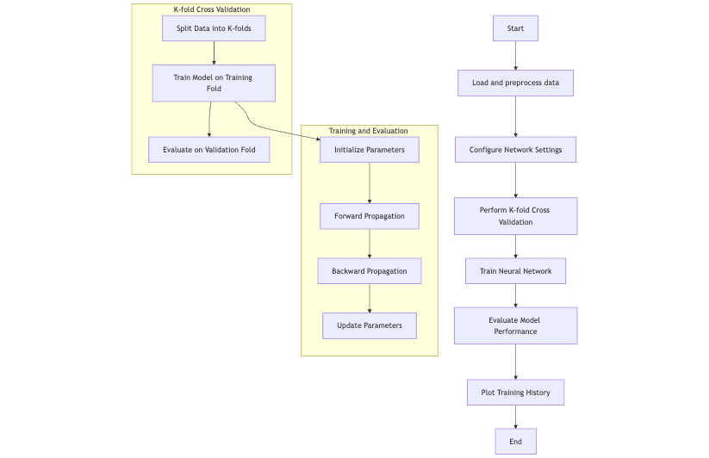
Flow
NetworkConfig
ActivationFunctions
BatchNorm
NeuralNetwork
k_fold_cross_validation

Slide 3
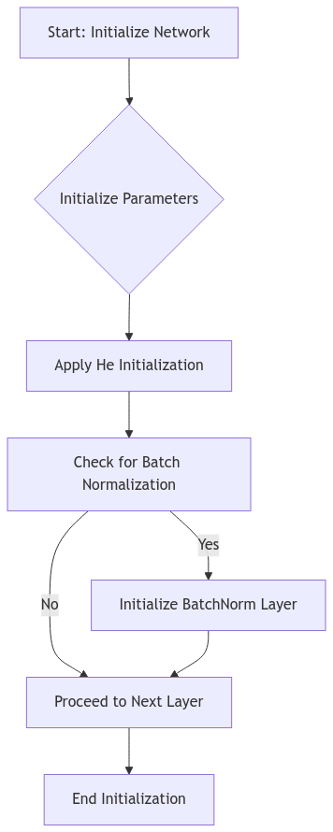
Part 1: Initialization and Parameter Setup

Slide 4
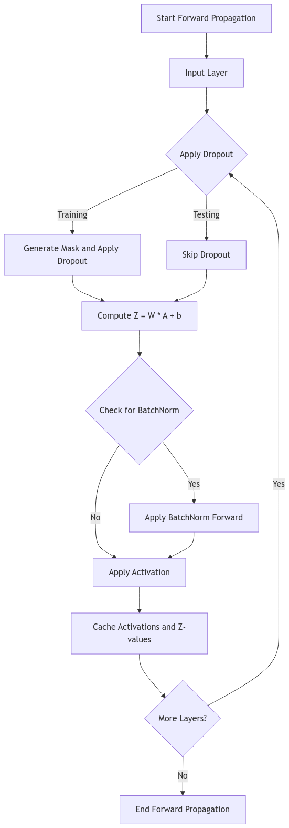
Part 2: Forward Propagation

Slide 5
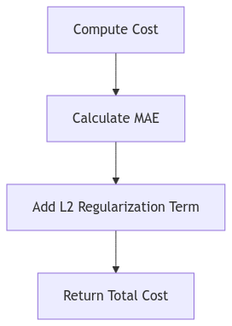
Part 3: Cost Calculation

Slide 6
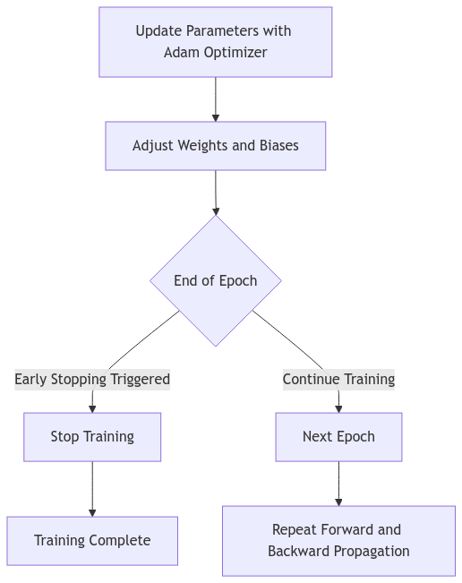
Part 5: Parameter Update and Training Loop

