Slide 1






Apps4X WordPress plugin
Sponsor:
MMLab
Cedric Van Bockhaven
@c3c
@Apps4EU
#oSoc13
Anastasia Dimou
@natadimou
Pieter Colpaert
@pietercolpaert

Slide 2


The problem
Sponsor
Name
Stad Gent
Contact
gentinfo@ugent.be
Event
Location
AC Portus
When
01 July – 19 July
Sponsor
Organizer
OKFN
Sponsor

Slide 3
The problem
Sponsor
Name
Stad Gent
Contact
gentinfo@ugent.be
Event
Location
AC Portus
When
01 July – 19 July
Sponsor
Organizer
OKFN
Sponsor

Slide 4



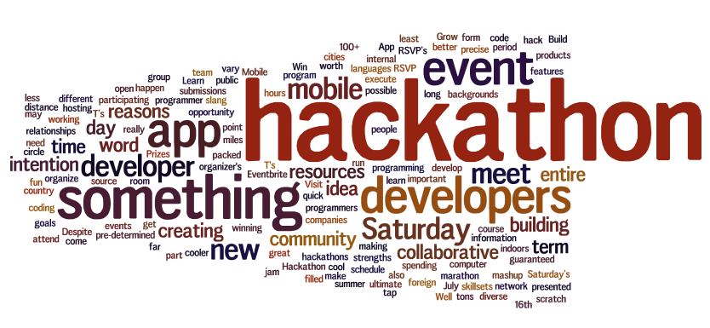


The problem

Slide 5



Solution
Semantic web enabled WordPress plugin
Organizers can manage their events
Events can be associated with
Ideas (App Concepts)
Apps (implementations of these ideas)
People can submit Ideas and Apps

Slide 6
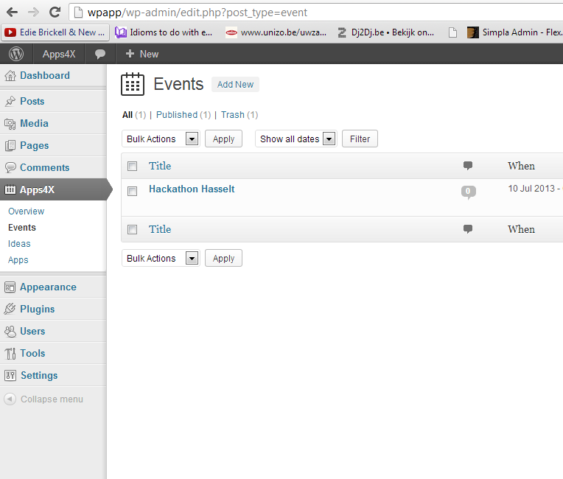
WordPress forms
Events, Ideas, Apps next to Posts & Pages

Slide 7
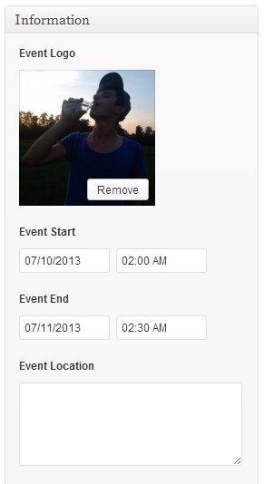
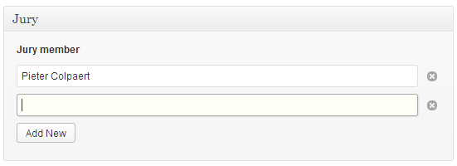
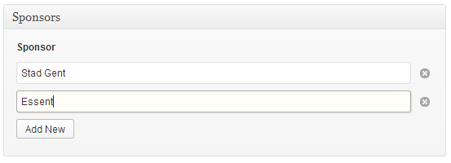
WordPress forms
Events, Ideas, Apps next to Posts & Pages

Slide 8
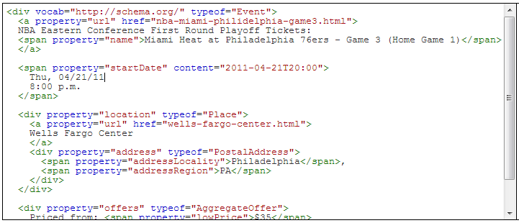
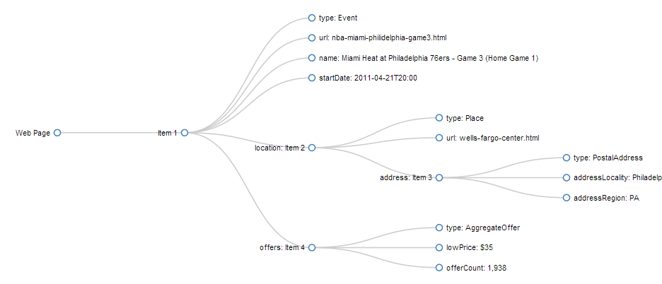
RDFa
Semantic Web
Vocabularies

Slide 9
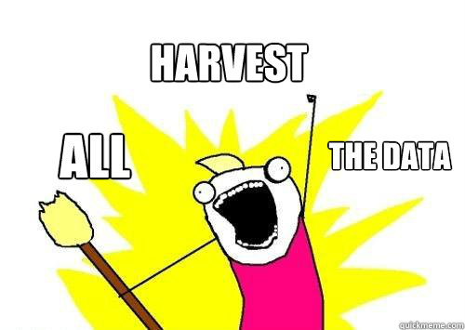
Perspectives
More people start using the plugin
Code reuse
Data becomes structured
Data becomes harvestable
More visibility
Business potential

Slide 10


Questions?
@c3c
@natadimou
@pietercolpaert
@Apps4EU

