Slide 1

REPORT OF GREENTAIL OUTDOORS’ PROMOTION
By: Andini Wijayanti, S.Pd.

Slide 2
A. Increases and Decreases in Sales (Comparing Jacksonville between El Paso)
1. The promotion in Jacksonville was very well received in urban areas, most likely due to higher purchasing power and a fast-paced lifestyle. In addition, the store took advantage of special events to promote its products. I think people in urban areas enjoy big events—not only do they get to window-shop, but they can also explore the products. Keep it up!
2. The promotion in El Paso location have declined, likely due to a drop in purchasing power following the “buy one, get one free” promotion. Purchasing power in suburban areas is likely lower than in urban areas, especially with the “buy one, get one free” offer, since buying an item and receiving another identical one is unnecessary. Sometimes, people only need one item—not two. Therefore, we’re switching the promotion to a discount.
3. In addition mostly store that utilize Buy One Get One (BOGO) as promotion has declined either urban or suburban. Therefore, change promotion type to discount or Special-Event can make it better.

Slide 3
B. Increases and Decreases in Visits (Comparing Los Angeles and Boston )
1. At the Los Angeles store, daily foot traffic declined following a promotional campaign. This warrants further evaluation, particularly regarding the promotional strategy and customer service. The promotion was adjusted to offer discounts, and greater emphasis was placed on customer service—such as being more welcoming to customers, providing clearer answers to their questions, and offering real-time promotions as customers arrived.
2. Meanwhile, the Boston store has seen an increase in daily foot traffic. This store, located in Urba, uses a “buy one, get one free” (BOGO) promotion. While the BOGO promotion is one factor contributing to the rise in daily foot traffic, it may not be the only reason; other factors, such as good service and a comfortable atmosphere, could also be driving the increase in visitors. A suggestion for the future is to use digital receipts to reduce trash paper.

Slide 4
C. A Suggestion for The Future
Compare the stores in San Antonio and Jacksonville. Use the same type of promotion for four weeks. Whether San Antonio experiences an increase in sales and whether Jacksonville maintains that increase or not will be a significant indicator of whether the promotion has a major impact on a store.

Slide 5
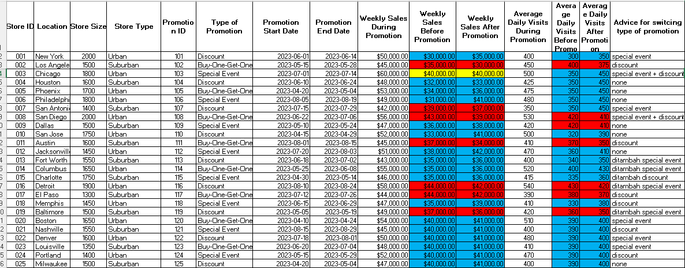
D. Advice for The Data
1. Blue shows increase in sales, whereas red shows decreas in sales, and yellow shows stagnan.
2. Going forward, I hope the data provided will be comprehensive. So, that the data analysis more valid and accurate. Likely what commodity that the store sales and average weekly visits. That’s important for further analysis data.

Slide 6
E. CONCLUSION
Use other promotions if the one you’re currently using seems to be stagnating or even causing sales to drop.
Consider your target market, such as urban or suburban areas. Urban residents have higher purchasing power and a higher standard of living; they prefer promotions that make a big impression, such as major events or discounts, rather than “buy one, get one free” offers.
Suburban residents prioritize functionality; discounts are generally more effective in suburban areas. However, this isn’t true for evaery area—it applies to almost all. Therefore, it’s still necessary to conduct a one-week promotional test. However, if the previous promotion has already increased sales or foot traffic, there’s no need to change it.
Evaluate initiatives, such as switching from paper receipts to digital ones to reduce paper waste (if sales have successfully increased)Store cleanliness, store comfort, and most importantly, the store’s friendliness toward all customers without exception

