Slide 1



Predicting Free Parking Spots using Data Analytics and Machine Learning + +
Andrei Ionita
Supervisors: André Pomp (IMA), Jó Agila Bitsch Link
Aachen / Master Initial Talk, December 2016

Slide 2

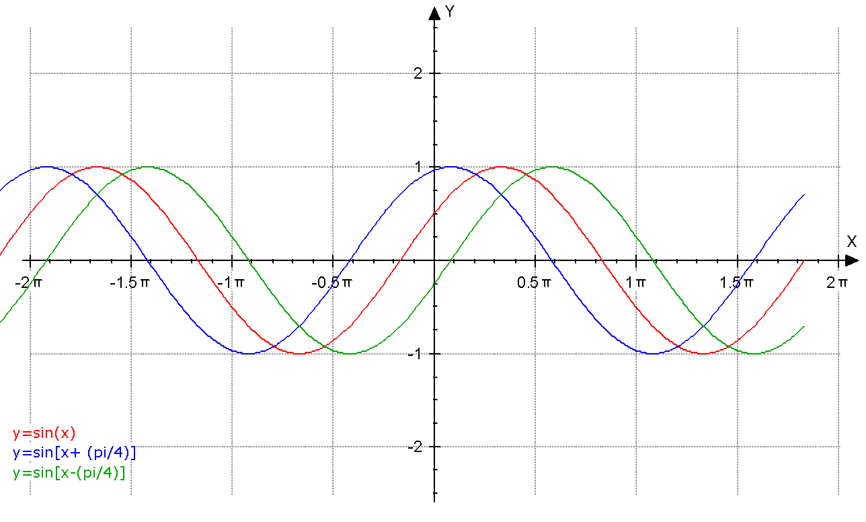
Motivation
Problem: Finding a parking spot takes a long time
pollutes the environment
causes unnecessary traffic
Ideal: Information about nearby parking occupancy rates
Real-time
Before departure!
Starting points
Recurring patterns in parking occupancy
Detect influencing factors in parking landscape
Notes:
Drivers search for parking spots and go in circles; or stay in lines in front of parking entrances; Gas emissions; 30% more traffic says a study
The solution for this would be …
How do we go about this? Well, let us first observe some points: fluctuations of parking rates; Factors that play a role: time of day, day of week/weekend, holiday, weather, events, etc

Slide 3
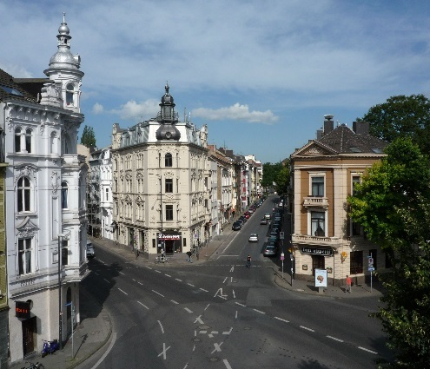

Goals
Develop application for parking queries
Vision: back-end for in-car mobile apps
Simple query: return nearby locations with free spots
Build machine learning models for forecasting
Based on current free spots + contextual data
Events, Weather, Traffic
Transfer models to locations with less data
Based on similar parking providers
Schools, Offices, Restaurants, etc.
78%
?
P₂
P₁
P₂
P₁
P₂
P₁
Notes:
Application that is invoked by a mobile app; Basic query: here is my destination, give me the nearest parking options with free spots; Frankenberger Viertel in Aachen will be used as test quarter
Use Machine Learning for prediction;
As soon as data is forecasted accurately enough, we will move to applying the resulting models to areas where no source data is available

Slide 4
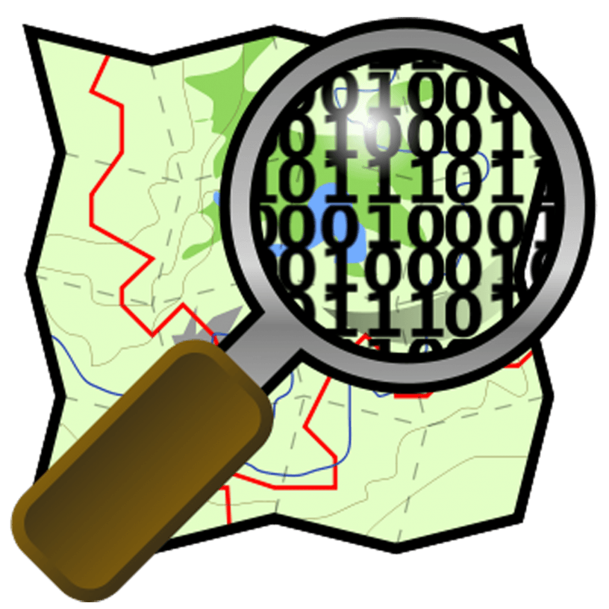

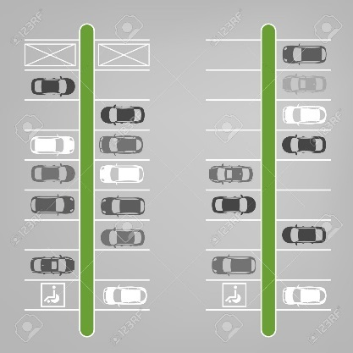
Approach (1/2)
Identify parking spots on the map
Used data sources
Sensors
Monitor parking spot changes
Parking Meters (City of Aachen)
Historical data
Car Parks, Concerts, Weather, Traffic
Public available online
Feature engineer
Cluster parking spots into parking locations
Associate events to PLs using (lat, lon)
Notes:
We will start by mapping the parking spots to geographic coordinates; we will use OSM for this purpose, since it has the capability of storing such information; for Frankenberger Viertel there are already some parking spots & locations marked
Already some Sensors are installed; they deliver live data; Parking Meters from City of Aachen via SoNah, currently only sparse data with a few measurements a day, but more data should be coming out way; Car Parks, … -data is available either as API or as data display on websites (we will contact the owners and ask for permission to scrape the data)
Data is collected raw and needs processing first; grouping parking spots around a parking meter makes sense; events need to be brought in relation to the PL, so capturing all inside a radius of e.g. 500m may be an option

Slide 5
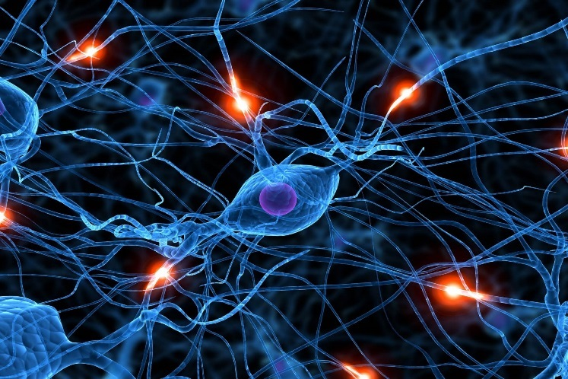
Approach (2/2)
Model / parking location
Features: Timestamp, [...], Free Spots
Target: Free Spots in 1h, 2h, etc.
Prediction Models
Neural Networks
Support Vector Machines
ARIMA
…
Define similarity measures for parking locations
Based on parking providers and PL size
Notes:
ARIMA = autoregressive integrated moving average
Regression will be preferred over classification, since we are dealing with continuous data. Nevertheless, classifiers for 30min, 1h, 2h, etc will also be tried out if time permits, to see how they perform
- Transferring models from a PL to another needs to take into account the neighborhoods (schools, kindergartens, banks, supermarkets) but also the total size of the PL

Slide 6


Challenges
Parking-data shortage
Interpolation of sparse parking data
On-site collection of data
Use online available data
Identification of Parking Spots
Data is not up to date
Short-term closing of streets / construction-sites
Events not captured
E.g. Demonstration suspends traffic for streets
Unexpected incidents
Notes:
There may be some things going wrong
- There may not be enough data that I am counting on: if parking meters deliver just a few rates per day then I will use interpolation to arrive at 1h interval rates (which would be ideal to train the models with); If still not enough data, collecting the numbers of occupied spots physically is manageble; otherwise as back-up plan, use open data from other cities (Dresden has open data available)
Other things that may go wrong: say police changes parking areas; OSM most probably will not be updated immediately, so the data received by the sensors will be false
Also, spontaneous events may occur, like demonstrations, or fires, etc – the data delivered may therefore affect the model

Slide 7
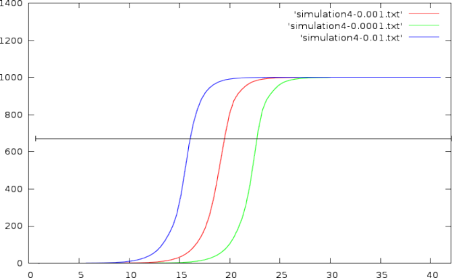
Evaluation
…during Feature Selection
Visualize and check independence of ML features
…during Parking Location Clustering
Check parking-provider separation of parking spots
Compare forecasted to real-time values
Detect and explain differences
Add Feature and reiterate
Visualize Parking Profiles
make associations to parking activities
Notes:
Evaluation will run throughout the thesis
The features will be checked for correlation with the parking rate changes; since they were selected mainly on guided intuition, this will prove whether they indeed contribute to a better result
Parking Locations groups is not trivial; so verifying that parking spots belong together is important; we may use heat maps here to see whether parking rates reflect cluster separation
Of course, the predicted rates will be checked against the real value -> we will try to find factors that account for the deltas and interatevely improve the model
Extracting Parking Profiles would be nice to detect: „office worker that arrives at work at 8am, leaves for lunch break between 12 and 1, and leaves work at 5“ or „parents driving their kids to school at 8am and coming back for them at 1pm“

Slide 8


Time Planning
Literature Review (2 weeks)
Identify relevant sources
Concept Design (2 weeks)
Decide on in-detail approach
Implementation (10 weeks)
Architecture design (2 weeks)
Feature collection and engineering (4 weeks)
Model application (4 weeks)
Evaluation (3 weeks)
Writing and Documentation (6 weeks)
Buffer (1 week)
Notes:
I have already read some 20 or so papers; the design is described already in my proposal, although the details are going to follow
I would be starting with the implementation right away – the focus here is to write an application that is extensible, since it will be further developed beyond this thesis
The evaluation will be given the attention is deserves; it already helps that I have an idea what to look for, and in some of the papers this part is rich with findings
In case I need more time, I have a 1 week buffer; the implementation will be the first to be cut straight to the point, in case I start lagging behind

Slide 9
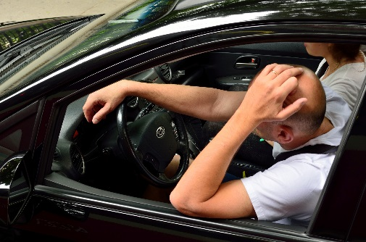



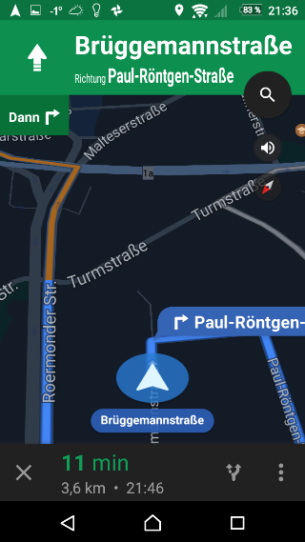
Conclusion
Tackling the parking problem in cities
Complementary data sources
Train models with current & historical data
Apply models where no data exists
Use the application to answer simple driver queries
Notes:
Attempting to solve the parking problem and help the drivers by providing them live parking rates. The core of the application is however providing predicted rates, which allows the drivers to plan ahead and drive directly to the parking spot
The data we use is heterogeneous, possily even redundant (which is good for cross-validation. Ideally the sources will complement each other and make up a complex picture
Use Machine Learning for prediction
When satisfying results have been reached (and we hope it is the case), we will move on to areas where no data is available and adapts the models accordingly
The vision is that the application will be used as back-end for a mobile app and complement the current car navigation

Slide 10



Backup: Model Construction
Date | Time | Holiday | Event | Weather | Traffic | Now | +30m | + 1h
01/06/2017 | 09:00 | no | none |  | Normal | 25 | 20 | 15
02/06/2017 | 18:30 | no | small |  | High | 45 | 65 | 90
0306/2017 | 12:00 | Yes | small |  | Low | 90 | 90 | 85

Slide 11
Back-up: Related Work
Focus on hardware
Sensors in cars
Insufficient sensor data
Focus on one data source
Insufficient historical data
On-Site collection too inexact
Focus on sites with data supply
No attempts to extrapolate to areas with no data
Notes:
1st Point:
Siemens, Bosch: only a fraction traffic!
2nd Point:
Ticket dodgers not included!

