Slide 1



Predicting Free Parking Spots using Data Analytics and Machine Learning + +
Andrei Ionita
Supervisor: André Pomp, Jó Agila Bitsch Link
Aachen / Master Initial Talk, December 2016

Slide 2

Motivation
Find a parking spot is a waste of time for any driver
… and pollutes the environment
… and causes unnecessary traffic
Navigation Systems should incorporate this function
Parking landscape is highly dynamic and volatile however
Need to monitor all parking spots individually?
Detect patterns in parking behavior in the city
Weekdays 8–17 at the office, Weihnachtsmarkt evenings in city center
Use Machine Learning for Prediction!

Slide 3
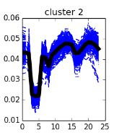
Goals
Build ML models to forecast parking occupancy rates
Using multiple data sources: sensors, parking meters, car parks, events, weather, traffic, etc.
Detect Parking Profiles based on Parking Providers
Apply models to Parking Locations with less data
Develop an application that responds to parking queries
Can be used as back-end for in-car mobile apps
What are the nearest parking locations with
available parking spots?

Slide 4
Related Work: On the shoulders of giants?
Data sources
Sensors that monitor parking spot changes
- sensors can only monitor so much
Parking Meters vs. Car Parks
- the first is harder to quantify since the area it covers varies
Concerts/Fairs, Weather, Traffic
- assigning an event to the impacted parking location is not trivial
Data insufficiency
- relatively small # approaches to extracting parking profiles
Model selection
Neural Networks, Support Vector Machines, ARIMA, etc.

Slide 5
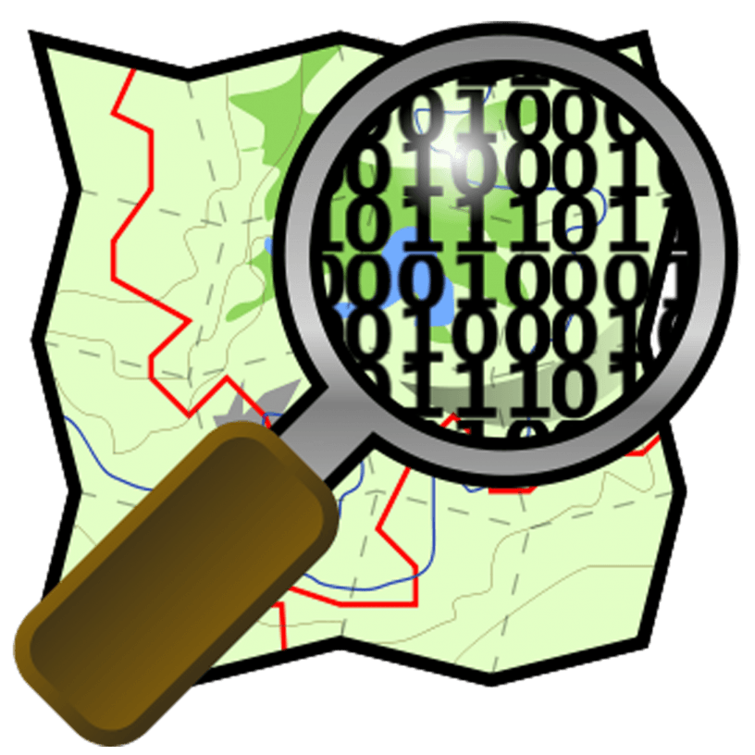
My approach
Identify parking spots on the map
Feature-engineer various data in order to train ML models
Interpolate missing parking rate reports
Attribute events to parking locations using geographic coordinates
Cluster parking spots into parking locations
Extract parking profiles
Using similarity of parking providers: schools, offices, cinemas, etc.
Apply parking profiles to parking locations with little or no data

Slide 6
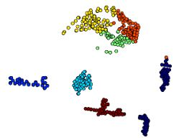
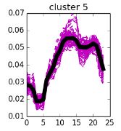
Evaluation
…during Feature Selection
Visualize and check independence of ML features
…during Parking Location Clustering
Check parking-provider separation of parking spots
Compare forecasted values to real-time values
Detect other possible features that explain the differences
Adjust and reiterate
Visualize Parking Profiles
make associations to parking activities

Slide 7


Challenges
Parking-data shortage
Interpolation of sparse parking data
On-site collection of data
Use online available data
Identification of Parking Spots
Data is not up to date
Short-term closing of streets / construction-sites
Events not captured
E.g. Demonstration suspends traffic for streets
Unexpected incidents, e.g. fires, etc.

Slide 8


Time Planning
Literature Review (2 weeks)
Identify relevant sources
Concept Design (2 weeks)
Decide on in-detail approach
Implementation (10 weeks)
Architecture design (2 weeks)
Feature engineering (4 weeks)
Model application (4 weeks)
Evaluation (4 weeks)
Writing and Documentation (6 weeks)
Buffer (1 week)

Slide 9
Conclusion
Tackling the nasty parking problem in cities
Relying on sensor and parking meter data primarily
Train Machine Learning models using correlating data
Detect Parking Profiles and apply them where no data exists
Use the application to answer queries from front-end (mobile) applications when driving

Slide 10



Backup: Model Construction
Date | Time | Holiday | Event | Weather | Traffic | Now | +30m | + 1h
01/06/2017 | 09:00 | no | none |  | Normal | 25 | 20 | 15
02/06/2017 | 18:30 | no | small |  | High | 45 | 65 | 90
0306/2017 | 12:00 | Yes | small |  | Low | 90 | 90 | 85

