Slide 1




Predicting Free Parking Spots using Data Analytics and Machine Learning + +
Andrei Ionita
Supervisors: André Pomp (IMA), Jó Agila Bitsch Link,
Aachen / Master Initial Talk, December 2016

Slide 2

Motivation
Problem: Finding a parking spot takes a long time
pollutes the environment
causes unnecessary traffic++
Ideal: Info about nearby parking occupancy rates
Real-time
Before departure!
Starting points
Parking landscape is highly dynamic
Rainy Thursday mornings before bridge holiday => 50% less spots @office
Notes:
3rd Point
How many sensors are needed to monitor?

Slide 3
Goals
Develop application that responds to parking queries
Vision: back-end for in-car mobile apps
Simple query: return nearby locations w/ free spots
Build machine learning models for forecasting
Based on current free spots + contextual data
Events, Weather, Traffic
Transfer models to locations with less data
Based on similar parking providers
Schools, Offices, Restaurants, etc.
Notes:
1st point
Input: there is my destination
Output: parking options with free spots

Slide 4

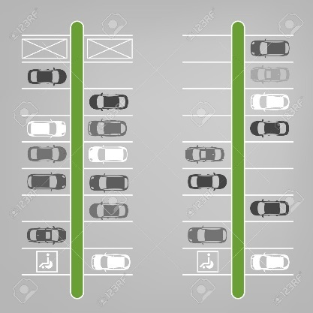
Approach (1/2)
Identify parking spots on the map
Data sources
Sensors
Monitor parking spot changes
Parking Meters (City of Aachen)
Historical data
Car Parks, Concerts, Weather, Traffic
Public available online
Feature engineer
Cluster parking spots into parking locations
Associate events to PLs using (lat, lon)

Slide 5

Approach (2/2)
Model / parking location
Features: Timestamp, [...], Free Spots
Target: Free Spots in 1h, 2h, etc.
Prediction Models
Neural Networks
Support Vector Machines
ARIMA
Define similarity measures for parking locations
Based on parking providers

Slide 6


Challenges
Parking-data shortage
Interpolation of sparse parking data
On-site collection of data
Use online available data
Identification of Parking Spots
Data is not up to date
Short-term closing of streets / construction-sites
Events not captured
E.g. Demonstration suspends traffic for streets
Unexpected incidents
Notes:
Unexpected incidents: e.g. fire

Slide 7
Evaluation
…during Feature Selection
Visualize and check independence of ML features
…during Parking Location Clustering
Check parking-provider separation of parking spots
Compare forecasted values to real-time values
Detect other possible features that explain the differences
Adjust and reiterate
Visualize Parking Profiles
make associations to parking activities

Slide 8


Time Planning
Literature Review (2 weeks)
Identify relevant sources
Concept Design (2 weeks)
Decide on in-detail approach
Implementation (10 weeks)
Architecture design (2 weeks)
Feature engineering (4 weeks)
Model application (4 weeks)
Evaluation (3 weeks)
Writing and Documentation (6 weeks)
Buffer (1 week)

Slide 9
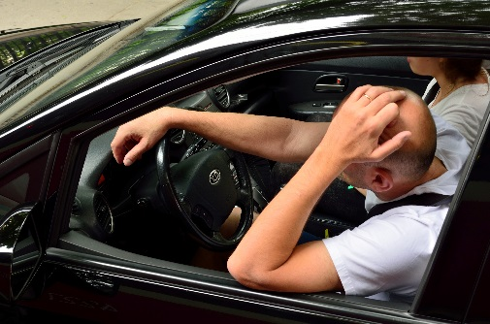


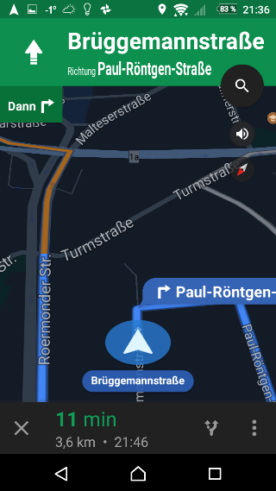
Conclusion
Tackling the parking problem in cities
Complementary data sources
Train models with current & historical data
Apply models where no data exists
Use the application to answer simple driver queries

Slide 10


Backup: Model Construction
Date | Time | Holiday | Event | Weather | Traffic | Now | +30m | + 1h
01/06/2017 | 09:00 | no | none |  | Normal | 25 | 20 | 15
02/06/2017 | 18:30 | no | small |  | High | 45 | 65 | 90
0306/2017 | 12:00 | Yes | small |  | Low | 90 | 90 | 85

Slide 11
Back-up: Related Work
Focus on hardware
Sensors in cars
Insufficient sensor data
Focus on one data source
Insufficient historical data
On-Site collection too inexact
Focus on sites with data supply
No attempts to extrapolate to areas with no data
Notes:
1st Point:
Siemens, Bosch: only a fraction traffic!
2nd Point:
Ticket dodgers not included!

