Slide 1
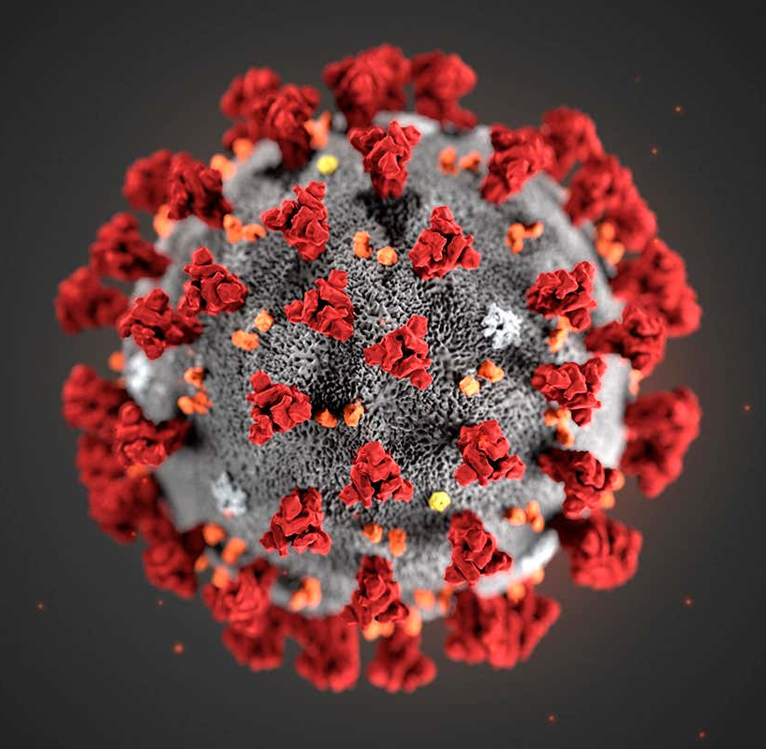
COVID-19
Primary Contributing Factors for Contraction
Presented by: Andi Osika

Slide 2
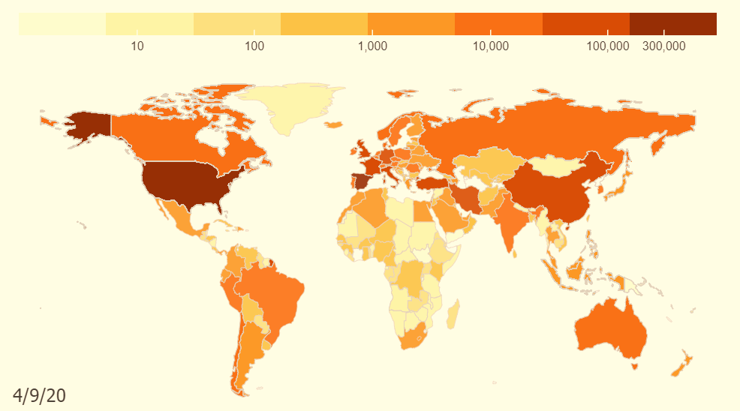
Background:
April 10, 2020:
1.6 million cases globally
COVID-19: Pandemic
Goal: Use classification to Identify primary contributing factors for contracting the disease.
https://coronavirus.jhu.edu/data/animated-world-map
Notes:
On the date of the last collection globally there were1.6 million cases with more than 102,000 deaths, https://www.nbcnews.com/health/health-news/coronavirus-timeline-tracking-critical-moments-covid-19-n1154341
https://www.contagionlive.com/news/contagion-live-news-network-coronavirus-updates-for-april-10-2020
Dates;
'4/4/2020', '4/5/2020', '4/3/2020', '4/6/2020', '3/27/2020', '3/28/2020', '3/26/2020', '3/29/2020', '3/30/2020', '3/31/2020', '4/1/2020', '4/2/2020', '4/7/2020', '4/8/2020', '4/9/2020', '4/10/2020’

Slide 3



Factor Datatypes Collected:
Biological | Behavioral | Environmental
Age | Drug(prescription/non) Use | Number of Contacts
Sex | Alcohol Use | Co-Habitation Numbers
BMI | Hand Washing, Social Distancing | Travel Habits
Preexisting Health Conditions | Mask Wearing Outside of Home

Slide 4
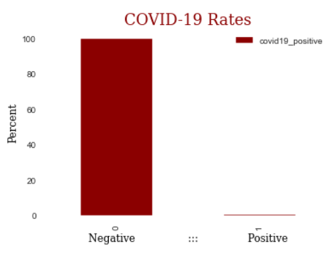
Data Background:
Nexoid
618K Self-Reported Samples
Top Countries: US, Canada and UK
2.3%
5%
.013% Tested Positive
87%
Notes:
Top Countries
US 0.878483
CA 0.049560 - negative correlation
GB 0.023211
AU 0.011354 – negative correlation
BR 0.005552

Slide 5

Methodology:
Classification Modeling: Random Forest

Slide 6

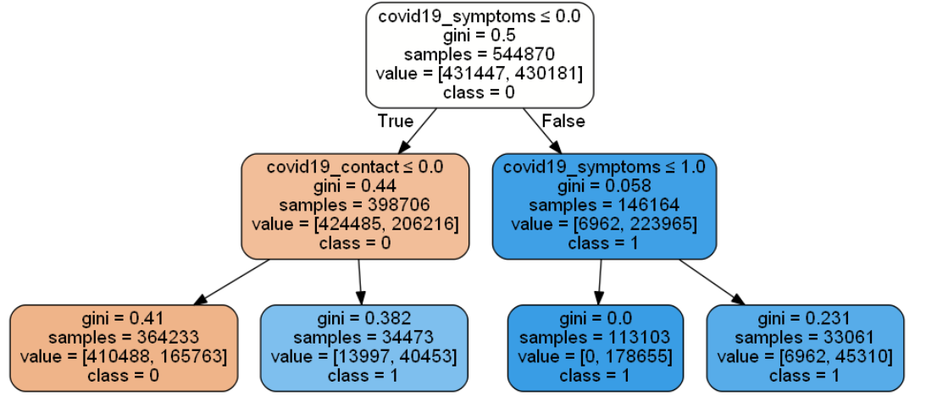
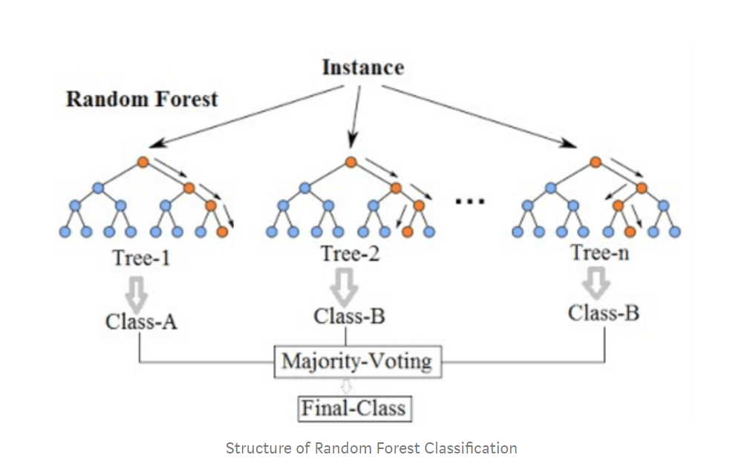

Random Forest Classification:
Decision Tree:
Many Decision Trees = Decision Forest

Slide 7
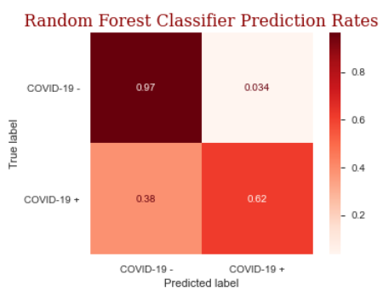
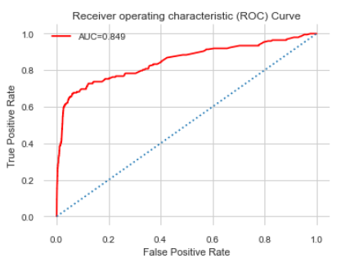
Modeling Results:
Sensitivity
Specificity
Notes:
A Receiver Operator Characteristic (ROC) curve is a graphical plot used to show the diagnostic ability of binary classifiers. It shows the tradeoff between sensitivity and specificity (any increase in sensitivity will be accompanied by a decrease in specificity). The closer the curve follows the left-hand border and then the top border of the ROC space, the more accurate the test. The area under an ROC curve is a measure of the usefulness of a test in general, where a greater area means a more useful test, the areas under ROC curves are used to compare the usefulness of tests.

Slide 8

FINDINGS:
TOP FACTORS THAT CONTRIBUTE TO CONTRACTING COVID19

Slide 9
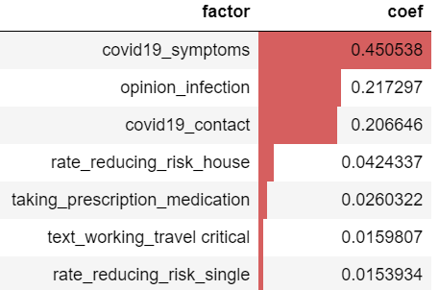
Behavioral Patterns Matter Top Factors by level of importance:
Description
The individual exhibited COVD-19 symptoms
The individual believed they could contract the disease
The individual came into contact with someone who tested positive for COVID-19
The household practiced social distancing and hand washing
The individual is taking prescription medication
The individual travels to work that is critical
The household practiced social distancing and hand washing
+
+
+
-
-

Slide 10
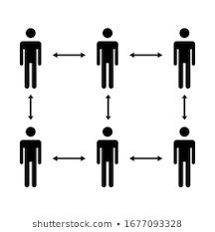



Recommendations:
Minimize travel
If taking prescription medications, discuss with physician increased risk for infection.
Practice social distancing and good hygiene.
Encourage/ensure those in your household do the same.

Slide 11

FUTURE WORK:
Opinion Infection:
Prescription Medications:
???
There is not much data to inform what this feature is about. The questionnaire has had several versions an is no longer collecting data on this.
Out of the 1200 unique medications:
Identify what medications or combinations
Evaluate if increase in number of prescriptions
Are contributing factors

Slide 12
THANK YOU
Stay healthy!

