Slide 1
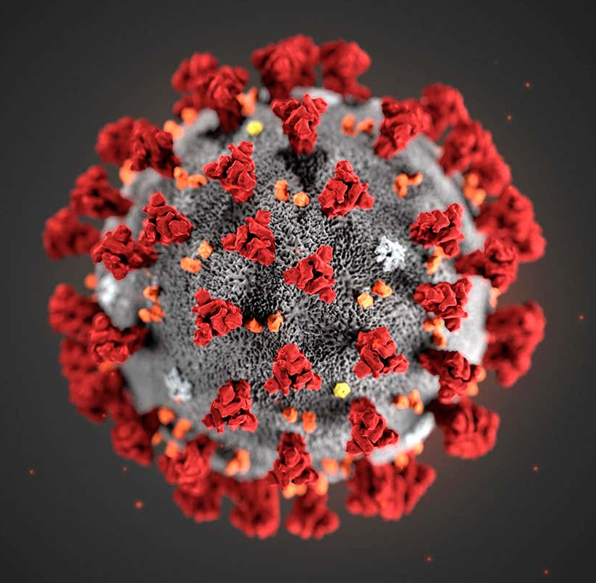
COVID-19
Primary Contributing Factors for Contraction
Presented by: Andi Osika

Slide 2
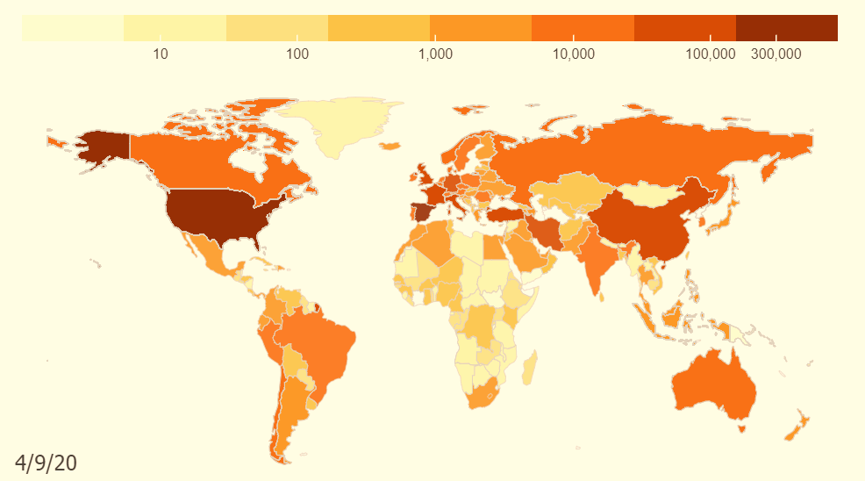
Background:
April 10, 2020:
1.6 million cases globally
COVID-19: Pandemic
Goal: Use classification to Identify primary contributing factors for contracting the disease.
https://coronavirus.jhu.edu/data/animated-world-map
Notes:
On the date of the last collection globally there were1.6 million cases with more than 102,000 deaths, https://www.nbcnews.com/health/health-news/coronavirus-timeline-tracking-critical-moments-covid-19-n1154341
https://www.contagionlive.com/news/contagion-live-news-network-coronavirus-updates-for-april-10-2020
Dates;
'4/4/2020', '4/5/2020', '4/3/2020', '4/6/2020', '3/27/2020', '3/28/2020', '3/26/2020', '3/29/2020', '3/30/2020', '3/31/2020', '4/1/2020', '4/2/2020', '4/7/2020', '4/8/2020', '4/9/2020', '4/10/2020’

Slide 3
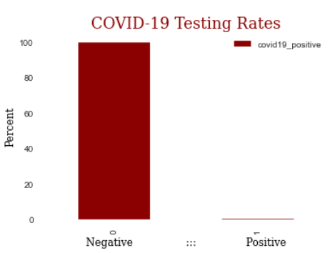
Data Background:
Nexoid
619K Self-Reported Samples
Top Countries: US, Canada and UK
2.3%
5%
.013% Tested Positive
87%
Notes:
Top Countries
US 0.878483
CA 0.049560 - negative correlation
GB 0.023211
AU 0.011354 – negative correlation
BR 0.005552

Slide 4



Factor Datatypes Collected:
Biological | Behavioral | Environmental
Age | Drug(prescription/non) Use | Number of Contacts
Sex | Alcohol Use | Co-Habitation Numbers
BMI | Hand Washing, Social Distancing | Travel Habits
Preexisting Health Conditions | Mask Wearing Outside of Home

Slide 5

Methodology:
Classification Modeling: Random Forest

Slide 6


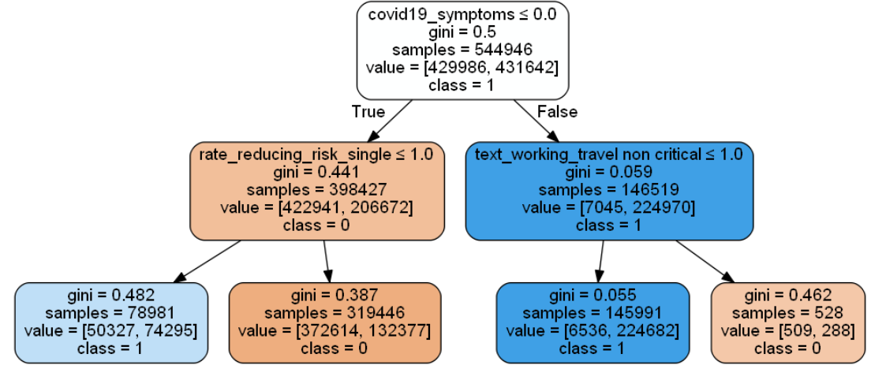
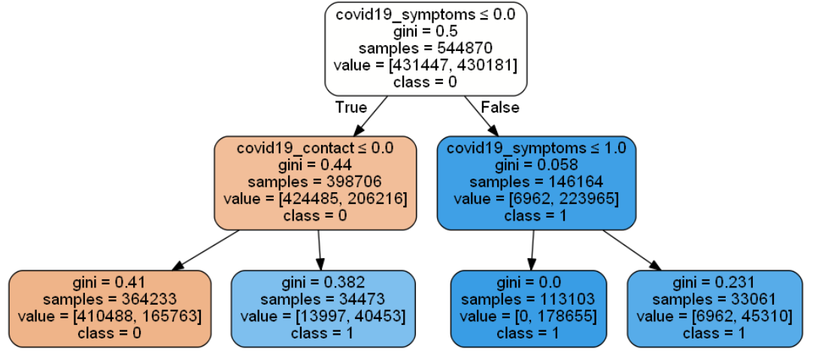
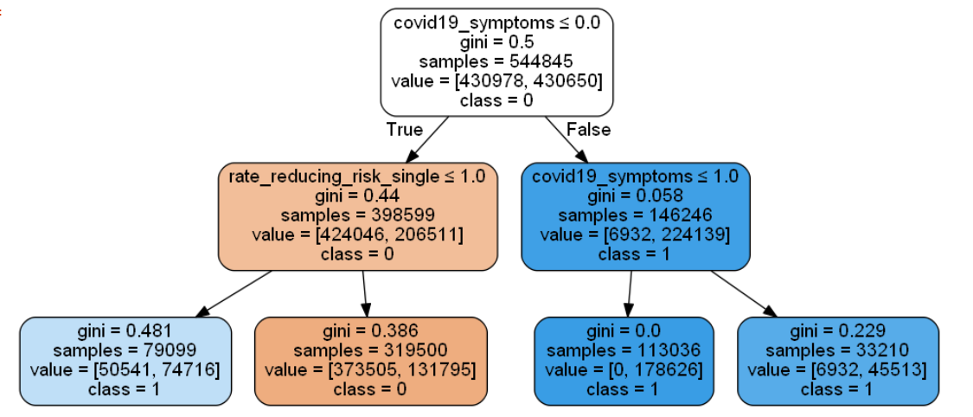
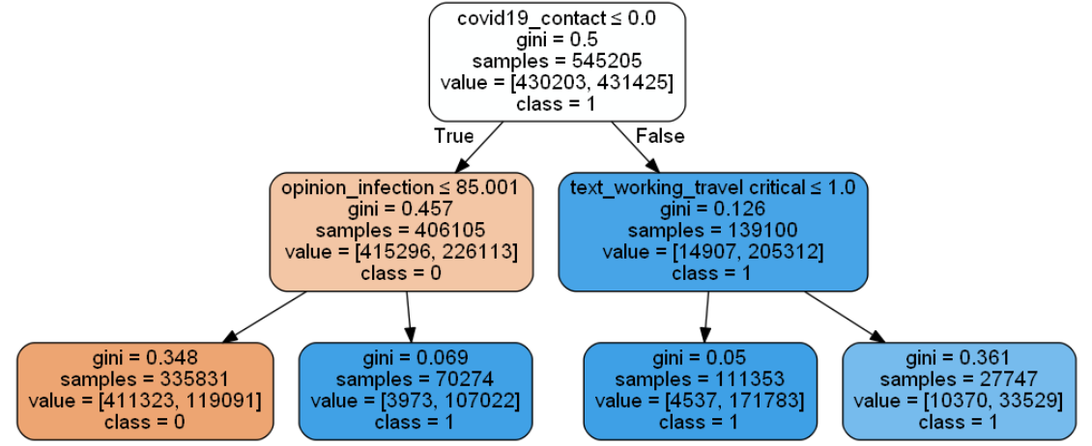
Random Forest Classification:
Decision Tree:
Many Decision Trees = Decision Forest

Slide 7
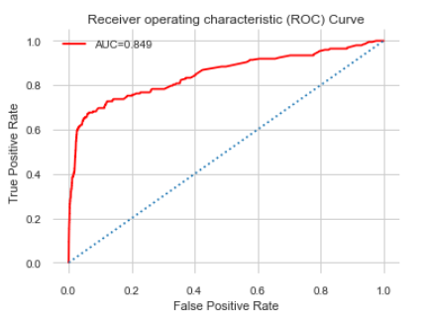
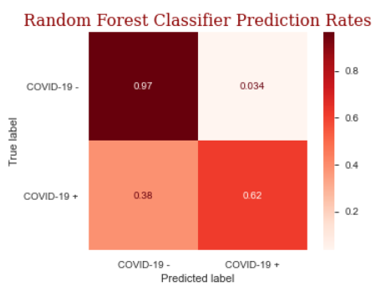
Modeling Results:
True Negatives
True Positives
Notes:
A Receiver Operator Characteristic (ROC) curve is a graphical plot used to show the diagnostic ability of binary classifiers. It shows the tradeoff between sensitivity and specificity (any increase in sensitivity will be accompanied by a decrease in specificity). The closer the curve follows the left-hand border and then the top border of the ROC space, the more accurate the test. The area under an ROC curve is a measure of the usefulness of a test in general, where a greater area means a more useful test, the areas under ROC curves are used to compare the usefulness of tests.

Slide 8

FINDINGS:
TOP FACTORS THAT CONTRIBUTE TO CONTRACTING COVID19

Slide 9
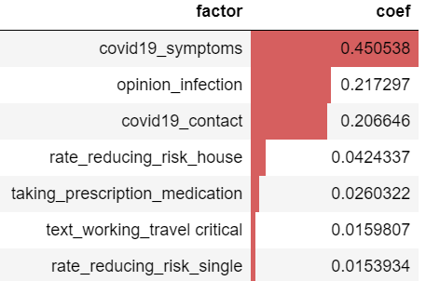
Top Factors by level of importance:
+
-
-
-
-

Slide 10


FUTURE WORK:
Opinion Infection:
Prescription Medications:
???
This feature was complex and the unsorted data contained over 57K values. Since this feature demonstrated a top factor in contraction of COVID19, isolated work could be done to identify what medications or combination of medications if any could reduce contraction of the disease.
There is not much data to inform what this feature is about. It would be worth investigating since it is a top factor.

Slide 11
THANK YOU
Stay healthy!

