Slide 1
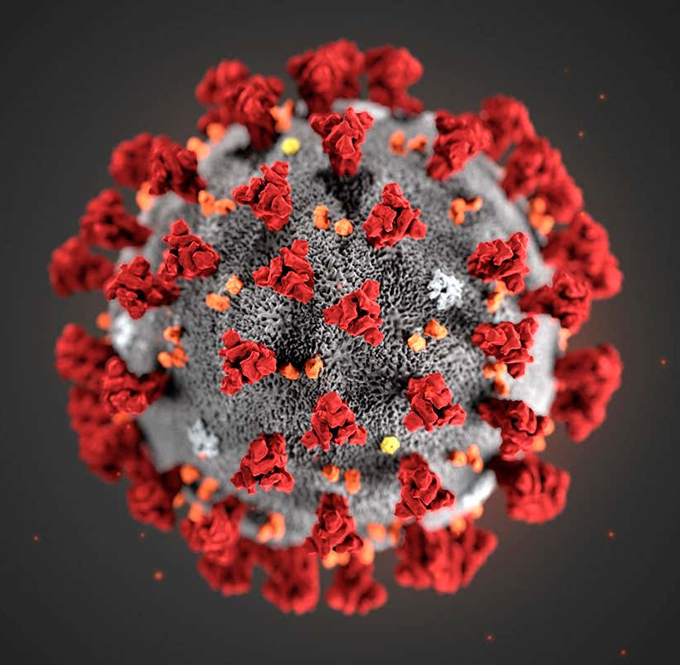
COVID-19
Primary Contributing Factors for Contraction
Presented by: Andi Osika

Slide 2
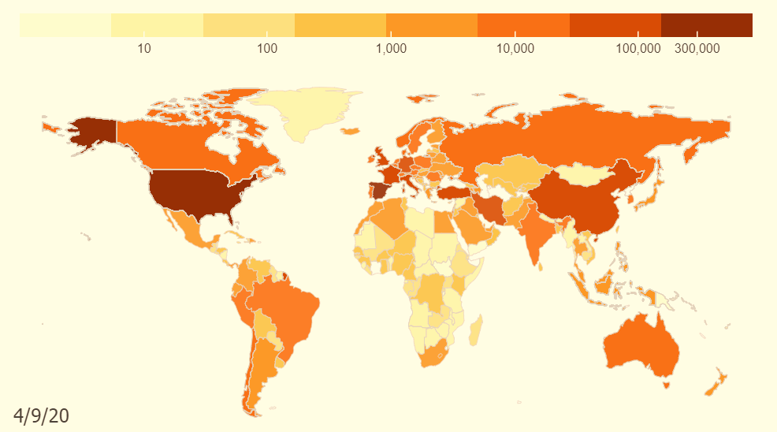
Background:
April 10, 2020:
1.6 million cases globally
COVID-19: Pandemic
Goal: Use classification to Identify primary contributing factors for contracting the disease.
https://coronavirus.jhu.edu/data/animated-world-map
Notes:
On the date of the last collection globally there were1.6 million cases with more than 102,000 deaths, https://www.nbcnews.com/health/health-news/coronavirus-timeline-tracking-critical-moments-covid-19-n1154341
https://www.contagionlive.com/news/contagion-live-news-network-coronavirus-updates-for-april-10-2020
Dates;
'4/4/2020', '4/5/2020', '4/3/2020', '4/6/2020', '3/27/2020', '3/28/2020', '3/26/2020', '3/29/2020', '3/30/2020', '3/31/2020', '4/1/2020', '4/2/2020', '4/7/2020', '4/8/2020', '4/9/2020', '4/10/2020’

Slide 3



Factor Datatypes Collected:
Biological | Behavioral | Environmental
Age | Drug(prescription/non) Use | Number of Contacts
Sex | Alcohol Use | Co-Habitation Numbers
BMI | Hand Washing, Social Distancing | Travel Habits
Preexisting Health Conditions | Mask Wearing Outside of Home

Slide 4
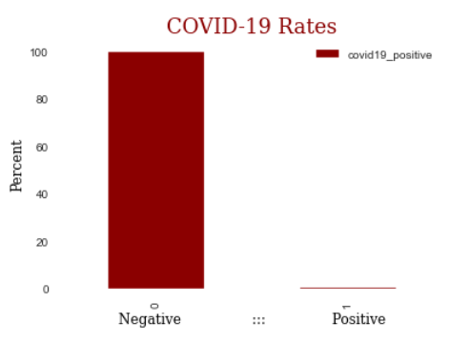
Data Background:
Nexoid
618K+ Self-Reported Samples
Top Countries: US, Canada and UK
2.3%
5%
.013% Tested Positive
87%
Notes:
Top Countries
US 0.878483
CA 0.049560 - negative correlation
GB 0.023211
AU 0.011354 – negative correlation
BR 0.005552
Testing in the United States at this time was limited due to shortages of supplies and latency in receiving results.

Slide 5

Methodology:
Classification Modeling: Random Forest

Slide 6


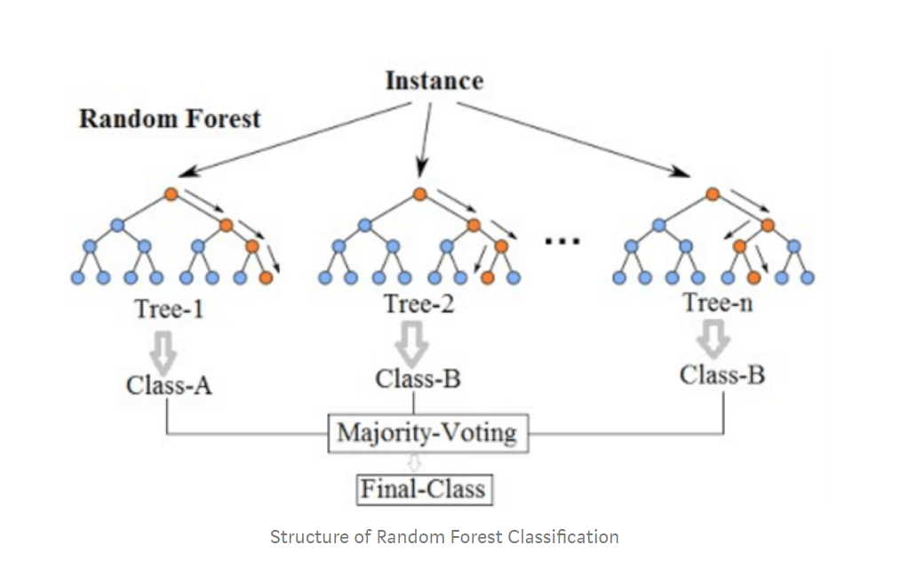
Random Forest Classification:
Decision Tree:
Many Decision Trees
Biological,
Behavioral,
Environmental
Data
COVID-19+
COVID-19 Contact=False
FALSE
TRUE
Other Feature
COVID-19 -
Other Feature
COVID-19 +
True/False Decisions Develop
“Feature Importance”

Slide 7

FINDINGS:
TOP FACTORS THAT CONTRIBUTE TO CONTRACTING COVID19

Slide 8
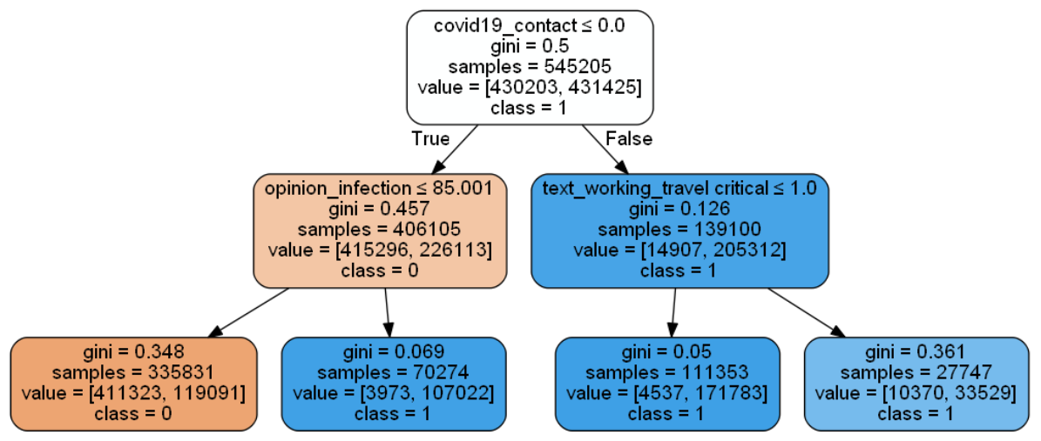
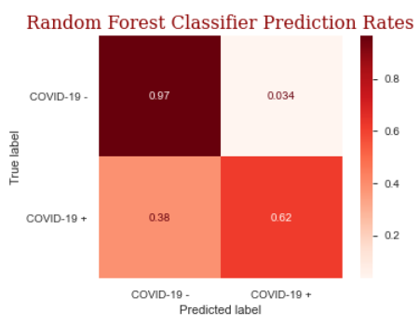
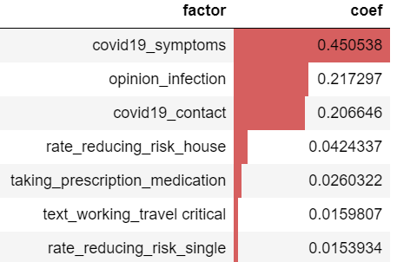
Modeling Results: Accuracy: 96%
Importance
True Negative
True Positive
Notes:
A Receiver Operator Characteristic (ROC) curve is a graphical plot used to show the diagnostic ability of binary classifiers. It shows the tradeoff between sensitivity TP/(TP+FN) and specificity TN/(TN+FP) (any increase in sensitivity will be accompanied by a decrease in specificity). The closer the curve follows the left-hand border and then the top border of the ROC space, the more accurate the test. The area under an ROC curve is a measure of the usefulness of a test in general, where a greater area means a more useful test, the areas under ROC curves are used to compare the usefulness of tests.

Slide 9
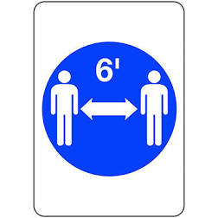


Top Factors by level of importance in prediction using Random Forest
Feature: | Correlation:
Exhibiting COVID-19 symptoms | +
Belief in contracting the disease | +
Contact with others infected with COVID-19 | +
Household practiced social distancing & hygiene | -
Taking prescription medication | +
Travel | +
Individual practiced social distancing & hygiene | -
Behavior Matters:
Behavior Matters:
-
Notes:
Feature importance directly measures variable importance by observing the effect on model accuracy of randomly shuffling each predictor variable.

Slide 10
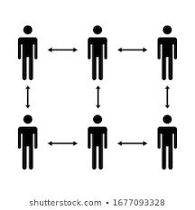



Recommendations:
Practice social distancing and good hygiene.
Encourage/ensure those in your household do the same.
Avoid contact with those known to be infected.
Minimize travel
If taking prescription medications, discuss with physician possibility for increased risk for infection.

Slide 11


Future Work:
Prescription Medications:
Opinion Infection:
???
Out of the 1200 unique medications:
Identify what medications or combinations could be contributing factors
Evaluate if increase in number of prescriptions are contributing factors
Investigate the meaning behind this feature. The questionnaire to collect data has had several versions and questions surrounding this no longer exist.

Slide 12
THANK YOU
Stay healthy!

