Slide 1
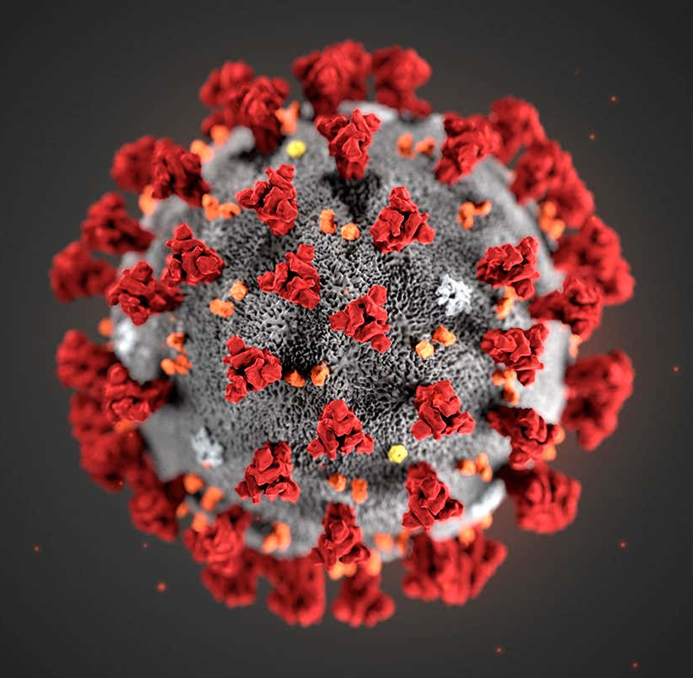
Covid19
Primary Contributing Factors for Contraction
Presented by: Andi Osika

Slide 2




Background:
Independent data source: Nexoid- UK based open-source platform
619K samples, 173 Countries, self-reported
40 factors
Biology, Behavioral, Environmental

Slide 3
Top Factors:

Slide 4
Top Factors for Testing Positive:
First bullet point here
Second bullet point here
Third bullet point here
Class | Group A | Group B
Class 1 | 82 | 95
Class 2 | 76 | 88
Class 3 | 84 | 90

Slide 5
Two Content Layout with SmartArt
First bullet point here
Second bullet point here
Third bullet point here
Step 1
Task Description
Task Description
Step 2
Task Description
Task Description
Step 3
Task Description
Task Description

Slide 6
Add a Slide Title - 1

Slide 7
Add a Slide Title - 2

Slide 8
Add a Slide Title - 3

Slide 10
Add a Slide Title - 4

Slide 11
Add a Slide Title - 5

