Slide 1
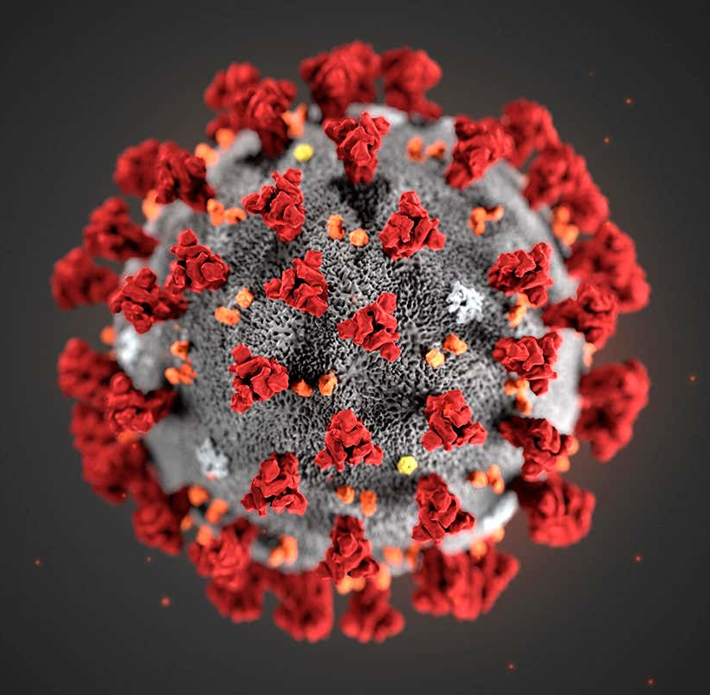
COVID-19
Primary Contributing Factors for Contraction
Presented by: Andi Osika

Slide 2
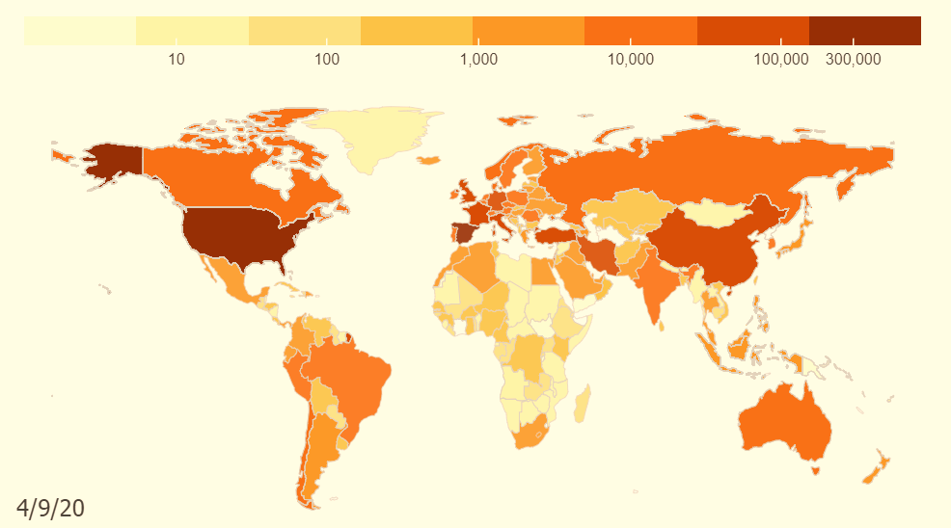
Background:
April 10, 2020:
1.6 million cases globally
COVID-19: Pandemic
Goal: Use classification to Identify primary contributing factors for testing positive for the disease.
https://coronavirus.jhu.edu/data/animated-world-map
Notes:
On the date of the last collection globally there were1.6 million cases with more than 102,000 deaths, https://www.nbcnews.com/health/health-news/coronavirus-timeline-tracking-critical-moments-covid-19-n1154341
https://www.contagionlive.com/news/contagion-live-news-network-coronavirus-updates-for-april-10-2020
Dates;
'4/4/2020', '4/5/2020', '4/3/2020', '4/6/2020', '3/27/2020', '3/28/2020', '3/26/2020', '3/29/2020', '3/30/2020', '3/31/2020', '4/1/2020', '4/2/2020', '4/7/2020', '4/8/2020', '4/9/2020', '4/10/2020’

Slide 3



Factor Datatypes Collected:
Biological | Behavioral | Environmental
Age | Drug(prescription/non) Use | Number of Contacts
Sex | Alcohol Use | Co-Habitation Numbers
BMI | Hand Washing, Social Distancing | Travel Habits
Preexisting Health Conditions | Mask Wearing Outside of Home

Slide 4
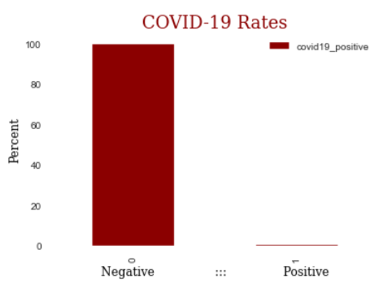
Data Background:
Nexoid
618K+ Self-Reported Samples
Top Countries: US, Canada and UK
2.3%
5%
.13% Tested Positive
87%
Notes:
Top Countries
US 0.878483
CA 0.049560 - negative correlation
GB 0.023211
AU 0.011354 – negative correlation
BR 0.005552
Testing in the United States at this time was limited due to shortages of supplies and latency in receiving results.

Slide 5

Methodology:
Classification Modeling: Random Forest

Slide 6


Random Forest Classification:
Decision Tree:
Many Decision Trees
Biological,
Behavioral,
Environmental
Data
(COVID-19 +)
Practicing Social Distancing & Hygiene
(low score)
TRUE
FALSE
(Covid-19 +)
Other Feature
(Covid-19 -)
Other Feature
True/False Decisions Develop
“Feature Importance”
Notes:
Decision trees look at each feature and the factors associated with each and examine how many cases of each align with each class. Based on the results, move to other layers until each class is sorted out. During this process feature importance is developed. Feature importance is a score assigned to each feature in it’s usefulness in predicting a class. When totaled, all features values equal 1.

Slide 7

FINDINGS:
TOP FACTORS THAT CONTRIBUTE TO CONTRACTING COVID19

Slide 8
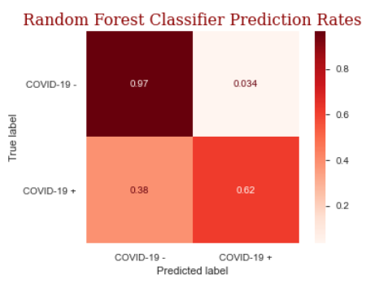
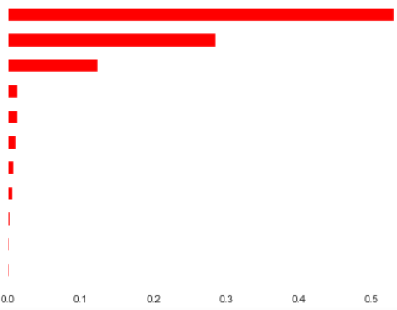
Modeling Results from Random Forest: 95.8% Accuracy
Feature Importance in Predicting the
Testing Positive for COVID-19
Belief individual is infected
Exhibiting COVID-19 symptoms
Contact with others infected with COVID-19
Social distancing and hand washing practiced as a household
No answer when asked if respondent believed they could die from the infection
True Negative
Social distancing and hand washing practiced as an individual
No answer when asked if respondent believed had the infection
Male
Sex
Female
BMI
True Positive
Taking prescription medications
Notes:
Feature importance directly measures variable importance by observing the effect on model accuracy of randomly shuffling each predictor variable. The values total 1.

Slide 9
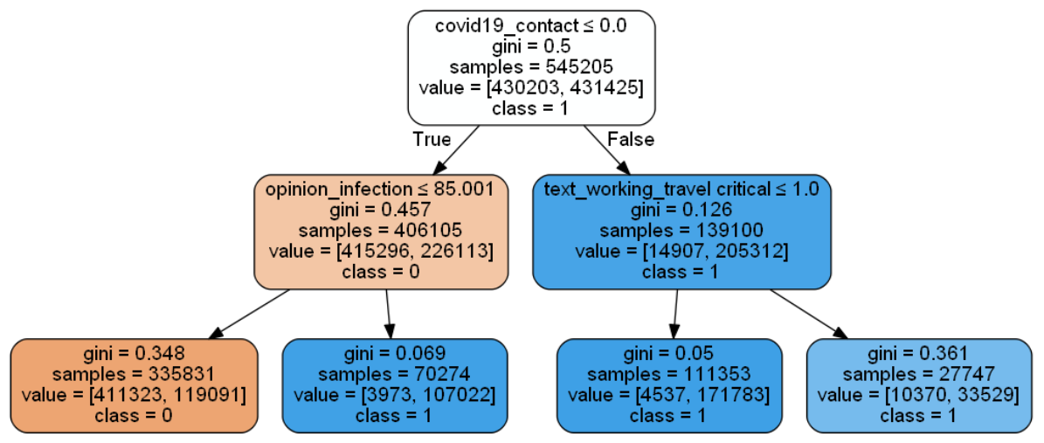



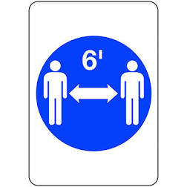




Top Feature Correlations:
Positively Correlated
Individual believed they contracted COVID-19
Individual exhibited COVID-19 symptoms
Individual came in contact with another who was COVID-19+
Individual did not respond if they believed they had COVID-19
Individual did not respond if they believed they could die from COVID-19
Individual was male
Body Mass Index (kg/m** 2)
The individual was taking prescription medication
Negatively Correlated
Household practiced social distancing and hygiene
Individual practiced social distancing and hygiene
Individual was female
Behavior Matters:
-
Notes:
covid19_positiveopinion_infection0.049646*
covid19_symptoms0.088013*
covid19_contact0.050423*
rate_reducing_risk_house-0.008963
omwasnull0.002919
rate_reducing_risk_single-0.012114
oiwasnull0.002919
sex_male0.009141
sex_female-0.009122
bmi0.004146
taking_prescription_medication-0.004571

Slide 10
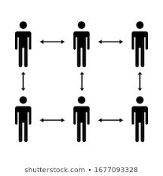

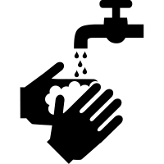
Recommendations:
If taking prescription medications, discuss with physician possibility for increased risk for infection.
Practice social distancing and good hygiene.
Individually & Collectively
Avoid contact with those known to be infected.
Especially true for males, and those with higher BMI

Slide 11
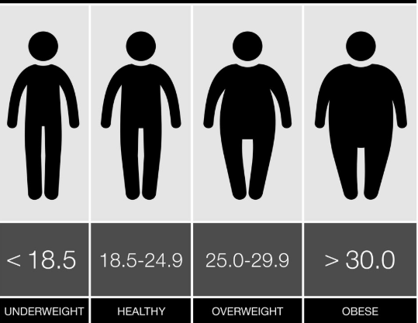

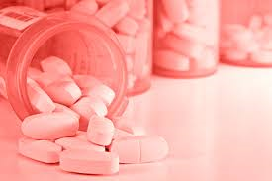
Future Work:
Prescription Medications:
BMI
???
Opinion Infection:
Out of the 1200 unique medications:
Identify what medications or combinations could be contributing factors
Evaluate if increase in number of prescriptions are contributing factors
In addition to this result, studies show that BMI is an important factor. This feature could be further examined to determine what a possible threshold might be.
Meaning/Description
Data collection surrounding this no longer exist.

Slide 12
THANK YOU
Stay healthy!

Slide 13
Appendix:

Slide 14
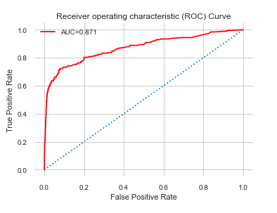
Receiver Operator Curve (ROC) Results for Random Forest Classification Model:
Blue dotted line represents the 50:50 chance in predicting if someone tests positive for COVID-19.
The red line represents the diagnostic ability or Area Under the Curve (AUC) of the binomial classifier to be 87.1% reliable or approximately 37% better than randomly guessing.
Notes:
A Receiver Operator Characteristic (ROC) curve is a graphical plot used to show the diagnostic ability of binary classifiers. It shows the tradeoff between sensitivity TP/(TP+FN) and specificity TN/(TN+FP) (any increase in sensitivity will be accompanied by a decrease in specificity). The closer the curve follows the left-hand border and then the top border of the ROC space, the more accurate the test. The area under an ROC curve is a measure of the usefulness of a test in general, where a greater area means a more useful test, the areas under ROC curves are used to compare the usefulness of tests.

Slide 15
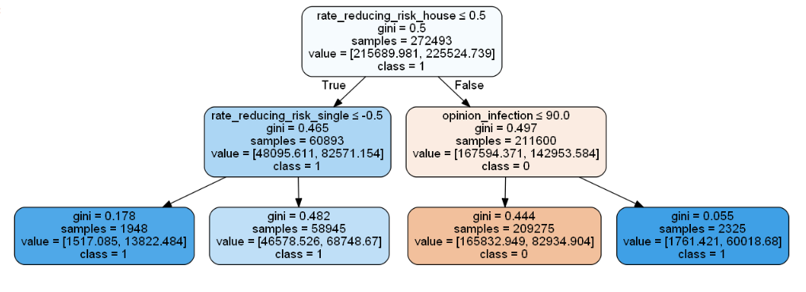
One sample tree from the random forest: (a closer look)
Notes:
The top feature here is practicing social distancing and hygiene as a household scored at a value less than .5 where the individual is positive for COVID-19. If this is classified as true, the next layer examines this same feature but as an individual scored low on this as well, in both cases the individual tested positive for COVID-19.
Alternatively if it was false and the person believed they had the infection was less than a score of 90 more cases than not the individual was not positive for COVID-19.

