Slide 1



Health and wellness app review
Andi osika

Slide 2
Background:
Health and wellness apps
User review insight

Slide 3


Background:
Mobile application programs focusing on various aspects of promoting digital health
Categories/Examples:
Positive user sentiment key component of conversion rate.
Top 5 Grossing Health/Wellness Apps on Google Play:
Sports/Fitness Tracking
Diet Nutrition/Weight Loss
Stress Reduction
Mediation
Medical Tracking, Community, and Services
Calm
MyFitnessPal
Head Space
BetterMe(Me)
FitBit

Slide 4
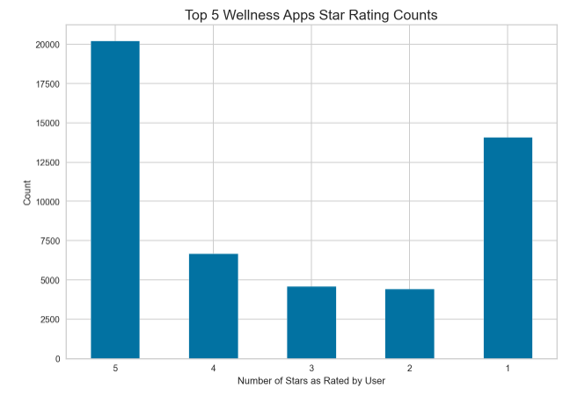
Across the board, reviewers rate wellness apps 5 or 1 stars most frequently when it comes to most relevant reviews:

Slide 5
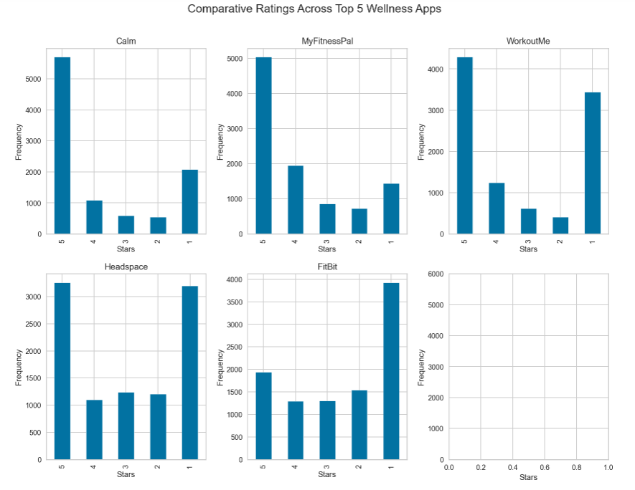
THE SAME PATTERN CARRIED THROUGH EACH INDIVIDUAL APP, WITH ONE EXCEPTION.
Surprising that FitBit rendered more one-star reviews than 5s by more than 2X
Notes:
Versions * A version of '.' indicates none was entered on the review:
com.calm.android's lowest rated version had 775 reviews for version ., and 543 reviews for the highest rated version: 4.19
com.myfitnesspal.android's lowest rated version had 377 reviews for version 20.7.0, and 723 reviews for the highest rated version: 20.10.0 com.getsomeheadspace.android's lowest rated version had 919 reviews for version ., and 434 reviews for the highest rated version: 3.57.0 com.gen.workoutme's lowest rated version had 1289 reviews for version ., and 358 reviews for the highest rated version: 3.8.2
com.fitbit.FitbitMobile's lowest rated version had 735 reviews for version 3.25, and 457 reviews for the highest rated version: 3.21
Who replies more?
Rating: 1 stars
com.fitbit.FitbitMobile 3927
com.gen.workoutme 3438
com.getsomeheadspace.android 3196
com.calm.android 2077
com.myfitnesspal.android 1437
-------- Rating: 4 stars
com.myfitnesspal.android 1946
com.fitbit.FitbitMobile 1295
com.gen.workoutme 1246
com.getsomeheadspace.android 1101
com.calm.android 1089
-------- Rating: 5 stars
com.calm.android 5704
com.myfitnesspal.android 5040
com.gen.workoutme 4287
com.getsomeheadspace.android 3258
com.fitbit.FitbitMobile 1936
-------- Rating: 3 stars
com.fitbit.FitbitMobile 1302
com.getsomeheadspace.android 1238
com.myfitnesspal.android 853
com.gen.workoutme 619
com.calm.android 586
-------- Rating: 2 stars
com.fitbit.FitbitMobile 1540
com.getsomeheadspace.android 1207 c
om.myfitnesspal.android 724
com.calm.android 544
com.gen.workoutme 410
--------

Slide 6
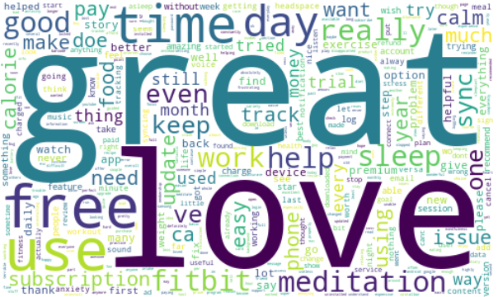

What’s in a review? Methodology:
Natural language processing, support vector classification and ‘clustering’
a.k.a.
(NLP, lsvc, & lda)

Slide 7
The process of examining review content
Natural Language Processing:
Makes words →’Vectors’
Support Vector Machine Classification
Vectors →Classification
‘Positive’, ‘Negative’ or ‘Neutral’
Clustering
Looks for patterns in terms based on how they ‘relate’ to each other.
LDA: Latent Dirichlet Allocation
Step 3 Clustering
‘LDA ‘
Step 2 Support Vector Classification
Step 1 NLP

Slide 8
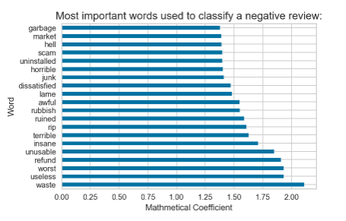
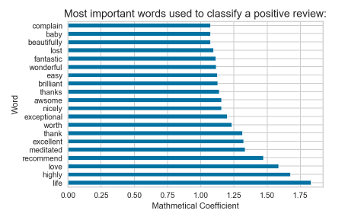
Results:
Class | Baseline Values: | lSVC Recall Values:
Positive Sentiment | 41% | 92%
Negative Sentiment | 31% | 85%
Neutral Sentiment | 28% | 43%
lSVC: Linear Support Vector Classification
Notes:
75% Accuracy Rate

Slide 9

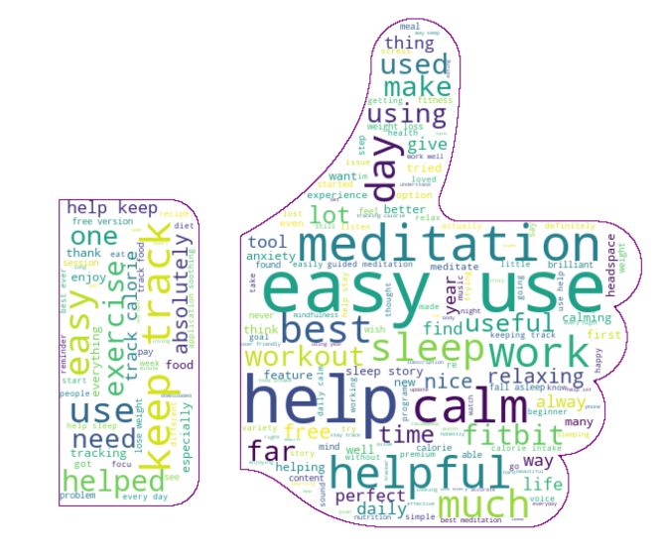
Positive sentiment cluster analysis using latent Dirichlet allocation – L.D.A
What trends are observed by comparing words used in relation to the rating?
What are the most frequent terms used in a
5 - star review?

Slide 10
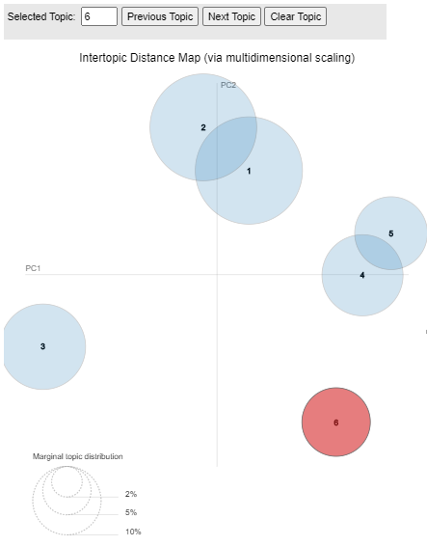
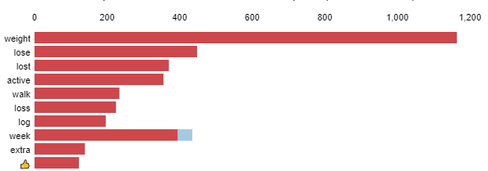
5-Star LDA Model Results
6 Topics
4 Areas
Cross- topic terms:
Tracking/logging, use, help
Topic 2:
meditation
workout
life
day
help
Well-Being
Topic 1:
sleep
help
night
story
sleeping
Topic 5:
information
result
customer
inspire
logging
Information
Ease of Use/
Tracking
Topic 4:
monitor
losing
report
burn
figure
Topic 6:
track
easy
keep
use
help
Top 10 Most Relevant Terms for Topic 6 ( 10% of tokens )
Weight Loss
Topic 6:
weight
lose/loss/lost
active
walk
log

Slide 11
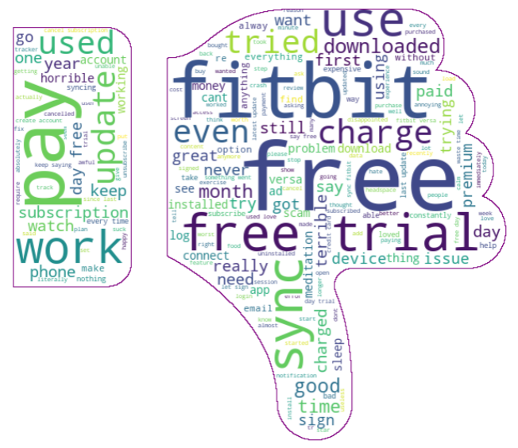
Negative sentiment analysis using Latent Dirichlet allocation – L.D.A.
What are the most informative terms used in a
1 - star review?
What trends are observed by comparing words used in relation to the rating?

Slide 12
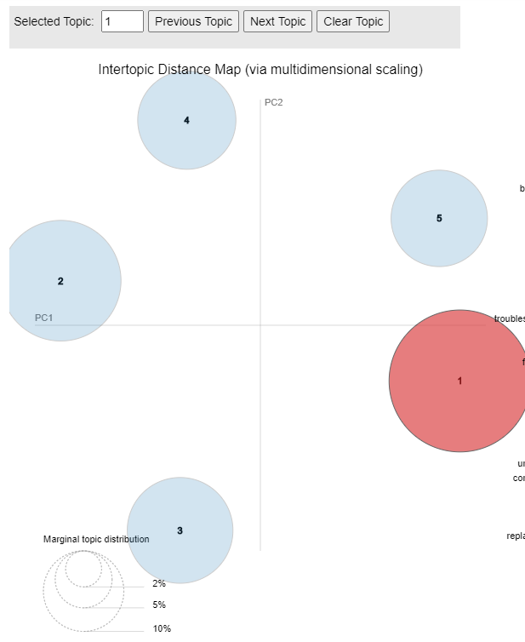
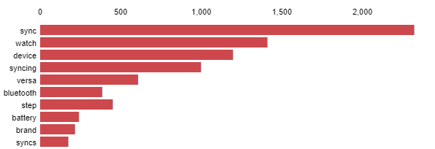
1-Star LDA Model Results
5 Topics
4 Areas
Cross- topic terms:
Subscription, payment
Topic 4:
refund
cancel
charged
subscription
account
Topic 5:
log
internet
error
password
login
Billing Terms
Access
Topic 2:
free
trial
pay
7
subscription
Technical
Synching/Device Specific
Topic 1:
sync
watch
device
bluetooth
battery
Top 10 Most Relevant Terms for Topic 1 ( 31.1% of tokens )
Ease of use/Features:
Topic 3:
alarm
easy
nope
asleep
friendly

Slide 13
5-star Vs 1-Star review composition comparison:

Slide 14



recommendations
Support Vector Classification
LDA
Internal Cross-Functional Systems
Support Vector Model
LDA
UX
R & D
Engineering
Marketing
Identify Positive and Negative Sentiment
Identify which topic(s) sentiment aligns with
NexGen Dev
Make Ease of use a priority
Improve UX with access to relevant DATA
Exploit app-specific features
Resolve syncing issues
Be clear on trial and payment terms

Slide 15



Future work:
Groups of Words
v. Terms aka N-Grams
Model
Refinement
App-Specific Modeling

Slide 16
Thank you
Visit: https://github.com/andiosika/Flatiron_Capstone

