Slide 1

King county residential Real estate Evaluation
2014 – 2015
Price Factors
Notes:
May 02 2014- May 27 2015

Slide 2

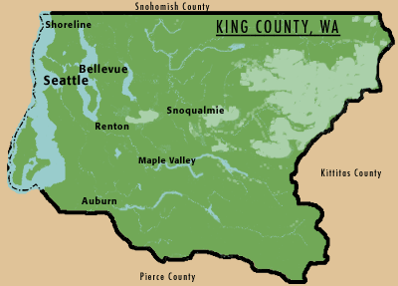
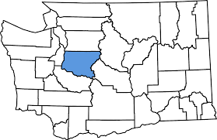
Background:
King County, Washington
Urban: Seattle, Kirkland, Renton, Bellevue
Rural: Including islands and those in mountain ranges.
Tech and Retail Industries
Art, Culture and Sports
Outdoor Activity
Notes:
Median income around $75K https://datausa.io/profile/geo/king-county-wa

Slide 3
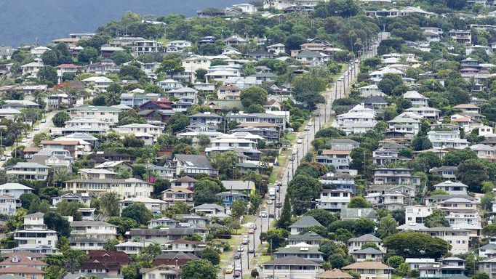
King County Residential Real Estate 2014-2015
21K Homes Sold
Average Price : $540K
Average Size: ~2K sq ft , 3 bedrooms, 15K sq ft lot
Evaluated 21 different features including:
Size
Number of Bedrooms
Number of Bathrooms
Lot Size
Age
Renovations
Neighboring Home Price
Condition
Grade
View
Notes:
May 2014 – May 2105

Slide 4
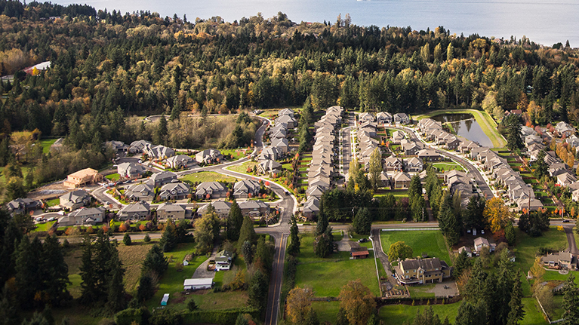
Top Factors in determining Price: location Size Quality
King County, Washington
2014-2015

Slide 5
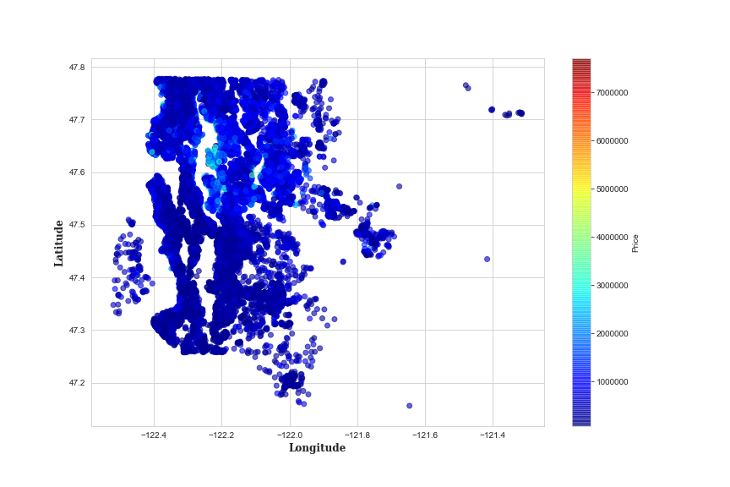
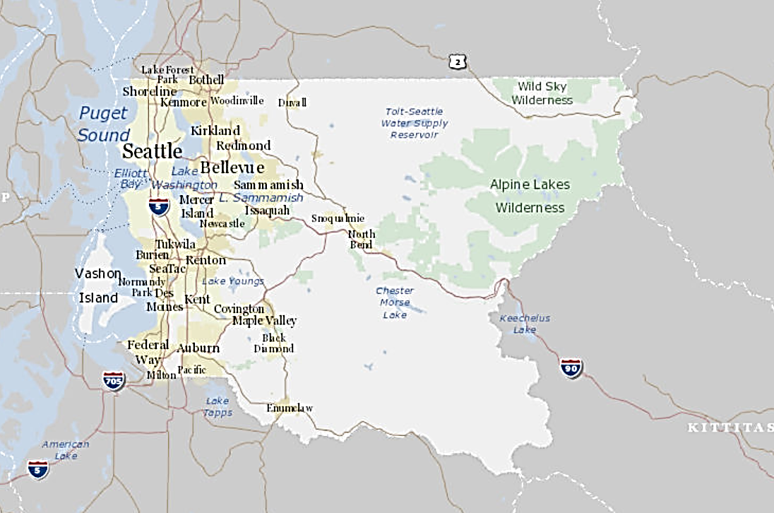
Location! Location! Location!
Residential properties around Lake Washington fetched a higher price.
Bellevue is one of the most desirable areas to live with access to both the city and outdoor recreational activities.
zipcode | Average Home Sale Price 2014-2015 | Area
98039 | $ 2,135,612 | Bellevue
98004 | $ 1,359,437 | Bellevue
98040 | $ 1,186,082 | Mercer Island
98112 | $ 1,988,993 | Madison Park
98102 | $ 903,702 | East Lake/Capitol Hill

Slide 6
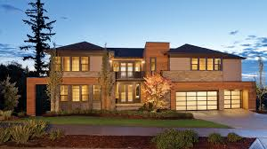
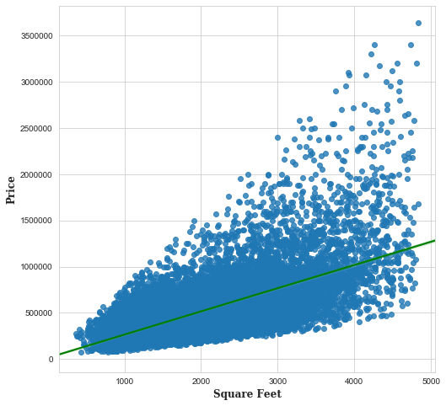

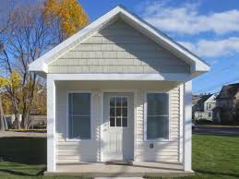

Size matters!
Size matters!
But it’s not everything…

Slide 7

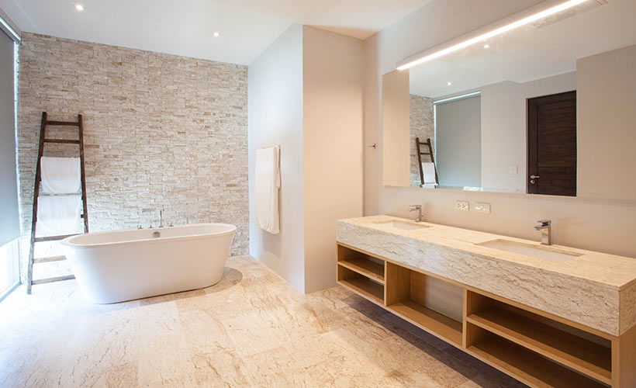
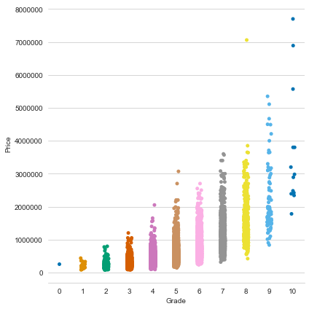
Grade:
>4 doesn’t meet code
5 – 6
Lowest meeting code
7 – 9
Average
construction and materials
10 +
Quality finishes and fixtures, Custom Design & Superior
Price increases with grade
Types of materials used and the quality of workmanship based on scale 1-13:
Notes:
https://www.kingcounty.gov/depts/assessor/~/media/depts/Assessor/documents/AreaReports/2018/Residential/015.ashx
Residential Building Grades Grades 1 - 3 Falls short of minimum building standards. Normally cabin or inferior structure.
Grade 4 Generally older low quality construction. Does not meet code.
Grade 5 Lower construction costs and workmanship. Small, simple design.
Grade 6 Lowest grade currently meeting building codes. Low quality materials, simple designs.
Grade 7 Average grade of construction and design. Commonly seen in plats and older subdivisions. Grade 8 Just above average in construction and design. Usually better materials in both the exterior and interior finishes. Grade 9 Better architectural design, with extra exterior and interior design and quality. Grade 10 Homes of this quality generally have high quality features. Finish work is better, and more design quality is seen in the floor plans and larger square footage. Grade 11 Custom design and higher quality finish work, with added amenities of solid woods, bathroom fixtures and more luxurious options. Grade 12 Custom design and excellent builders. All materials are of the highest quality and all conveniences are present. Grade 13 Generally custom designed and built. Approching the Mansion level. Large amount of highest quality cabinet work, wood trim and marble; large entries.
Image credit: https://www.aclassbathrooms.com.au/simple-ways-to-give-your-bathroom-a-luxury-feel/#iLightbox[gallery1704]/0

Slide 8
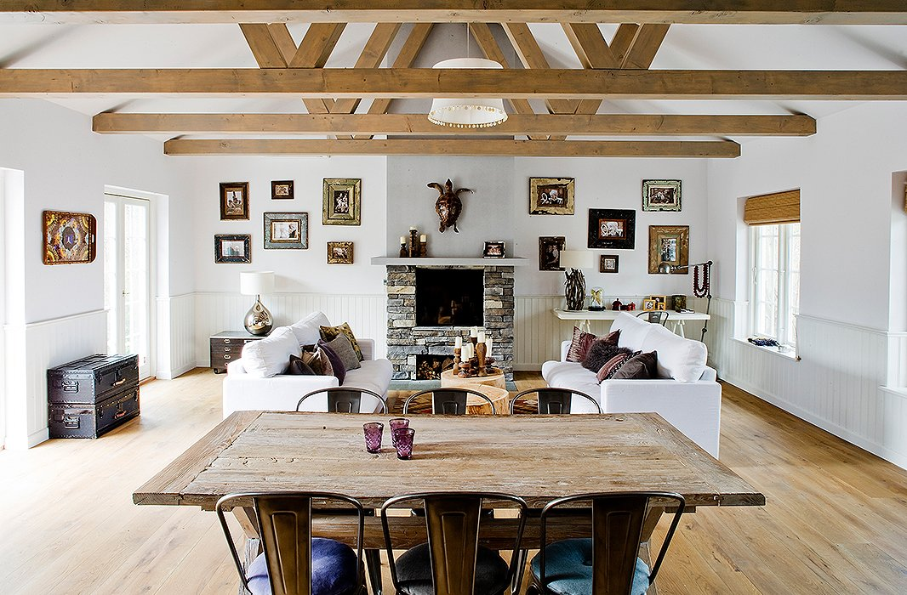
Recommendations:
Consider Condition:
( maintenance relative to age)
How recently the home was built or renovated effects price. Repair, update or renovate a property to maximize sale price.
If adding space or renovating:
Fewer bedrooms and floors
Too many can negatively impact price.
More bathrooms
Quality construction and materials
Notes:
Condition: Relative to Age and Grade 1= Poor Many repairs needed. Showing serious deterioration. 2= Fair Some repairs needed immediately. Much deferred maintenance. 3= Average Depending upon age of improvement; normal amount of upkeep for the age of the home. 4= Good Condition above the norm for the age of the home. Indicates extra attention and care has been taken to maintain. 5= Very Good Excellent maintenance and updating on home. Not a total renovation
Bedrooms:
Initial look revealed multiple oultiers which were removed outside of 3 standard deviations.
The filtered data is skewed, and shows a correlation up to 4 bedrooms, after that there is no correlation
Observations: only a small amount of homes were renovated out of 21K .03% indicating that the trend is not to renovate or it's not accurately recorded.

Slide 9





Future work could further explore reporting or outcomes
Only 3% of the data reflected :renovations:
View: Relatively low reporting ~10%.
Were there months in the calendar that got a higher price? What would cause this?

Slide 10
Thank you. Happy hunting.

