Slide 1


NoN-Toxic Communication
Using Natural Language Processing to Identify Toxic Language
By Andi Osika
WARNING: Offensive Language Identified

Slide 2
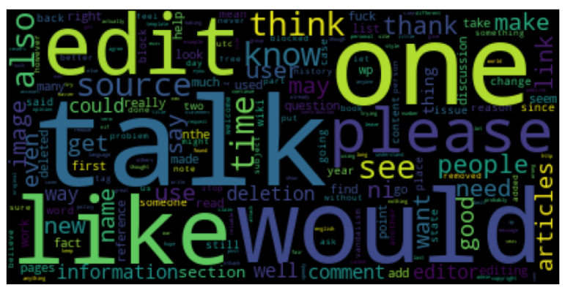
28
Let’s talk….
be completely honest in a safe, inclusive way.

Slide 3

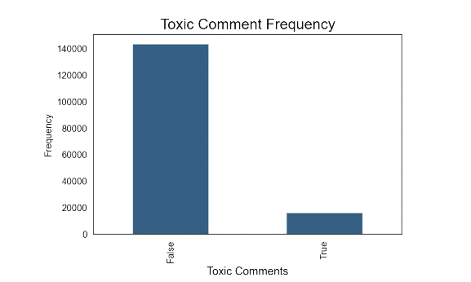
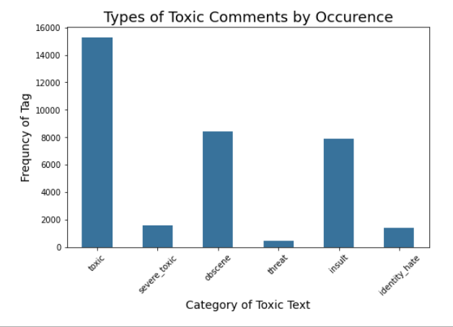
Problem: Freedom of speech is … sometimes toxic
The dataset was provided by Conversation AI in hopes to improve online discussion.
Wikipedia Talk Pages 150K + samples rated by humans for toxic effect varying in range from
Toxic
Severe Toxic
Obscene
Threat
Insult
Identity Hate
Notes:
Conversation AI Dataset: https://conversationai.github.io/
From Kaggle:
Discussing things you care about can be difficult. The threat of abuse and harassment online means that many people stop expressing themselves and give up on seeking different opinions. Platforms struggle to effectively facilitate conversations, leading many communities to limit or completely shut down user comments.
The Conversation AI team, a research initiative founded by Jigsaw and Google (both a part of Alphabet) are working on tools to help improve online conversation. One area of focus is the study of negative online behaviors, like toxic comments (i.e. comments that are rude, disrespectful or otherwise likely to make someone leave a discussion). So far they’ve built a range of publicly available models served through the Perspective API, including toxicity. But the current models still make errors, and they don’t allow users to select which types of toxicity they’re interested in finding (e.g. some platforms may be fine with profanity, but not with other types of toxic content).

Slide 4
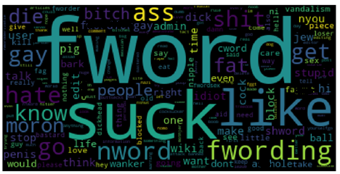

Examples:
Word Clouds display words in a collection. The larger the word, the more frequently used the word is.
Toxic
Clean

Slide 5
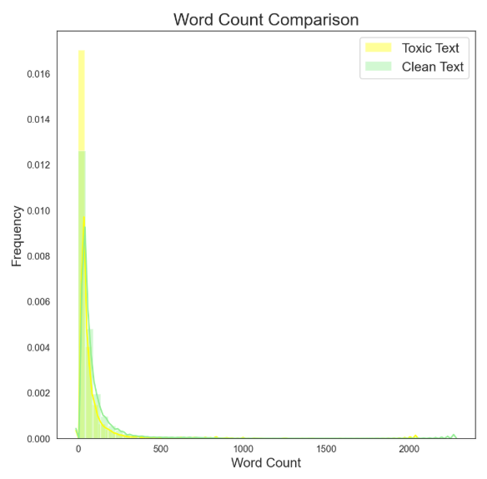


Are toxic comments longer than non-toxic?
Nope…..
They are about the same.

Slide 6
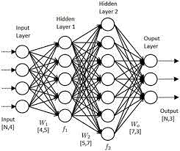





Methodology:
Toxic = 1
“You are a $@^%!”
[1 4 8 6]
dataset
Comment labels
Comments
Word Vectors
Deep Learning using
Natural Language Processing and Neural Networks
Neural Network
N L P
Neural Network
Natural Language Processing (NLP):
“Tokenizes” text
Uses resulting tokens to create vectors as data
Neural Networks:
multilayer perceptron
Neurons
Synapses
Input and output
Artificial Neural Networks
Updating ‘weights’ as it learns patterns

Slide 7

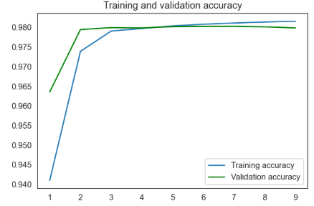
Results:
98% Accuracy Rate
99- 100% of the time identified
clean text
Better at predicting classes where there is more data… a lot better.
Category | Rate of Accurately Predicting Cases or ‘Recall”
Toxic | 70
Severe toxic | 32
Obscene | 75
Threat | not enough samples
Insult | 60
Identity Hate | not enough samples
Accuracy
Epoch # (Round of training)

Slide 8
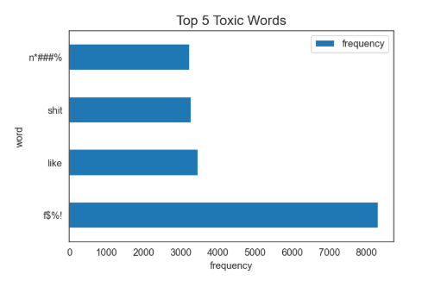
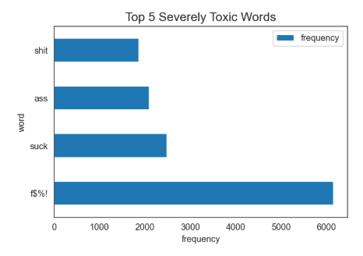
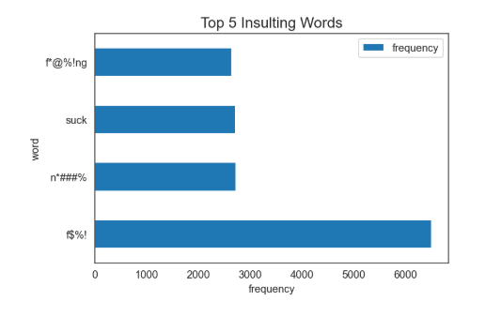
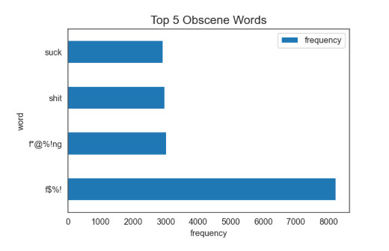
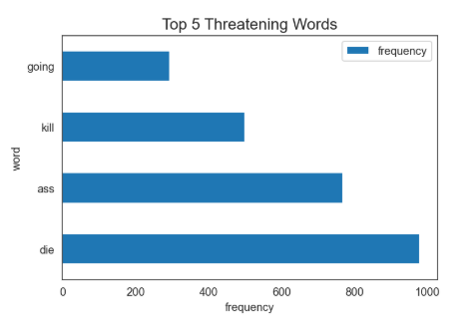
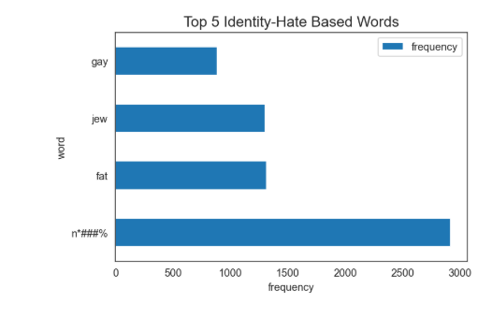
Top 5 Words Per Category:
Findings:
Patterns Emerged
The same words appeared in 4 categories:
Toxic, Severely Toxic, Insulting & Obscene
f$#! shit suck
Two categories had more distinct top 5 words:
Threatening & Identity-Based Hate
4/4
3/4
3/4

Slide 9
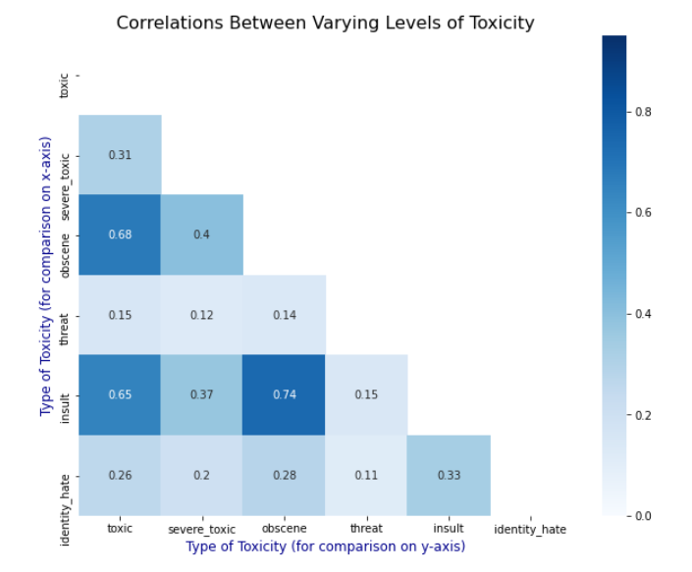
Correlations:

Slide 10






Recommendations
Develop metrics and actionable plans for varying levels of toxicity
Use model to identify varying levels of toxicity to promote brand loyalty by aligning with ideals of free speech AND creating a safe culture where true threats and hate aren’t tolerated
So now what?:
Research and implement best practices so that everyone feels comfortable sharing thoughts.
Invest in future work to further develop existing models to specifically identify severe forms, targeting threats and identity-based hate specifically

Slide 11


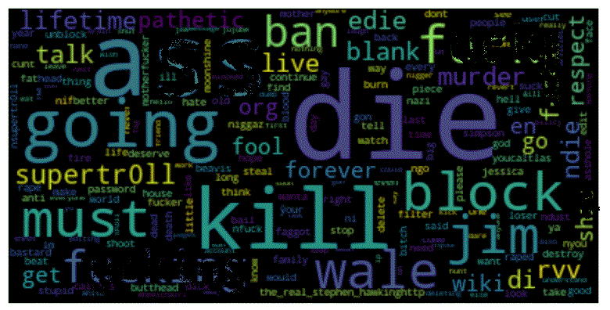
Future Work:
Collect more data around these more severe types of toxic comments to improve recognition.
Make threatening content main target
THREATS &
SENTIMENT ANALYSIS
Thankfully the most severe types of toxic comments are less frequent. In some situations, speech can constitute a crime, such as in the case of criminal threats.
Hopefully, collective work can help everyone express themselves in more meaningful ways.
Comparative analysis on sentence sentiment rather than word.

Slide 12




Photo Collage
Thank you

Slide 13
Appendix:

Slide 14
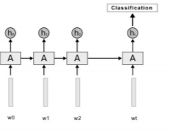
LSTM

